Slide 1
SeeDot: Compiling ML to IoT Devices
Sridhar Gopinath, Nikhil Ghanathe, Vivek Seshadri, Rahul Sharma
PLDI 19
github.com/Microsoft/EdgeML/tree/master/Tools/SeeDot

Slide 2
Background: ML on IoT devices
相比 ML on Cloud
  Improves the security and privacy of data
  Eliminates data communication
  Reduces the latency
ML on IoT devices 的挑战
  IoT 设备的计算与内存资源受限（本文考虑仅 32KB 内存的 IoT 设备）
  ML算法需要浮点数计算，IoT设备缺少浮点数计算的支持
本文提出 SeeDot 语言及其编译器

Slide 3
SeeDot Overview
ML inference algorithm
SeeDot compiler
Efficient integer program
Language
  Mathematical syntax
  Linear algebra operations
  Supports ML operators like conv, maxpool, relu
Compiler
  Automatic floating-point to fixed-point compiler

Slide 4




Fixed-point Representation
Floating Point
8-bit Fixed Point
$$x$$
$$(y,k)$$
where,
$$y=\left\lfloor x ∗ 2^{k}\right\rfloor$$
y is an 8-bit signed integer,
k is scale, higher k implies better precision
$$x=y∗2^{−k}$$
Overflow
Ideal
Low Precision
pi=3.1415..
(-55,6)
(100,5)
(50,4)
e=2.718
(-83,6)
(86,5)
(43,4)
(-70,5)
Overflow
pi + e
=
(100,5) + (86,5)
(93,4)
Correct

Slide 5
Related work:
Low-bitwidth fixed-point
SeeDot
(Low-bitwidth fixed-point)
Floating-point emulation
  Arduino IDE, 用硬件模拟
  IEEE-754
high-bitwidth fixed-point
  natively supported by DSPs,
  expensive on microcontrollers
Low-bitwidth fixed-point
  8 or 16-bit, fast
  bad accuracy
SeeDot，Low-bitwidth fixed-point
  Fast and accurate
performance
High-bitwidth fixed-point
Floating-point
emulation
accuracy

Slide 6
Standard Fixed-point Arithmetic
a = (x,k); b = (y,k)
8-bit Fixed-point Addition:
  a + b = (x>>1 + y>>1, k-1)
8-bit Fixed-point Multiplication:
  a * b = (x>>4 * y>>4, 2k-8)
为了避免 Overflow，计算后 scale 减少，精度下降

Slide 7
Naïve fixed-pint program
ML algorithm
Generated code
u = a * b
v = c + d
w = …
x = u * w
y = x + v
u = a>>4 * b>>4
v = c>>1 + d>>1
w = …
x = u>>4 * w>>4
y = x>>1 + v>>1
Equivalent to a random classifier due to imprecision

Slide 8
Insight 1/2
ML algorithm
Generated code
u = a * b
v = c + d
w = …
x = u * w
y = x + v
u = a>>4 * b>>4
v = c>>1 + d>>1
w = …
x = u * w
y = x + v
Prefix
standard fixed point
Suffix
No scaling down
避免 scaling down
prefix 中会执行大量 scalling down 操作，导致后面的数值会变得很小
suffix 部分，我们可以假设，这些数据的计算不会导致 overflow。
问题：如何找 Boundary?
Notes:
将 ML 算法分为两部分，
prefix 部分执行 标准定点运算。
prefix 中会执行大量 scalling down 操作，导致后面的数值会变得很小
suffix 部分，我们可以假设，这些数据的计算不会导致 overflow。
问题是如何找到这个分界线。

Slide 9
Insight 2/2
Compilation
Execution
boundary-1
Program-1
Accuracy-1
Program-2
Accuracy-2
ML algorithm
boundary-n
Program-n
Accuracy-n
使用分类的准确度来评估生成代码的好坏
选择分类准确率最高的模型
Notes:
将 ML 算法分为两部分，
prefix 部分执行 标准定点运算。
prefix 中会执行大量 scalling down 操作，导致后面的数值会变得很小
suffix 部分，我们可以假设，这些数据的计算不会导致 overflow。
问题是如果找到这个分界线。
先确定想要搜索的一系列分界线，然后对每个分界线都生成一个程序，执行程序
选择准确率最好的方案。
（ boundary 大小是 constant，与输入算法无关。

Slide 10
Experiments
IoT 设备
  Arduino Uno，2KB RAM, 32KB flash, 16-bit MCU
  Arduino MKR1000, 32KB RAM, 256 KB flash, 32-bit MCU
  Xilinx Arty FPGA, 20 KB LUT, 225 KB Mem, 450 MHz
ML models
  Bonsai, Strong and shallow non-linear tree based classifier.
  ProtoNN, Prototype based k-nearest neighbors (kNN) classifier
  LeNet, CNN, pooling, FC
Datasets
  Cifar, Character recognition, Curet, Letter, Mnist, Usps, Ward

Slide 11
Experimental results
Low-bitwidth fixed-point
SeeDot
(Low-bitwidth fixed-point)
精度损失，加速
46%, ~4.8x
0.8%, 4.8x
performance
8.2%, 4.8x
High-bitwidth fixed-point
Floating-point
emulation
High-bitwidth fixed-point 代码由Matlab 生成
Classification accuracy
Random
Ideal

Slide 12
Other contributions
Optimized exponentiation
  Two table look-ups and one fixed-point multiplication
  Performs 23.3x faster that math.h
FPGA backend
  Generates Verilog code
    Custom SpMV(稀疏矩阵向量乘法) implementation is 13.6x faster than HLS(高级综合)
  SeeDot Performs 7.1x better
  SeeDot improves FPGA programmability
Notes:
用户只需要写算法代码。

Slide 13
Conclusion
Running ML on IoT devices is an emerging domain
SeeDot
  Language can express ML algorithms succinctly
  Float-to-fixed compiler to run ML efficiently on IoT devices
Results
  Improved performance on microcontrollers by 4.8x
  Improved performance on FPGAs by 7.1x
  Implementation available on GitHub: github.com/Microsoft/EdgeML

Slide 14
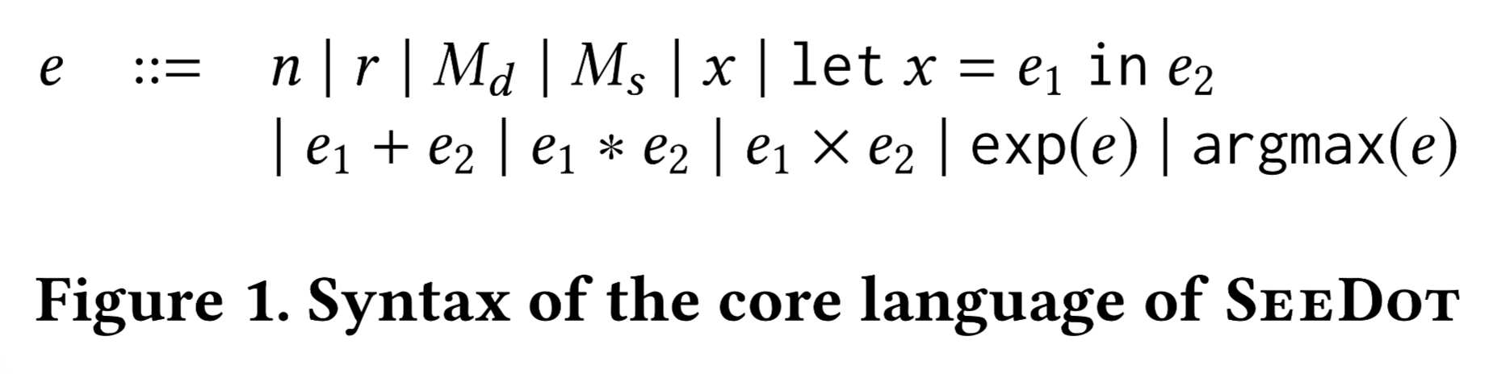
SeeDot Language

Slide 15
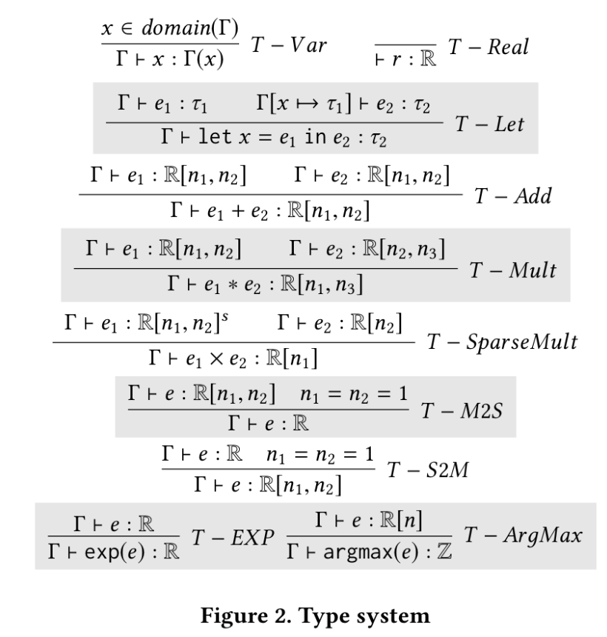
只有标量，向量和矩阵，以及稀疏矩阵
对数据维度做类型检查

Slide 16
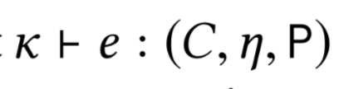
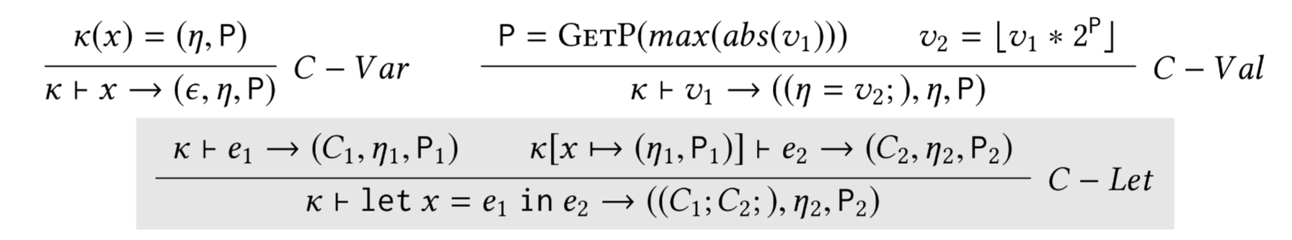
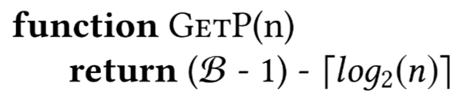
The compilation environment κ maps a variable x to a unique location η and a scale P
表示 : under an environment κ, an expression e is compiled to a code C, a sequence of procedure calls. The return value of C is stored at location η, which has a scale P
fixpoint 的 bit 数

Slide 17
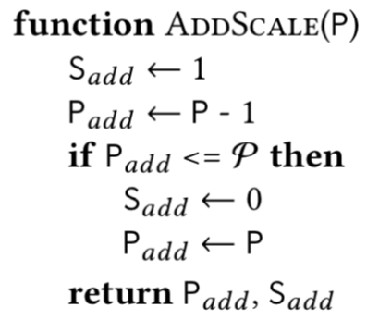
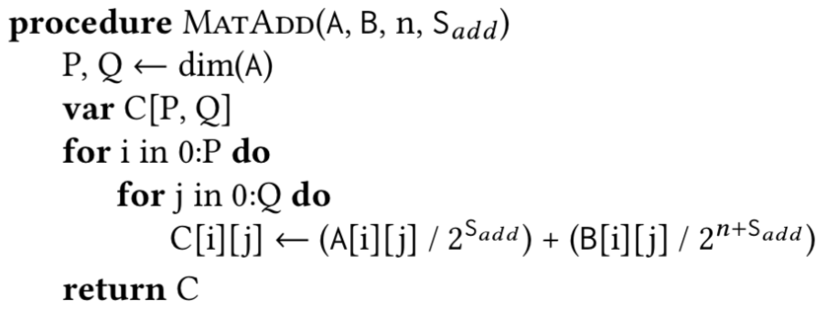
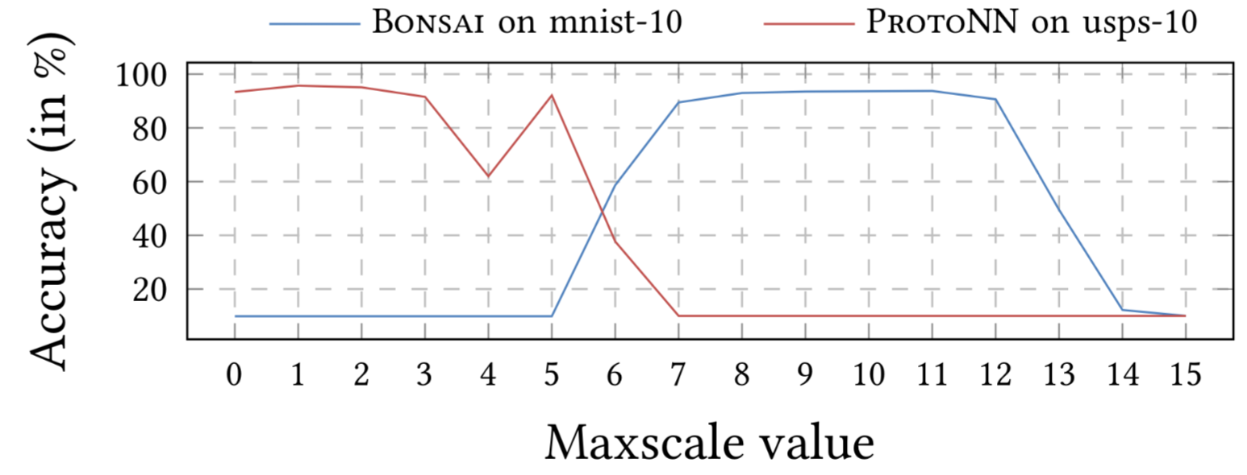
决定 “Bounary”

Slide 18
Comparison with TF-Lite
TF-Lite uses a hybrid approach for quantization. The quantized tensors are converted to floating-point while performing arithmetic operations. Hence, arithmetic operations of TF-Lite code are all performed in floating-point
TF-Lite Runtime 体积太大，实验时用 C 将量化后的模型重新实现

Slide 19
Comments
生成的程序只有一种 bit-width, not mixed.
应用场景特殊，硬件非常弱，都是很小的模型。在 GPU 上，较大的模型上效果如何？
P 属性是什么？在编译时需要知道 P，但是 P 需要在运行时才知道。P 可否静态计算？

