Slide 1
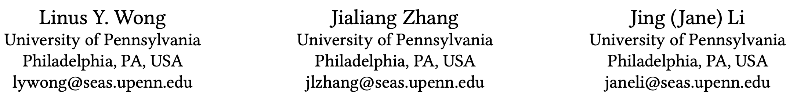

DONGLE: Direct FPGA-Orchestrated NVMe Storage for HLS
FPGA 2023

Slide 2
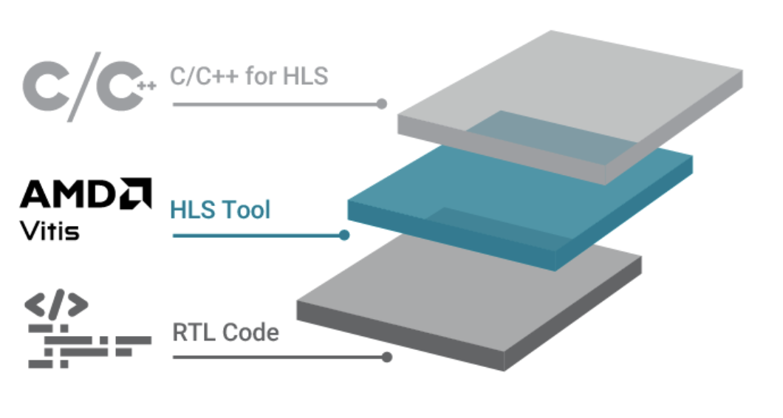
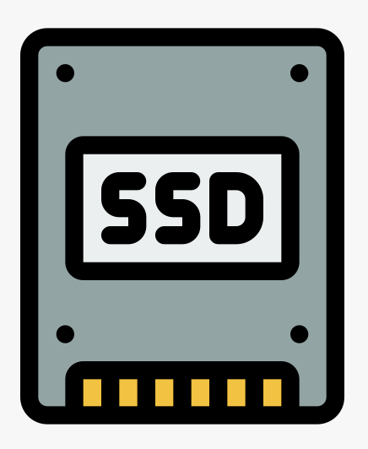
Background
Two Ingredients for Terabyte-Scale Acceleration
Simple and efficient Acceleration
Extensive vendor and community support
Widely adopted for variety of applications
Store Terabyte-Scale data
High bandwidth low latency access
Ideal for data-intensive application
Simple, performant and scalable solution for terabyte-scale applications
e.g. Database, Graph Processing, Machine Learning

Slide 3
Background
Interface Gap between HLS and SSD
Interface Gap
Byte addressing
Direct data load-store
Block addressing
Copy data to buffer before access
Buffer
Memory
SSD

Slide 4
Background
Current HLS + SSD Strategy
  PCle Peer-to-Peer (P2P)
Host Code
CPU
Host
FPGA Driver
PCIe Controller
SSD Driver
Indirect
Control Path
HLS
Kernel
SSD Controller
FPGA
DRAM
Direct P2P
Data Path
Block
Storage
Byte addressing
Direct data load-store
Block addressing
Copy data to buffer before access

Slide 5
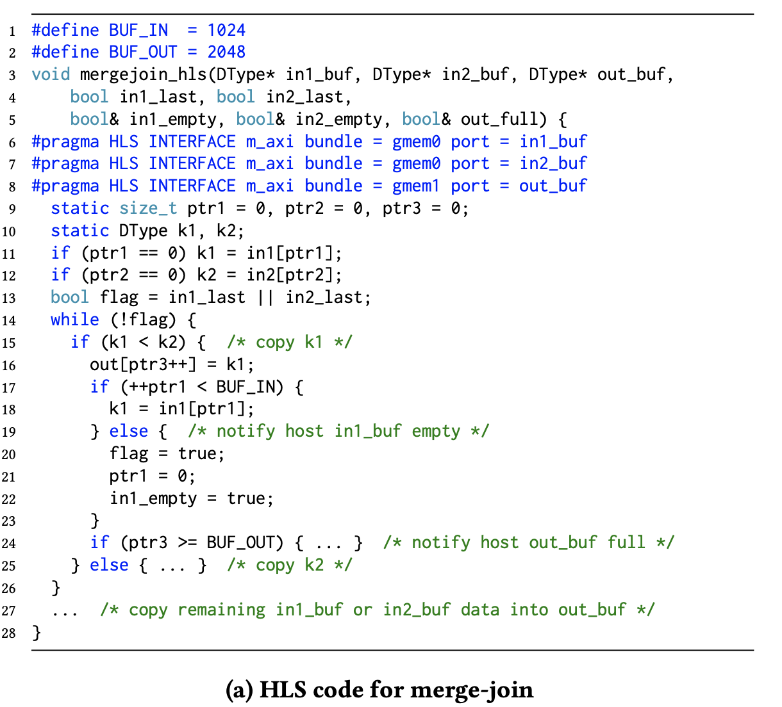
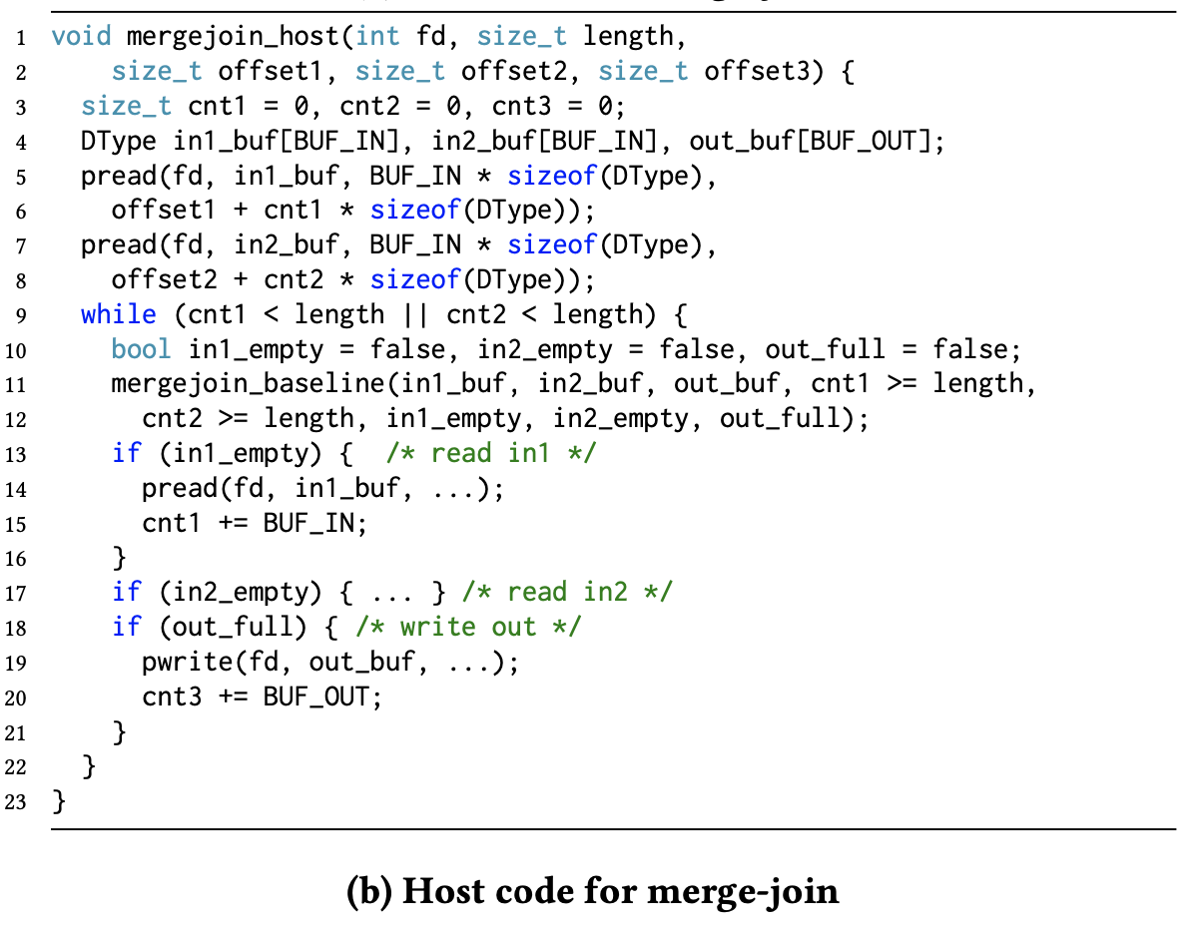
Motivational Example
Merge-Join
  Merge two sorted arrays
Indirect Control

Slide 6
Design Goals
Single-source programming
  Simple design, simulation, and debug
Decouple storage control from algorithm
  Clean algorithm specification
Eliminate excessive control path
  Low latency storage access
DRAM-compatible and non-intrusive design flow
  Minimize changes to user program and experience
Programmability
Performance
Compatibility

Slide 7
DONGLE Design
Host Code
CPU
Host
Host Code
HLS Code
Storage Control
Host Interfacing
PCIe Controller
Algorithm
Suspend
and Resume
HLS Interfacing
Algorithm
HLS
Kernel
SSD Controller
Storage
Control
Suspend
and Resume
Host Interfacing
FPGA
DRAM
Block
Storage
Multi-Source
Indirect control

Slide 8
DONGLE Design
HLS
Kernel
DONGLE Module
HLS Code
Algorithm
FPGA
DRAM
PCIe Controller
Storage
Control
Algorithm
Storage
Control
SSD Controller
Algorithm
Block
Storage
Single-Source
Direct control

Slide 9
DONGLE Design
HLS Code
HLS Code
Algorithm
Algorithm
Algorithm
Storage
Control
Algorithm
Algorithm
Storage
Control
SSD
Algorithm
DONGLE
Storage
Control
Entangled algorithm and control
Storage
Control

Slide 10
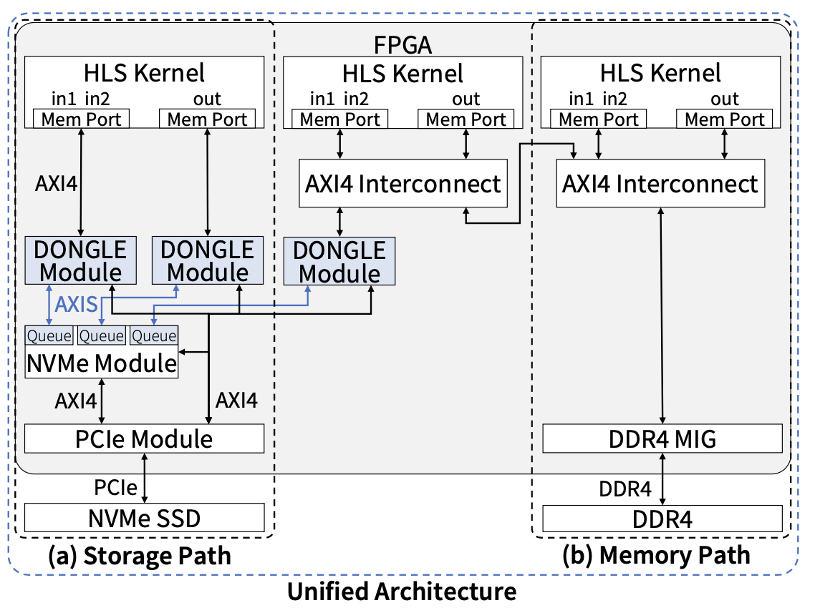
DONGLE Design
Architecture Overview
  A Unified Architecture that accesses both NVMe and DRAM
  Communicate with NVMe and PCIe modules to control the SSD
  Multiple DONGLE modules can be used on a single underlying NVMe SSD
    Take advantage of the queue-level parallelism of NVMe.
    allows a single NVMe SSD to serve multiple memory ports.

Slide 11
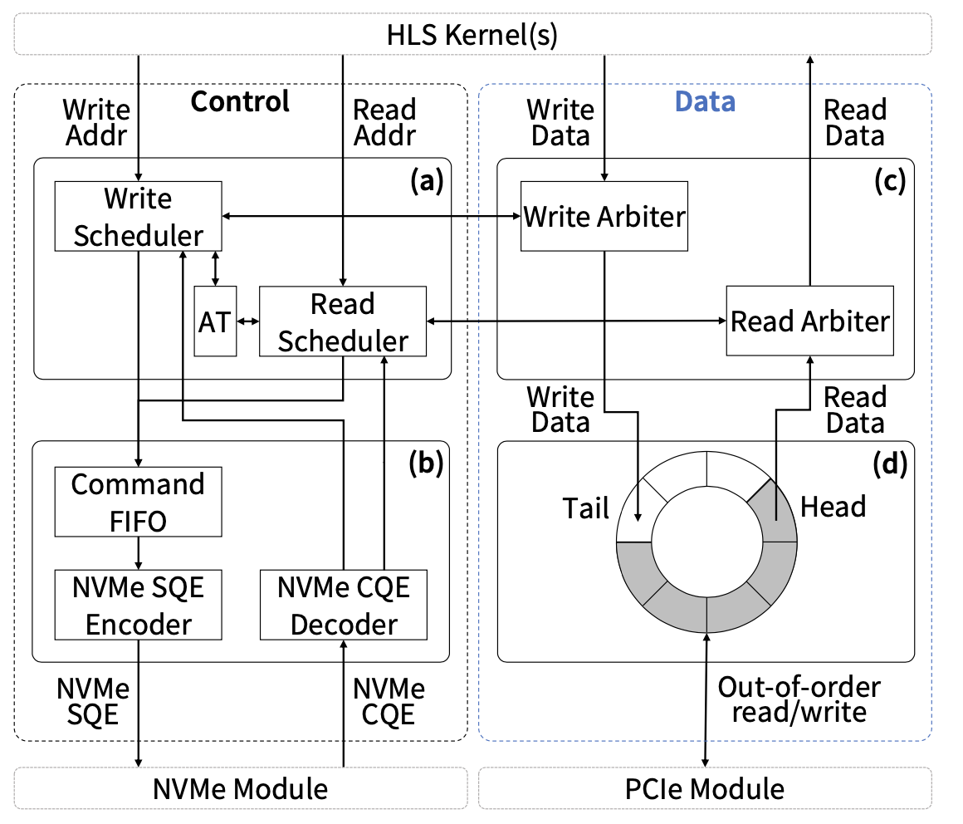
DONGLE Design
DONGLE Module
  (a) Scheduling Unit
  (b) Command Unit
  (c) Arbitration Unit
  (d) Reorder Buffer

Slide 12
DONGLE Design
Scheduling Unit
  Receive HLS AXI4 addresses.
  Schedule the execution.

Slide 13
DONGLE Design
Command Unit
  Construct NVMe commands
    Based on
      the type of operation
      block address
      schedule id
      transfer size
  Decode the NVMe completions

Slide 14
DONGLE Design
Arbitration Unit
  Transfer data between HLS and Reorder Buffer
    Arbitrate the granularity of write and read
    Bytes vs. Blocks

Slide 15
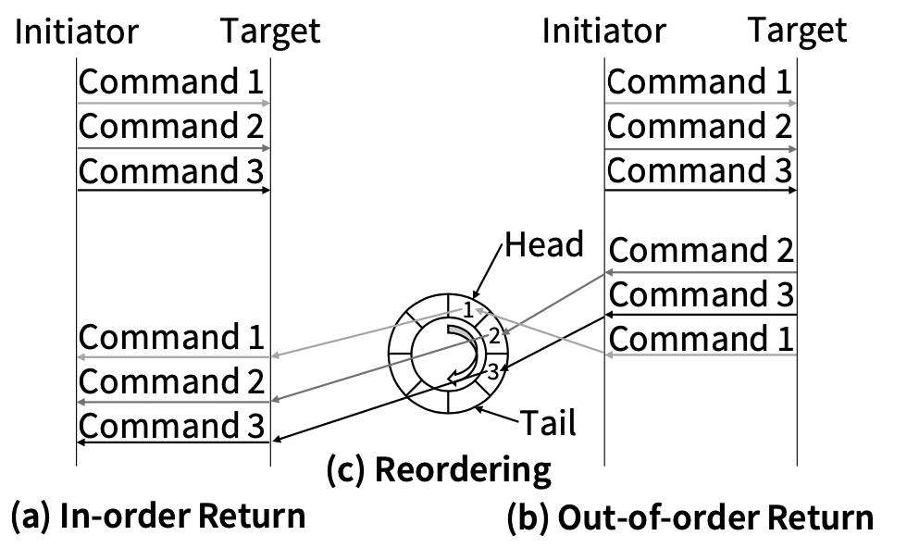
DONGLE Design
Reorder Buffer
  A ring DMA buffer
    Reorder data between HLS and NVMe

Slide 16
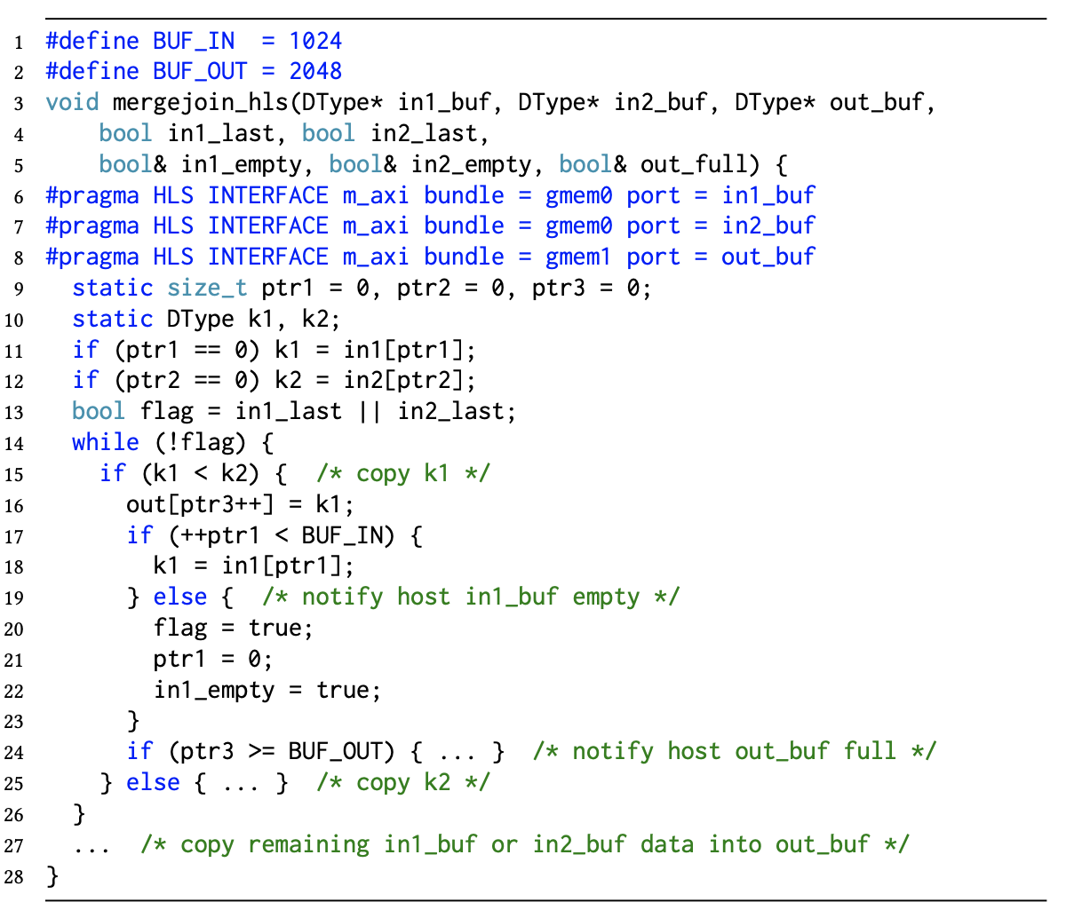
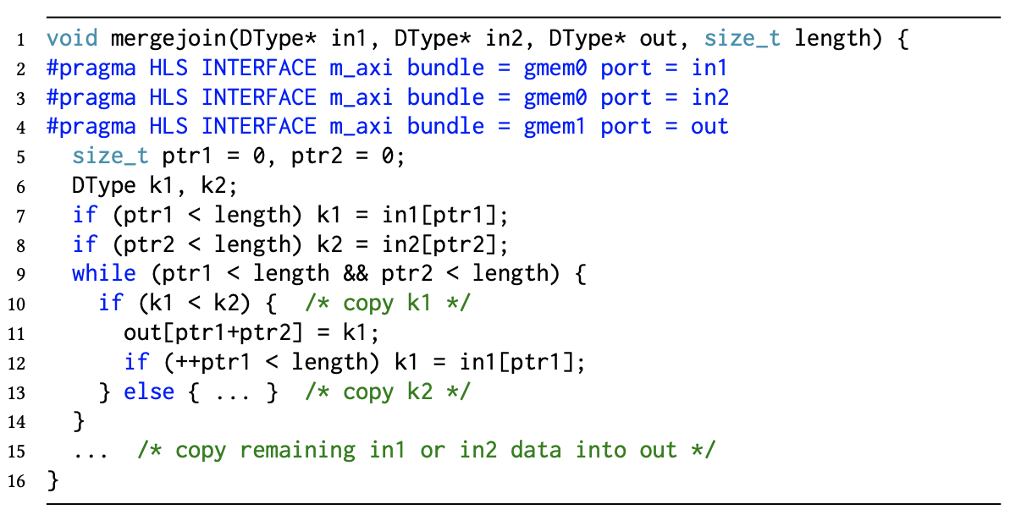
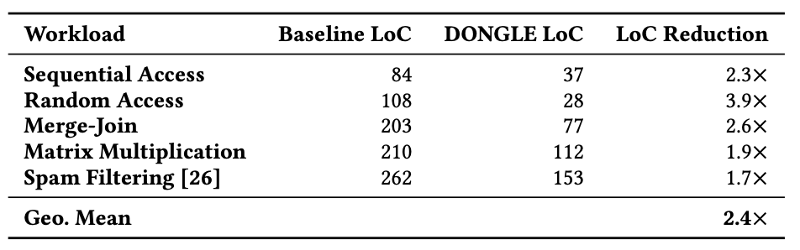
Evaluation
Simpler Code
HLS Code for merge-join
HLS Code for merge-join using DONGLE

Slide 17
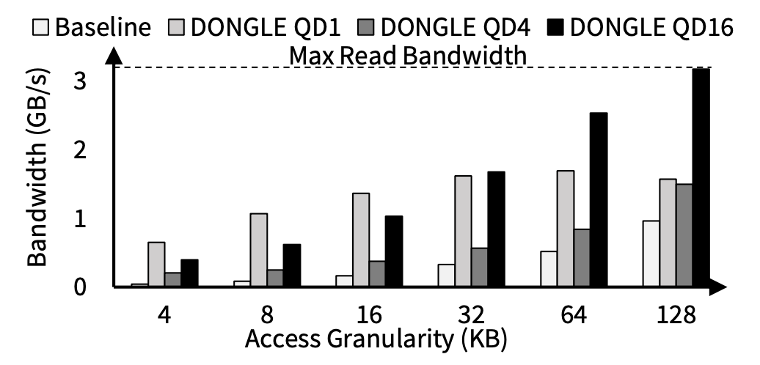
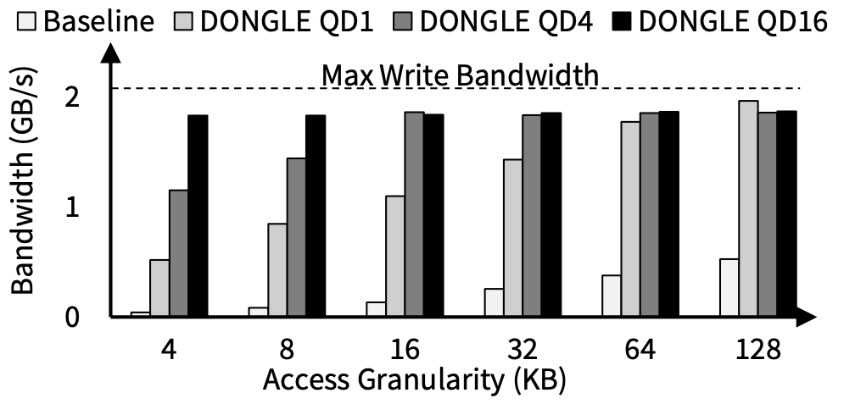
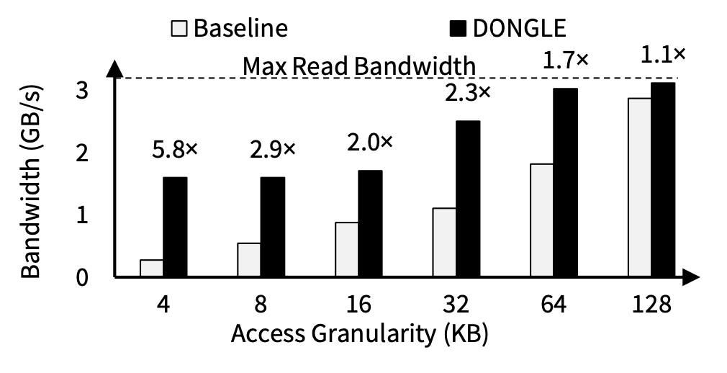
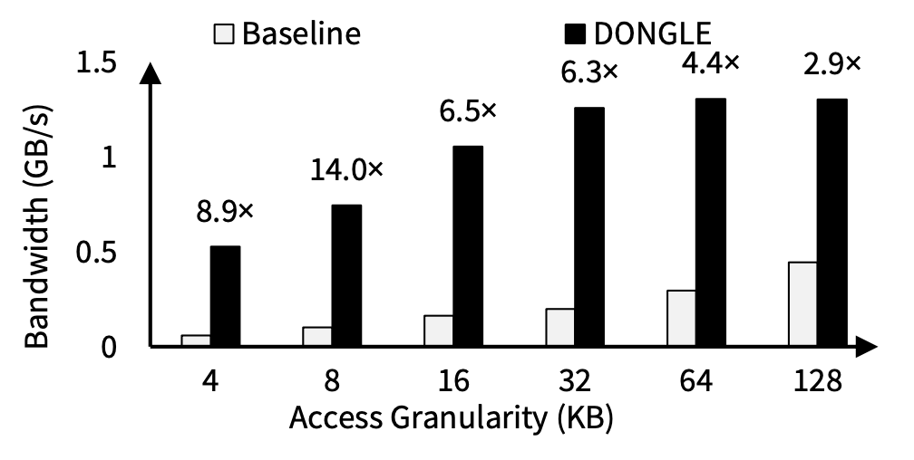
Evaluation
Better Bandwidth
Bandwidth of sequential read
Bandwidth of sequential write
Bandwidth of merge-join
Bandwidth of matrix multiplication

Slide 18
Thank you!

