Slide 1
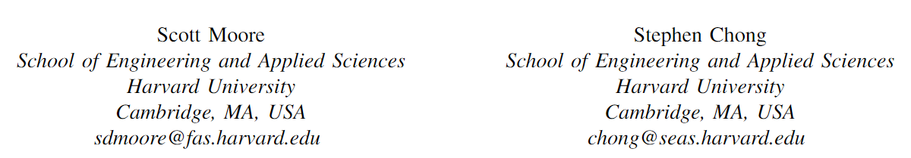

Static analysis for efficient hybrid information-flow control
CSF 2011

Slide 2
Introduction
information security
  跟踪和控制信息流
传统措施
  Static mechanisms
    Security type systems
  Dynamic mechanism
    监视/插桩程序执行以确定特定执行是否安全
    比静态更精确，但有额外的运行时开销
混合措施
  静态+动态

Slide 3
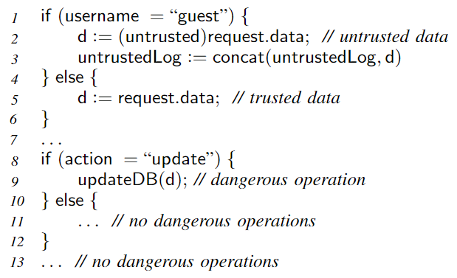
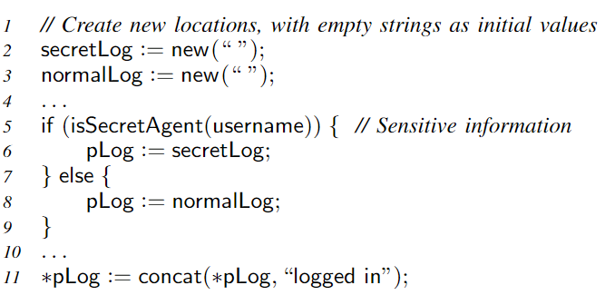
Introduction
混合措施
  静态+动态
  本文贡献：
    security-type system + memory abstraction
Selective tracking
memory abstraction

Slide 4
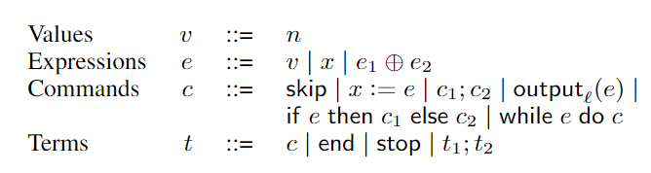



Background
Information Flow Monitor
  基于简单的命令式语言
  Hybrid monitor
    基于Russo and Sabelfeld先前的工作
    将2点格扩展到任意格
      安全等级构成完全格 ，最大元记为 ，最小元记为
      表示格中的连接操作（最小上界）、 表示偏序关系

Slide 5
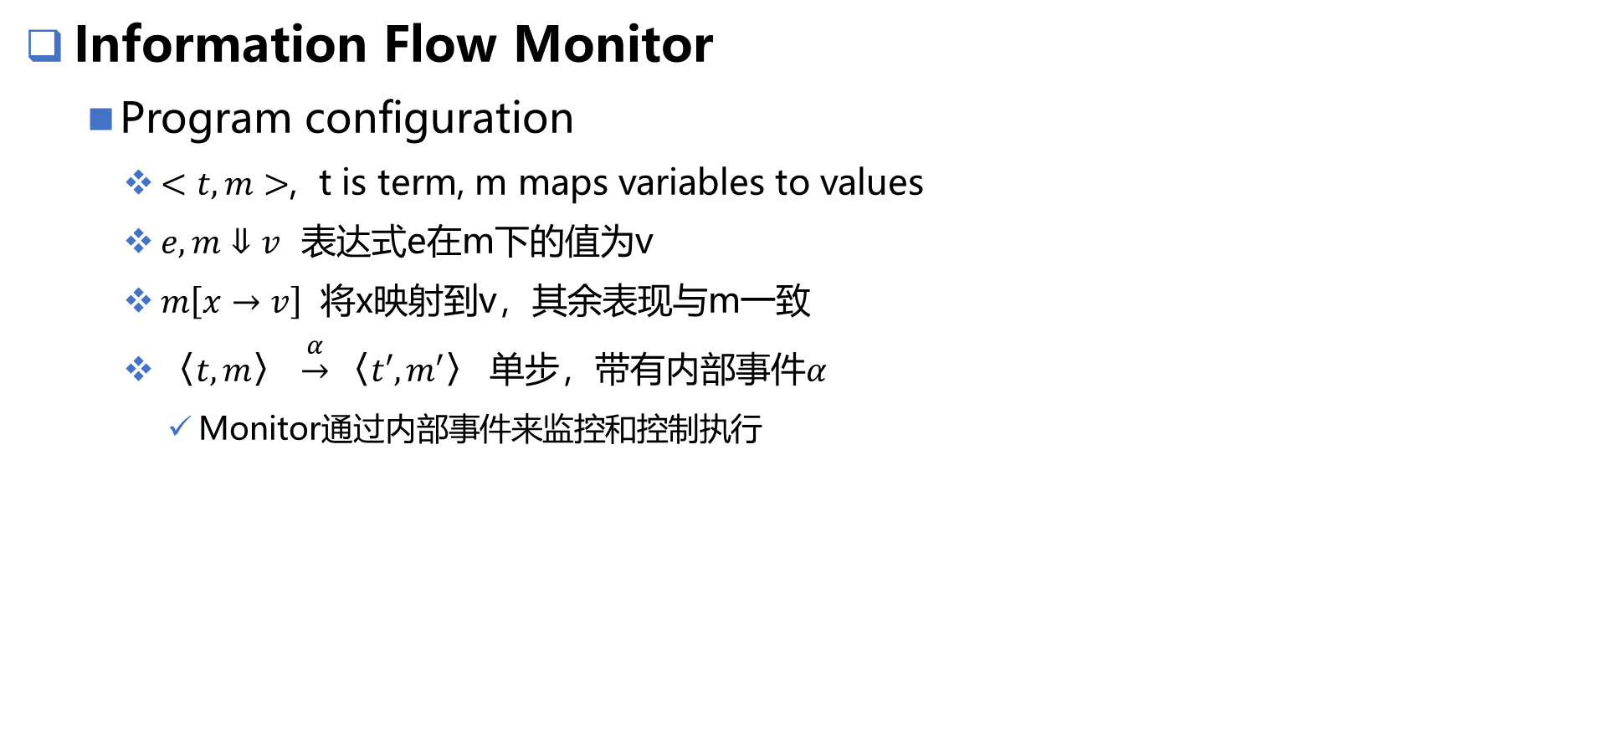
Background
Information Flow Monitor
  Program configuration
    $<t, m>$, t is term, m maps variables to values
    $e, m⇓v$ 表达式e在m下的值为v
    $m\left[x→v\right]$ 将x映射到v，其余表现与m一致
    $⟨t, m⟩ \underset{→}{α}⟨t′, m′⟩$ 单步，带有内部事件$α$
      Monitor通过内部事件来监控和控制执行

Slide 6
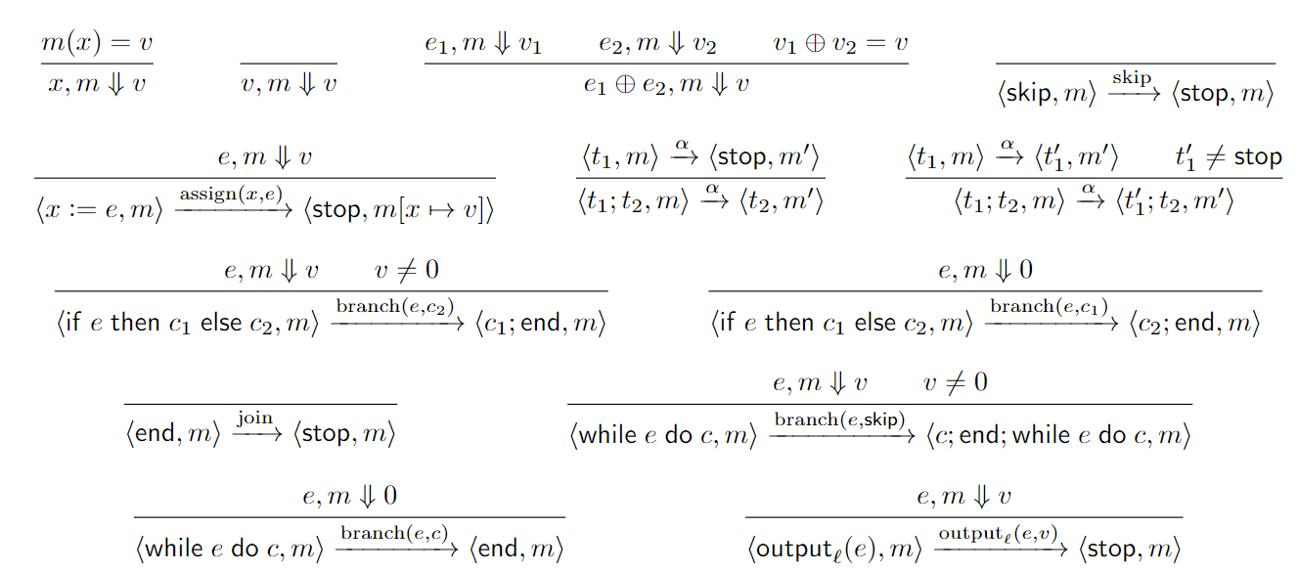
Background
Information Flow Monitor
  Program configuration
Language semantics

Slide 7
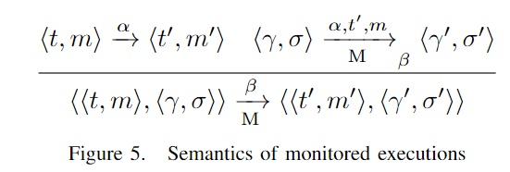
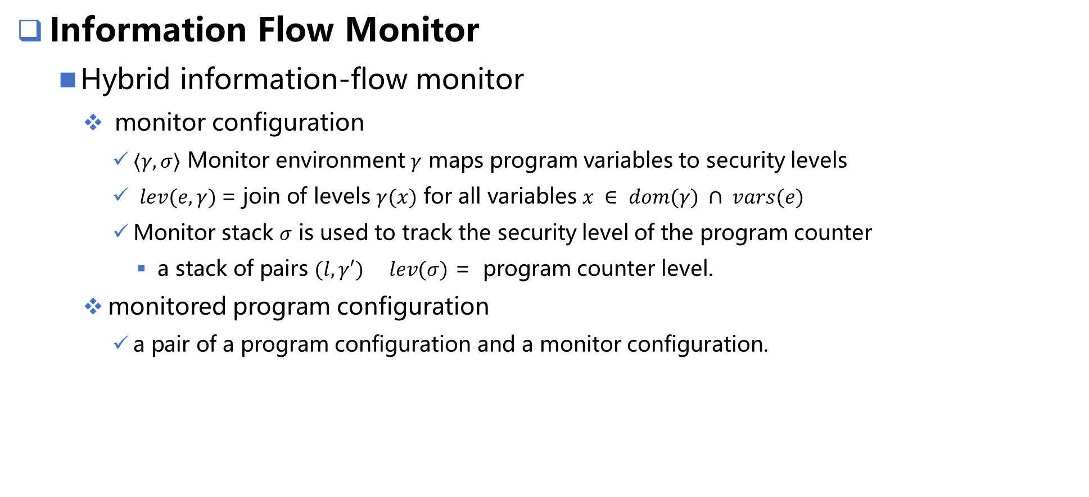
Background
Information Flow Monitor
  Hybrid information-flow monitor
    monitor configuration
      $⟨γ, σ⟩$ Monitor environment $γ$ maps program variables to security levels
      $lev(e, γ)$= join of levels $γ(x)$ for all variables $x ∈ dom(γ) ∩ vars(e)$
      Monitor stack $σ$ is used to track the security level of the program counter
        a stack of pairs $(l, γ′)$ $lev(σ)$ = program counter level.
    monitored program configuration
      a pair of a program configuration and a monitor configuration.

Slide 8
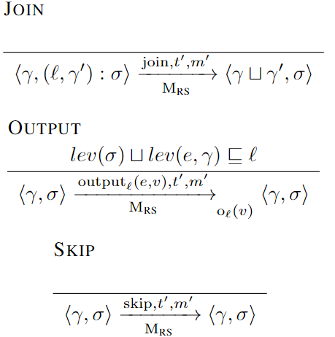
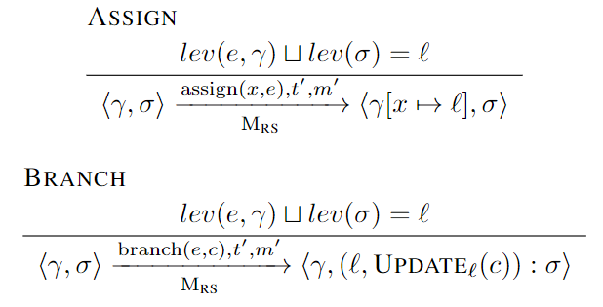
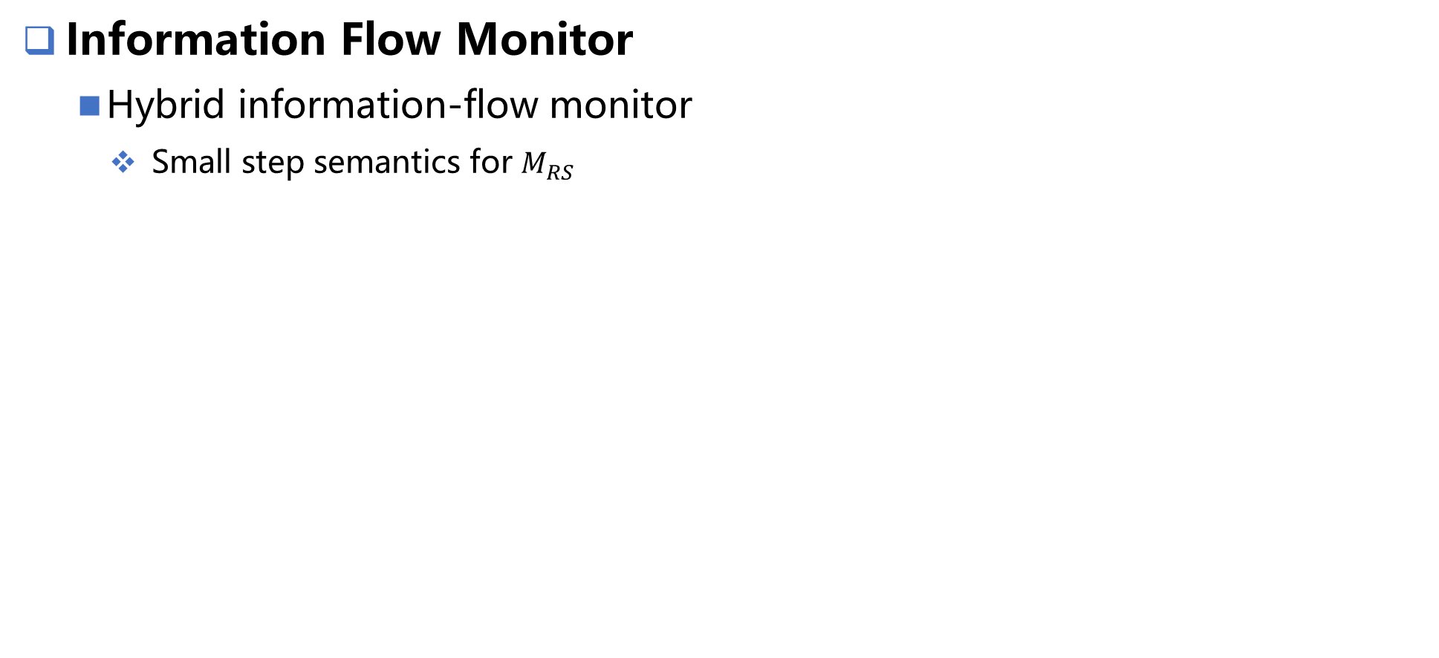
Background
Information Flow Monitor
  Hybrid information-flow monitor
    Small step semantics for $M_{RS}$

Slide 9
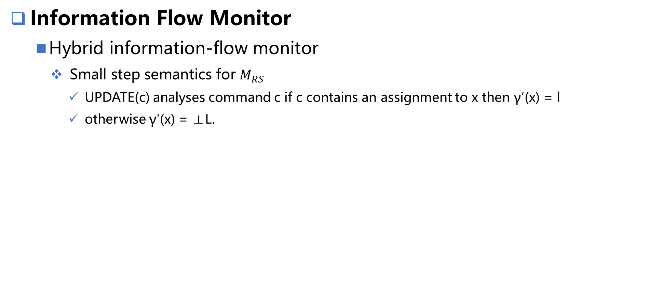
Background
Information Flow Monitor
  Hybrid information-flow monitor
    Small step semantics for $M_{RS}$
      UPDATE(c) analyses command c if c contains an assignment to x then γ′(x) = l
      otherwise γ′(x) = ⊥L.

Slide 10



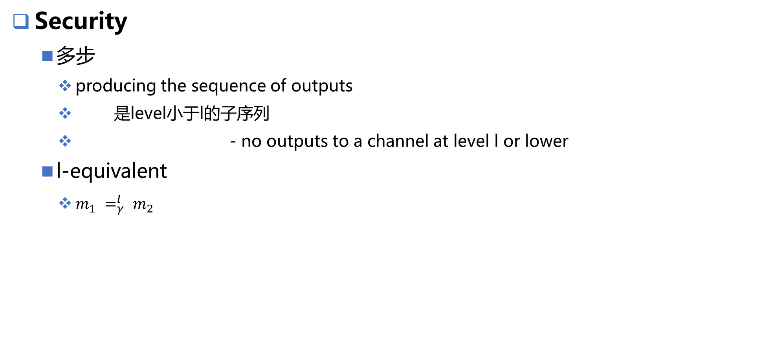
Background
Security
  多步
    producing the sequence of outputs
    是level小于l的子序列
    - no outputs to a channel at level l or lower
  l-equivalent
    $m_{1} =_{γ}^{l} m_{2}$

Slide 11
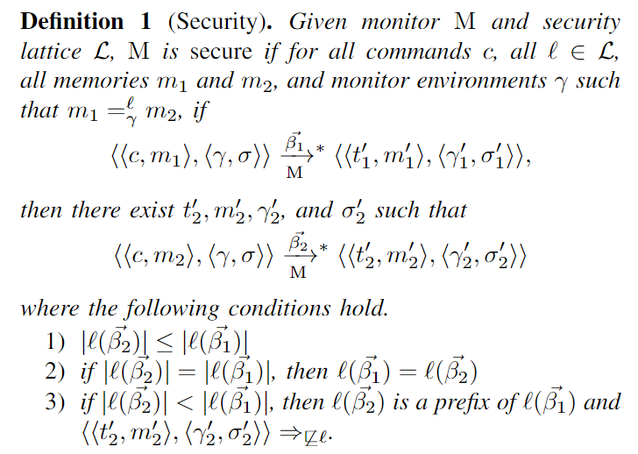

Background
Security

Slide 12
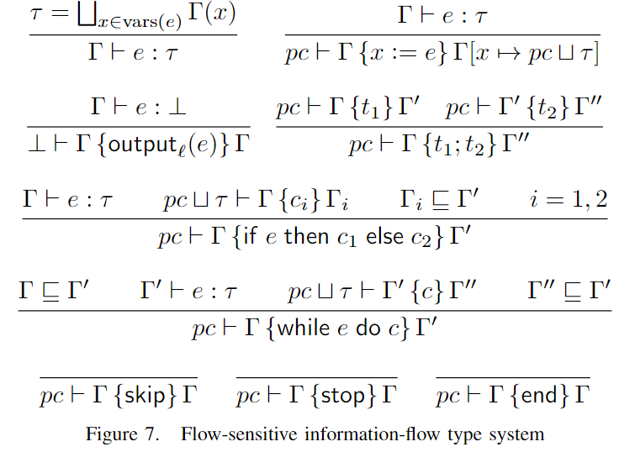
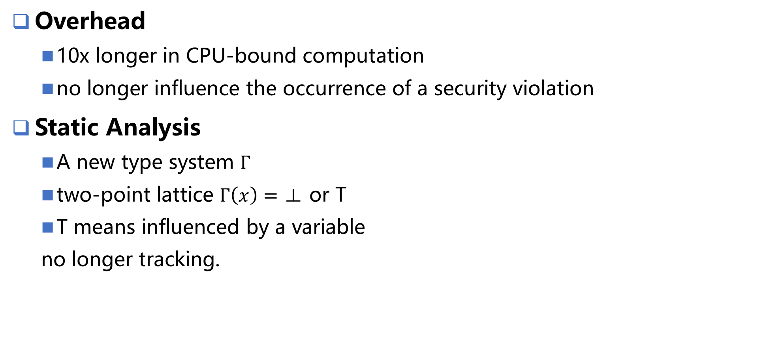
Selective Tracking
Overhead
  10x longer in CPU-bound computation
  no longer influence the occurrence of a security violation
Static Analysis
  A new type system $Γ$
  two-point lattice $Γ\left(x\right)=\text{⊥ }\text{or} \text{T}$
  T means influenced by a variable
  no longer tracking.

Slide 13
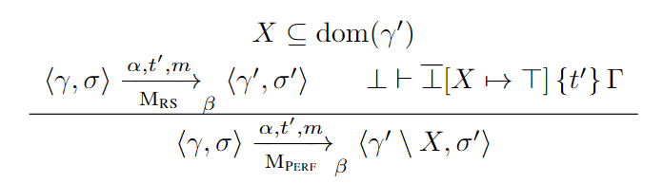
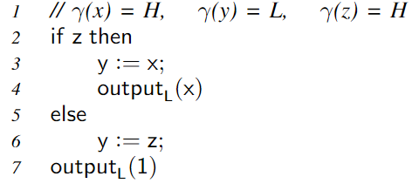
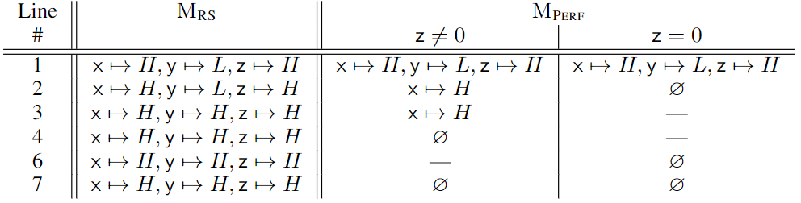
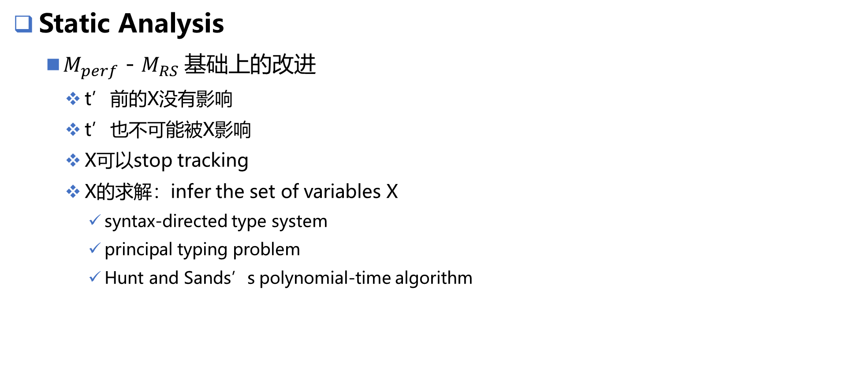
Selective Tracking
Static Analysis
  $M_{perf}$ - $M_{RS} 基础上$的改进
    t’前的X没有影响
    t’也不可能被X影响
    X可以stop tracking
    X的求解：infer the set of variables X
      syntax-directed type system
      principal typing problem
      Hunt and Sands’s polynomial-time algorithm

Slide 14
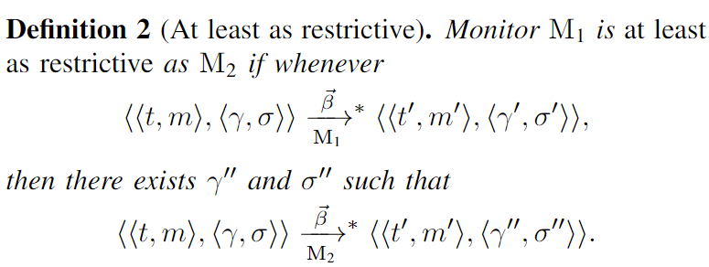
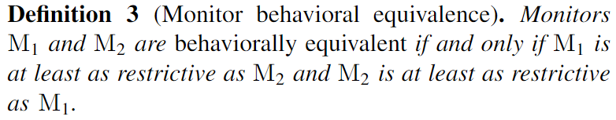

Selective Tracking
Security

Slide 15
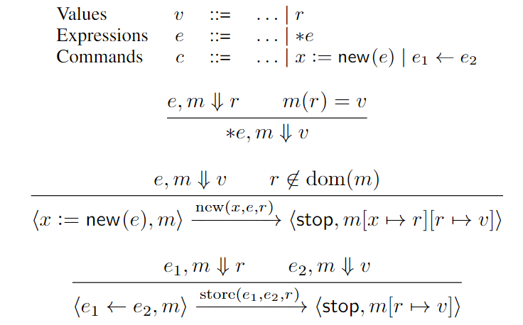
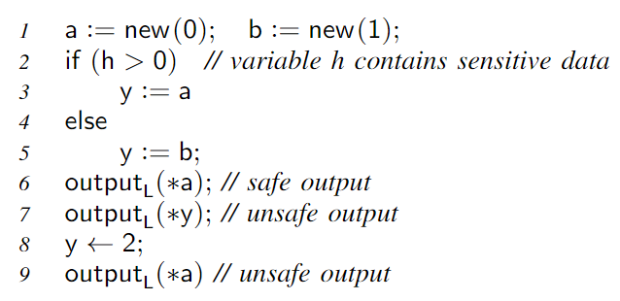
Mem Abstraction
Extended Language
  Dynamic memory, first-class ref

Slide 16
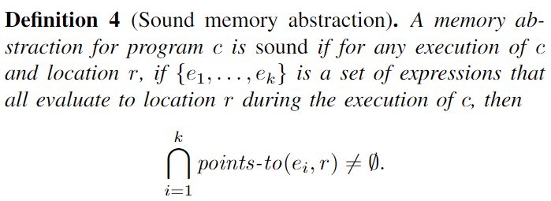

Mem Abstraction
Sound memory abstractions
  $points−to\left(e, r\right)$
    a given expression e and location r, a set of abstract locations

Slide 17
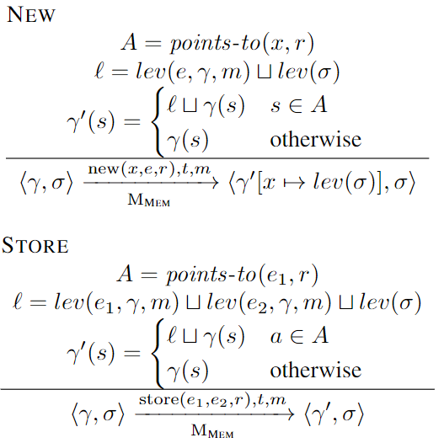
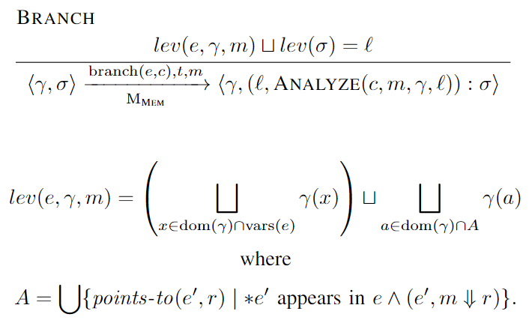
Mem Abstraction
Sound memory abstractions

Slide 18
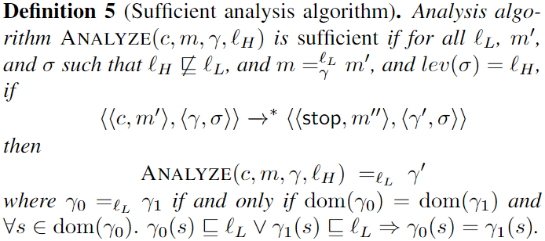
Mem Abstraction
Sound memory abstractions
  Sufficient analysis algorithm

Slide 19
谢谢！

