Slide 1

Spindle: Informed Memory Access Monitoring
ATC 2018

Slide 2
Introduction
Intro
  Memory access monitoring
    understand applications and evaluate system
    for memory bug、race condition detection、information flow tracking
  Problem
    Some information not available at compile time
    Execution time checking
      Expensive overhead (typically bringing 2× )

Slide 3
Introduction
Intro
  Observation
    important information not well utilized at compile time.
    patterns in memory accesses
      accesses to large objects form groups with highly behaviors
    memory access patterns recognizable during static analysis
      summarize common structural information useful to memory checking/tracing tasks

Slide 4
Introduction
Intro
  提出 Spindle
  特性
    hybrid static+dynamic analysis for efficient memory monitoring
    利用常见的静态分析从目标程序中识别运行时mem check中的冗余
    by computing rather than collecting memory accesses whenever possible
    插桩可从指令粒度变为对象粒度
  Implementation
    LLVM compiler infrastructure
    a memory bug detector (S-Detector) and a memory trace collector (S-Tracer)

Slide 5
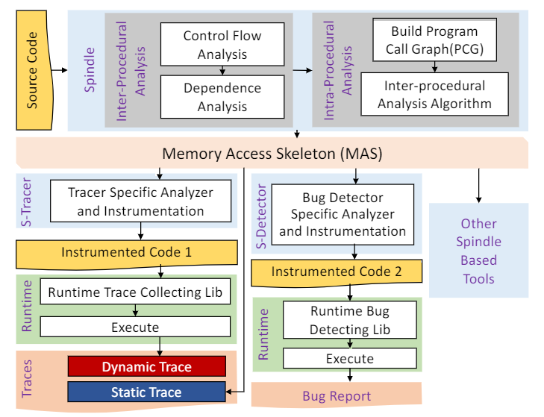
Overview
Spindle Framework
  Spindle generates Memory Access Skeleton(MAS)
    describing the structured, predictable memory access components
  Limitation
    requires source level information
    starts with LLVM IR
    translate binary codes into IR
  Future work
    direct static analysis on binaries
Notes:
Spindle 工具开发人员编写他们自己的分析器，该分析器使用 MAS 来优化他们的代码检测，积极修剪不必要或冗余的运行时检查或监控数据收集。
通常，此类特定于任务的工具可以计算在程序执行之前或之后访问的内存地址组，以避免在运行时检查单个内存访问。通常，此类特定于任务的工具可以计算在程序执行之前或之后访问的内存地址组，以避免在运行时检查单个内存访问。

Slide 6
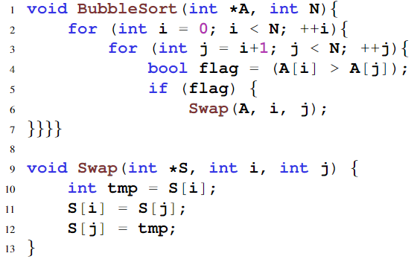
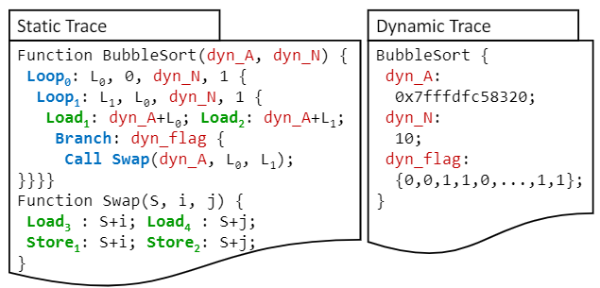
Overview
Sample Input/Output: Memory Trace Collector
  Static trace
    the control flow, the memory accesses pattern and the call graph
    information items that cannot be determined during static analysis
  Dynamic trace
    Instrumented code records these missing values at executing time
    compose the dynamic trace(compressed)

Slide 7
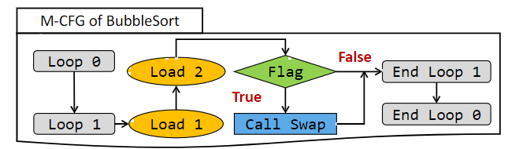
Static Analysis
Intra-procedural Analysis
提取函数控制流来决定哪些trace是可计算的
  Extracting Program Control Structure
  内存访问pattern总是和控制流相结合
    M-CFG – 包含内存引用的指令而非基本块
      以及其余控制流指令。记录和循环、控制流相关的变量
    之后讨论有关内存依赖以及函数调用的处理

Slide 8
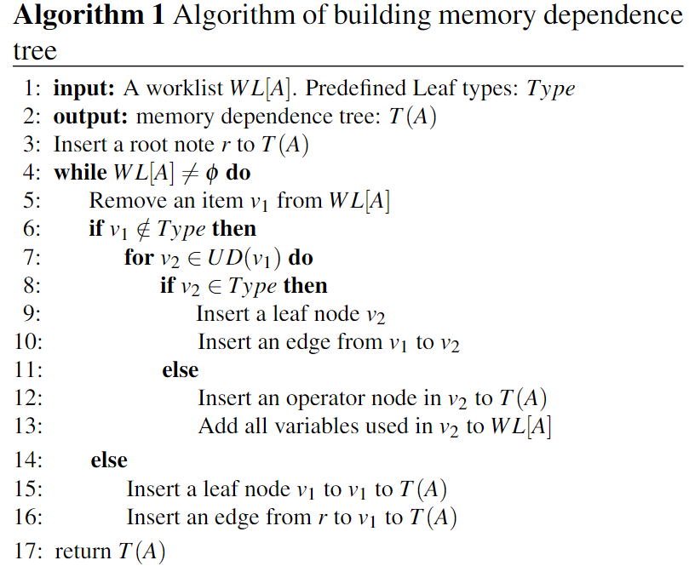
Static Analysis
Intra-procedural Analysis
  Building Memory Dependence Trees
    Two types of mem access - computable or non-computable
    树的结构
      该树以访问的内存地址为根
      非叶节点表示变量之间的运算符
      叶节点表示程序中的变量
        Constant value、Base memory address
        Function parameter、循环归纳变量
    树的构建
      反向数据流分析
      对被写入的变量，遍历Use-define

Slide 9
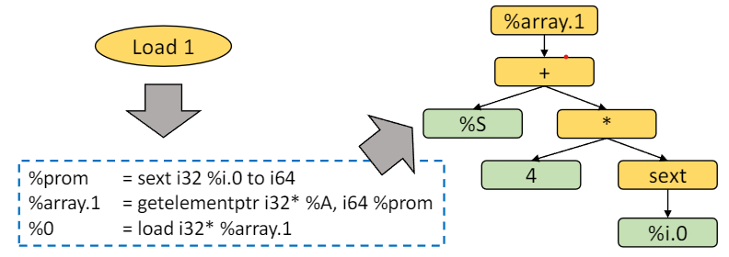
Static Analysis
Intra-procedural Analysis
  Building Memory Dependence Trees
    Allows the central task: computable memory access identification
      Analyzing the types of the leaf nodes
      若是Constants、循环归纳变量，则是可计算的

Slide 10
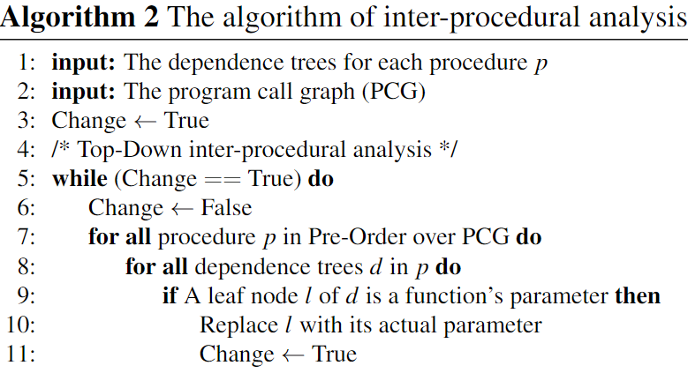
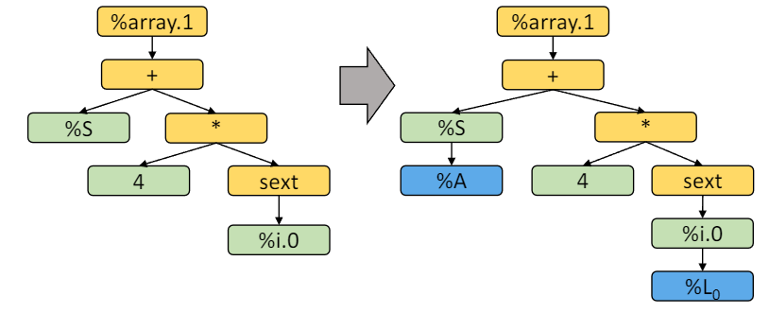
Static Analysis
Inter-procedural Analysis
  将函数参数的依赖从caller传给callee
  首先构建程序函数调用图（PCG）
    Top-down进行过程间分析
  将依赖树上的函数参数替换为实参

Slide 11
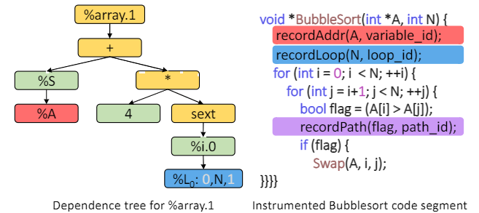
Spindle-based Runtime Monitoring
Runtime information collection
  MAS在运行时通过插桩进一步填充
  Control structures
    记录循环次数、循环归纳变量初值、循环的退出点、branch的分支
  Input dependent variables
    certain static analysis can indeed reduce runtime overhead
      只在指定位置插桩，比如初始化和更新时
  Non-computable memory accesses
    对于不可计算的内存地址，退回到传统的动态插桩
Notes:
本节说明如何使用 Spindle 的静态分析结果来减少运行时插桩

Slide 12
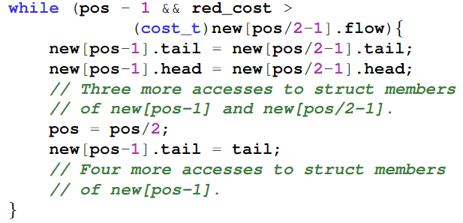
Spindle-based Runtime Monitoring
Spindle-based tool developing
  使用Spindle的API构建内存监测工具
  Memory Bug Detector (S-Detector)
    数组越界、use-after-free、内存泄漏
    In-structure accesses
      所有access都可以表示为base+offset
      offset确定后，只需检查base到base+offset是否valid，为per element的检查
    In-loop accesses
      确定归纳变量的初值、最终值、更新方法
      [pos_end/2-1, pos_init-1]，确定该范围是否有效
Notes:
本节说明如何使用 Spindle 的静态分析结果来减少运行时插桩

Slide 13
Spindle-based Runtime Monitoring
Spindle-based tool developing
  使用Spindle的API构建内存监测工具
  Memory Trace Collector (S-Tracer)
    generate highly compressed memory access traces
    Register spilling、Implicit memory accesses with function calls
      Simulation
    Dynamically linked libraries
      fall back again to traditional dynamic instrumentation
Notes:
本节说明如何使用 Spindle 的静态分析结果来减少运行时插桩

Slide 14
Evaluation
Setup
  Test programs
    11 C programs from SPEC CPU2006 for memory bug detection
      400.perlbench, 401.bzip2, 403.gcc,429.mcf, 433.milc, 445.gobmk, 456.hmmer,458.sjeng, 464.h264ref, 470.lbm, and 482.sphinx3
    NPB parallel benchmark suite for memory trace collection
    data-intensive and irregular datacenter applications
      the Breadth First Search (BFS) component of the Graph500 Benchmark
      a convolutional neural network for digit recognition(MNIST)
      kissdb, a key-value store
      Fido, a lightweight, modular machine learning library
    3 programs from the PARSEC suite for multi-threaded applications
      streamcluster(stream processing), freqmine (data mining), and blackscholes (PDE solving)

Slide 15
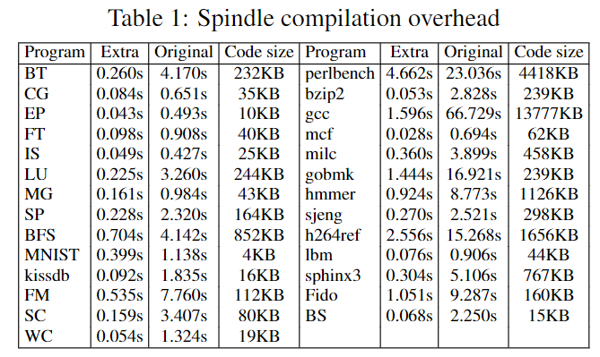
Evaluation
Spindle Compilation Overhead
  2% to 35%, average at 10%
    Negligible considering the significant savings in the much
    larger runtime checking/tracing cost

Slide 16
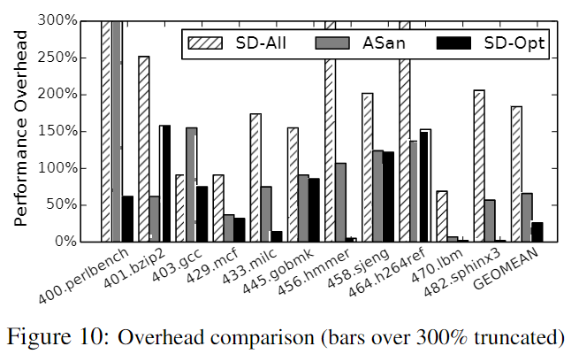
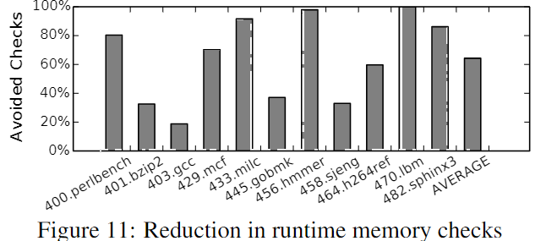
Evaluation
S-Detector for Memory bug detection
  S-Detector runtime overhead
      compare with ASAN and DynamoRIO
      two versions: SD-All and SD-Opt
        Bring down 26% overhead
        Reduce 64% mem checks

Slide 17
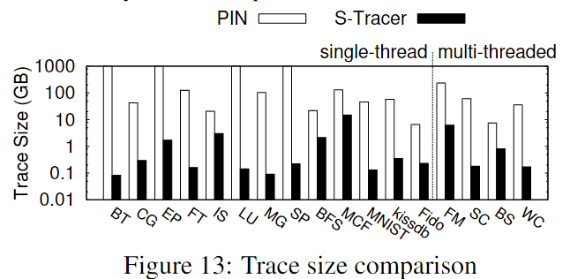
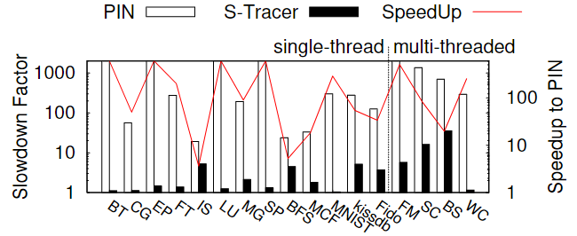
Evaluation
S-Tracer for Memory Trace Collection
  Result Trace Verification
    解压缩后和Pin的结果对别
  Trace Size Reduction
    NPB benchmark中程序可以减少100x
    最差情况有6.93x的减少
  Runtime Tracing Overhead Reduction
    61× on average

Slide 18
谢谢！

