Slide 1

张量程序调优

Slide 2
Tensor Compiler
From the program language perspective:
Python / C++
Workloads
High Level Graph IR
Subgraphs
Search Algorithm
Low Level Tensor IR
Tensor Programs
Accelerator Backend
LLVM IR
CUDA / Metal / OpenCL
Deployable Module
Notes:
从承载的语言上面来说
抽象成两个ir的原因

Slide 3
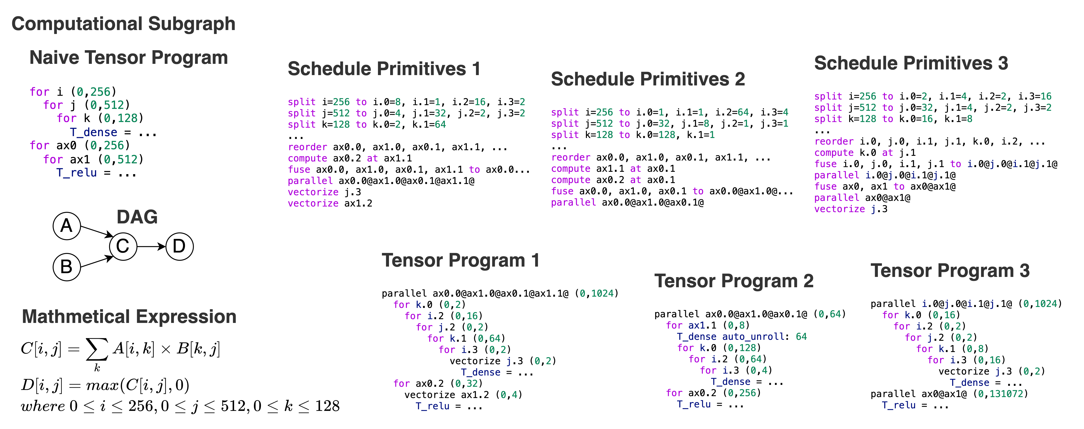
An Example

Slide 4

How to Search?
The most accurate
but inefficient
approach: Execute each candidate on the target hardware.
Subgraph
X 1
$$500ms × {10}^{6} ≈5.78 days$$
Search Algorithm Guided by
Cost Model
How to Search?
Tensor Programs
Previous works:
Empirical Formula Cost Model
  Halide16
Online Learning Cost Model
  AutoTVM, Ansor, Chameleon, FlexTensor, Halide20
Offline Learning Cost Model
  TenSet, TIRAMISU cost model, The work of Benoit Steiner et al.
CPU
X 10⁶
GPU
X 10⁹

Slide 5
Challenges
C1: Feature Extraction
Ansor / TenSet
Extract 164 features from five aspects for the innermost assignment statement
TIRAMISU cost model
Extract 2534 features from the innermost assignment statement
Extract the AST structure as a computational stream to forward propagate input features
Drawbacks
Complex feature engineering
Limited by prior knowledge
Drawbacks
Complex feature engineering
Features are sparse
The AST information in it is difficult to extract and utilize
Ours
Extract features from schedule primitives rather than tensor programs
Treat schedule primitives as tensor language and turn the task of predicting tensor program latency into an NLP regression task

Slide 6
Challenges
C2: Cross-Hardware Unavailability
Data
Machine A
Domain Gap
Machine B
Cost Model
High Performance
Poor Performance

Slide 7
Challenges
C2: Cross-Hardware Unavailability
TenSet
Build a local model to predict the latency gap between the source and target hardware
Moses
Use model distillation to distill out transferable and non-transferable parameters
Drawbacks
Suboptimal performance
Not open source
Ours
Use multi-task learning techniques to solve the cross-hardware unavailability
Use shared and non-shared parameters to fit hardware-independent and hardware-dependent features

Slide 8
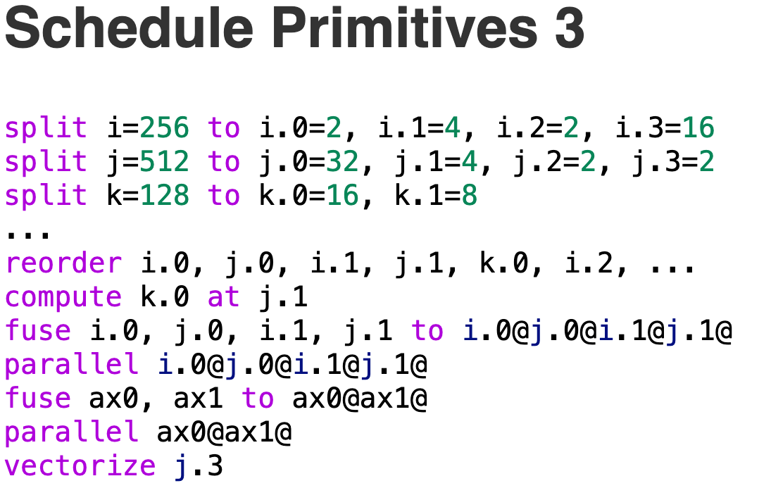
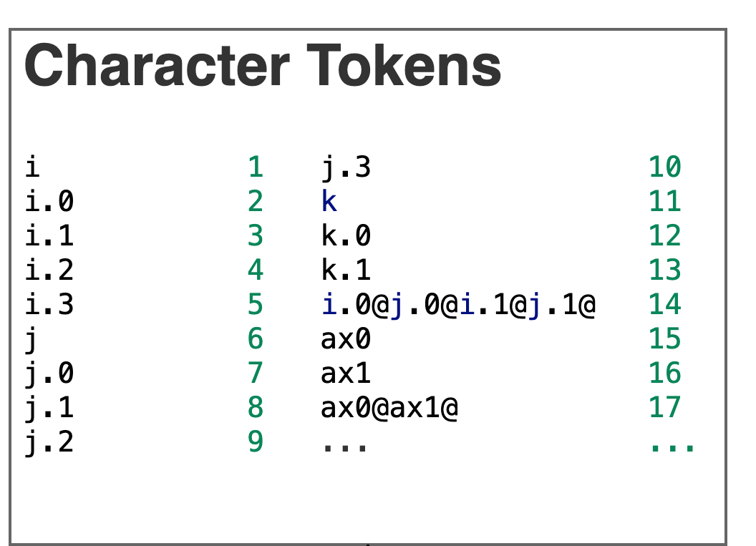
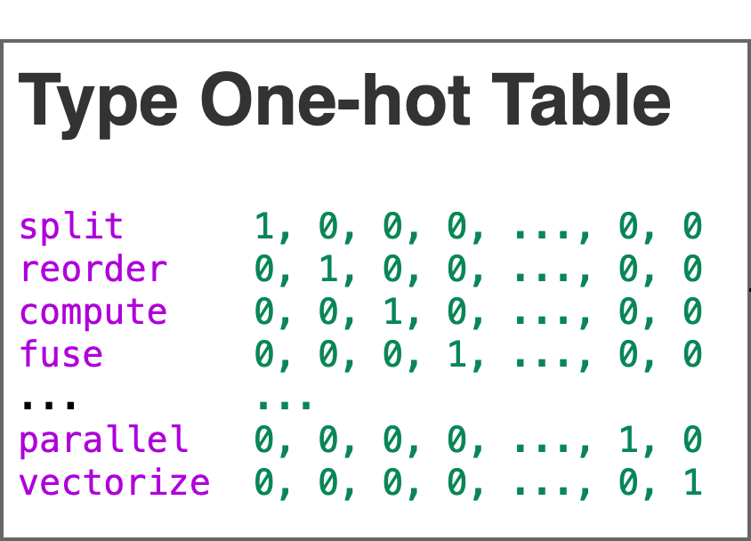
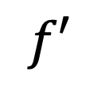
Feature Extraction
HOW?
split i=256 to i.0=2, i.1=4, i.2=2, i.3=16
split, i, 256, i.0, 2, i.1, 4, i.2, 2, i.3, 16
split, i, 256, i.0, 2, i.1, 4, i.2, 2, i.3, 16
split, i, 256, i.0, 2, i.1, 4, i.2, 2, i.3, 16
$$f′$$
1, 0, 0, 0, ..., 0, 0, 1, 256, 2, 2, 3, 4, 4, 2, 5, 16
1, 0, 0, 0, ..., 0, 0, 1, 256, 2, 2, 3, 4, 4, 2, 5, 16
1, 0, 0, 0, ..., 0, 0, 1, 256, 2, 2, 3, 4, 4, 2, 5, 16
0.83

Slide 9
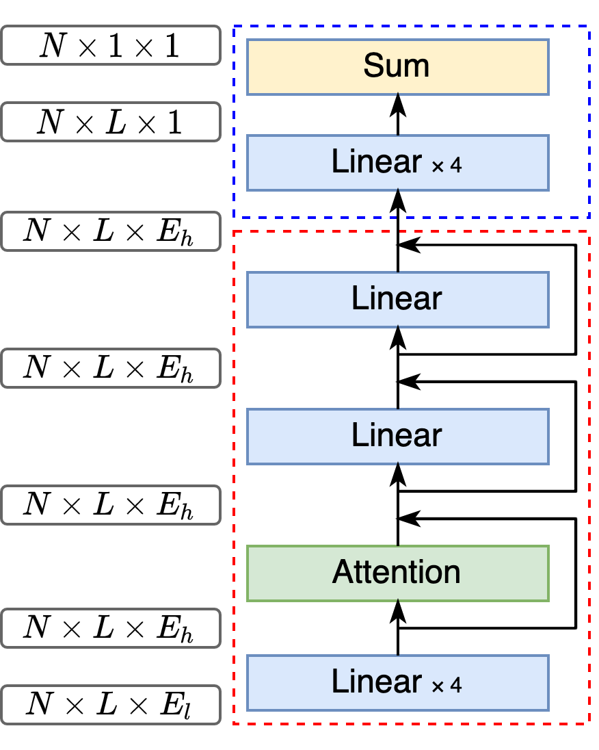
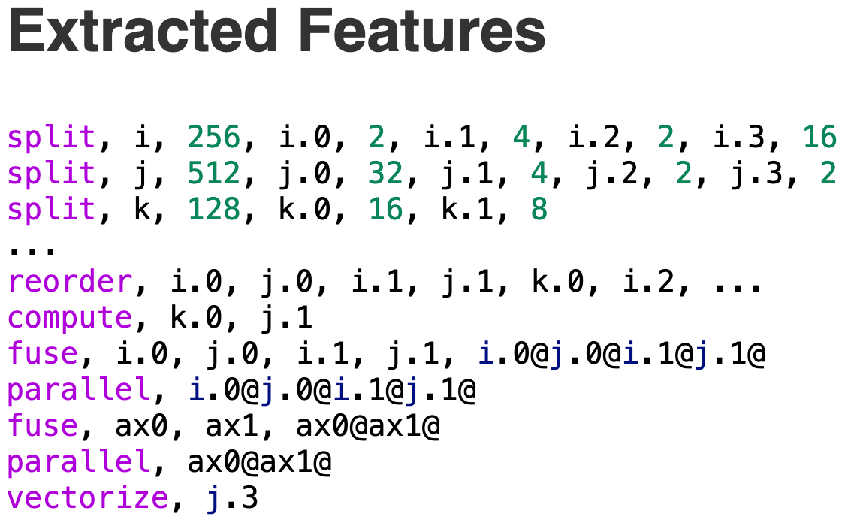
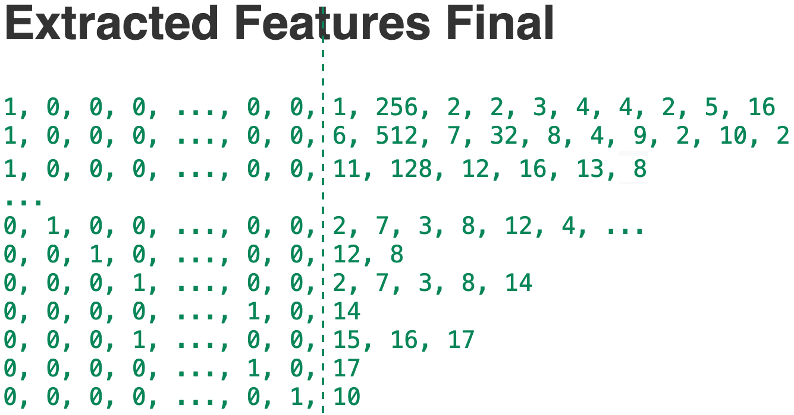
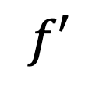
TLP
$$f′$$
0.83

Slide 10
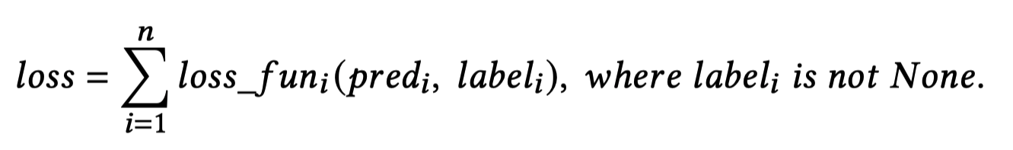
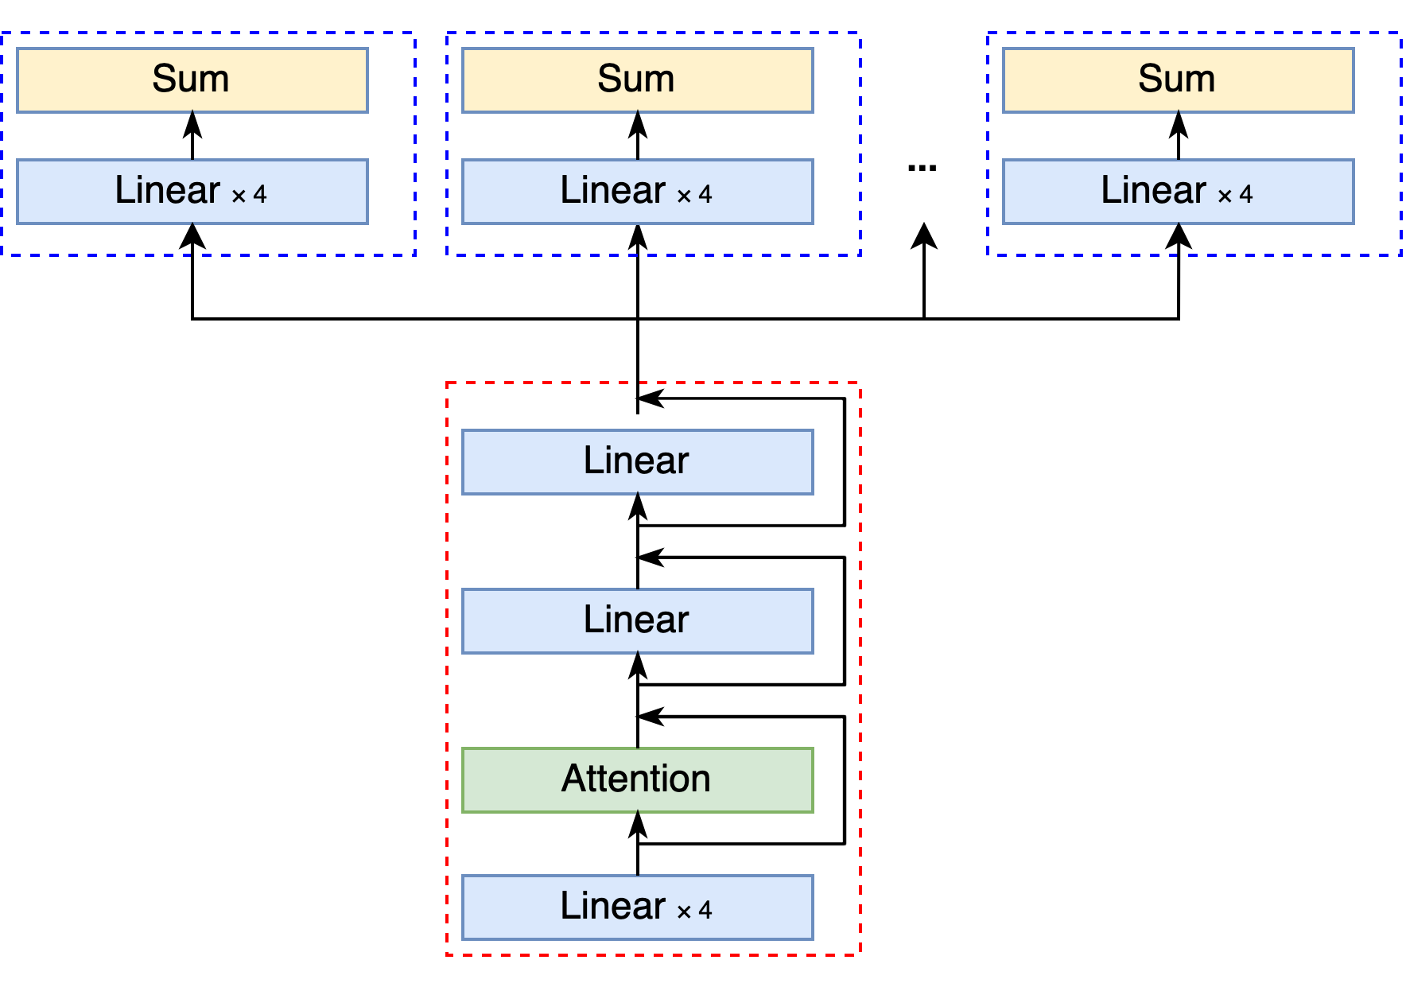
MTL-TLP
Cross-Hardware Unavailability
Domain Gap
Label1: None
Label2: 0.88
Label3: 0.89
A
B
Pred1: 0.53
Pred2: 0.86
Pred3: 0.93
Input Features

Slide 11
The End
Thank you for listening
Email me to ask follow-up questions: zhaiyi0@mail.ustc.edu.cn

