Slide 1
PG-Keys:
Keys for Property Graphs
Published in SIGMOD ’21, June 20–25, 2021
Neo4j, TigerGraph etc.
汇报人：胡海蓉
日期：2023.6.29

Slide 2
Why Keys for Property Graph
Keys are key in data management for identifying, referencing and constraining objects.
Keys are vital for managing both identity and integrity in the graph
举个栗子：
(:Person)->[:hasModerator]-(:Forum)
Person nodes are uniquely identified by their login ID
Can be referenced using their mandatory properties
Have zero or more aliases which are exclusive
Notes:
键对于引用和识别图中的节点、边或属性，避免重复的节点和边，为描述一个实体如何连接到另一个实体提供基础，约束数据库的结构，以及强制图中节点、边和属性的身份和完整性等至关重要

Slide 3
Why Now?
属性图查询语言的标准化目前正在通过ISO图查询语言(GQL)项目进行
ISO/IEC JTC1 SC32 WG3 Database Languages（即负责开发和增强数据库语言SQL的委员会)
重点：标准化图形查询语言
此外还需要考虑:数据模型的扩展(extensions to the data model)、模式语言(schema language)、约束(constraints)
目前流行的图数据库系统有各自版本的模式和约束，很难协调出一致的方案

Slide 4
Current GraphDB Support for Keys is Limited
Landscape is diverse
  Some systems offer property-based primary keys for nodes
  Some systems support uniqueness
  Some systems support mandatoriness
  以上特性全都要支持，并且还需要满足实际需求
  但现状是：
  目前属性图数据库没有统一的键处理方法
  学术成果与工业界应用脱节
Notes:
考虑到属性图的流行和众多数据库供应商的兴起，人们可能会认为在属性图中合并键将是一个必然的结论.

Slide 5
Proposal: PG-keys
设计要求：
  Flexible choice of key scope and descriptor of key values
  Keys for nodes, edges, and properties
  Identity, reference, and constrain objects
  Easy to validate
Notes:
一是要能灵活地选择作用域和描述符

Slide 6
Requirments
R1: Key Scope
R2: Key Descriptor
R3: Node Identity
R4: Edge Identity
R5: Property Value Identity
R6: Usability
R7: Validation

Slide 7
Flexible choice of scope and key values
声明式地指定key的作用域和值，此处使用类似 Cypher的语法
例如：
  FOR p WITHIN (p: Person) IDENTIFIER p.login;
  Says that “each person is identified by their login”
  FOR f WITHIN (f:Forum) <- [:joined] – (:Person)
  IDENTIFIER f.name, p WITHIN (f) <- [:moderates] – (p: Person);
  Says that “each forum with a member is identified by its name and moderator”

Slide 8
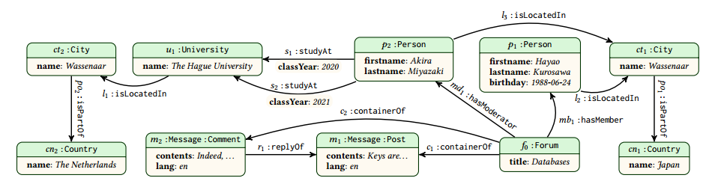

Slide 9
Keys for nodes, edges, and properties
The scope query selects a set of nodes, edges, or property values
例如
  FOR p WITHIN (p: Person) IDENTIFIER p.login;
  Says that “each Person node is identified by the value of property login”
  FOR e WITHIN (:Person) – [e: joined] -> (:Forum)
  IDENTIFIER p, f WITHIN (p: Person) – [e: joined] -> (f: Forum);
  Says that “each joined edge is identified by its endpoints”
  （no other joined edge has the same endpoints, so one cannot join the same forum twice)

Slide 10
Identify, reference, and constrain objects
Identification is provided by IDENTIFIER
  FOR f WITHIN (f:Forum) <– [e: joined] - (:Person)
  IDENTIFIER f.name, p WITHIN (f) <– [:moderates] -> (p:Person)
IDENTIFIER means:
  EXCLUSIVE – no objects in the scope share a key value
  MANDATORY – each object in the scope has at least one key value
  SINGLETON – each object in the scope has at most one key value
  SQL中，EXCLUSIVE 就是UNIQUE关键字，MANDATORY 是NOT NULL 关键字，SINGLETON 由1NF保证
  在属性图中，以上三个特性同样需要

Slide 11
Identify, reference, and constrain objects
Referencing is provided by EXCLUSIVE MANDATORY:
Eg: FOR p WITHIN (p: Person)
  EXCLUSIVE MANDATORY e WITHIN (p) – [:has] ->(e: Email)
Says that “emails are not shared and each person has an email”
Constraining can be done in many ways
Eg: FOR p WITHIN (p: Person)
  EXCLUSIVE p.alias;
  FOR p WITHIN (p: Person)
  EXCLUSIVE SINGLETON e WITHIN (p) – [:preferred] -> (e:Email)

Slide 12
Easy to validate
检查是否符合PG-key， 采用运行查询的方式
例如：FOR p WITHIN (p: Person)
EXCLUSIVE MANDATORY e WITHIN (p) – [:has] -> (e:Email);
如果上述PG-key的定义成立，以下查询没有返回值：
MATCH (p1:Person) – [:has] -> (:Email) <- [:has] –(p2:Person)
WHERE p1 <> p2 RETURN p1, p2;
MATCH (p:Person)
WHERE NOT EXITS (p1:Person) – [:has] -> (:Email);

Slide 13
Extension of PG-Keys
支持处理数据中的空值
支持正则表达式
目前属性图数据模型已经可以支持复杂的值类型，例如：tuples, sets, lists, JSON structures

Slide 14
Relationship to Relational Keys
关系数据库常被迁移到图数据库，因此需要考虑：关系数据库中的Key是否可以被 PG-Keys 表达
一个例子：
City ( ID , name , country , population ) ,
Person ( name , birthday , cityID )
迁移到图数据库需要做：1）在两个节点间添加边；
2）FOR ( x : City ) IDENTIFIER x . ID .
3）FOR ( x : City ) EXCLUSIVE x . name , x . country .

Slide 15
Looking ahead
PG-keys 是工业界和学术界共同的需求
  为商用和非商用的图系统提供设计和实现的指导
  提出一些可以研究的问题：
    具体查询语言的验证和maintenance complexity
    Implication and inference
    优化问题的静态分析
    更丰富的属性图限制(Constaint)语言
PGSWG is getting started
  Design of PG schema and constraint languages
  Extensions to the PG model driven by practical applications

