Slide 1
Ansor: Generating High Performance Tensor Programs for Deep Learning
Lianmin Zheng 1, Chengfan Jia 2, Minmin Sun 2, Zhao Wu 2, Cody Hao Yu 3 ,
Ameer Haj-Ali 1, Yida Wang 3, Jun Yang 2, Danyang Zhuo 1;4 ,
Koushik Sen 1, Joseph E. Gonzalez 1, Ion Stoica 1
1 UC Berkeley, 2Alibaba, 3Amazon Web Services, 4 Duke University
OSDI2020, Paper link

Slide 2
Kernel libraries for deep learning framework
Existing deep learning framework map the operators to vendo-provided kernel libraries
  CuDNN and MKL-DNN, etc.
Significant engineering effort in manual tuning towards each hardware and operator
  Limit the innovation of new operator and accelerator

Slide 3
Search-based automated generation of tensor program
Given operator or sub-graph
  User define computation in high-level declarative language
  Compiler searches for performant program tailed towards hardware platform
Existing approaches fail to cover a large enough search space
  Manually-written templates
  Aggressive pruning by accurately evaluating in complete program
Notes:
灵活的枚举，自动创建搜索空间

Slide 4
Ansor
Large search space with comprehensive coverage of optimizations
  Hierarchical representation decouples high-level structures and low-level details
Efficient searching without comparing incomplete programs
  Sample complete programs and fine-tune with learned cost model
Prioritizing more important subgraphs in optimizing DNN end to end
  Optimizing with gradient descent

Slide 5
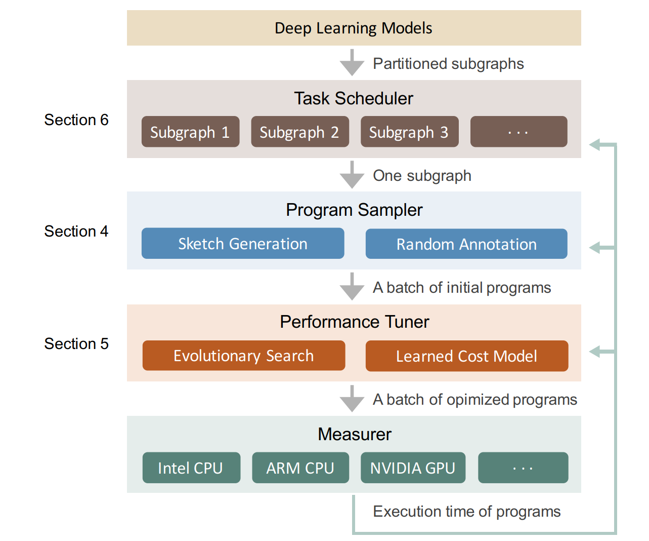
Design overview
Task scheduler:
  Allocate tuning time resources among subgraphs
Program Sampler
  Enumerate program structures hierarchically
  Random sample a bath of initial parameterized programs
Performance Tuner
  Tuning the parameters

Slide 6
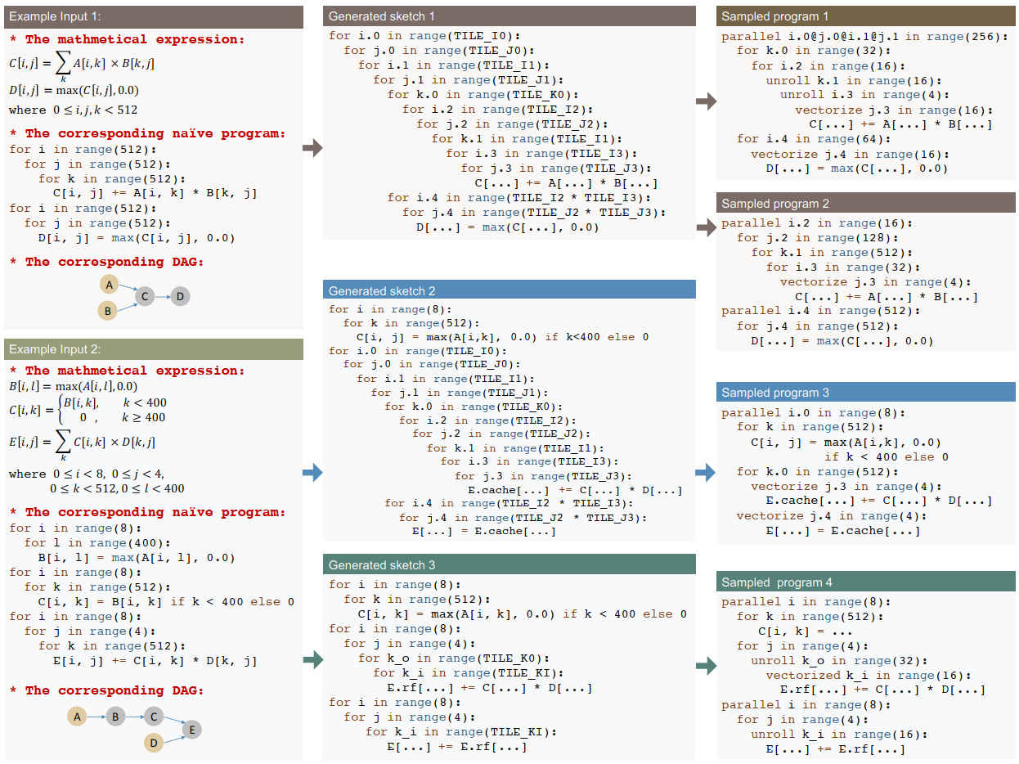
Program Sampler
Hierarchical search space with two levels
  Sketch
  Annotation

Slide 7
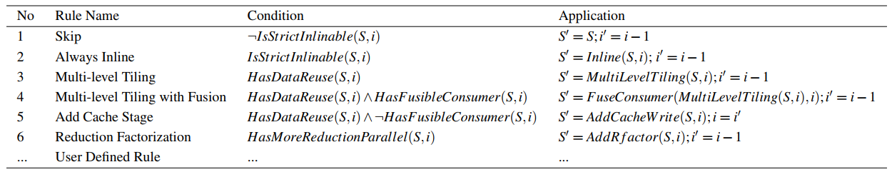
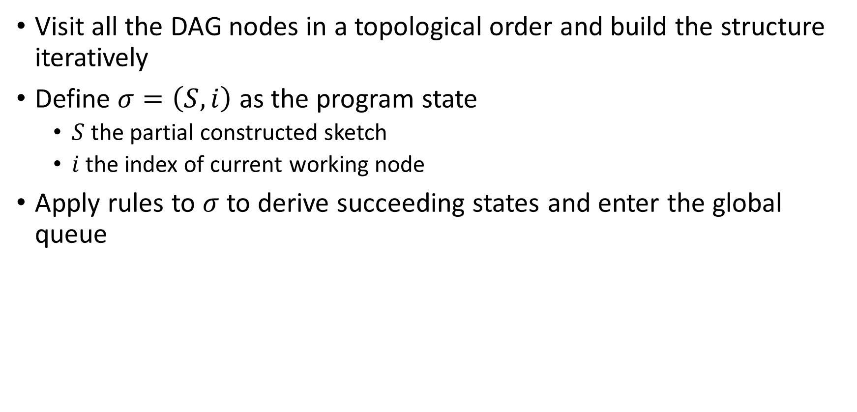
Pogrom Sampler: Sketch Generation
Visit all the DAG nodes in a topological order and build the structure
iteratively
Define $σ=\left(S,i\right)$ as the program state
  $S$ the partial constructed sketch
  $i$ the index of current working node
Apply rules to $σ$ to derive succeeding states and enter the global queue

Slide 8
Program Sampler: Random Annotation
generated sketches are incomplete
  They only have tile structures without specific tile sizes and loop annotations,
    parallel, unroll, and vectorization
randomly pick one sketch from list and randomly annotation sketch
  fill out tile sizes
  parallelize some outer loops
  vectorize some inner loops
  unroll a few inner loops

Slide 9
Program Sampler: Random Annotation

Slide 10
Performance Fine-tuning
The qualities of sampled programs are not guaranteed
Iteratively performance fine-tuning
  First use evolutionary search to find a small batch of promising programs base on a learned cost model
  Then measure these programs on hardware to get the actual execution
  time cost
  Finally feedback profiling data got from measurement to re-train the cost model

Slide 11
Performance Fine-tuning: Evolutionary Search
Start from the sampled initial generation
Next generation
  Some from current generation + Some randomly sampled
  The probability to be selected is proportional to its fitness predicted by the learned cost model
Mutation
  Tile size mutation
  Parallel, vectorization mutation
Crossover
  Rewriting steps as the gene of the grogram
  To avoid dependency breakup, the granularity of crossover is based on DAG nodes

Slide 12
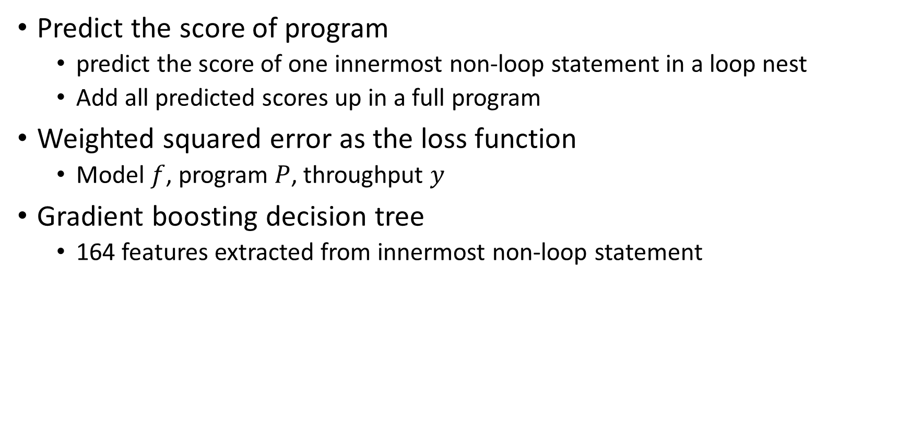
Performance Fine-tuning: Learned cost model
Predict the score of program
  predict the score of one innermost non-loop statement in a loop nest
  Add all predicted scores up in a full program
Weighted squared error as the loss function
  Model $f$, program $P$, throughput $y$
Gradient boosting decision tree
  164 features extracted from innermost non-loop statement

Slide 13
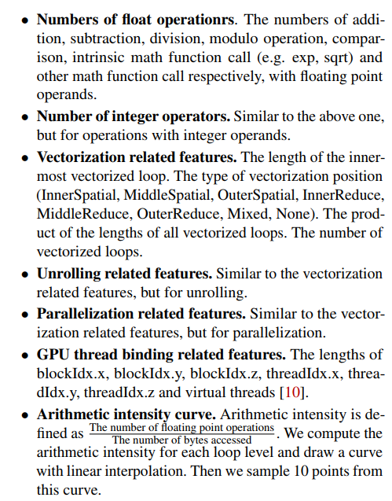
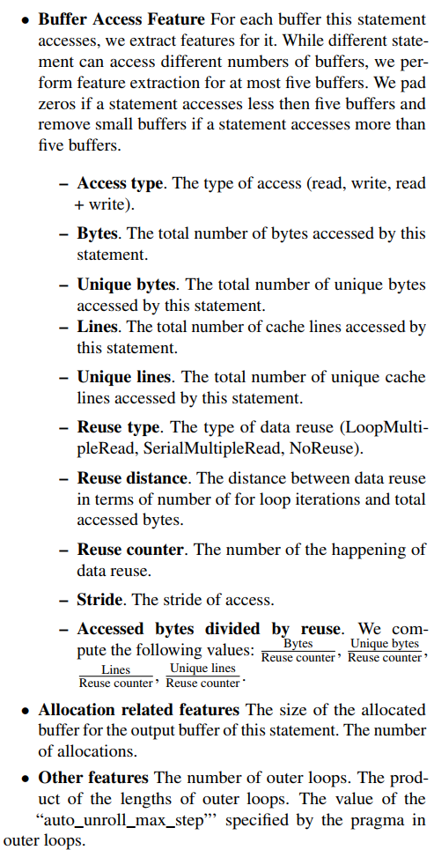
Performance Fine-tuning: Learned cost model

Slide 14
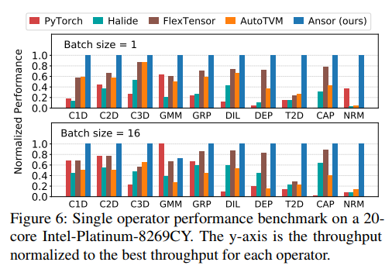
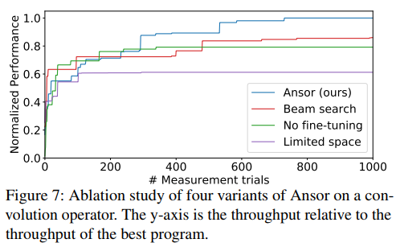
Evaluation: single operator

Slide 15
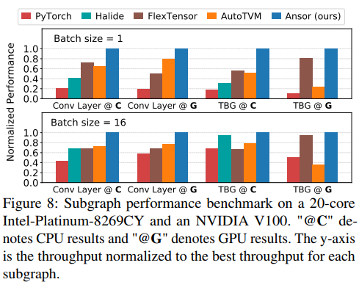
Evaluation: subgraph

Slide 16
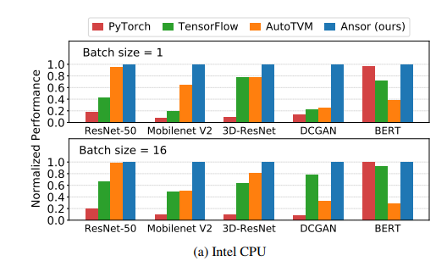
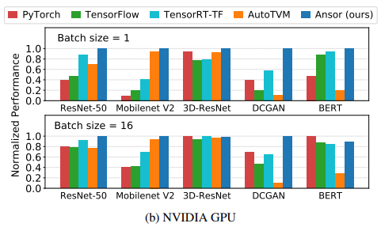
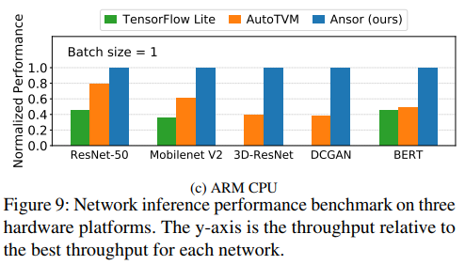
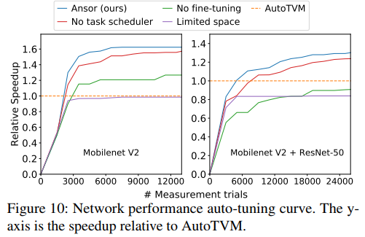
Evaluation: end-to-end network

