Slide 1
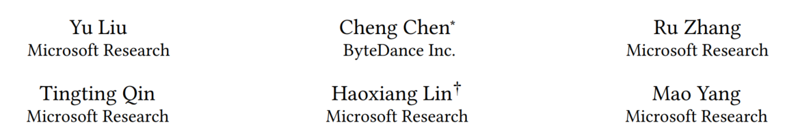
Enhancing the Interoperability between Deep Learning
Frameworks by Model Conversion
Paper: https://www.microsoft.com/en-us/research/uploads/prod/2019/11/mmdnn.pdf
Repo: https://github.com/microsoft/MMdnn

Slide 2
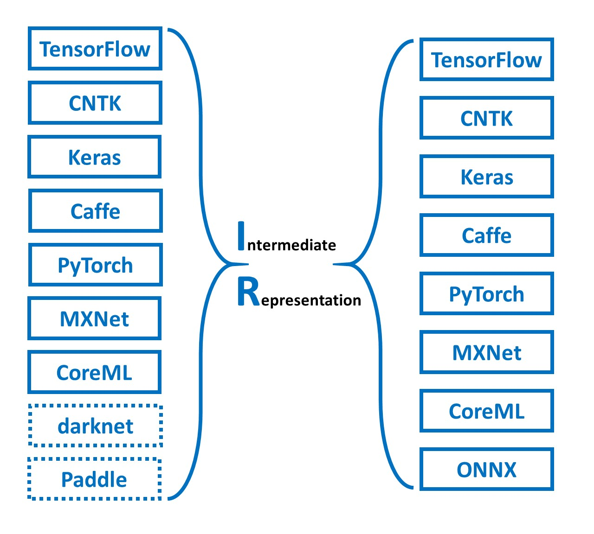
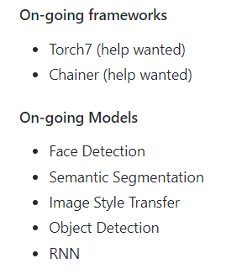
MMdnn Introduction
Model management for dnn
Supported ops: 60 ~
Python 23000+ lines
Supported Models: 15
  Only ImageNet models

Slide 3
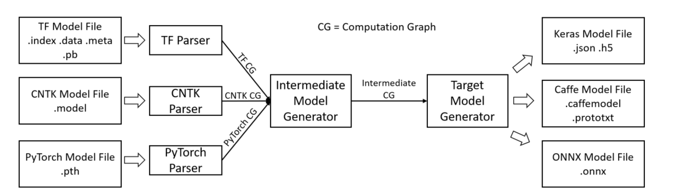
MMdnn Architecture
Second Phase
MMdnn IR generator transforms source IR to MMdnn IR
MMdnn IR node : inputs, outputs, attributes
Learnable parameters are saved in Numpy format
First Phase
Read model files from source framework
Use corresponding parser to generate source IR
Final Phase
Generator generates serialization target model
Source learnable parameters are also converted

Slide 4
Challenges for a Converter
Features difference between frameworks
  Unavailable operators
  Incompatible arguments
  Unsupported padding mode
  Inconsistent tensor layout : NCHW、NHWC
  Saved model files are different from original expression, e.g.
    CG construction schema, optimization, …
Front-end and back-end combined complexity

Slide 5
MMdnn Key Points
Features difference between frameworks
  Unavailable operators
    Translates IR node to semantically equivalent subgraph of target model
    Simply generates a placeholder
Notes:
1. Unavailable operators
2. Incompatible arguments
3. Unsupported padding mode
4. Inconsistent tensor layout : NCHW、NHWC
5. Saved model files are different from original expression, e.g. CG construction schema, optimization, …

Slide 6
MMdnn Key Points
Features difference between frameworks
  Incompatible arguments like python tuple vs. tensor
    Current: Accepted python object argument must be a constant
    Ideal: Code analysis on entire program; general IR(e.g. MLIR)
Notes:
1. Unavailable operators
2. Incompatible arguments
3. Unsupported padding mode
4. Inconsistent tensor layout : NCHW、NHWC
5. Saved model files are different from original expression, e.g. CG construction schema, optimization, …

Slide 7
MMdnn Key Points
Features difference between frameworks
  Unsupported padding mode
    Enlarge input then pad it then prune
Notes:
1. Unavailable operators
2. Incompatible arguments
3. Unsupported padding mode
4. Inconsistent tensor layout : NCHW、NHWC
5. Saved model files are different from original expression, e.g. CG construction schema, optimization, …

Slide 8
MMdnn Key Points
Features difference between frameworks
  Inconsistent tensor layout : NCHW、NHWC
    Emit transpose node, make nodes transpose-commutative(转置可交换)
Notes:
1. Unavailable operators
2. Incompatible arguments
3. Unsupported padding mode
4. Inconsistent tensor layout : NCHW、NHWC
5. Saved model files are different from original expression, e.g. CG construction schema, optimization, …

Slide 9
MMdnn Key Points
Features difference between frameworks
  Saved model files are different from original expression, e.g. CG construction schema, optimization, …
    DAG convering
Front-end and back-end combined complexity
  N front-end parsers and M back-end target generators,
    complexity: O(N+M)
Notes:
1. Unavailable operators
2. Incompatible arguments
3. Unsupported padding mode
4. Inconsistent tensor layout : NCHW、NHWC
5. Saved model files are different from original expression, e.g. CG construction schema, optimization, …

Slide 10
MMdnn Key Points
Features difference between frameworks
  Translates IR node to semantically equivalent subgraph of target model or Simply generates a placeholder
  Current: Accepted python object argument must be a constant
    Ideal: Code analysis on entire program; general IR(e.g. MLIR)
  Enlarge input then pad it then prune
  Emit transpose node, make nodes transpose-commutative(转置可交换)
  DAG convering
Front-end and back-end combined complexity
  N front-end parsers and M back-end target generators,
    complexity: O(N+M)
Notes:
1. Unavailable operators
2. Incompatible arguments
3. Unsupported padding mode
4. Inconsistent tensor layout : NCHW、NHWC
5. Saved model files are different from original expression, e.g. CG construction schema, optimization, …

Slide 11
MMdnn IR
GraphDef
NodeDef repeated
AttrValue
One of Value
ListValue string int float bool type shape tensor
Name string
op string
ListValue
List of string int float bool type shape tensor
input string repeated
TensorShape
Dim { size int, name optional } repeated
Unknow_rank bool
attr map
<string, AttrValue>
LiteralTensor
Dtype DataType Flattened value tensor_val
Shape TensorShape
Focus on graph syntax rather than implementation, defined here
Notes:
IR

Slide 12
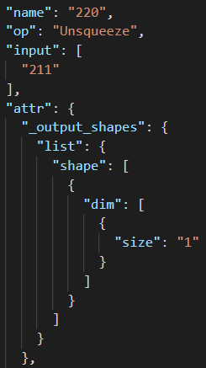
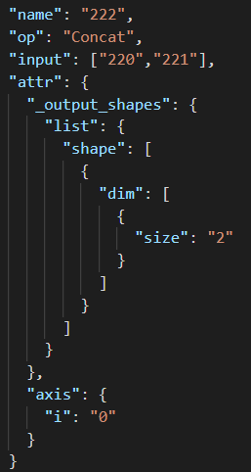
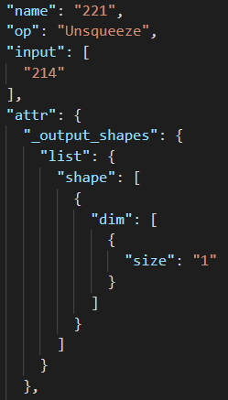
MMdnn IR

Slide 13
Tensor Layout
NCHW (channels first) and NHWC (channels last) are widely used by different computing devices
Simply inserting transpose nodes not works
  Some operators like Conv2d… has filters … hyper parameters
    Not transpose-commutative

Slide 14
Tensor Layout
Transpose node
Old layout
l1
l2
l3
Transpose node
Parent 1
Parent 2
Parent 3
Allowed in layout
l4
Assumpation
l4 != l1, l2, l3
(l2, l4) is not reverse
(l3, l4) is reverse
Node is not transpose-commutative
Node
l5
Out layout of Node

Slide 15
Tensor Layout
Transpose node
Assumpation
l4 != l1, l2, l3
(l2, l4) is not reverse
(l3, l4) is reverse
Node is not transpose-commutative
Old layout
l1
l2
l3
Transpose node
Parent 1
Parent 2
Parent 3
l1 → l4
l2 → l4
l4
Action:
Make new node
Emit transpose at P1, P2
Remove P3
Compare l5 with l6, l7, l8, if not equal, emit transpose
Allowed in layout
New Node(转置可交换)
l5
Out layout of Node
Output layout of New Node
l6
l7
l8

