Slide 1
The Tensor Algebra Compiler
2020.09.22
The Tensor Algebra Compiler
Fredrik Kjolstad, Shoaib Kamil, Stephen Chou, David Lugato, and Saman Amarasinghe
Massachusetts Institute of Technology, USA, Adobe Research, USA
Object-Oriented Programming, Systems, Languages & Applications, OOPLSA17

Slide 2
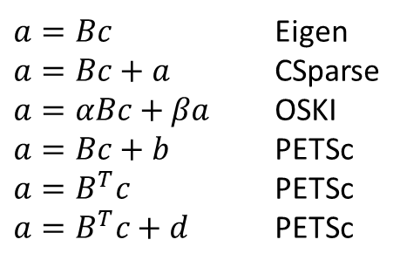
Why we need a Tensor Algebra Compiler
Writing a library?
  Done for the dense computation for a long time
$a=Bc$ Eigen
$a=Bc+a$ CSparse
$a=αBc+βa$ OSKI
$a=Bc+b$ PETSc
$a=B^{T}c$ PETSc
$a=B^{T}c+d$ PETSc
(D)(V)(B)CSR
(D)(V)(B)CSC
(V)(B)COO
(V)(B)ELL[???]
(V)(B)DIA
Dense Vectors
Sparse Vectors
x
x
Infinite variants
Compiler solution
B: blocked
V: variable slice blocked
D: double compressed[???]
Combine Library APIs
Lose performance

Slide 3
Outline
Sparse code and data
Intermedia Representation and Code Generation
Evaluation

Slide 4
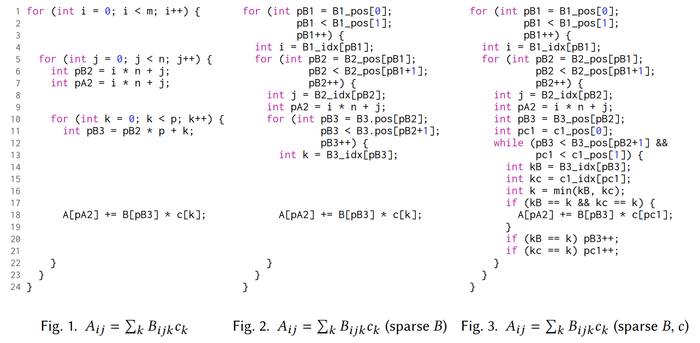
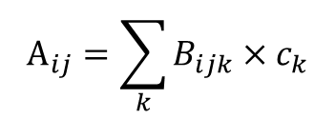


Tensor-vector multiplication example
$$A_{ij}=\sum_{k}{B_{ijk}×c_{k}}$$
Free variable ij
Summation variable k
$$B$$
$$c$$
30
0
40
50
0
0
0
0
0
0
0
0
i
1
0
3
0
0
0
0
0
10
0
10
0
k
j
0
80
20
60
k

Slide 5
Tensor-vector multiplication example
$$A_{ij}=\sum_{k}{B_{ijk}×c_{k}}$$
Free variable ij
Summation variable k
$$B$$
$$c$$
30
0
40
50
0
0
0
0
0
0
0
0
1
0
3
0
i
0
0
0
0
10
0
10
0
k
j
0
80
20
60
k

Slide 6
Tensor-vector multiplication example
$$A_{ij}=\sum_{k}{B_{ijk}×c_{k}}$$
Free variable ij
Summation variable k
$$B$$
$$c$$
30
0
40
50
0
0
0
0
0
0
0
0
i
0
0
0
0
10
0
10
0
j
0
80
20
60
1
0
3
0
k
k

Slide 7
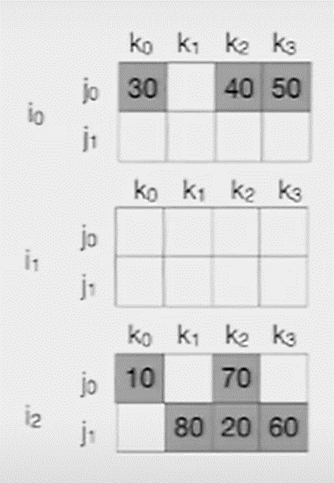
Dense storage formats

Slide 8
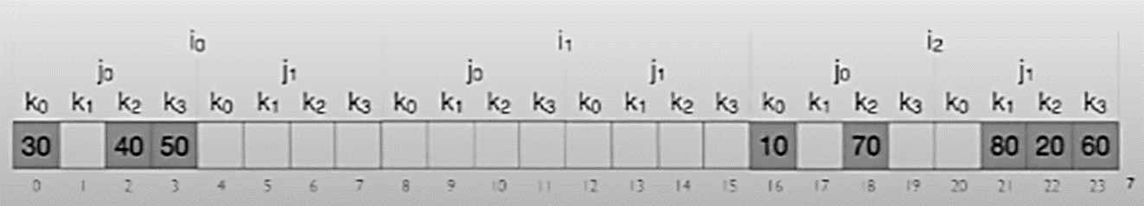

Dense storage formats
Locate (2, 0,2 ) $→$ offset = i * 2 * 4 + j * 4 + k = 18
Random access, but waste memory
18

Slide 9

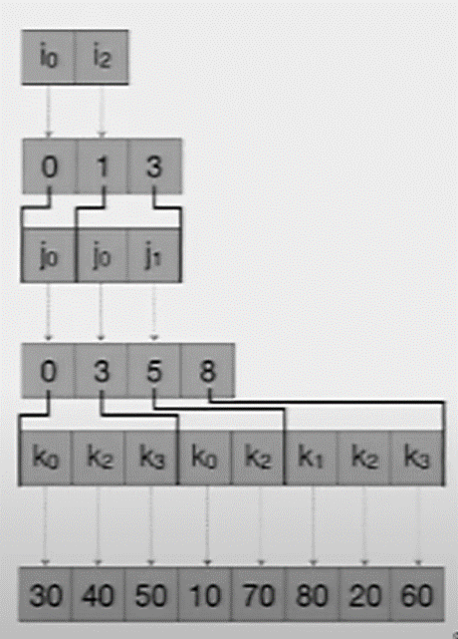
Dense storage formats
No random access: must traverse level by level to locate the coordinate
Begin and end of index array

Slide 10
Outline
Sparse code and data
Intermedia Representation and Code Generation
Evaluation

Slide 11
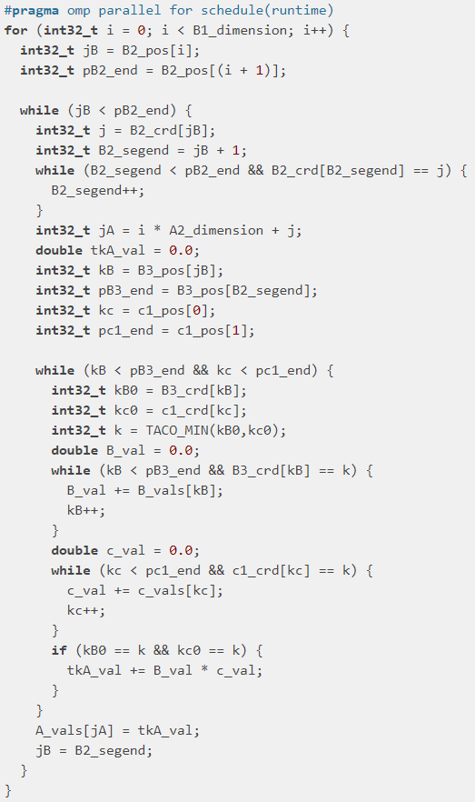
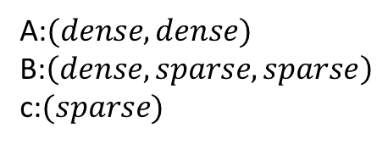
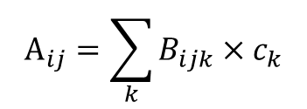
The Tensor Algebra Compiler(taco)
taco
$$A_{ij}=\sum_{k}{B_{ijk}×c_{k}}$$
Tensor expression
Iteration Graph IR
Code Generation
C code
A:$(dense, dense)$
B:$\left(dense,sparse, sparse\right)$
c:$(sparse)$
formats
Merge lattice

Slide 12
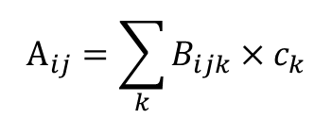


Sparse iteration spaces and iteration Graphs
$$A_{ij}=\sum_{k}{B_{ijk}×c_{k}}$$
$$B$$
$$c$$
30
0
40
50
0
0
0
0
0
0
0
0
i
0
0
0
0
10
0
10
0
j
0
80
1
0
3
0
20
60
k
k
Notes:
理解稀疏性如何影响迭代空间
如果都是稠密的

Slide 13
Sparse iteration spaces and iteration Graphs
$$A_{ij}=\sum_{k}{B_{ijk}×c_{k}}$$
$$B$$
$$c$$
30
0
40
50
1
0
3
0
0
0
0
0
1
0
3
0
0
0
0
0
1
0
3
0
i
0
0
0
0
1
0
3
0
10
0
10
0
1
0
3
0
j
0
80
20
60
1
0
3
0
k
k
Notes:
理解稀疏性如何影响迭代空间
如果都是稠密的

Slide 14

Sparse iteration spaces and iteration Graphs
$$A_{ij}=\sum_{k}{B_{ijk}×c_{k}}$$
$$B_{ijk}×c_{k}$$
30
0
1
0
40
50
3
0
0
0
1
0
0
0
3
0
1
0
3
0
0
0
0
0
i
1
0
3
0
0
0
0
0
10
0
10
0
1
0
3
0
j
0
80
1
0
20
60
3
0
k
Dense
Notes:
理解稀疏性如何影响迭代空间
如果都是稠密的

Slide 15


Sparse iteration spaces and iteration Graphs
$$A_{ij}=\sum_{k}{B_{ijk}×c_{k}}$$
$$B$$
$$c$$
$$B_{ijk}×c_{k}$$
30
0
1
0
1
0
40
50
30
0
40
50
3
0
3
0
0
0
1
0
1
0
0
0
0
0
0
0
3
0
3
0
1
0
3
0
0
0
0
0
1
0
3
0
0
0
0
0
i
i
1
0
3
0
0
0
0
0
1
0
3
0
0
0
0
0
10
0
10
0
10
0
10
0
1
0
3
0
1
0
3
0
j
j
0
80
0
80
1
0
20
60
20
60
1
0
3
0
3
0
k
k
k
Dense
Notes:
理解稀疏性如何影响迭代空间
如果都是稠密的

Slide 16
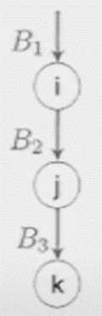
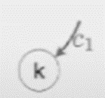
Sparse iteration spaces and iteration Graphs
$$A_{ij}=\sum_{k}{B_{ijk}×c_{k}}$$
$$B$$
$$c$$
$$B_{ijk}×c_{k}$$
30
0
1
0
1
0
40
50
30
0
40
50
3
0
3
0
0
0
1
0
1
0
0
0
0
0
0
0
3
0
3
0
1
0
3
0
0
0
0
0
1
0
3
0
0
0
0
0
i
i
1
0
3
0
0
0
0
0
1
0
3
0
0
0
0
0
10
0
10
0
10
0
10
0
1
0
3
0
1
0
3
0
j
j
0
80
0
80
1
0
20
60
20
60
1
0
3
0
3
0
k
k
k
Dense
Notes:
理解稀疏性如何影响迭代空间
如果都是稠密的

Slide 17
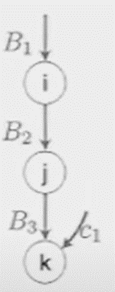
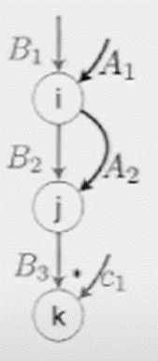

Sparse iteration spaces and iteration Graphs
$$A_{ij}=\sum_{k}{B_{ijk}×c_{k}}$$
$$B_{ijk}×c_{k}$$
$$B_{ijk}×c_{k}$$
30
0
1
0
1
0
40
50
30
0
3
0
3
0
40
50
0
0
1
0
1
0
0
0
0
0
3
0
3
0
0
0
1
0
3
0
1
0
3
0
0
0
0
0
0
0
0
0
i
i
1
0
3
0
1
0
3
0
0
0
0
0
0
0
0
0
10
0
10
0
10
0
10
0
1
0
3
0
1
0
3
0
j
j
0
80
0
80
1
0
20
60
1
0
20
60
3
0
3
0
k
k
Dense
Notes:
理解稀疏性如何影响迭代空间
A不影响合并

Slide 18
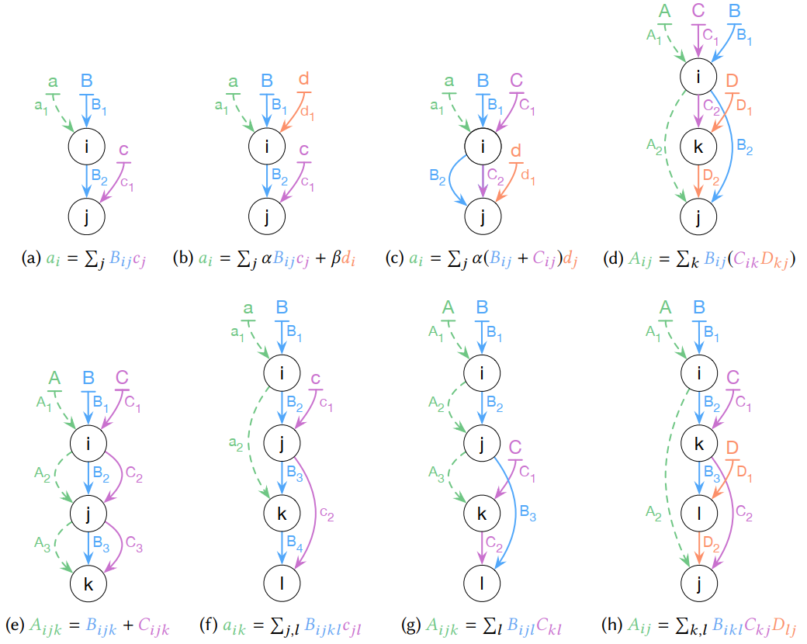
Example of Iteration Graph
Notes:
编译器自动地为表达式生成迭代图
把代码生成的复杂度分解为按层生成代码，每层只为一个迭代变量生成代码

Slide 19
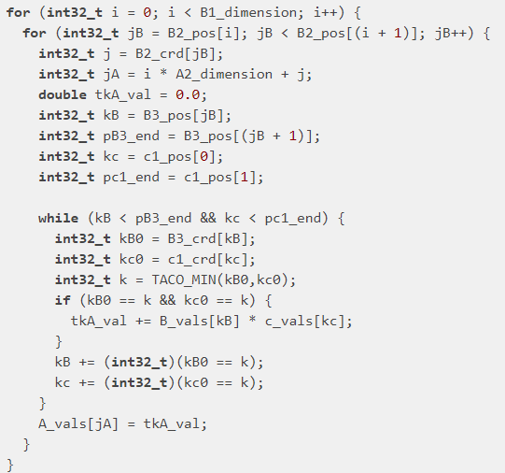
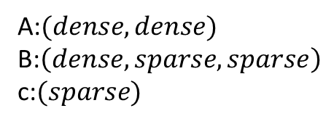
Code Generation from iteration Graph
A:$(dense, dense)$
B:$\left(dense,sparse, sparse\right)$
c:$(sparse)$
$$A_{ij}=\sum_{k}{B_{ijk}×c_{k}}$$
Dense
Sparse
Merge
Lattice
Sparse
Generate code level by level
Notes:
引入合并格的目的是解决每个迭代变量层次上对不同参与迭代变量的访问情况（各变量稠密or稀疏有非常多种组合）

Slide 20



Merge Lattice for a Conjunction
$$a_{i}=b_{i}c_{i}$$
a
b
c
$$=$$
$$×$$

Slide 21






Merge Lattice for a Conjunction
$$a_{i}=b_{i}c_{i}$$
a
b
c
b和c在位置i都非零
0
0
$$b_{i}∧c_{i}$$
int pb1 = b1_pos[0];
int pc1 = c1_pos[0];
while (pb1 < b1_pos[1] && pc1 < c1_pos[1]) {
int ib = b1_idx[pb1];
int ic = c1_idx[pc1];
int i = min(ib, ic);
if (ib == i && ic == i) {
a[i] = b[pb1] * c[pc1];
}
if (ib == i) pb1++;
if (ic == i) pc1++;
}
1
2
4
$$∩$$
4
$$b_{i}$$
$$c_{i}$$
6
$$Φ$$
$$=$$
7
Notes:
解释格的含义

Slide 22


Merge Lattice for a Disjunction
$$a_{i}=b_{i}+c_{i}$$
a
b
c
$$=$$
$$+$$

Slide 23








Merge Lattice for a Disjunction
$$a_{i}=b_{i}+c_{i}$$
int pb1 = b1_pos[0];
int pc1 = c1_pos[0];
while (pb1 < b1_pos[1] && pc1 < c1_pos[1]) {
int ib = b1_idx[pb1];
int ic = c1_idx[pc1];
int i = min(ib, ic);
if (ib == i && ic == i) {
a[i] = b[pb1] * c[pc1];
}
else if (ib == i) {
a[i] = b[pb1];
}
else {
a[i] = c[pc1];
}
if (ib == i) pb1++;
if (ic == i) pc1++;
}
while (pb1 < b1_pos[1]) {
int i = b1_idx[pb1];
a[i] = b[pb1++];
}
while (pc1 < c1_pos[1]) {
int i = c1_idx[pc1];
a[i] = c[pc1++];
}
a
b
c
0
0
$$b_{i}∧c_{i}$$
1
2
$$c_{i}$$
$$b_{i}$$
4
$$∪$$
4
6
$$b_{i}$$
$$c_{i}$$
$$=$$
7
$$b_{i}$$
$$c_{i}$$
$$Φ$$

Slide 24































Merge Lattice for a Compound Expression
$$a_{i}=\left(b_{i}+c_{i}\right)d_{i}$$
$$a_{i}=b_{i}+c_{i}+d_{i}$$
$$b_{i}∧c_{i}∧d_{i}$$
$$b_{i}∧c_{i}∧d_{i}$$
$$b_{i}$$
$$c_{i}$$
$$d_{i}$$
$$b_{i}$$
$$c_{i}$$
$$d_{i}$$
$$c_{i}∧d_{i}$$
$$b_{i}∧d_{i}$$
$$b_{i}∧c_{i}$$
$$c_{i}∧d_{i}$$
$$b_{i}∧d_{i}$$
$$d_{i}$$
$$b_{i}$$
$$d_{i}$$
$$c_{i}$$
$$b_{i}$$
$$c_{i}$$
$$d_{i},c_{i}$$
$$b_{i},d_{i}$$
$$d_{i}$$
$$c_{i}$$
$$b_{i}$$
$$Φ$$
$$d_{i}$$
$$c_{i}$$
$$b_{i}$$
$$Φ$$

Slide 25



Merge Lattice for a Compound Expression
$$a_{i}=\left(b_{i}+c_{i}\right)d_{i}$$
$$a_{i}=b_{i}+c_{i}+d_{i}$$
If $d$ is dense
$$b_{i}∧c_{i}∧d_{i}$$
$$b_{i}∧c_{i}∧d_{i}$$
$$b_{i}$$
$$c_{i}$$
$$b_{i}$$
$$c_{i}$$
$$d_{i}$$
$$c_{i}∧d_{i}$$
$$b_{i}∧d_{i}$$
$$d_{i}$$
$$c_{i}∧d_{i}$$
$$b_{i}∧d_{i}$$
$$d_{i}$$
$$b_{i}$$
$$c_{i}$$
$$d_{i},c_{i}$$
$$b_{i},d_{i}$$
$$d_{i}$$
$$d_{i}$$
$$Φ$$
$$d_{i}$$
$$Φ$$

Slide 26
Outline
Sparse code and data
Intermedia Representation and Code Generation
Evaluation

Slide 27
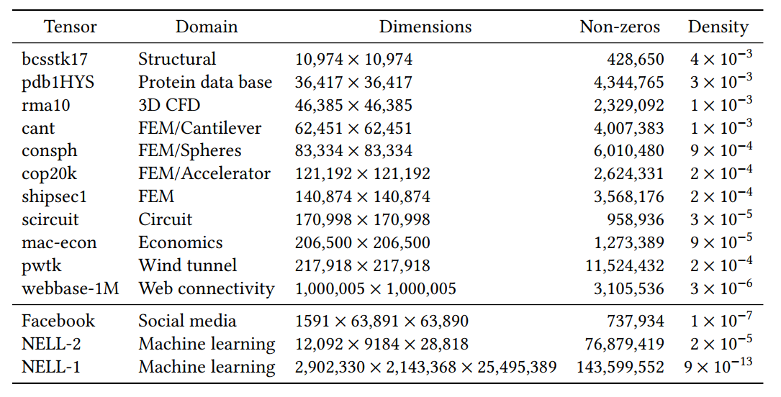
Summary of real-world matrices and higher-order tensors used in experiments.

Slide 28
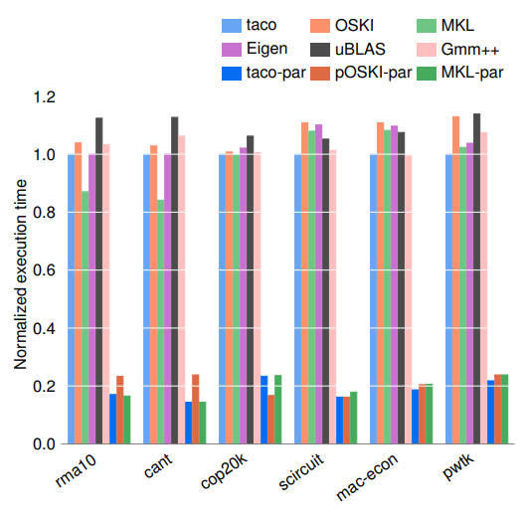
SpMV is competitive with hand-optimized implementation
Taco-par: taco emits parallel code with openmp
Execution time is normalized with taco (running serially)
Different applications using SpMV

Slide 29
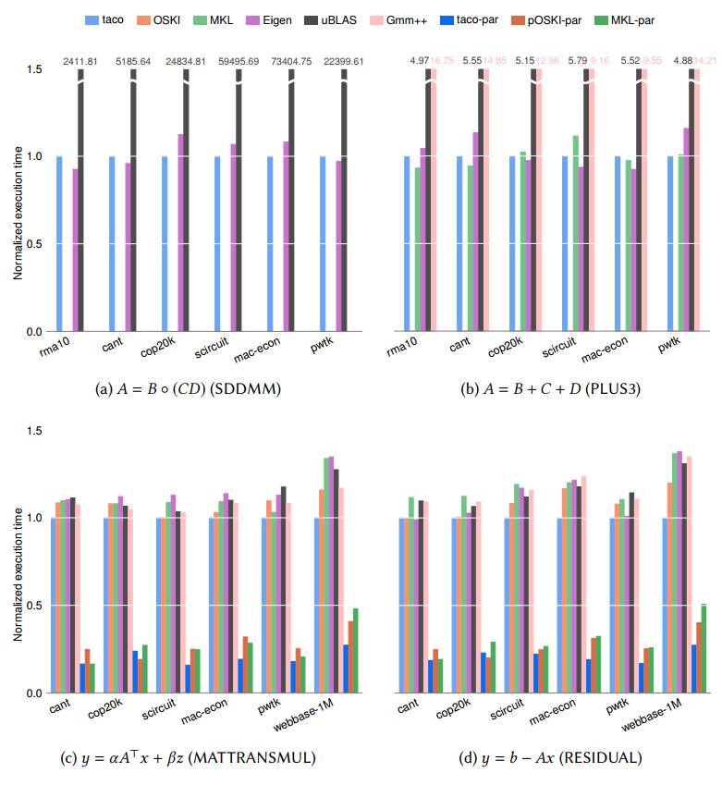
Compound Linear Algebra

Slide 30
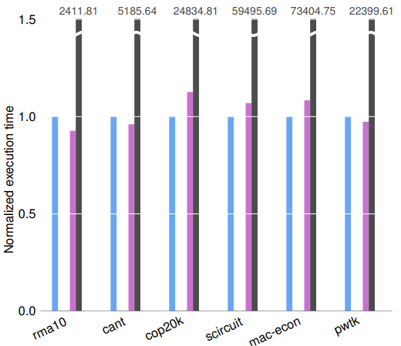
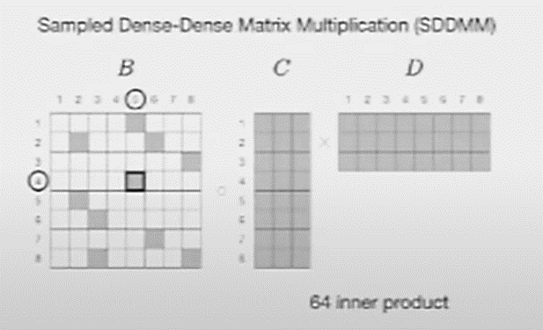


SDDMM must be computed in a single kernel
$$A=B∘(CD)$$

Slide 31
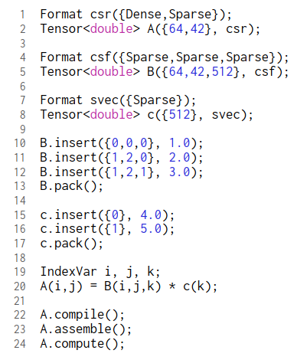
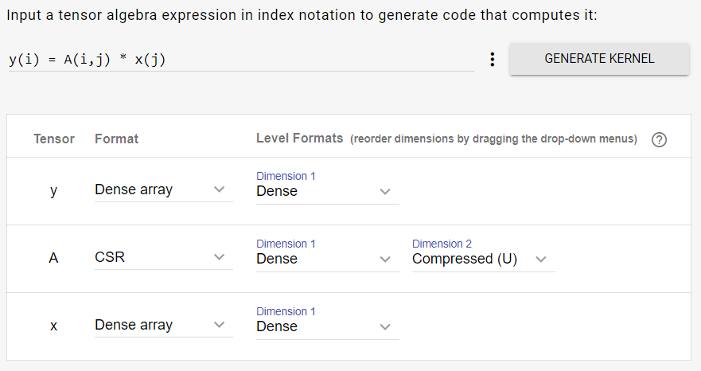
Tensor Algebra Compiler Library and Tool
C++ Tensor Library
Online Code Generator

