Slide 1

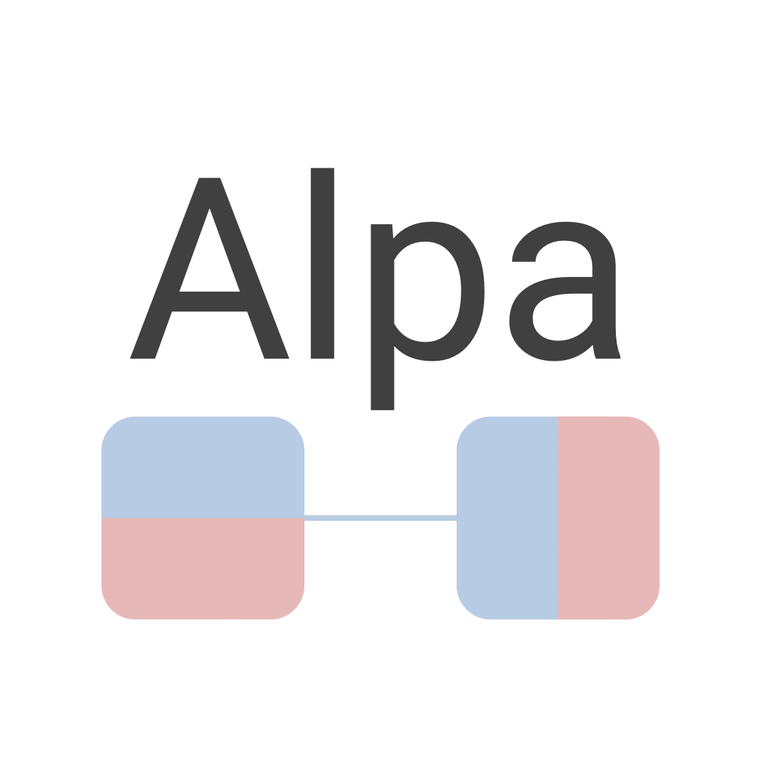

Automating Inter- and Intra-Operator Parallelism for Distributed Deep Learning
Lianmin Zheng^{1,*} Zhuohan Li^{1,*} Hao Zhang^{1,*} Yonghao Zhuang⁴
Zhifeng Chen³ Yanping Huang³ Yida Wang² Yuanzhong Xu³ Danyang Zhuo⁶
Eric P. Xing⁵ Joseph E. Gonzalez¹ Ion Stoica¹
¹UC Berkeley ²Amazon Web Services ³Google ⁴Shanghai Jiao Tong University
⁵MBZUAI & Carnegie Mellon University ⁶Duke University
*Equal contribution

Slide 2
Background

Slide 3
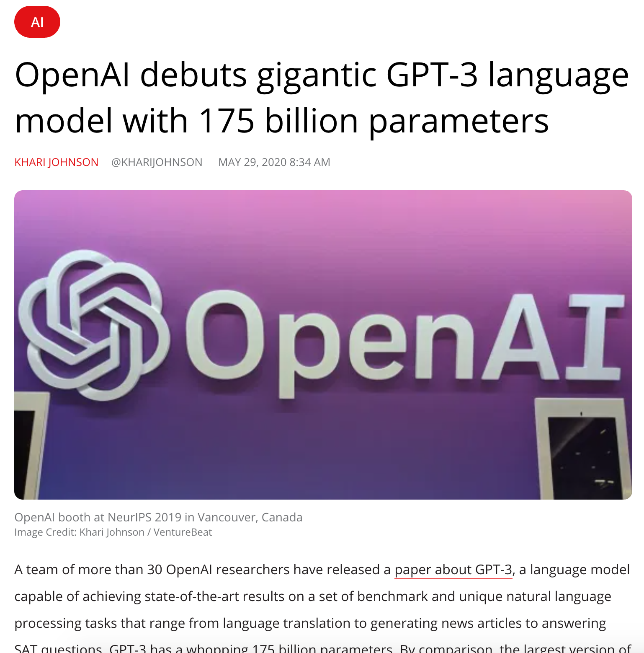
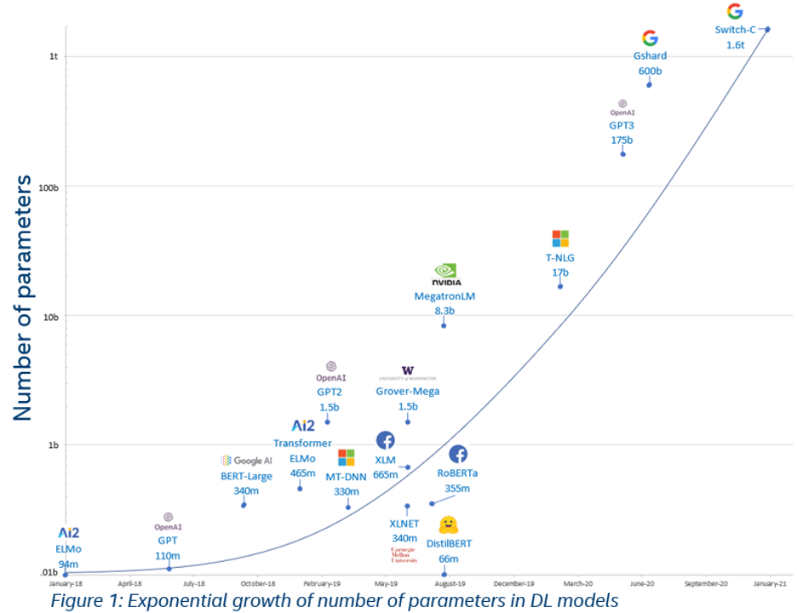
Large Models Enable Breakthroughs in Machine Learning
10,000× model size increase in 3 years
Image source: towardsdatascience.com

Slide 4


What are System Challenges?
Input
Prediction
Forward Propagation
Cat
Layer 1
Layer 2
…
Layer n
Dog
Backward Propagation
1. What if the input dataset is very large?
2. What if the model is very large?

Slide 5
What are System Challenges?
1. What if the input dataset is very large?
2. What if the model is very large?
😃 Easy.
Use data parallelism: partition input data
and replicate the model
😖 Hard !!
GPU 1
GPU 1
(32 GB)
input batch 1
model
model
(350 GB)
GPU 2
GPU 2
(32 GB)
input batch 2
model
Challenge: How to partition a computational graph?

Slide 6
Partition Computational Graphs
w1
w2
Device 1
x
matmul
relu
matmul
sub
Device 2
Strategy 1: Inter-operator Parallelism
Trade-off
w1
w2
x
matmul
relu
matmul
sub
 | Inter-operator Parallelism | Intra-operator Parallelism
Communication | Less | More
Device Idle Time | More | Less
Strategy 2: Intra-operator Parallelism
w1
w2
x
matmul
relu
matmul
sub

Slide 7
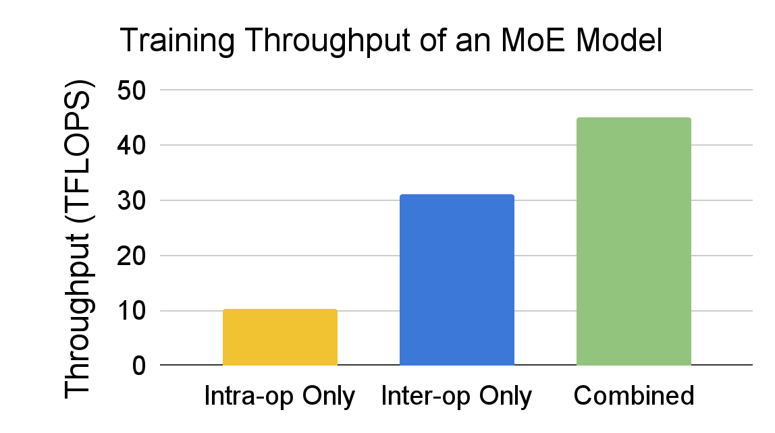
Partition Computational Graphs
Multiple intra-op strategies for a single node
Combine Intra-op and Inter-op
Row-partitioned
Column-partitioned
Replicated
w1
w2
x
matmul
relu
matmul
sub
w1
w2
x
matmul
relu
matmul
sub
Pipeline the execution for inter-op parallelism
w1
matmul
matmul
matmul
w2
matmul
matmul
matmul
w3
matmul
matmul
matmul

Slide 8

Network Topology
w1
w2
x
matmul
relu
matmul
sub
Challenge: How to handle heterogeneous network topology?
Fast connections
Slow connections
machine
machine
machine
machine

Slide 9
Prior Works
Intra-op Parallelism
(w/ operator-level)
Megatron-LM
Mesh-Tensorflow
GShard
Megatron-LM
V2
Tofu
FlexFlow
Alpa
(Ours)
GPipe
ZeRO
PipeDream
Dapple
Inter-op Parallelism
(w/ pipeline)
Automatic

Slide 10
Alpa Compiler

Slide 11
A unified compiler that
automatically finds and executes the
best Inter-op and Intra-op parallelism
for large deep learning models.

Slide 12
Alpa User API
@alpa.parallelize
def train_step(model_state, batch):
def loss_func(params):
out = model_state.forward(params, batch["x"])
return np.mean((out - batch["y"]) ** 2)
grads = grad(loss_func)(state.params)
new_model_state = model_state.apply_gradient(grads)
return new_model_state
# A typical JAX training loop
model_state = create_train_state()
for batch in data_loader:
model_state = train_step(model_state, batch)
@alpa.parallelize
Distribute the training function
with a simple decorator

Slide 13



Alpa’s Main Contributions
Two-level hierarchical space of parallelism techniques.
Effective optimization algorithms at each level.
Efficient compiler and runtime system implementation.

Slide 14
Computational Graph
A
B
C
D
Whole Search Space
Alpa Hierarchical Space
Inter-op Parallelism
A
B
C
D
A
B
C
D
Intra-op Parallelism
A
B
C
D
A
B
C
D
A
B
C
D
A
B
C
D
…
…
A
B
C
D
A
B
C
D
…
…

Slide 15

Alpa Compiler: Hierarchical Optimization
Computational Graph
Device Cluster
Dynamic Programming
Inter-op Pass
Cost Estimation
Integer Linear Programming
Intra-op Pass
Runtime
Orchestration

Slide 16
Inter-op Pass
Computational Graph
k1
k2
w1
w2
x
conv
relu
conv
add
avgpool
matmul
relu
matmul
softmax

Slide 17
Inter-op Pass
Stage 1
Stage 3
k1
k2
Stage 2
w1
w2
Stage 4
x
conv
relu
conv
add
avgpool
matmul
relu
matmul
softmax
Graph Partitioning
or
Stage 1
Stage 2
Stage 3
Stage 4
k1
k2
w1
w2
x
conv
relu
conv
add
avgpool
matmul
relu
matmul
softmax
or
…

Slide 18
Inter-op Pass
Partitioned Computational Graph
Stage 1
Stage 3
k1
k2
Stage 2
w1
w2
Stage 4
x
conv
relu
conv
add
avgpool
matmul
relu
matmul
softmax
Device Assignment

Slide 19
Inter-op Pass
Partitioned Computational Graph
Stage 1
Stage 3
k1
k2
Stage 2
w1
w2
Stage 4
x
conv
relu
conv
add
avgpool
matmul
relu
matmul
softmax
Cluster (2D Device Mesh)
Nodes 🐢
GPUs within a Node 🐇

Slide 20
Inter-op Pass
Stage 1
Stage 3
k1
k2
Stage 2
w1
w2
Stage 4
x
conv
relu
conv
add
avgpool
matmul
relu
matmul
softmax
or
or
…
Submesh Choice 1
Submesh Choice 2

Slide 21
Inter-op Pass
Stage 1
Stage 3
k1
k2
Stage 2
w1
w2
Stage 4
x
conv
relu
conv
add
avgpool
matmul
relu
matmul
softmax
Solved together by
Dynamic Programming
N
More details on the DP algorithm can be found in the paper.
M

Slide 22
Goal: Minimize Pipeline Execution Latency
Stage 1
Stage 2
Stage 3
Stage 4
Pipeline execution latency
Latency of a single batch through stage 1-4
Max stage
latency
(stage 3)
Max stage
latency
Max stage
latency
Max stage
latency
=
+
+
+
+
Time

Slide 23
Inter-op Pass: Dynamic Programming Formulation
Pipeline execution latency
Latency of a single datapoint through all stages
Max stage
latency
=
+
×
(#Batch - 1)
Goal: Derive the best graph partition and device assignment by selecting the optimal set of (stage, submesh) pairs that minimizes this latency.
Input: Run intra-op pass and profile for all possible (stage, submesh) pairs.
Algorithm: Enumerate all possible second term and convert the first term into a 2-dimensional knapsack problem.

Slide 24
DP Assumptions
The forward pass and backward pass of the same stage are assigned to the same submesh and considered together.
For a cluster of shape (N, M), only choose the following submesh shapes:
  Within a node: (1, 1), (1, 2), (1, 4), (1, 8), …, (1, M)
  Cross full nodes: (2, M), (3, M), …, (N, M)
Set the cost of all OOM settings to be infinity in DP
DP Complexity: O(K5NM(N+log(M)))
  K is the number of operators in the graph
  (N, M) is the mesh shape

Slide 25
Intra-op Pass
w1
w2
stage input
matmul
relu
matmul
Submesh
Stage
Solved by Integer Linear Programming
w1
w2
stage input
matmul
relu
matmul
Stage with intra-operator parallelization

Slide 26
Intra-op Pass
Integer Linear Programming Formulation
Decision vector
Parallel strategies of each operator
w1
w2
stage input
matmul
relu
matmul
Minimize
Computation cost + Communication cost
More details on the ILP algorithm can be found in the paper.

Slide 27
Operator Parallelization Strategy
Alpa defines a set of (SPMD) parallelization strategy for each operator (e.g., 2D matmul):
Replicated
Row-partitioned
Column-partitioned
w1
w2
stage input
b
matmul
relu
matmul
Data parallel
a
matmul (c)
b
b
Operator parallel (type 1)
a
matmul (c)
a
matmul (c)
c[i, j] = Σ_{k} a[i, k] · b[k, j]
b
Operator parallel (type 2)
+ all-reduce cost
a
matmul (c)
Single operator cost
…

Slide 28
Re-partition Communication Cost
Different operators’ parallelization strategies might require different partitions of the same tensor
Replicated
Row-partitioned
Column-partitioned
w1
w2
stage input
matmul
relu
matmul
slice
slice
all-gather
all-gather
Do not need re-partition
w2
matmul
relu
relu
matmul
all-to-all
all-to-all
w2
Need re-partition
by all-gather
relu
matmul
…

Slide 29
Compilation Time Optimization
Communication-aware operator clustering in ILP & DP
Early stopping in DP
Distributed Compilation
Alpa Compilation Time: < 40 min for the largest experiment.
Can be further reduced by at least 50% with search space pruning.

Slide 30



Alpa Implementation
Computational Graph
Device Cluster
JaxPR
Inter-op Pass
Stage 1
Stage 2
Stage N
HLO
Intra-op Pass
Sharded
Stage 1
Sharded
Stage 2
…
Sharded Stage N
Alpa pipeline instructions
Runtime
Orchestration
Mesh Executable 1
Mesh Executable 2
Mesh Executable N
NVIDIA NCCL
Intra-op Parallelism
Device Mesh 1
Device Mesh 2
Device Mesh N
Actor +
Worker
D0
D1
D2
D3
Worker
D0
D1
D2
D3
Worker
Devices …
Runtime
Worker
Worker
D0
D1
D2
D3
D0
D1
D2
D3
Worker
Devices …
…
…
…
Inter-op Parallelism

Slide 31
Evaluation

Slide 32
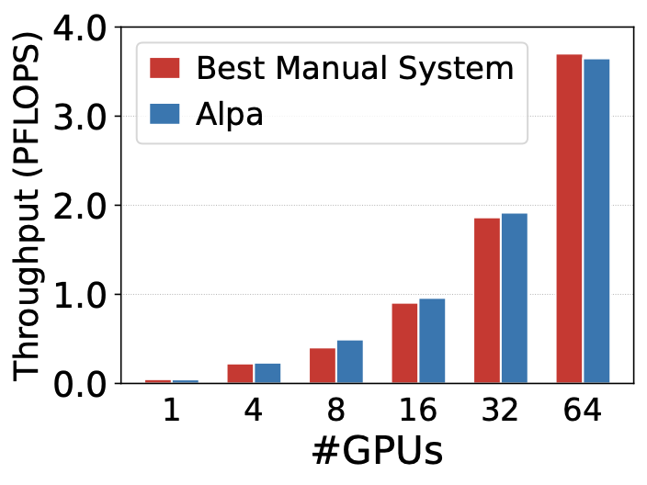
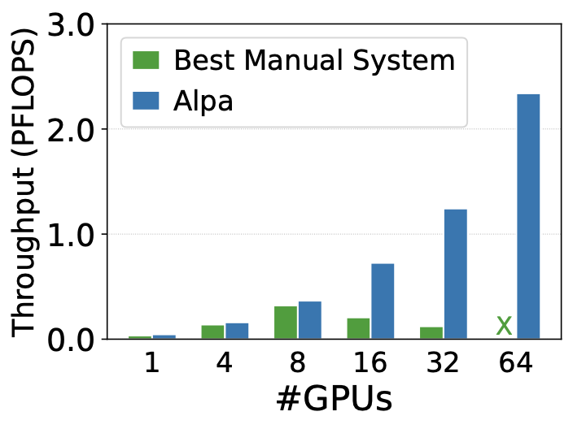
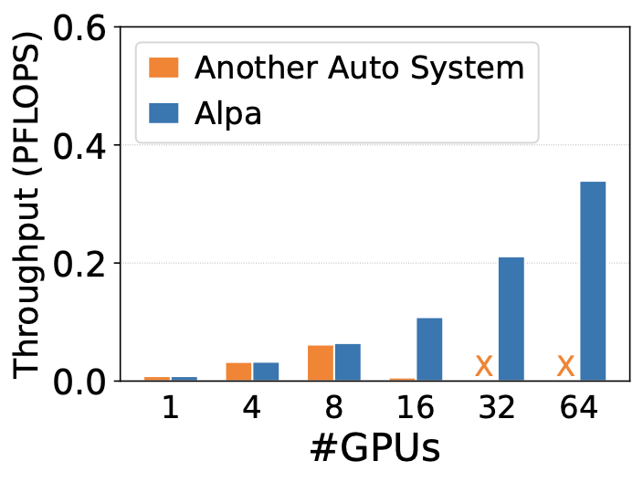
Evaluation: Comparing with Previous Works
GPT (up to 39B)
GShard MoE (up to 70B)
Wide-ResNet (up to 13B)
Match specialized manual systems.
Outperform the manual baseline by up to 8x.
Generalize to models without manual plans.
Weak scaling results where the model size grow with #GPUs.
Evaluated on 8 AWS EC2 p3.16xlarge nodes with 8 16GB V100s each (64 GPUs in total).

Slide 33
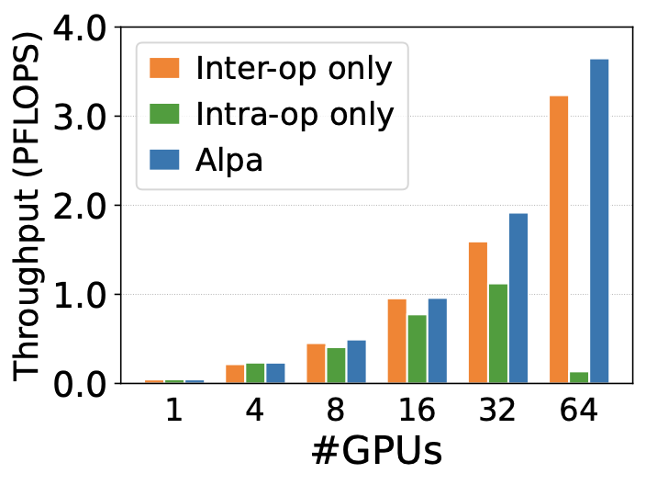
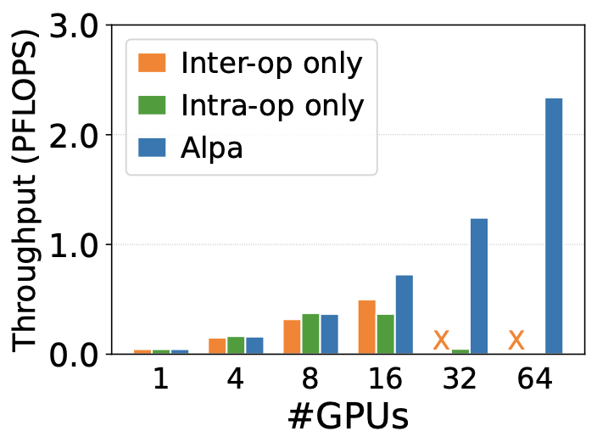
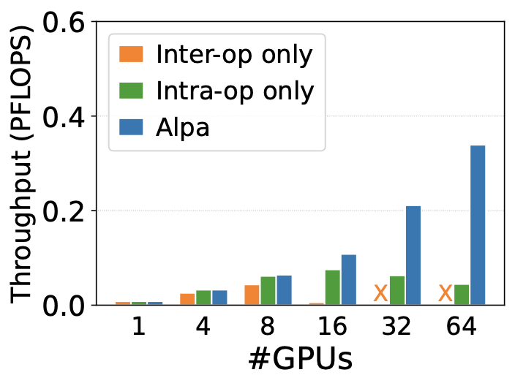
Evaluation: Ablation Study with Inter-op and Intra-op Only
GPT
GShard MoE
Wide-ResNet
Combining inter- and intra-operator parallelism scales to more devices.

