Slide 1
Zico: Efficient GPU Memory Sharing for Concurrent DNN Training
ATC 2021

Slide 2
Introduction
随着 GPU 算力的发展，单个深度网络模型很难用满 GPU 的计算资源
现有工作尝试将多个深度学习网络在 GPU 上并行训练，共享 GPU 资源
与 GPU 算力相比，GPU 显存资源较少，特别在多个训练任务并行时
如何在多个训练任务并行时减少显存使用，同时提升多个训练任务的吞吐率成为需要解决的一个问题
本文提出Zico，通过track模型运行时的显存信息，自动化调度多个模型共享显存资源

Slide 3
GPU Sharing Use Cases
Hyperparameter tuning (inter-job)
  several popular tools such as Hyperdrive and HyperOpt usually generate a large number of closely related training jobs (as much as 100s) that explore a different set of hyperparameters for the same reference model
Gradient accumulation (intra-job)
  runs a set of consecutive mini-batches and accumulates the gradients of those mini-batches before updating model parameters

Slide 4
GPU Sharing
Spatial Sharing
  Multi-Process Service (MPS)：share GPU among multiple CUDA pro- cesses
  Processes can run concurrently on a single GPU, with each process assigned with separate GPU compute resources, i.e., SMs
Temporal Sharing
  a software mechanism that dedicates both compute cores and memory in GPU solely to single training for a time quantum (e.g., 1 minute)

Slide 5
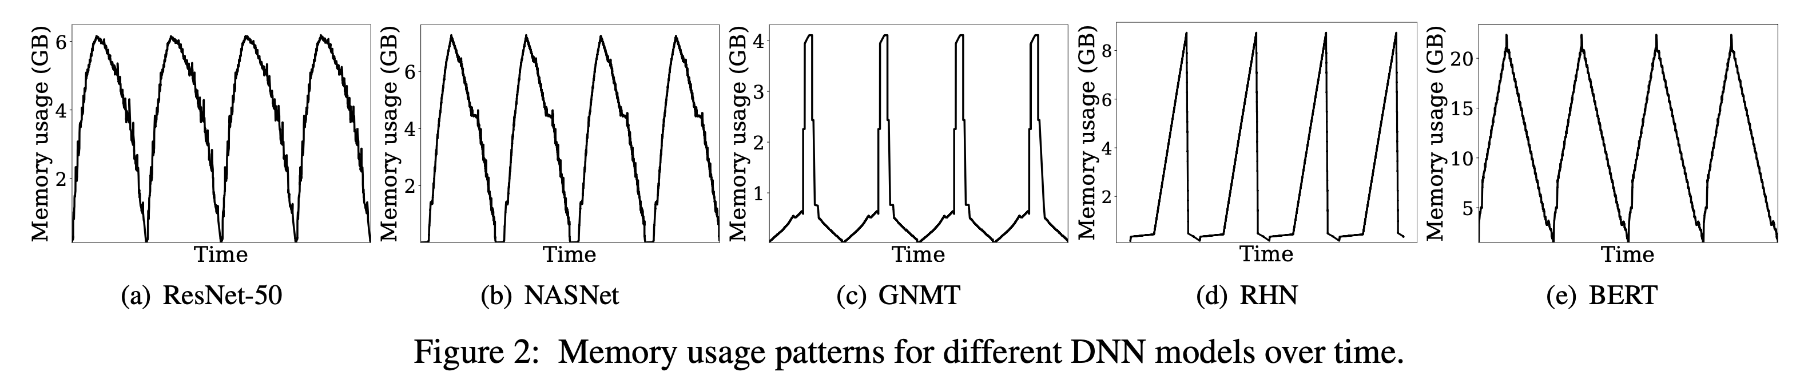
Challenges for Memory Sharing
Memory Bloating
  memory bloating: feature maps lead to the peak memory consumption substantially higher than the minimum that corresponds to the model size in each iteration
Workload Variability
  ResNet-50 has a beefy shape in which memory bloating appears for a fairly large time duration
  GNMT has a lean shape in which peak memory appears for a short period and quickly disappears

Slide 6
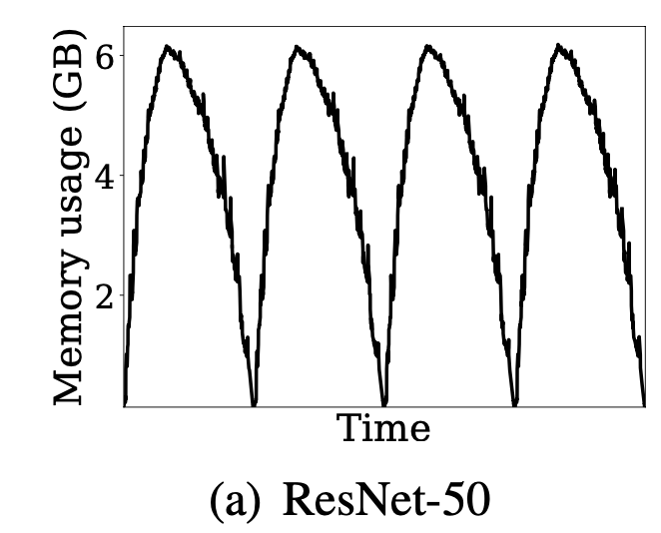
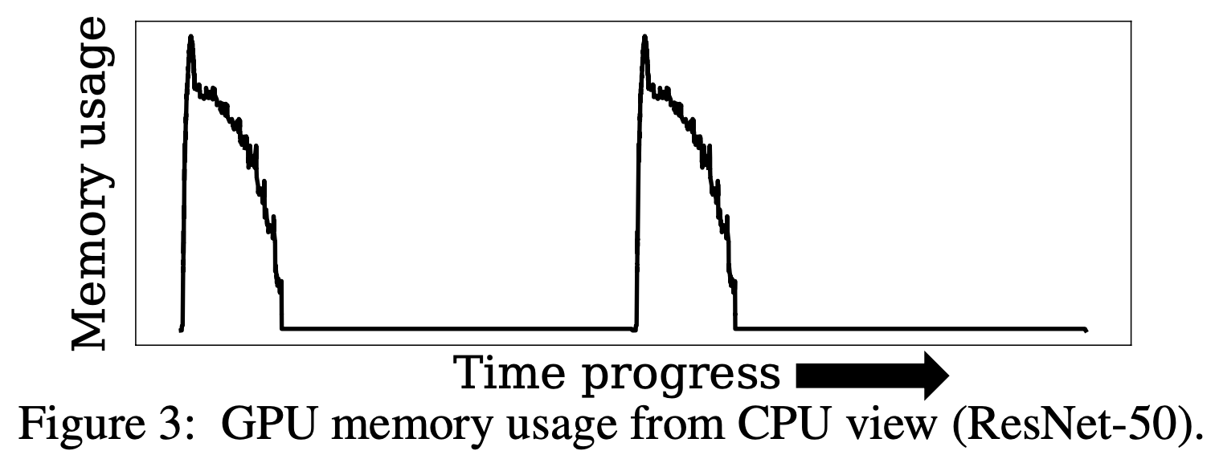
Challenges for Memory Sharing
Asynchrony with GPU Processing
  DNN frameworks usually allocate the memory required for kernel operations in sequence ahead of time while issuing as many kernels as possible to the stream to saturate GPU
GPU view

Slide 7
Design Overview
Goals:
  High performance: minimize overhead
  Wide model support
  Common approach: mainly compatible with DNN platforms that express a job execution as a computation graph ahead of time
    The memory-aware scheduler in Zico makes decisions based only on observed memory demands at runtime, making it also applicable to the eager mode.

Slide 8
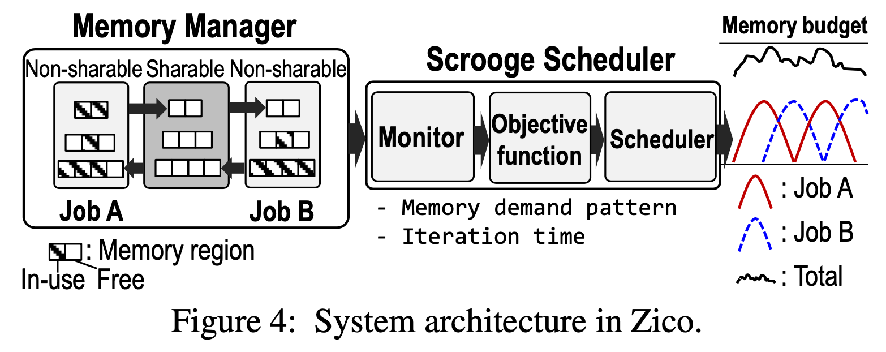
Design Overview
Scrooge scheduler
  monitors GPU progress to capture precise memory usage in GPU for each training over time; iteratively refines region lifespan based on feedback collected from prior iterations at runtime
  predicts whether allowing the iteration immediately will consume memory less than the memory budget; if this is nearly impossible, the scheduler estimates the minimum stall time to be applied on the new iteration so that memory allocations in the forward pass to be issued later are safely fulfilled when more memory is available.

Slide 9
Design Overview
Memory manager
  Region: is a contiguous memory space that stores a set of tensors in the same type
  sharable area: currently unused memory that can be granted to any in-flight training in need of more space
  non-sharable area: constitutes job-local memory pools
  allocation requests for feature map tensors are always served from their own regions first in the local memory pool. If regions in the local memory pool are used up, the memory manager assigns a new region from the sharable area.
For co-locating more than two jobs, a feasible approach is to organize the jobs into a group of pairs and schedule each pair independently with its own memory budget

Slide 10
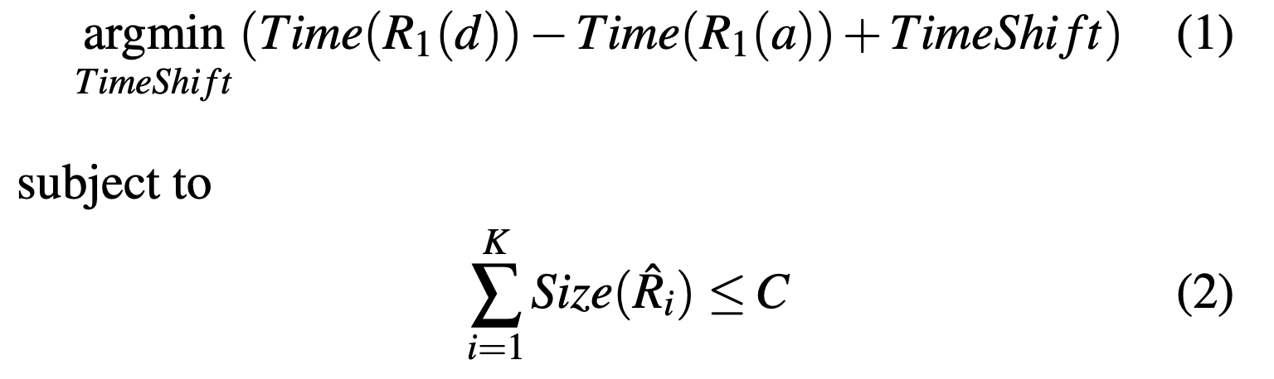
Scheduling Algorithm
Problem Definition
  denote M regions required for an iteration of a training job as {Ri : 1 ≤ i ≤ M} following the allocation order, with region Ri having two parameters to indicate its lifespan: Time(Ri(a)) for the allocation time and Time(Ri(d)) for the deallocation time
  minimize the time delay to be applied on each training iteration without overcommitting the system-wide memory budget C
active region

Slide 11
Scheduling Algorithm
Time Shift Model
  DNN training is highly periodic and deterministic.
  For each iteration, allocation times for adjacent regions exhibit strong temporal dependency
  The time interval between Time(Ri(a) ) and Time(Ri+1(a)) for a job is almost static and does not change drastically over iterations
  TimeShift is the most effective when applied to the entire iteration, not an individual region

Slide 12
Scheduling Algorithm
Memory Sharing Algorithm
  Profiling phase: When a new training job is issued, scrooge scheduler initiates profiling phase during which it collects basic information on the new job; the scheduler runs the first iteration of the new job in an isolated manner
  Informed phase: for a new iteration to be started for a job (e.g., job A) with TimeShift = 0, the scheduler navigates through time progress using lifespan information and predicts if the memory constraint in Equation 2 is violated or not
    If violated, the scheduler waits for time T, which leads to TimeShift += T , and does the prediction again
  In the informed phase, we first use a memory budget which is lower than the actual memory budget C to calculate region lifespans under a conservative schedule that incurs a smaller interference among jobs and thus a less aggressive memory sharing
    The scheduler gradually increases the lowered memory budget to allow more interference over time and keeps updating region lifespans until it reaches back the memory budget C

Slide 13
Memory Management with Concurrency
Tracking Memory Usage in GPU
  Memory deallocation: facilitates CUDA event
    Once GPU reaches a CUDA event, it is guaranteed that kernels launched before the detected CUDA event have finished the execution
    CUDA event has overhead. To reduce the overhead, Zico inserts CUDA event periodically at a certain memory allocation granularity (currently, 8 MB for CNNs and 256 MB for RNNs)
  Memory allocation
    maintain a small number of in-flight kernels (i.e., kernels pending on GPU stream), since this way would narrow the above time gap and ultimately avoid unnecessary pre-allocations of memory by CPU

Slide 14
Memory Management with Concurrency
Tensor Classification
  (i) whether the source belongs to the forward pass
  (ii) whether there is any destination operator accessing the tensor outside the source
  (iii) whether the destination belongs to the backward pass
  Feature map tensors: (i) (ii) (iii)
  gradient map tensors: (ii) (iii)
  temporary tensors: remaining

Slide 15
Memory Management with Concurrency
Managing Memory Regions
  Based on the tensor classification, the memory manager in Zico accepts the tensor type as parameter and then allocates the tensor on a region according to the type
  during forward pass, the local memory manager will continuously request regions from the sharable area and then during the backward pass, these regions will be returned back to the sharable area
  chose the region size to be at least tens of MB to minimize lock contention

Slide 16
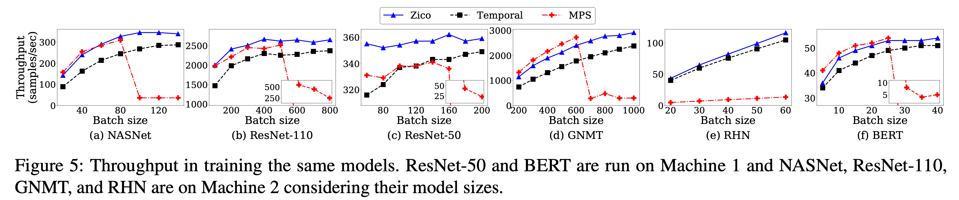
Evaluation
Machine1: NVIDIA Tesla V100 GPU with 32 GB GPU memory
Machine2: NVIDIA RTX 2080 Ti GPU with 11 GB GPU memory
注：MPS在显存用超之后会使用UVM

Slide 17
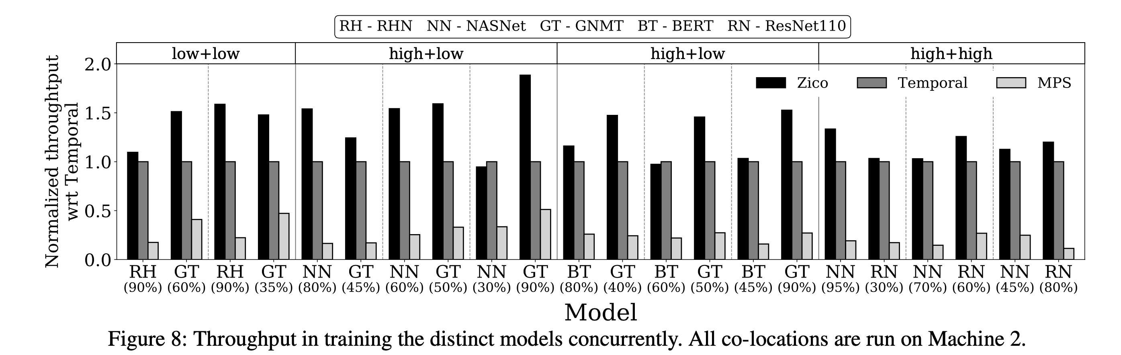
Training Non-identical Models
select five models to make combinations based on different GPU compute demands: GNMT (low), RHN (low), NASNet (high), ResNet-110 (high), and BERT (high)
throughput normalized by Temporal

Slide 18
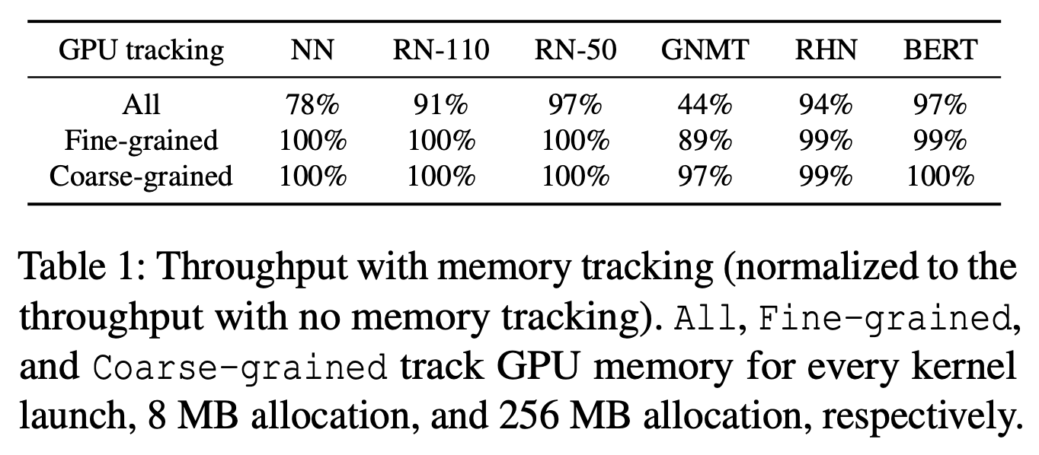
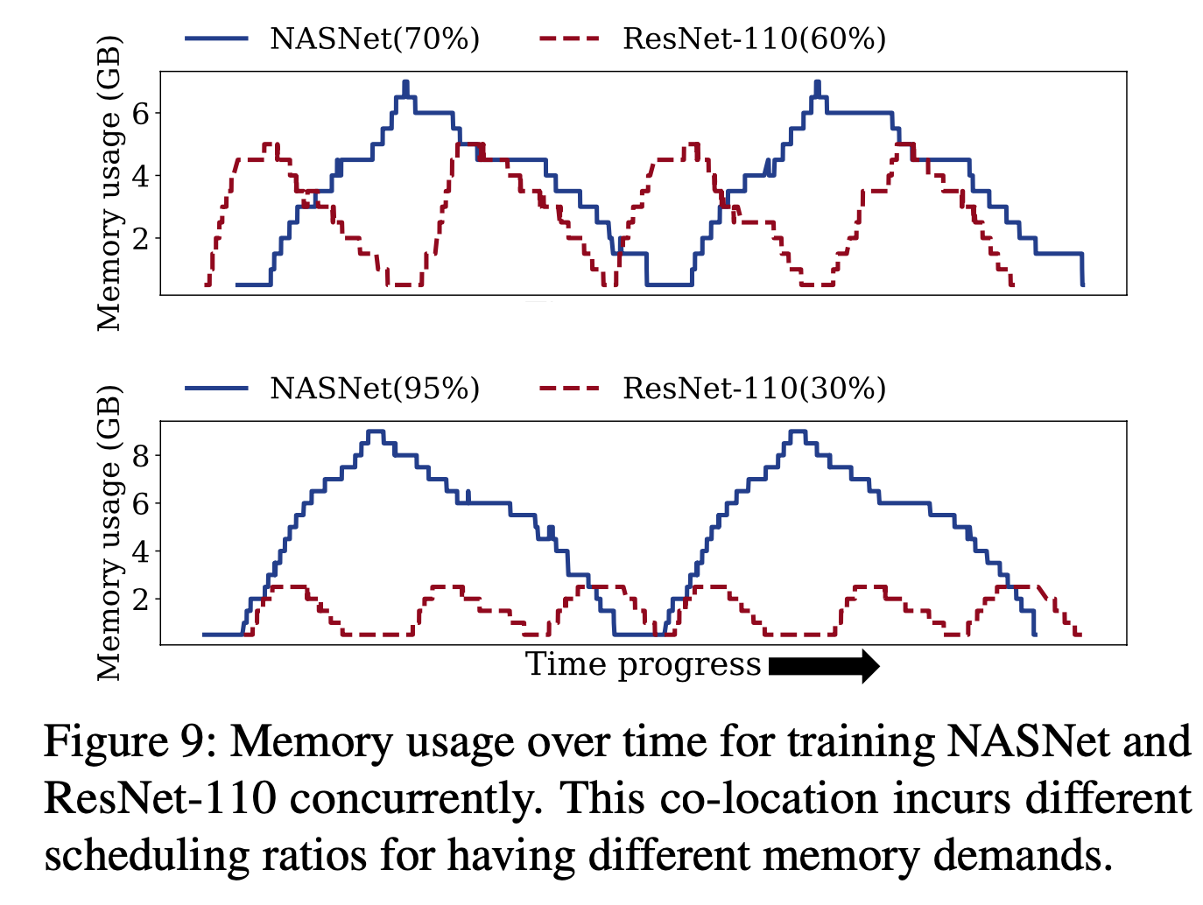
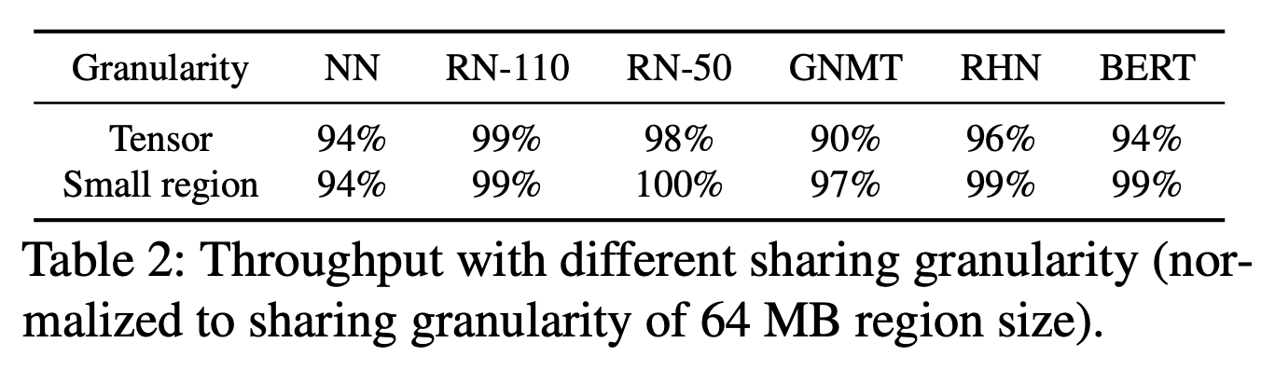
Other

