Slide 1

Suppressing ZZ Crosstalk of Quantum Computers through Pulse and Scheduling Co-Optimization
asplos

Slide 2
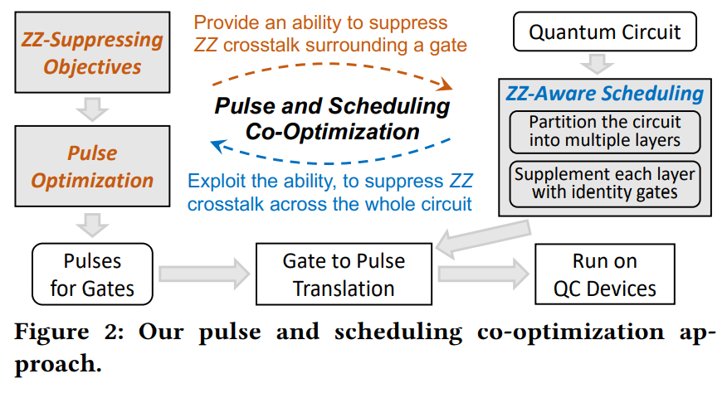
Overview
软硬件结合编译
Notes:
软硬件结合，交互

Slide 3
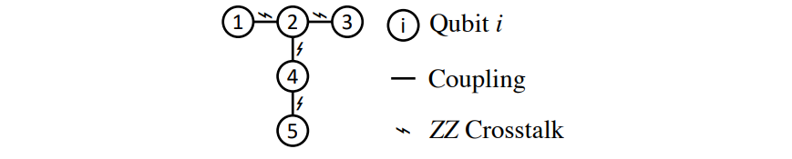
What is ZZ crosstalk
ZZ 串扰是量子计算机(QC)的一种噪声，它的哈密顿量表示为$σ_{z}⊗σ_{z}，$作用于相邻的两个qubits

Slide 4
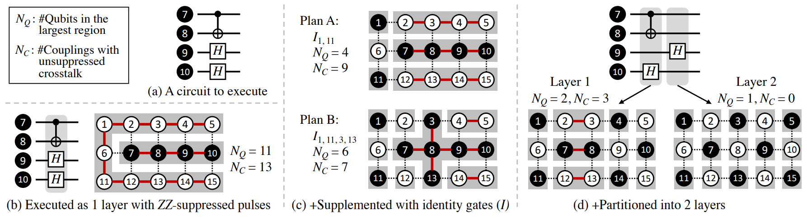
Motivative Example
黑色：执行中的qubits
白色：空闲qubits
灰色：区域，相邻的同色的qubits
区域间的串扰被抑制，区域内的串扰不被抑制

Slide 5
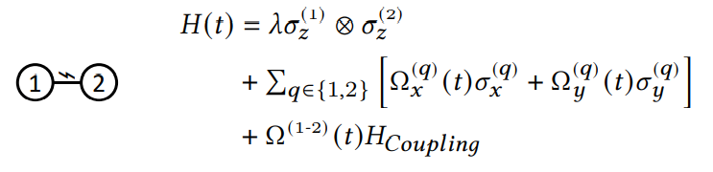

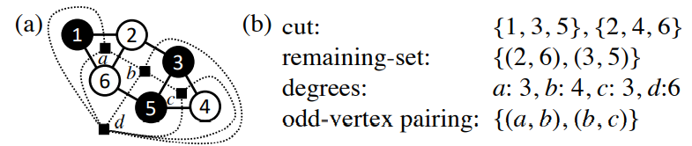
Preliminary
Quantum Evaluation
  Schrödinger equation
Graphs, Cuts, and Odd-Vertex Pairings
引理：原图的cut的保留集和对偶图的奇度顶点配对一一对应
Notes:
Phi H
三项
路径

Slide 6
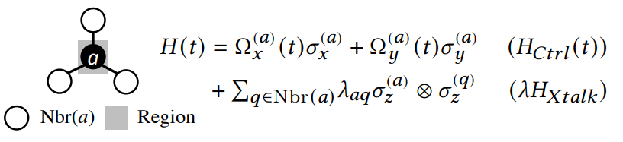
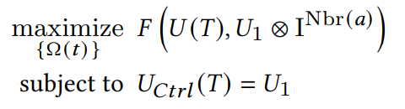
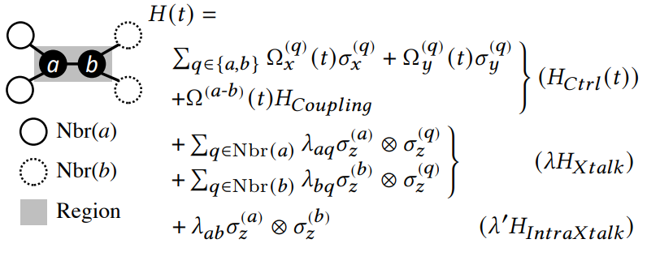
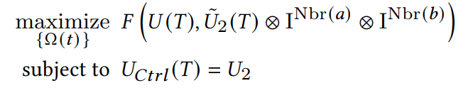
Pulse Optimization
Basic Region: One Single-Qubit Gate
Basic Region: One Two-Qubit Gate
Notes:
F：相似
U：积分

Slide 7
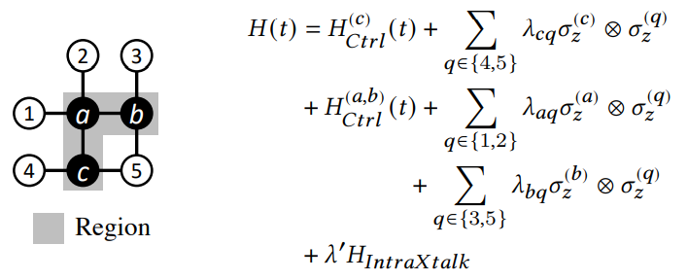
Pulse Optimization
General Regions
a 抑制 a-1, a-2
b 抑制 b-3, b-5
c 抑制 c-4, c-5
a-b和a-c不被抑制
考虑每个门在basic region中生成的脉冲
直接将这些脉冲作用于相应的门
Notes:
简单组合

Slide 8
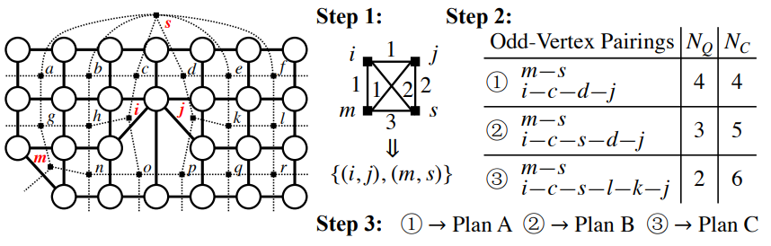
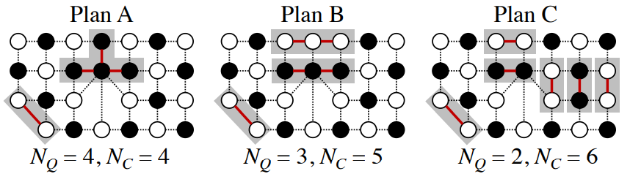
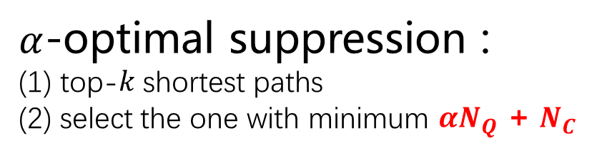

Optimal Suppression
Layers contain no gate
Steps to find cuts
Tradeoff between $N_{Q}$ and $N_{C}$
$α$-optimal suppression :
(1) top-𝑘 shortest paths
(2) select the one with minimum $αN_{Q} \text{+} N_{C}$
Notes:
最大奇度顶点配对
路径
NQ, NC
目标函数

Slide 9
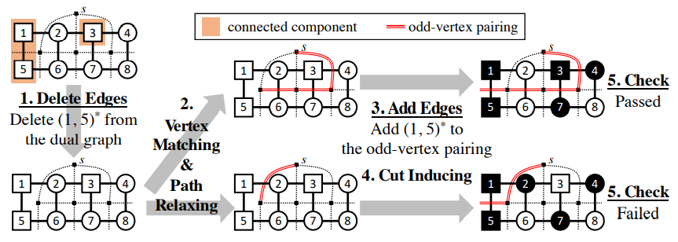
Optimal Suppression
Layers contain gates
Notes:
同一分割部分

Slide 10
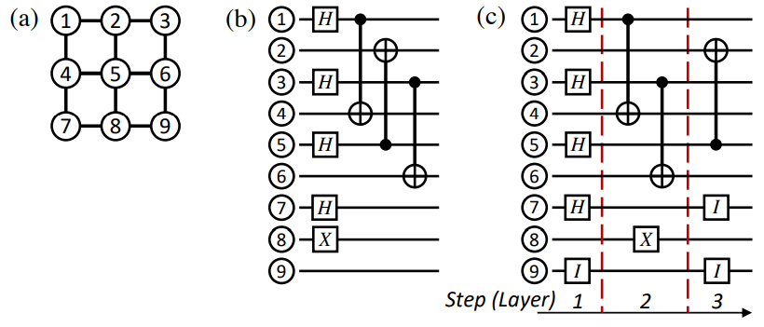
ZZ-Aware Scheduling
An example
Notes:
线路分层
输入输出

Slide 11
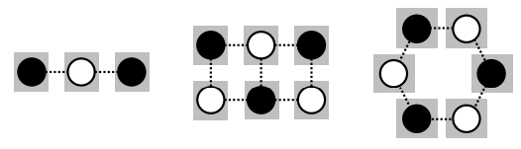
ZZ-Aware Scheduling
Schedulable gate
  A gate is schedulable if all of its preceding gates have been scheduled
Case 1 : only single-qubit gates
  Observation : Complete suppression can be achieved on bipartite topologies with single-qubit gates.
  Near-term QC devices have bipartite
  topology
Notes:
数据依赖
完全分割的两部分

Slide 12
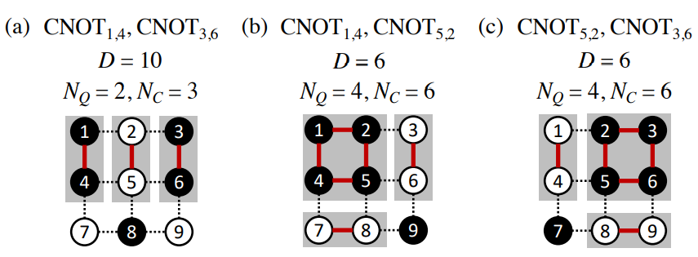
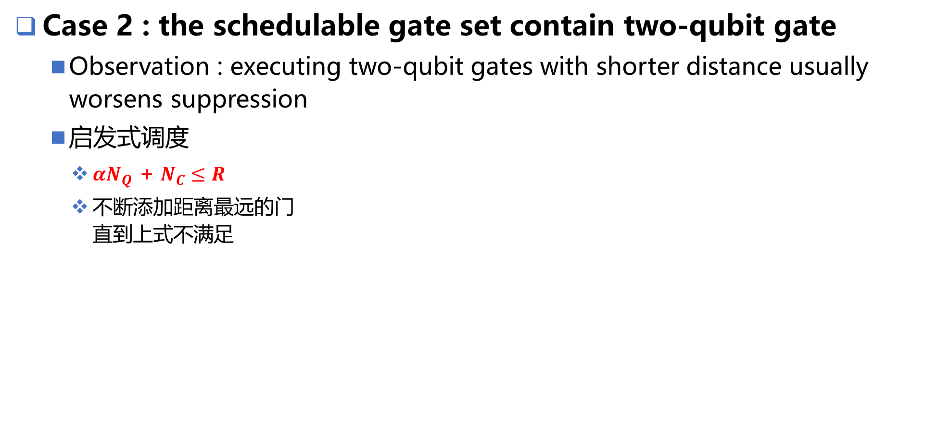
ZZ-Aware Scheduling
Case 2 : the schedulable gate set contain two-qubit gate
  Observation : executing two-qubit gates with shorter distance usually worsens suppression
  启发式调度
    $αN_{Q} \text{+} N_{C}≤R$
    不断添加距离最远的门
    直到上式不满足

Slide 13


Evaluation
3 pulse optimization methods
  OptCtrl
    常用的量子优化控制
  Pert
    OptCtrl不能直接抑制串扰
  DCG
    Dynamic corrected gates
2 scheduling strategies
  ZZXSched
  ParSched
Notes:
作用量
DCG：组合已有脉冲

Slide 14
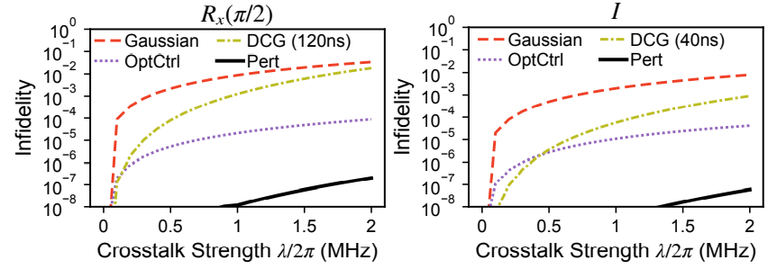
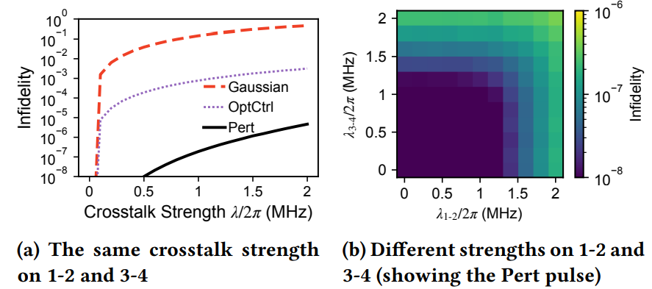
Evaluation
Performance
Single-qubit gate
Two-qubit gate
Notes:
Basic region

Slide 15
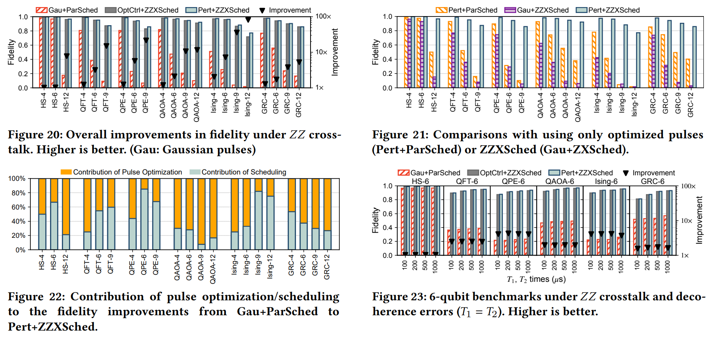
Performance On Circuits
Performance
Notes:
不同的Pulse optimal + scheduling组合
图4：tradeoff between parallelism and suppression

Slide 16
Conclusion
Main ideal
  只优化区域间的ZZ串扰
Problem & Method
  优化区域脉冲
    约束求解
  划分区域
    平面图的max cut
  划分层
    启发式调度

Slide 17
谢谢！

