Slide 1
Safe and Principled Language Interoperation
Valery Trifonov, Zhong Shao
European Symposium on Programming (ESOP), 1999

Slide 2
语言互操作的安全性
Accessing data structure of an unsafe language from a safe language is unsafe.
Accessing data structure of a safe language from an unsafe language is safe.
[Grimmer et al. 2015]: Safe calling unsafe is unsafe. Unsafe calling safe is safe.
Safety of interoperation of program fragments written in different safe languages may fail when the languages have different systems of computational effects.
[Trifonov & Shao 1999]: Safe calling safe can be unsafe.
Can some operations of safe calling unsafe be safe?

Slide 3
FI’s tradeoff between safety and Efficiency
Separate address space
  Safe: delegating the responsibility for correctness of their interaction to the OS
  Slow
Sharing address space
  Fast
  Unsafe: fail to prevent possible errors due to inconsistency of the computational models

Slide 4
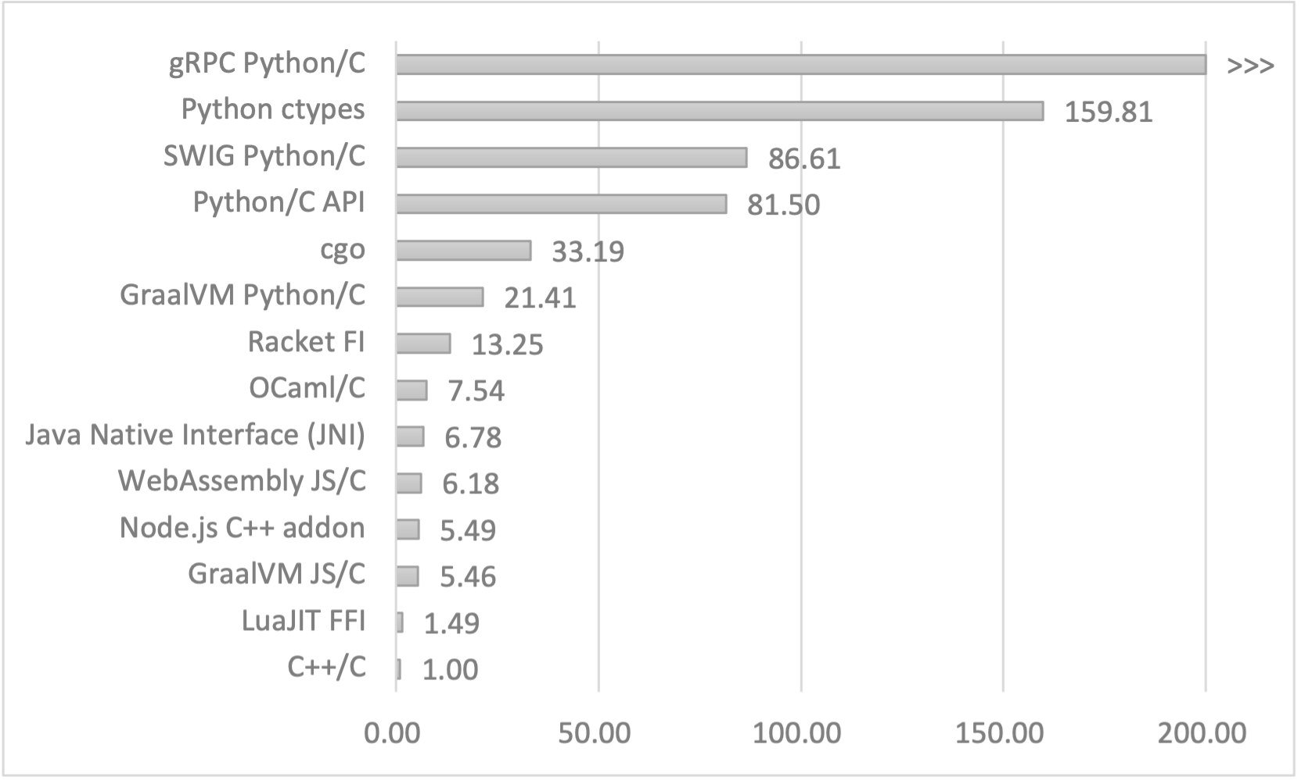
FI’s tradeoff between safety and Efficiency
Separate address space
  Safe: “delegating the responsibility for correctness of their interaction to the OS”
  Slow
Sharing address space
  Fast
  Unsafe: “fail to prevent possible errors due to inconsistency of the computational models”
175K

Slide 5
目标
Design an interoperability scheme
  Safe: not possible to violate the runtime safety of a language by calling a foreign function
  Efficient: a language implementation should not be forced to use suboptimal methods for its own features in order to provide support for other languages’ features
Features
  Mutable store
  Exceptions
  First-class continuation
  Heap and stack allocation of activation records
FI
  Marshall values between representations
  Effect systems
[Jones et al. 1997]

Slide 6
贡献
Formalize the notion of safe interoperability on effect systems
Type system which relates effects to the machine resources they required

Slide 7
Effect
Effects are static descriptions of the dynamic behavior of expressions.
Type describes what an expression computes.
Effect describes how an expression computes.
[Jouvelot & Gifford 1991]

Slide 8
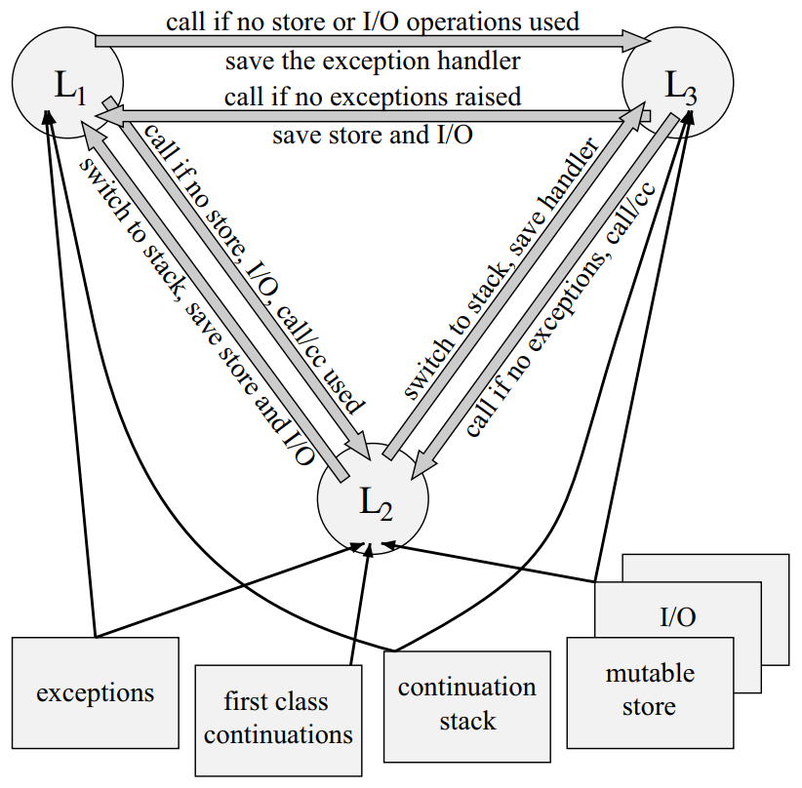

Slide 9
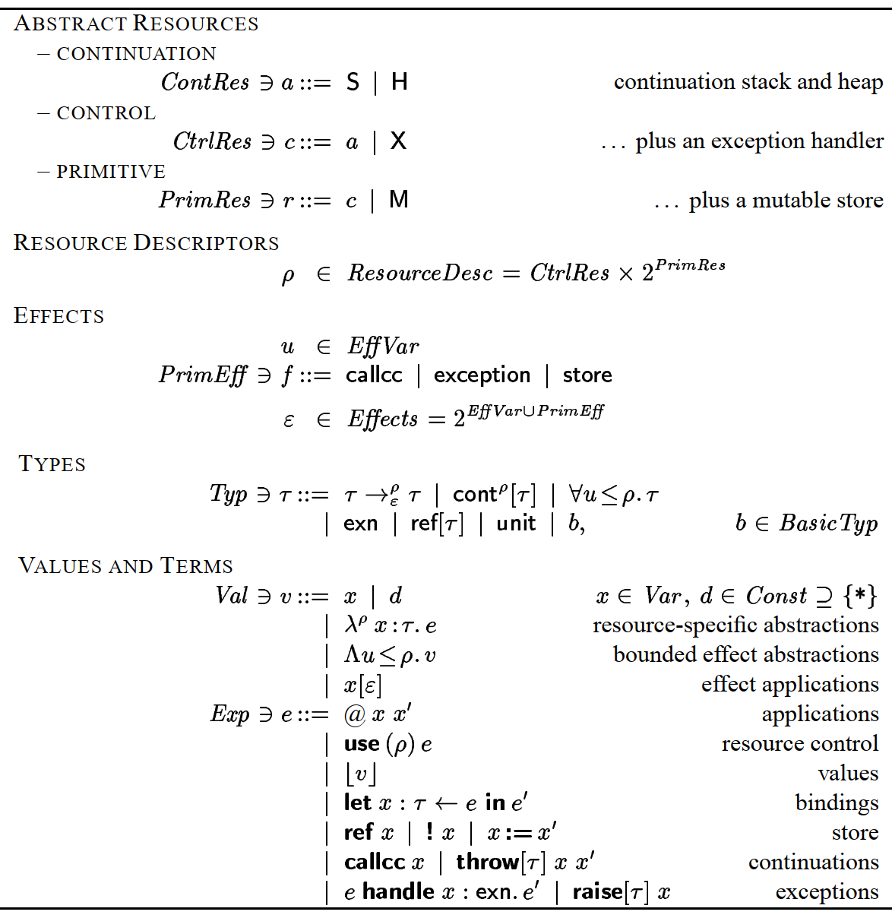

Slide 10
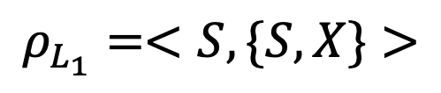
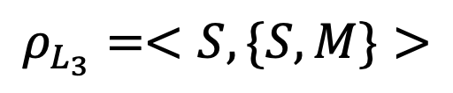
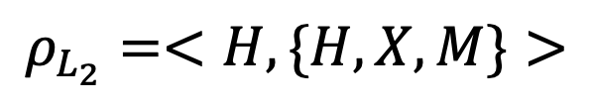
$$ρ_{L_{1}}=<S,\{S,X\}>$$
$$ρ_{L_{2}}=<H,\{H,X,M\}>$$
$$ρ_{L_{3}}=<S,\{S,M\}>$$

Slide 11
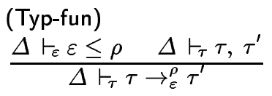
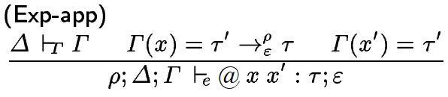
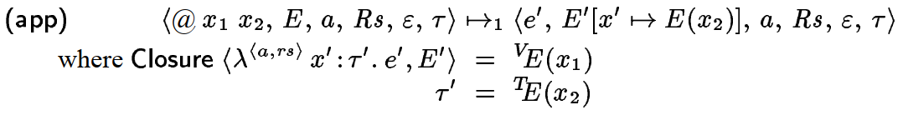


$$Γ⊢e:τ$$
$$Δ⊢ε≤ρ$$

Slide 12
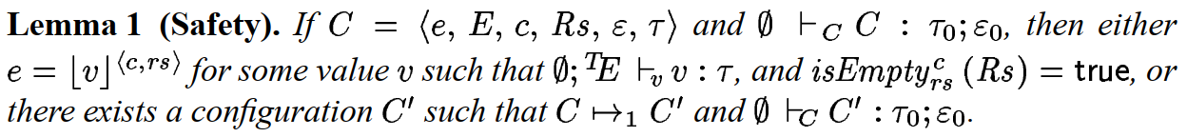

Slide 13
Thank you!

