Slide 1
Analytical Modeling Is Enough for High-Performance BLIS
ACM Transactions on Mathematical Software, June 2017
Tze Meng Low¹, Francisco D. Igual², Tyler M. Smith¹, Enrique S.Quintana-Orti
¹The University of Texas at Austin
²Unversidad Complutense de Madrid

Slide 2
Background
DLA(Dense Linear Algebra)
  BLAS(Basic Linear Algebra Subprograms)
  Distributed by vendors: Intel’s MKL, AMD’s ACML, IBM’s ESSL
  Open-source solutions: GotoBLAS, OpenBLAS, ATLAS
  Nevertheless, these solutions all require considerable effort in time and labor for each supported target architecture
Auto-tunning
  ATLAS^{[1]} and its predecessor PHiPAC
  The problem with ATLAS is that it leverages an inner kernel, optimized by a human expert, which still involves substantial manual encoding.
[1] Is Search Really Necessary to Generate High-Performance BLAS? K. Yotov et al. https://ieeexplore.ieee.org/document/1386657

Slide 3
Background
BLIS(BLAS-like Library Instantiation Software)
  Key benefit – productivity multiplier
    Allow developers to rapidly unfold new high-performance implementation of BLAS and BLAS-like operations on current and future architectures
  Featuring a layering that naturally exposes the parameters that need to be tuned
My Reading Motivation
  Get familiar with CPU model and high-performance programming

Slide 4
Background
Contributions
  An analysis of the best known algorithm
    Address the algorithm underlying BLIS instead of the algorithm in ATLAS
  Model
    More modern： 我们的模型相较于之前的模型更加通用，其允许现代硬件特征，例如向量寄存器文件和一个包含多级组相连数据cache的内存层次结构
    More comprehensive：我们的分析模型更加全面，因为它包含了能够特征化microkernel的参数值
    More actionable：我们的分析模型旨在能够提供给开发者用于为特定架构定制BLIS框架的实际值
  Competitive with manually tunned implementations

Slide 5
BLIS Implementation Of GEMM
A High-Performance Implementation of GEMM
The Importance of Packing
Data Usage Pattern(Data Reuse)

Slide 6
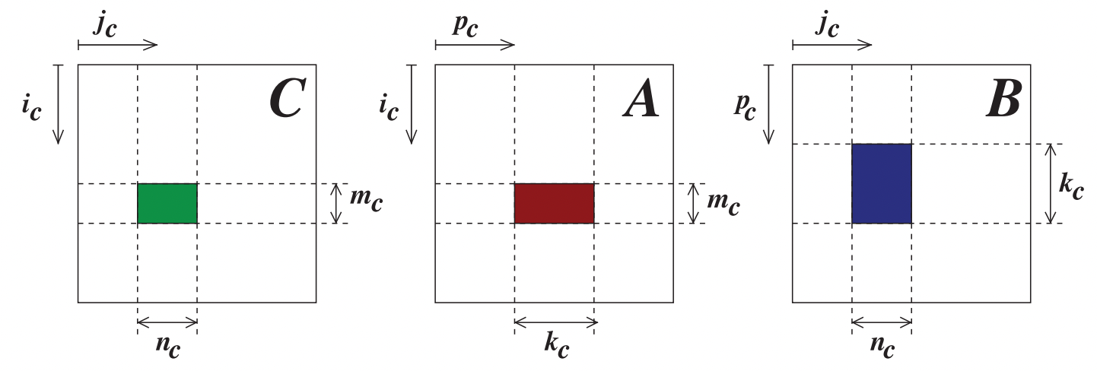
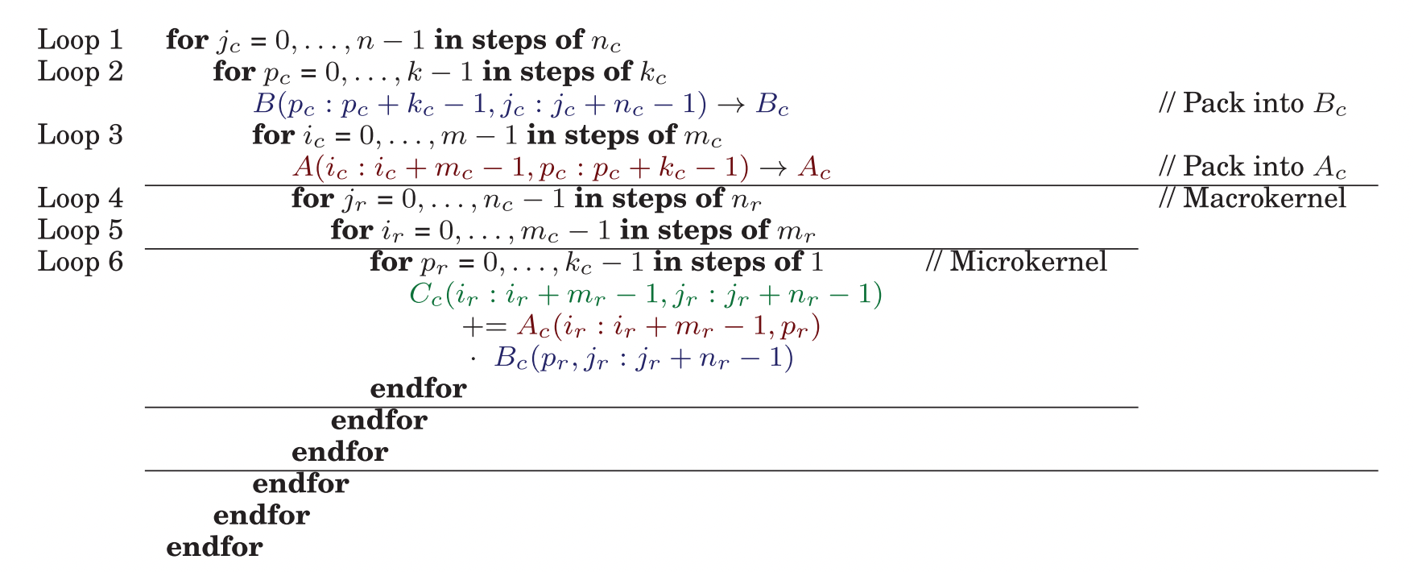











A High-Performance Implementation of GEMM
Loop 1, 2, 3
Loop 4, 5
$$p_{r}$$
$$j_{r}$$
$$i_{r}$$
$$A_{C}$$
$$B_{C}$$
$$p_{r}$$
$$m_{r}$$
$$m_{c}$$
micropanel
$$n_{r}$$
$$C≔AB+C$$
The microkernel is also known as the inner kernel in GotoBLAS
Define $C_{c}=C(i_{c}:i_{C}+m_{c}−1, j_{c}:j_{c}+n_{c}−1)$

Slide 7
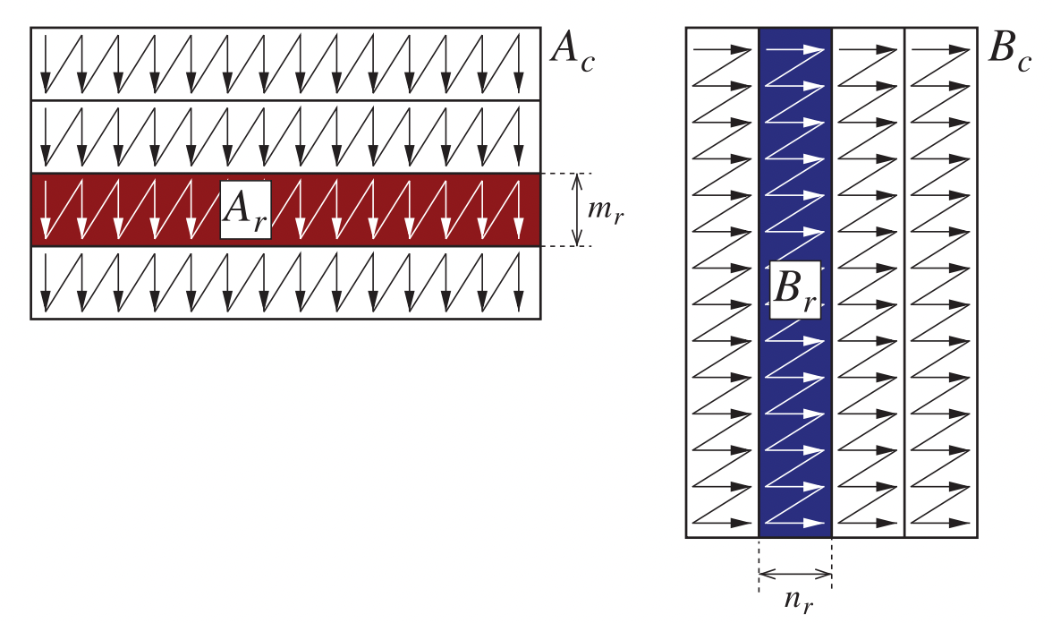
The Importance of Packing
Loop 1, 2, 3
Loop 4, 5
$$p_{r}$$
$$j_{r}$$
$$i_{r}$$
$$A_{C}$$
$$B_{C}$$
$$p_{r}$$
$$m_{r}$$
micropanel
$$m_{c}$$
$$n_{r}$$
1. The elements of Ac and Bc are accessed with unit stride when used to update a microtile of C;
2. Align data from Ac and Bc to cache lines boundaries and page boundaries;
3. Preload data from Ac and Bc into certain cache levels of the memory hierarchy.

Slide 8
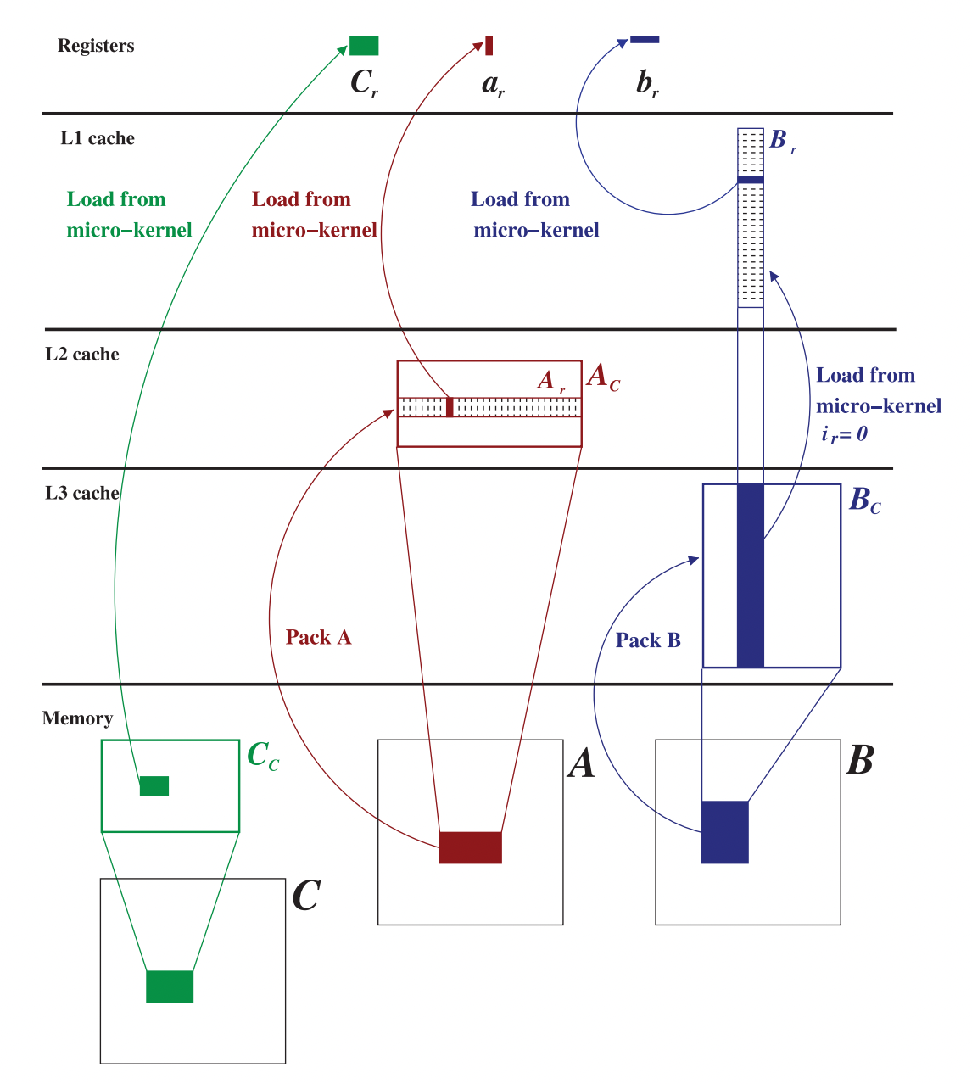
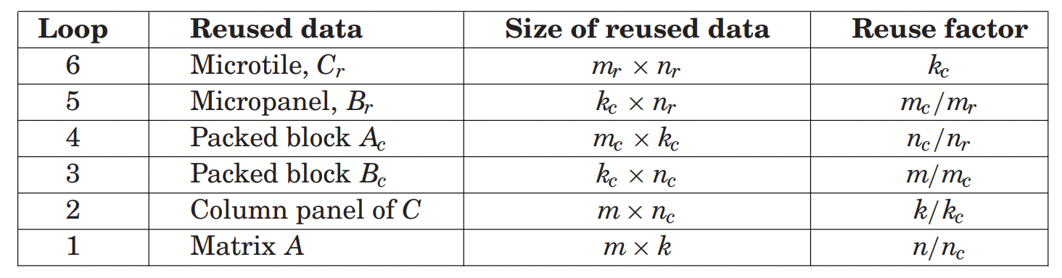







Data Usage Pattern
Reused data in Loop 6
Reused data in Loop 5
Reused data in Loop 4
GEMM maps smaller reused data to faster layers in the memory hierarchy.
Loop 6(microkernel)
$$p_{r}$$
$$A_{r}$$
$$m_{r}$$
microtile
$$n_{r}$$
$$m_{r}$$
$$p_{r}$$
$$n_{r}$$
$$C_{r}$$
$$B_{r}$$
Fig. Data Movement in the BLIS and GotoBLAS implementation of GEMM

Slide 9
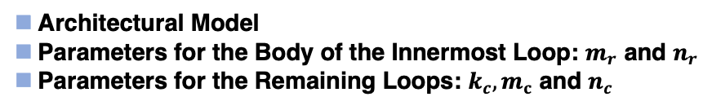
BLIS Implementation Of GEMM
A High-Performance Implementation of GEMM
The Importance of Packing
Data Usage Pattern
Mapping Algorithm to Architecture
Architectural Model
Parameters for the Body of the Innermost Loop: $m_{r}$ and $n_{r}$
Parameters for the Remaining Loops: $k_{c}, m_{c}$ and $n_{c}$

Slide 10
Mapping Algorithm to Architecture
Faithfully adhere to the aforementioned loop structures
  The order for the loops(except Loop 6) is hard-coded
  Traditional loop transformations, such as loop permutation/exchange and unroll-and-jam, are out of considerations

Slide 11
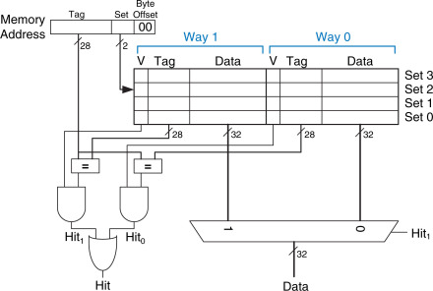
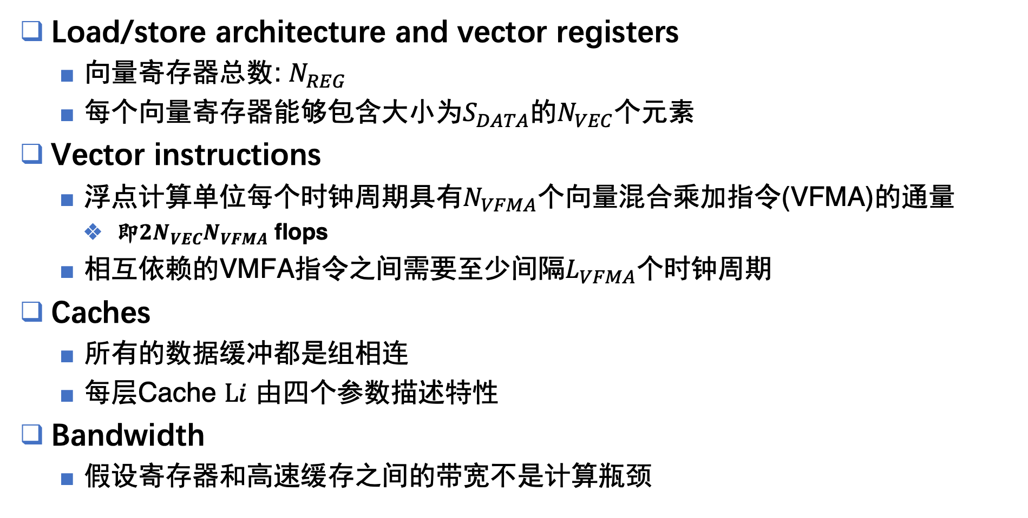
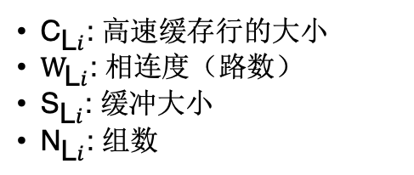
Architecture Model
Load/store architecture and vector registers
  向量寄存器总数: $N_{REG}$
  每个向量寄存器能够包含大小为$S_{DATA}$的$N_{VEC}$个元素
Vector instructions
  浮点计算单位每个时钟周期具有$N_{VFMA}$个向量混合乘加指令(VFMA)的通量
    即$2N_{VEC}N_{VFMA}$ flops
  相互依赖的VMFA指令之间需要至少间隔$L_{VFMA}$个时钟周期
Caches
  所有的数据缓冲都是组相连
  每层Cache $\text{L}i$ 由四个参数描述特性
Bandwidth
  假设寄存器和高速缓存之间的带宽不是计算瓶颈
${\text{C}}_{\text{L}i}$: 高速缓存行的大小
$W_{\text{L}i}$: 相连度（路数）
${\text{S}}_{\text{L}i}$: 缓冲大小
${\text{N}}_{\text{L}i}$: 组数
Fig. Two-way set associative cache

Slide 12
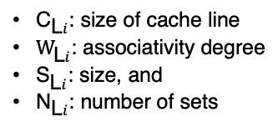
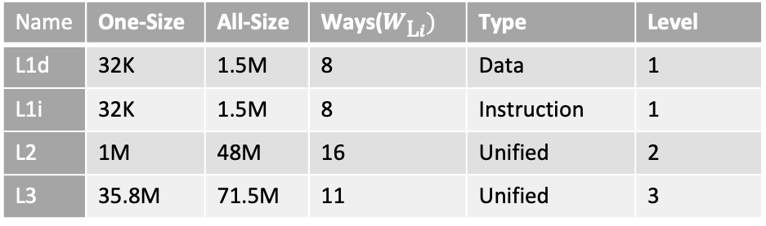
Table.2 Intel® Xeon® Gold 5220R Processor Specification at [1]
Architecture Model – Local Setting
Code Name | Products formerly Cascade Lake
Instruction Set Extensions | Intel® SSE4.2, Intel® AVX, Intel® AVX2, Intel® AVX-512
# of AVX-512 FMA Units | 1
Cache | 35.75 MB
Table.1 `lscpu` on the 48-core Intel(R) Xeon(R) Gold 5220R CPU server at 222.195.92.204:2022
Latency for VMFA is 4[3]
Architecture | x86_64
CPU(s) | 96
Thread(s) per code | 2
Core(s) per socket | 24
Socket(s) | 2
NUMA node(s) | 2
Model name | Intel(R) Xeon(R) Gold 5220R CPU @ 2.20GHz
CPU MHz | 1000.000
L1d cache | 1.5MiB
L1i cache | 1.5 MiB
L2 cache | 48 MiB
L3 cache | 71.5 MiB
Flags | … sse sse2 ... avx512f avx512dq … avx512cd avx512bw avx512vl …
How many FMA operations per cycle?
Table.3 `lscpu -C` on the 48-core server
Name | One-Size | All-Size | Ways($W_{\text{L}i})$ | Type | Level
L1d | 32K | 1.5M | 8 | Data | 1
L1i | 32K | 1.5M | 8 | Instruction | 1
L2 | 1M | 48M | 16 | Unified | 2
L3 | 35.8M | 71.5M | 11 | Unified | 3
Table.4 Get environment variable by `getconf`
LEVEL1_DCACHE_LINESIZE | 64
LEVEL2_CACHE_LINESIZE | 64
LEVEL3_CACHE_LINESIZE | 64
[1] https://ark.intel.com/content/www/us/en/ark/products/199354/intel-xeon-gold-5220r-processor-35-75m-cache-2-20-ghz.html
[2] https://www.intel.com/content/www/us/en/developer/articles/technical/intel-avx-512-instructions.html
[3] https://uops.info/html-instr/VFMADD213PS_YMM_YMM_YMM.html#ADL-P
From [2]:
Programs can pack eight double precision or sixteen single precision floating-point numbers, or eight 64-bit integers …
… Intel AVX-512 features include 32 vector registers each 512bits wide, …
${\text{C}}_{\text{L}i}$: size of cache line
$W_{\text{L}i}$: associativity degree
${\text{S}}_{\text{L}i}$: size, and
${\text{N}}_{\text{L}i}$: number of sets

Slide 13
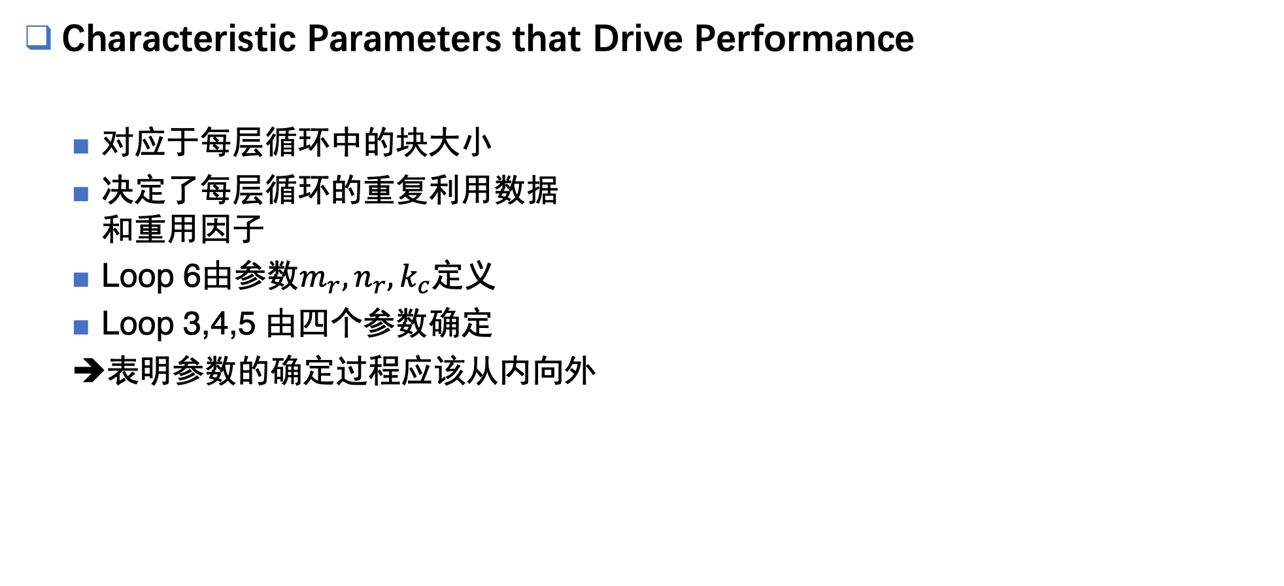

Parameters
Characteristic Parameters that Drive Performance
  对应于每层循环中的块大小
  决定了每层循环的重复利用数据
  和重用因子
  Loop 6由参数$m_{r},n_{r},k_{c}$定义
  Loop 3,4,5 由四个参数确定
  ➔表明参数的确定过程应该从内向外
$$n_{c},k_{c},m_{c},n_{r},m_{r}$$

Slide 14
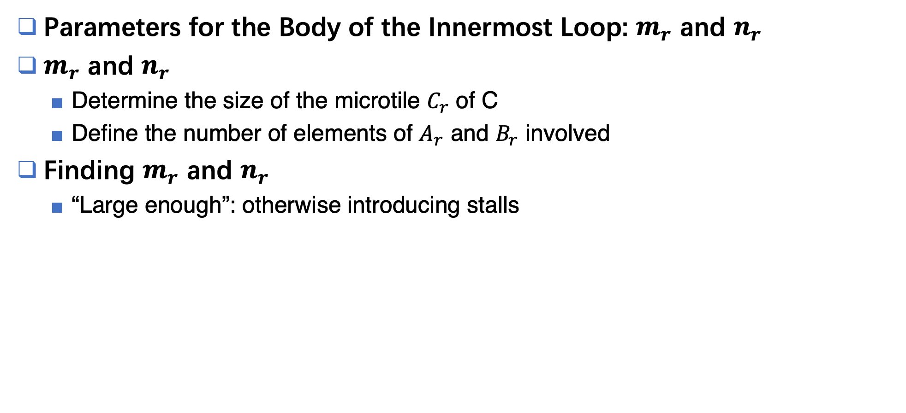



Parameters
Parameters for the Body of the Innermost Loop: $m_{r}$ and $n_{r}$
$m_{r}$ and $n_{r}$
  Determine the size of the microtile $C_{r}$ of C
  Define the number of elements of $A_{r}$ and $B_{r}$ involved
Finding $m_{r}$ and $n_{r}$
  “Large enough”: otherwise introducing stalls
$L_{VFMA}$ cycles
VFMA instr
$c_{r}\left[i\right][j]$
VFMA instr
$c_{r}\left[i\right][j]$

Slide 15
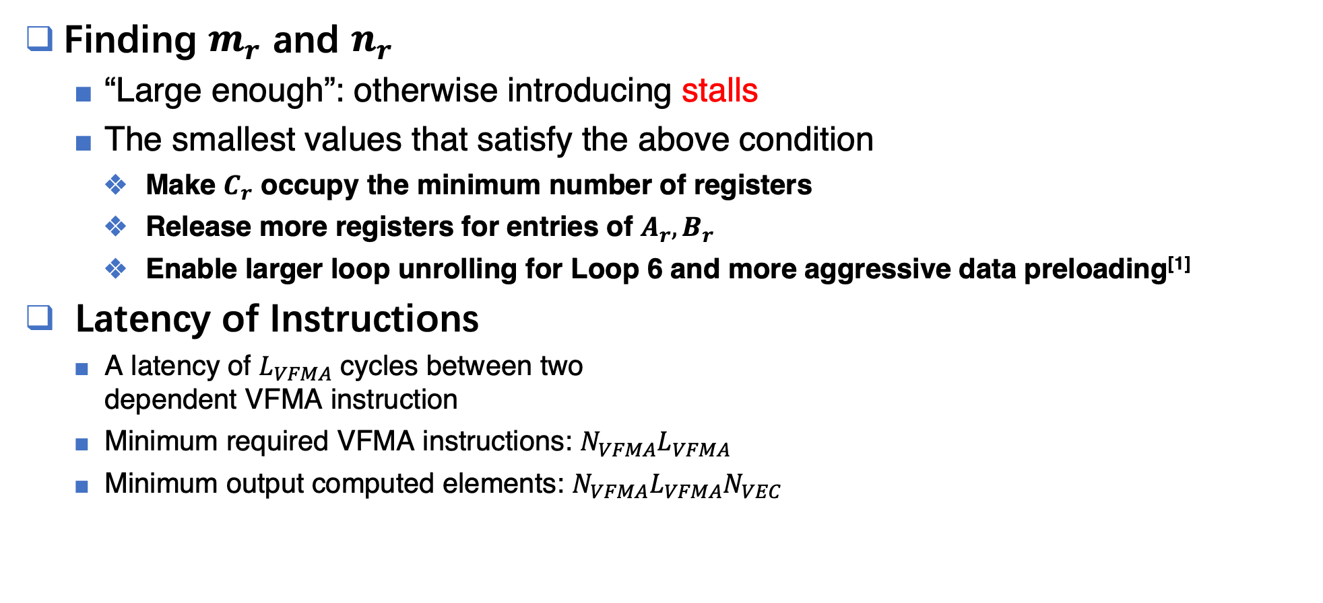

Parameters
Finding $m_{r}$ and $n_{r}$
  “Large enough”: otherwise introducing stalls
  The smallest values that satisfy the above condition
    Make $C_{r}$ occupy the minimum number of registers
    Release more registers for entries of $A_{r}, B_{r}$
    Enable larger loop unrolling for Loop 6 and more aggressive data preloading^{[1]}
Latency of Instructions
  A latency of $L_{VFMA}$ cycles between two
  dependent VFMA instruction
  Minimum required VFMA instructions: $N_{VFMA}L_{VFMA}$
  Minimum output computed elements: $N_{VFMA}L_{VFMA}N_{VEC}$
$L_{VFMA}$ cycles
VFMA instr
$c_{r}\left[i\right][j]$
VFMA instr
$c_{r}\left[i\right][j]$
$$m_{r}n_{r}≥N_{VEC}L_{VFMA}N_{VFMA}$$
﻿[1] John L. Hennessy and David A. Patterson. 2003. Computer Architecture: A Quantitative Approach. Morgan Kaufmann Pub., San Francisco.

Slide 16
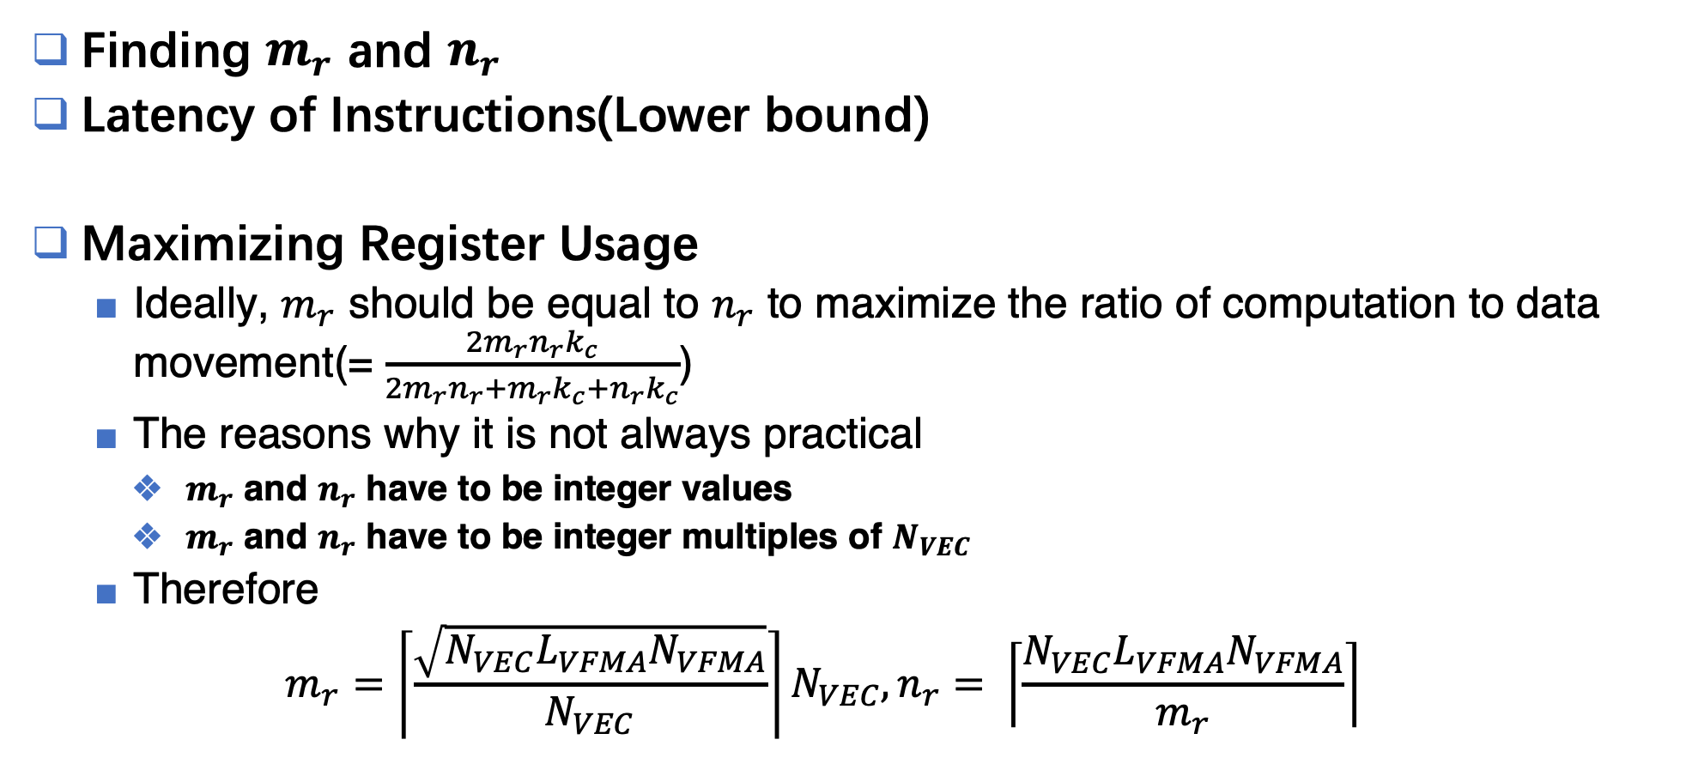

Parameters
Finding $m_{r}$ and $n_{r}$
Latency of Instructions(Lower bound)
Maximizing Register Usage
  Ideally, $m_{r}$ should be equal to $n_{r}$ to maximize the ratio of computation to data movement(= $\frac{2m_{r}n_{r}k_{c}}{2m_{r}n_{r}+m_{r}k_{c}+n_{r}k_{c}}$)
  The reasons why it is not always practical
    $m_{r}$ and $n_{r}$ have to be integer values
    $m_{r}$ and $n_{r}$ have to be integer multiples of $N_{VEC}$
  Therefore
  $$m_{r}=\left\lceil \frac{\sqrt{N_{VEC}L_{VFMA}N_{VFMA}}}{N_{VEC}}\right\rceil N_{VEC}, n_{r}= \left\lceil \frac{N_{VEC}L_{VFMA}N_{VFMA}}{m_{r}}\right\rceil$$
$$m_{r}n_{r}≥N_{VEC}L_{VFMA}N_{VFMA}$$

Slide 17
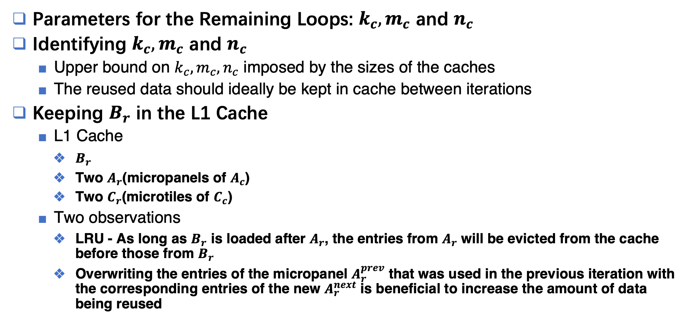
Parameters
Parameters for the Remaining Loops: $k_{c},m_{c}$ and $n_{c}$
Identifying $k_{c}, m_{c}$ and $n_{c}$
  Upper bound on $k_{c}, m_{c}, n_{c}$ imposed by the sizes of the caches
  The reused data should ideally be kept in cache between iterations
Keeping $B_{r}$ in the L1 Cache
  L1 Cache
    $B_{r}$
    Two $A_{r}$(micropanels of $A_{c}$)
    Two $C_{r}$(microtiles of $C_{c}$)
  Two observations
    LRU - As long as $B_{r}$ is loaded after $A_{r}$, the entries from $A_{r}$ will be evicted from the cache before those from $B_{r}$
    Overwriting the entries of the micropanel $A_{r}^{prev}$ that was used in the previous iteration with the corresponding entries of the new $A_{r}^{next}$ is beneficial to increase the amount of data being reused

Slide 18
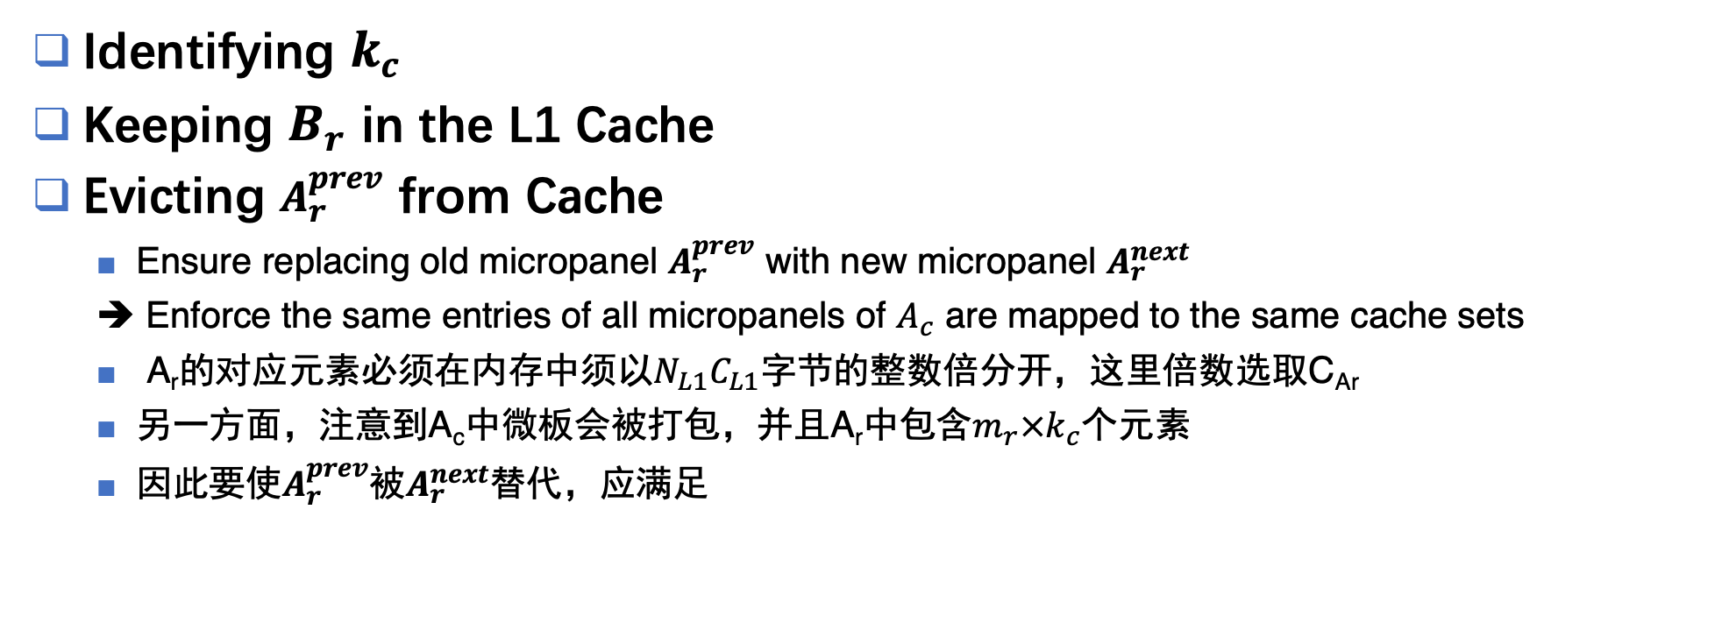


Parameters
Identifying $k_{c}$
Keeping $B_{r}$ in the L1 Cache
Evicting $A_{r}^{prev}$ from Cache
  Ensure replacing old micropanel $A_{r}^{prev}$ with new micropanel $A_{r}^{next}$
  ➔ Enforce the same entries of all micropanels of $A_{c}$ are mapped to the same cache sets
  A_{r}的对应元素必须在内存中须以$N_{L1}C_{L1}$字节的整数倍分开，这里倍数选取C_{Ar}
  另一方面，注意到A_{c}中微板会被打包，并且A_{r}中包含$m_{r}×k_{c}$个元素
  因此要使$A_{r}^{prev}$被$A_{r}^{next}$替代，应满足
$$m_{r}k_{c}S_{DATA}=C_{A_{r}}N_{L1}C_{L1}$$
$$C_{L1}$$
Set 0
Set 1
L1 D-Cache
Memory

Slide 19
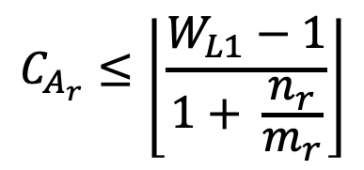
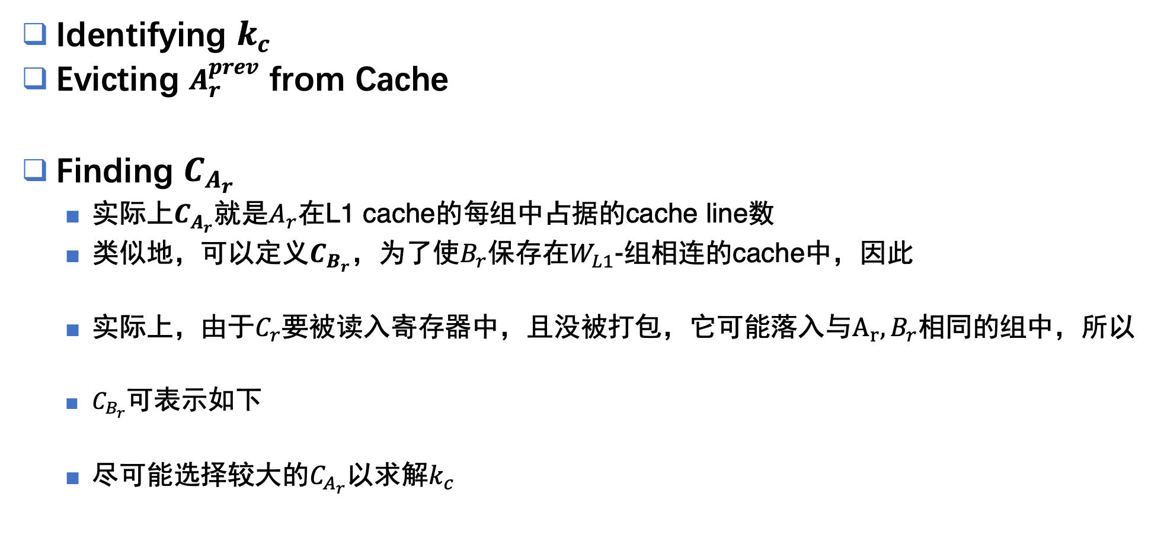
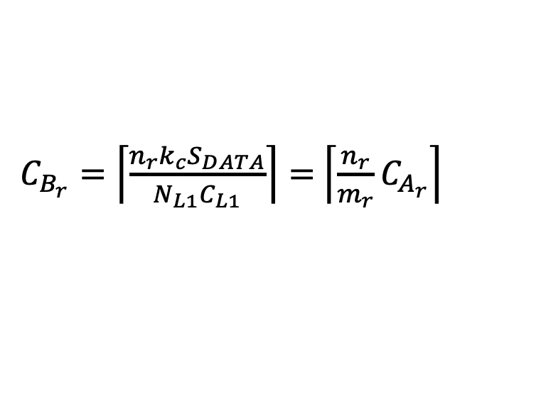



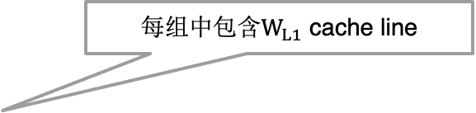
Parameters
Identifying $k_{c}$
Evicting $A_{r}^{prev}$ from Cache
Finding $C_{A_{r}}$
  实际上$C_{A_{r}}$就是$A_{r}$在L1 cache的每组中占据的cache line数
  类似地，可以定义$C_{B_{r}}$，为了使$B_{r}$保存在$W_{L1}$-组相连的cache中，因此
  实际上，由于$C_{r}$要被读入寄存器中，且没被打包，它可能落入与$A_{r},B_{r}$相同的组中，所以
  $C_{B_{r}}$可表示如下
  尽可能选择较大的$C_{A_{r}}$以求解$k_{c}$
$$m_{r}k_{c}S_{DATA}=C_{A_{r}}N_{L1}C_{L1}$$
每组中包含$W_{L1}$ cache line
$$C_{A_{r}}+C_{B_{r}}≤W_{L1}$$
$$C_{A_{r}}+C_{B_{r}}≤W_{L1}−1$$
  因此
$C_{B_{r}}=\left\lceil \left.\frac{n_{r}k_{c}S_{DATA}}{N_{L1}C_{L1}}\right\rceil \right.=$ $\left\lceil \left.\frac{n_{r}}{m_{r}}C_{A_{r}}\right\rceil \right.$
$$C_{A_{r}}≤\left\lfloor \frac{W_{L1}−1}{1+ \frac{n_{r}}{m_{r}}}\right\rfloor$$

Slide 20
BLIS Implementation Of GEMM
A High-Performance Implementation of GEMM
The Importance of Packing
Data Usage Pattern
Mapping Algorithm to Architecture
Architectural Model
Parameters for the Body of the Innermost Loop: $m_{r}$ and $n_{r}$
Parameters for the Remaining Loops: $k_{c}, m_{c}$ and $n_{c}$
Validation
Evaluating the Model
Experimental Validation

Slide 21
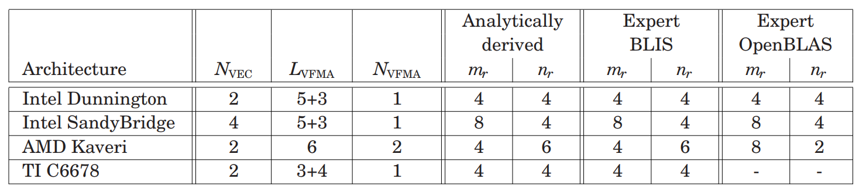
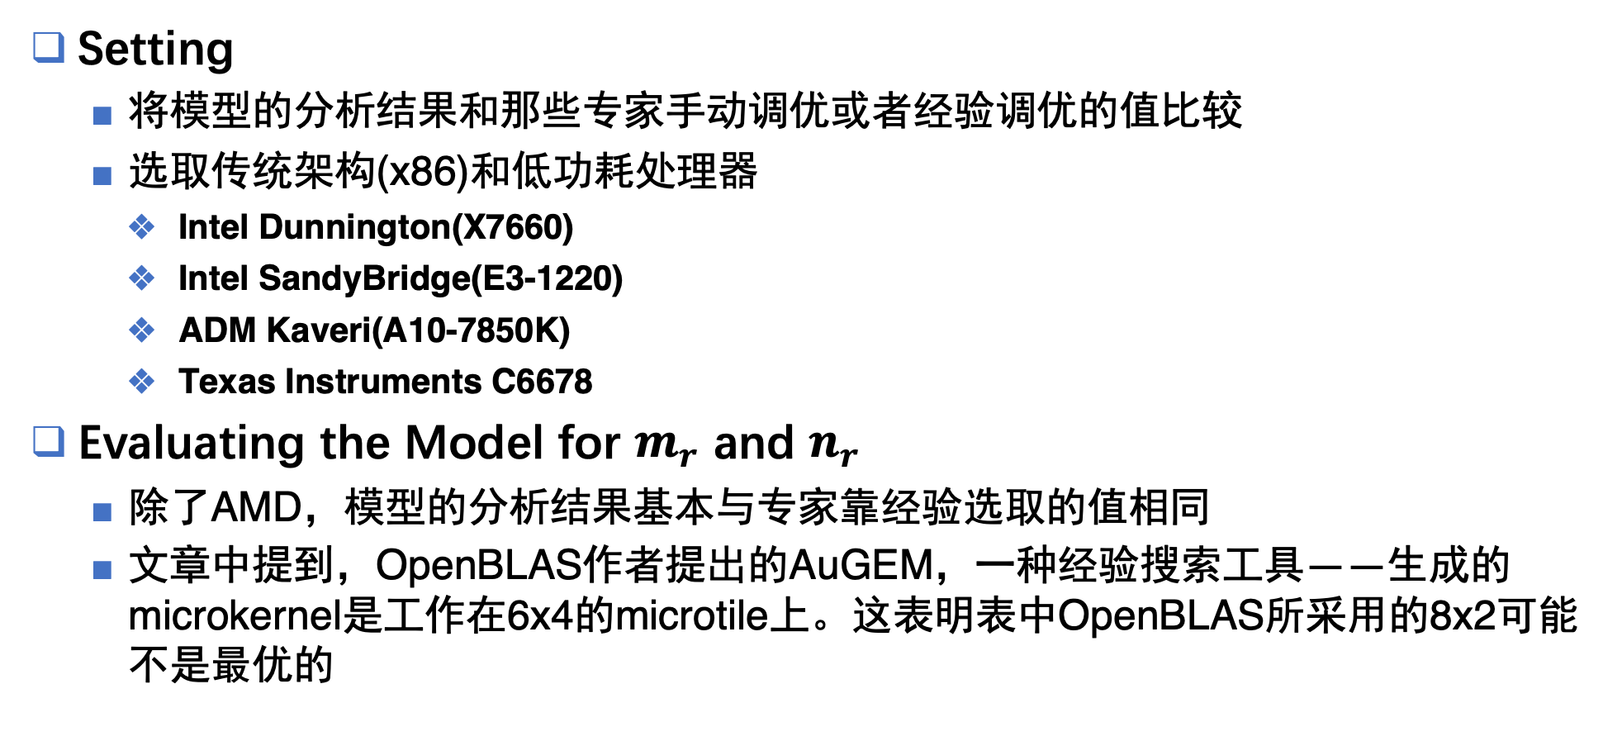
Evaluating the Model
Setting
  将模型的分析结果和那些专家手动调优或者经验调优的值比较
  选取传统架构(x86)和低功耗处理器
    Intel Dunnington(X7660)
    Intel SandyBridge(E3-1220)
    ADM Kaveri(A10-7850K)
    Texas Instruments C6678
Evaluating the Model for $m_{r}$ and $n_{r}$
  除了AMD，模型的分析结果基本与专家靠经验选取的值相同
  文章中提到，OpenBLAS作者提出的AuGEM，一种经验搜索工具——生成的microkernel是工作在6x4的microtile上。这表明表中OpenBLAS所采用的8x2可能不是最优的
Table. 对$m_{r},n_{r}$的分析值和专家选取的经验值比较

Slide 22
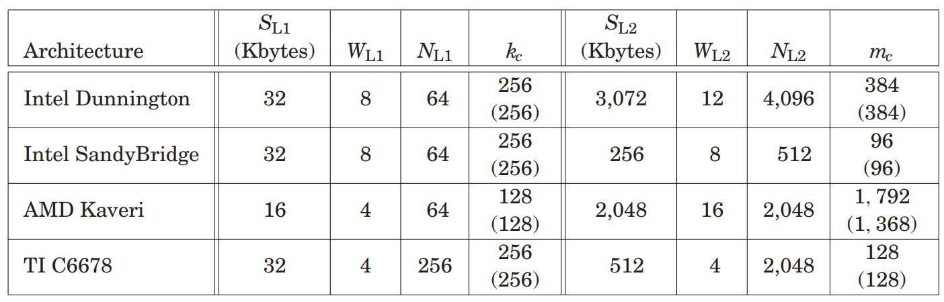
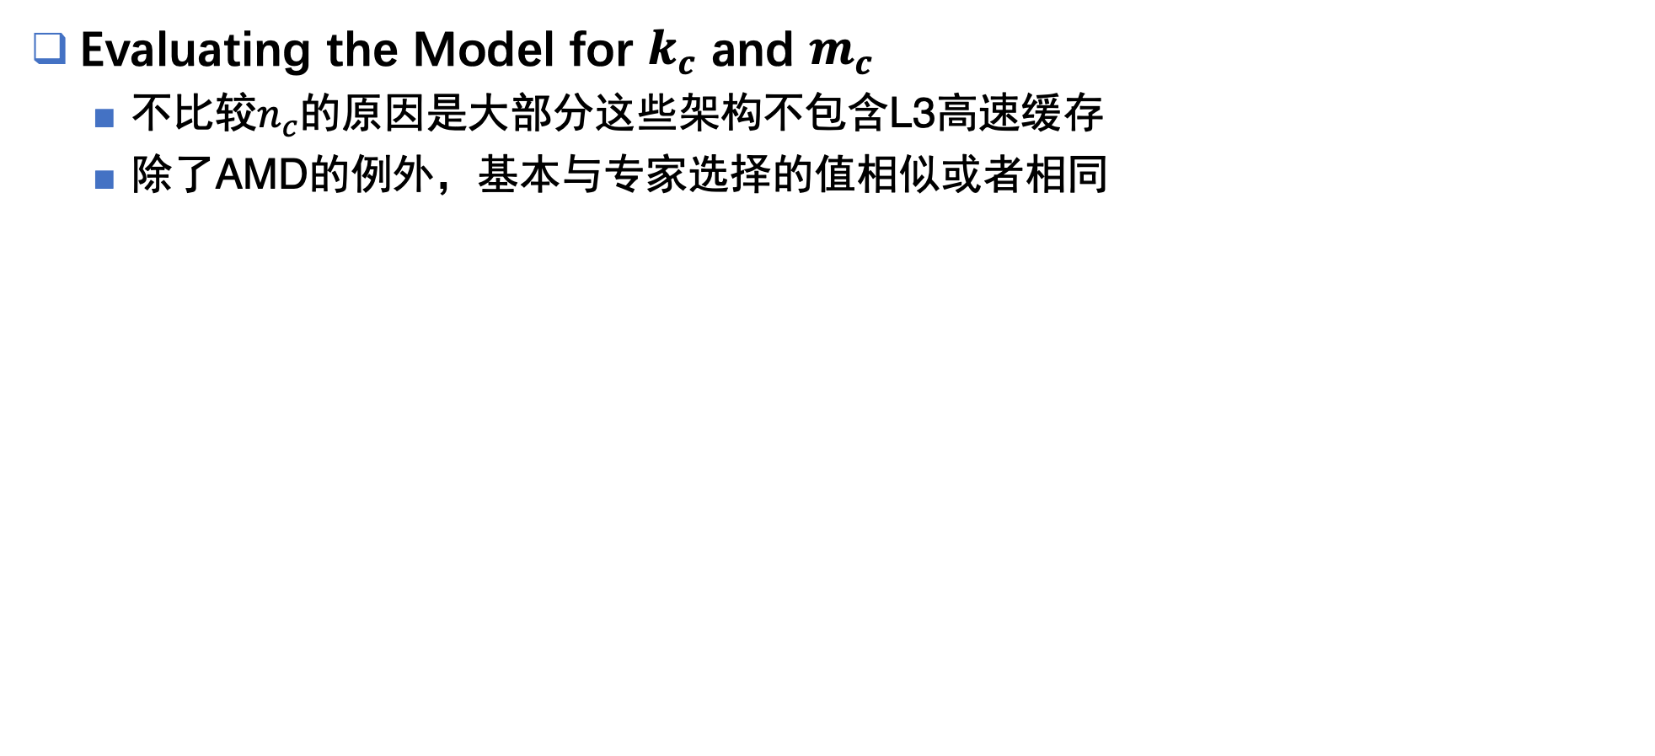
Evaluating Model
Evaluating the Model for $k_{c}$ and $m_{c}$
  不比较$n_{c}$的原因是大部分这些架构不包含L3高速缓存
  除了AMD的例外，基本与专家选择的值相似或者相同
Table. 对$k_{c},m_{c}$的分析值和专家经验选取或者手动优化的值比较

Slide 23
Experimental Validation
两个目标
  在能够分析出最优值的架构上，从性能和cache miss率两个方面分析BLIS的行为(Intel SandyBridge)
  在最优值不匹配的架构上，量化并解释性能的差异(AMD Kaveri)

Slide 24
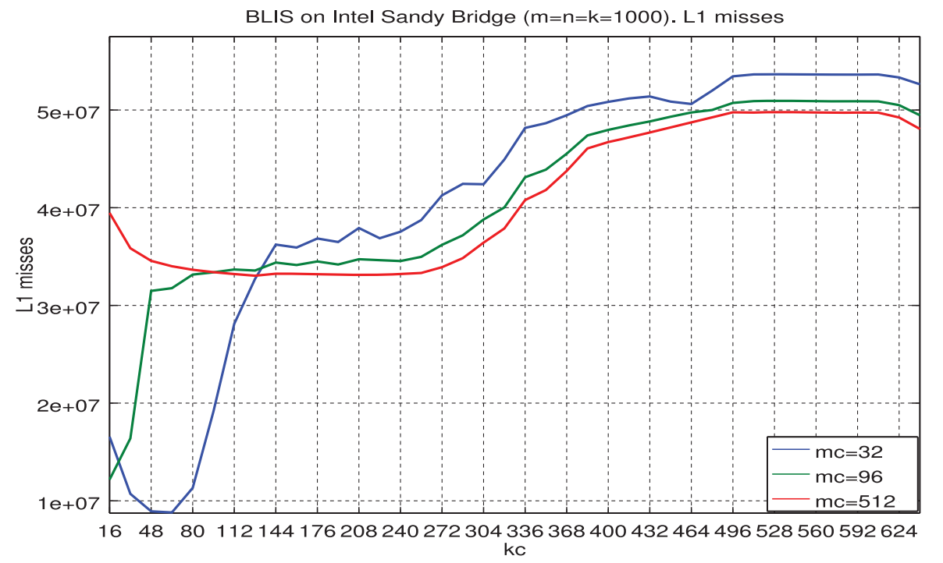
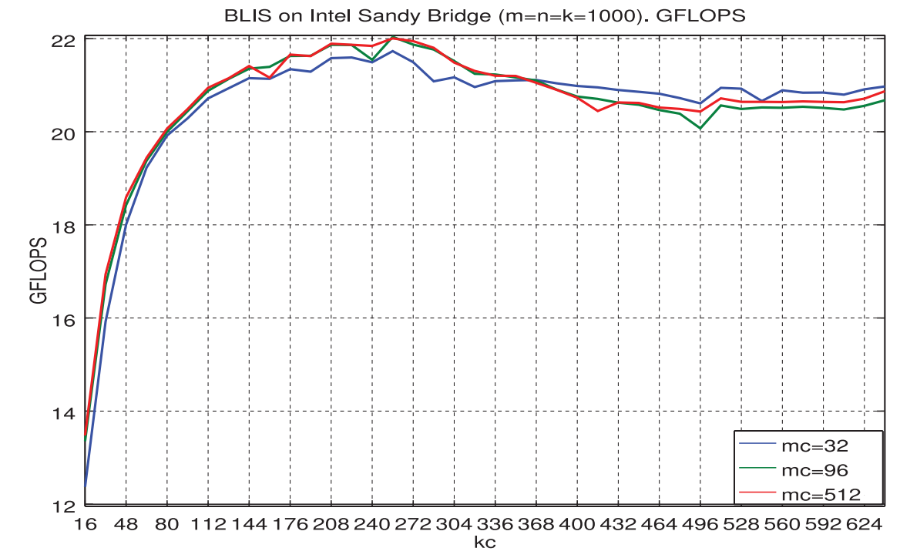
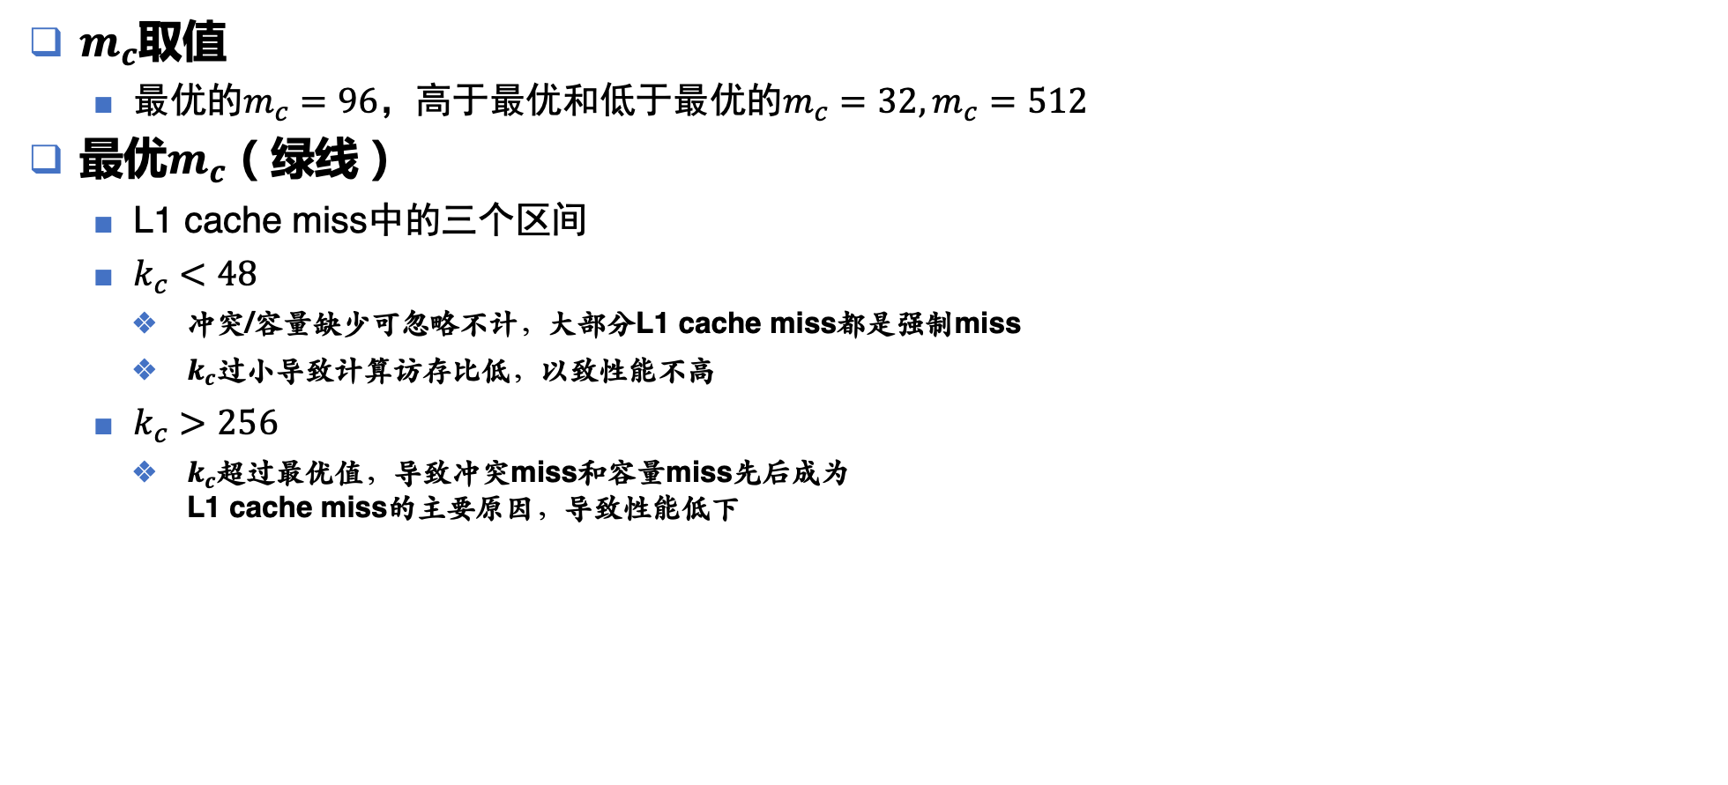
Empirical Validation of the Analytical Model
- Intel SandyBridge Case
$m_{c}$取值
  最优的$m_{c}=96$，高于最优和低于最优的$m_{c}=32, m_{c}=512$
最优$m_{c}$（绿线）
  L1 cache miss中的三个区间
  $k_{c}<48$
    冲突/容量缺少可忽略不计，大部分L1 cache miss都是强制miss
    $k_{c}$过小导致计算访存比低，以致性能不高
  $k_{c}>256$
    $k_{c}$超过最优值，导致冲突miss和容量miss先后成为
    L1 cache miss的主要原因，导致性能低下

Slide 25
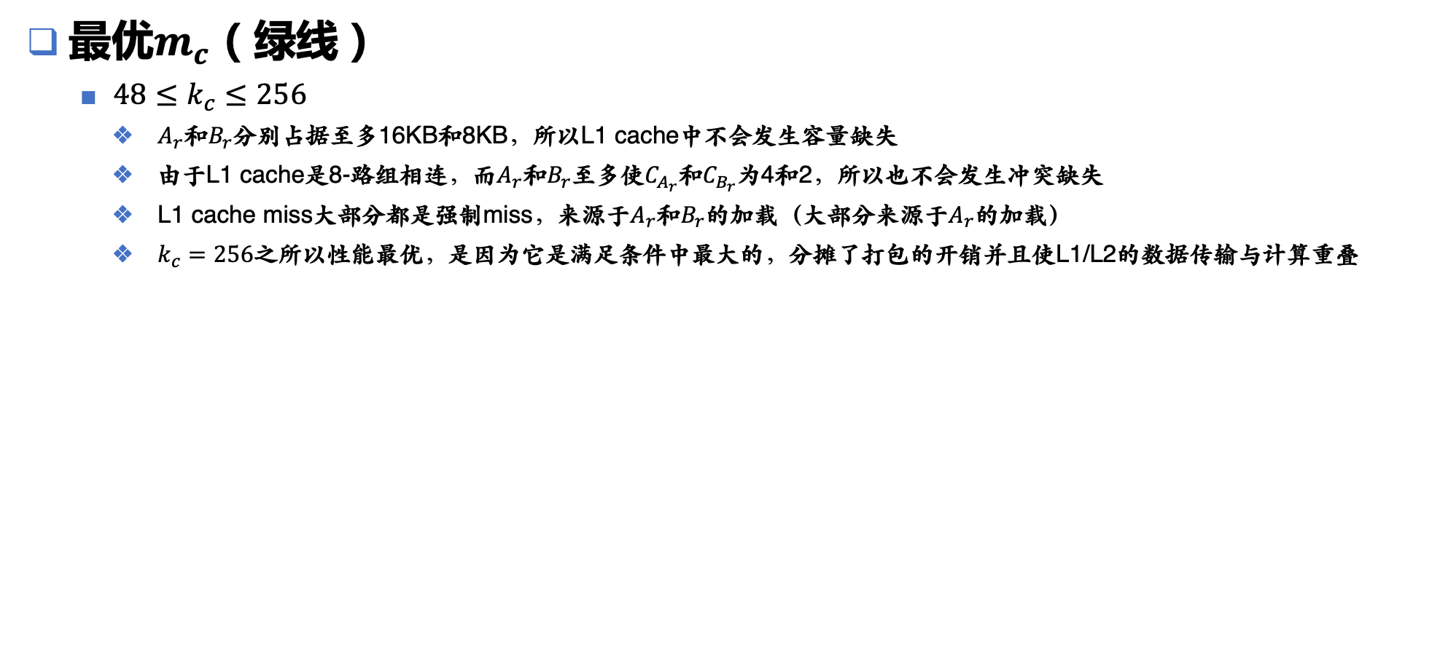
Empirical Validation of the Analytical Model
- Intel SandyBridge Case
最优$m_{c}$（绿线）
  $48≤k_{c}≤256$
    $A_{r}$和$B_{r}$分别占据至多16KB和8KB，所以L1 cache中不会发生容量缺失
    由于L1 cache是8-路组相连，而$A_{r}$和$B_{r}$至多使$C_{A_{r}}$和$C_{B_{r}}$为4和2，所以也不会发生冲突缺失
    L1 cache miss大部分都是强制miss，来源于$A_{r}$和$B_{r}$的加载（大部分来源于$A_{r}$的加载）
    $k_{c}=256$之所以性能最优，是因为它是满足条件中最大的，分摊了打包的开销并且使L1/L2的数据传输与计算重叠

Slide 26
Qualification of the Analytical Model Deviations
- The AMD Kaveri Case

Slide 27
Thanks, Q&A

