Slide 1
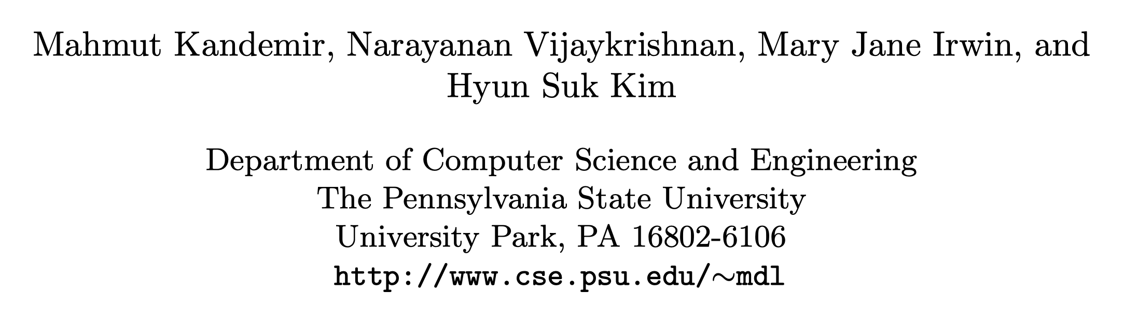

Experimental Evaluation of Energy Behavior of Iteration Space Tiling
LCPC 2000

Slide 2
Background
With the proliferation of embedded software, it is becoming important to identify the energy impact of these traditional performance-oriented optimizations and to develop new energy-aware schemes.
Towards this goal, this paper explores the energy consumption behavior of one of the widely-used loop-level compiler optimizations, iteration space tiling, by varying a set of software and hardware parameters.
Our results show that the choice of tile size and input size critically impacts the system energy consumption.
Specifically, we find that the best tile size for the least energy consumed is diﬀerent from that for the best performance.
Notes:
以性能为导向的优化

Slide 3
Contributions
We report the energy consumption caused by diﬀerent styles of tiling using a matrix-multiply code as a running example.
We investigate energy-sensitivity of tiling to tile size and input size.
We investigate its energy performance on several cache configurations.
We evaluate the energy consumption and discuss the results when tiling is accompanied by other code optimizations.

Slide 4
Platform and Methodology
The experiments in this paper were carried out using the SimplePower energy estimation framework.
  This framework includes a transition-sensitive, cycle-accurate datapath energy model that interfaces with analytical and transition-sensitive energy models for the memory and bus sub-systems, respectively.
  The memory system of SimplePower can be configured for diﬀerent cache sizes, block sizes, associativities, write and replacement policies, number of cache sub-banks, and cache block buﬀers.
We input our C codes into this framework to obtain the energy results.

Slide 5
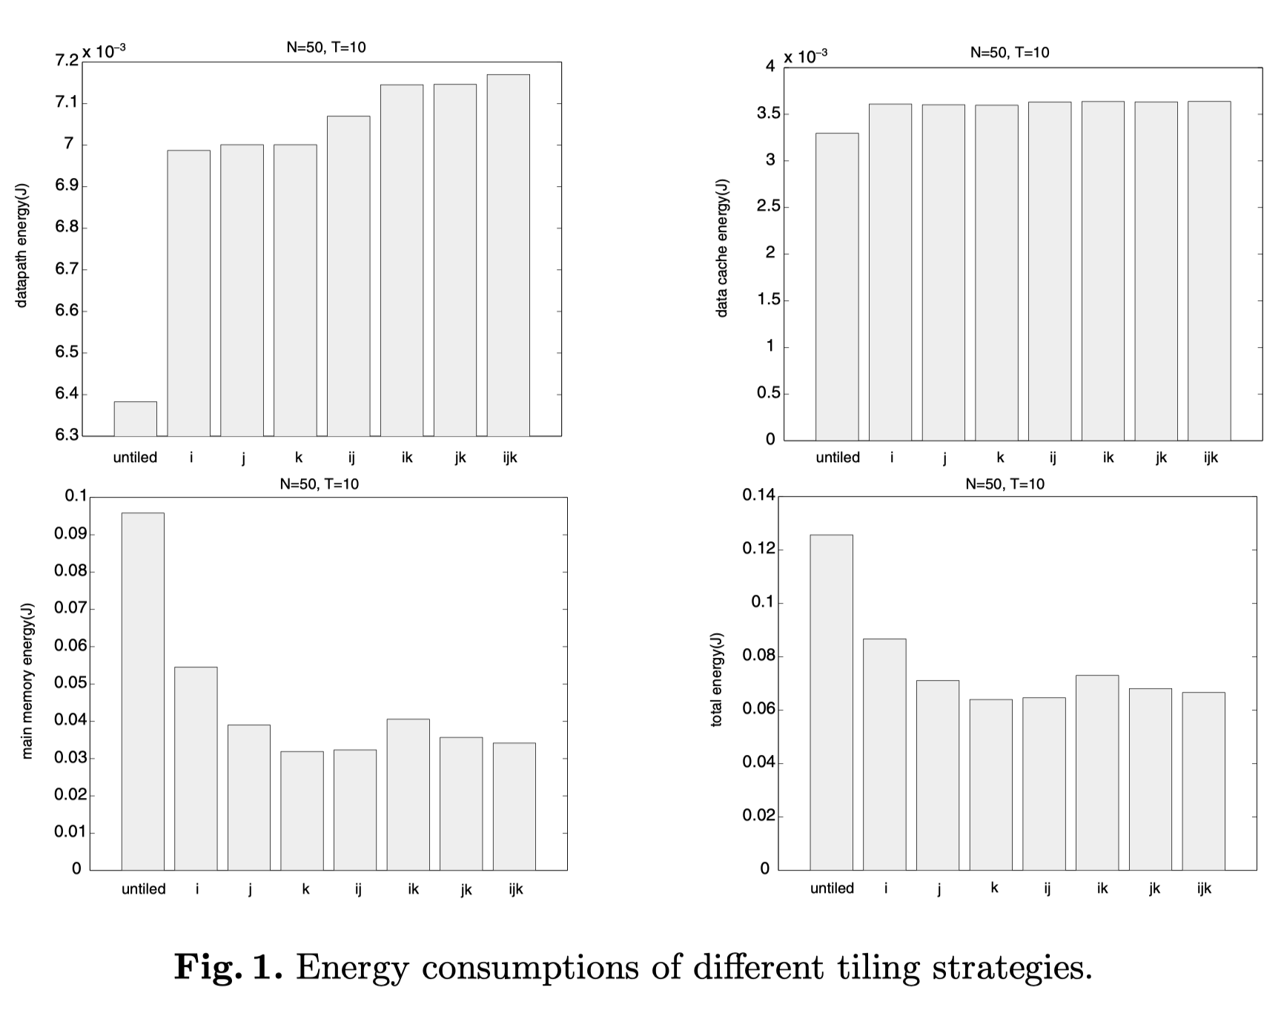
Experimental Evaluation - Tiling Strategy
tiling a larger number of loops in general increases the datapath energy consumption.
  loop tiling converts the input code into a more complex code
  cause more branch instructions in the resulting code and more comparison operations
tiling only the i loop increases the datapath energy consumption by approximately 10%.
Notes:
循环平铺将输入代码转换为更复杂的代码，其中涉及复杂的循环边界、大量的嵌套和宏/函数调用（用于计算循环上限）。
导致生成的代码中有更多的分支指令和更多的比较操作，这反过来又会增加数据路径中的切换活动（和能耗）。
仅平铺 i 循环会使数据路径能耗增加约 10%。

Slide 6
Experimental Evaluation - Tiling Strategy
observe a higher energy consumption in the instruction cache.
  the increased number of instructions accessed from the cache due to the more complex loop structure and access pattern.
the energy consumption is not that sensitive to the tiling strategy.
Notes:
循环平铺将输入代码转换为更复杂的代码，其中涉及复杂的循环边界、大量的嵌套和宏/函数调用（用于计算循环上限）。
导致生成的代码中有更多的分支指令和更多的比较操作，这反过来又会增加数据路径中的切换活动（和能耗）。
仅平铺 i 循环会使数据路径能耗增加约 10%。

Slide 7
Experimental Evaluation - Tiling Strategy
the main memory energy becomes 35.6% of the energy consumed by the untiled code.
  due to reduced number of accesses to the main memory as a result of better data locality.
To sum up, we can conclude that loop tiling increases the energy consumption in datapath, instruction cache, and data cache, but significantly reduces the energy in main memory.
Notes:
循环平铺将输入代码转换为更复杂的代码，其中涉及复杂的循环边界、大量的嵌套和宏/函数调用（用于计算循环上限）。
导致生成的代码中有更多的分支指令和更多的比较操作，这反过来又会增加数据路径中的切换活动（和能耗）。
仅平铺 i 循环会使数据路径能耗增加约 10%。

Slide 8
Experimental Evaluation - Sensitivity to the Tile Size and Input Size
Increasing the tile size reduces the datapath energy and instruction cache energy. This is because a large tile size (blocking factor) means smaller loop (code) overhead. However, as in the previous set of experiments, the overall energy behavior is largely determined by the energy spent in main memory.
There is little change in data cache energy as we vary the tile size. This is because the number of accesses to the data cache is almost the same for all tile sizes (in a given tiling strategy).

Slide 9
Experimental Evaluation - Sensitivity to the Tile Size and Input Size
The energy consumption of a given tiling strategy depends to a large extent on the tile size. For instance, when N is 50 and both j and k loops are tiled, the overall energy consumption can be as small as 0.064J or as large as 0.128J depending on the tile size chosen. It was observed that, for each version of tiled code, there is a most suitable tile size beyond which the energy consumption starts to increase.
For a given version, the best tile size from energy point of view was diﬀerent from the best tile size from the performance (execution cycles) point of view. For example, as far as the execution cycles are concerned, the best tile size for the ik version was 10 (instead of 5).

Slide 10
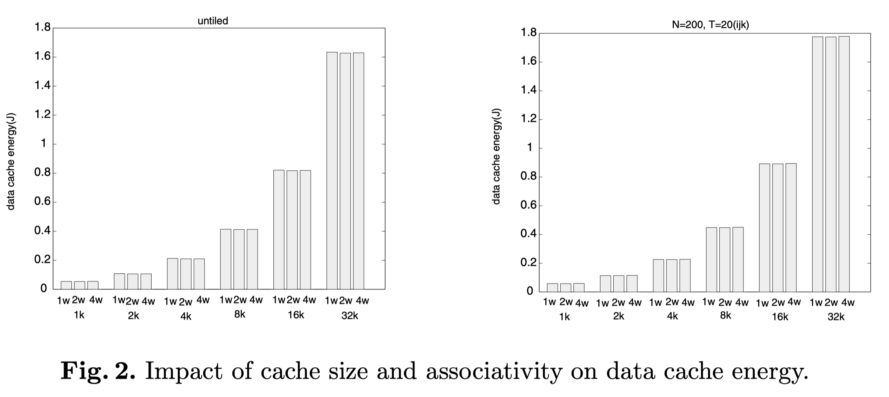
Experimental Evaluation - Sensitivity to the Cache Configuration
As a result, embedded system designers need to determine minimum data cache size for the set of applications in question .
for all cache sizes and associativities going from the untiled code to tiled code increases the data cache energy.
the data cache energy is not too sensitive to the associativity but, on the other hand, is very sensitive to the cache size.

Slide 11
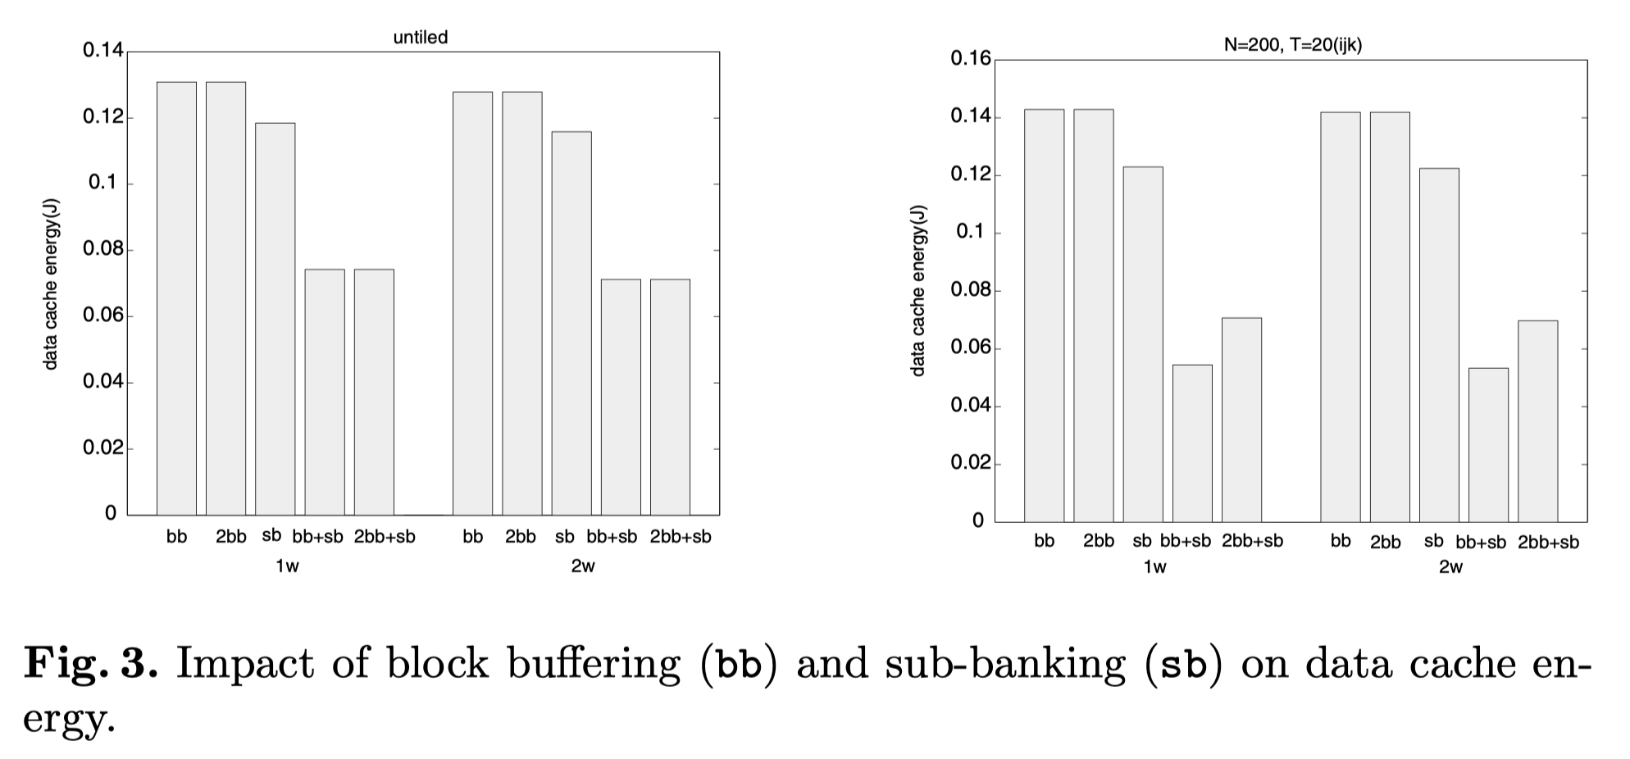
Experimental Evaluation - Sensitivity to the Cache Configuration
The results reveal that for the best energy reduction block buffering and sub-banking should be used together.
When used alone, neither sub-banking nor block buﬀering is much eﬀective.
The results also show that increasing the number of block buﬀers does not bring any benefit.

Slide 12
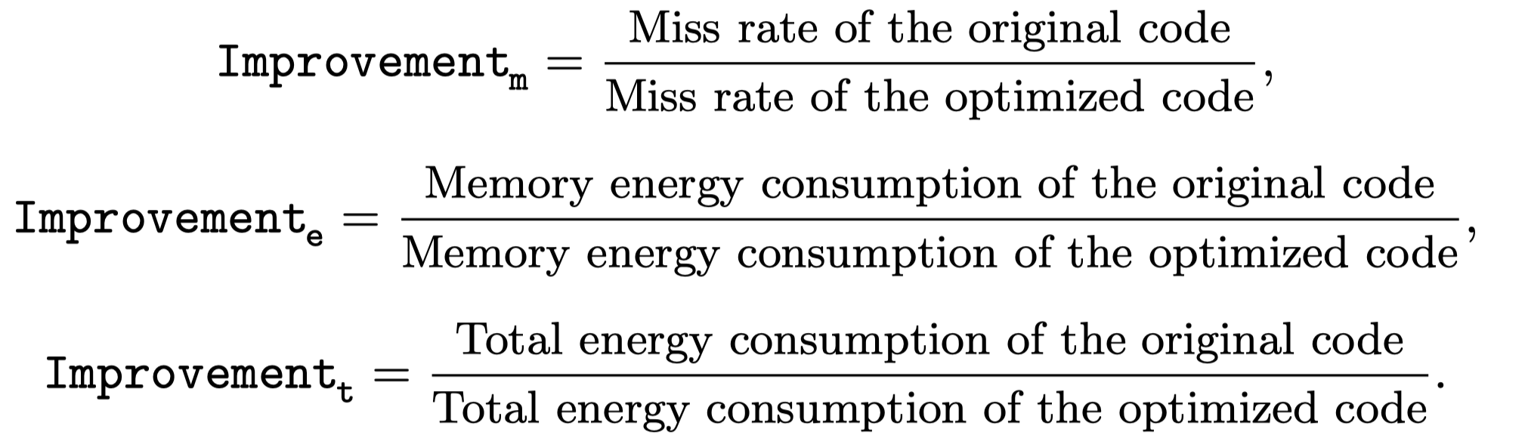
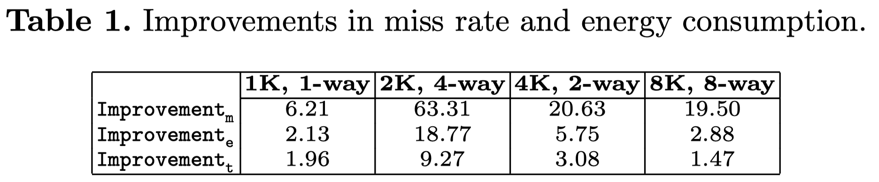
Experimental Evaluation - Cache Miss Rates Vs. Energy
expect an overall energy reduction as a result of tiling, but not as much as the reduction in the miss rate.

Slide 13
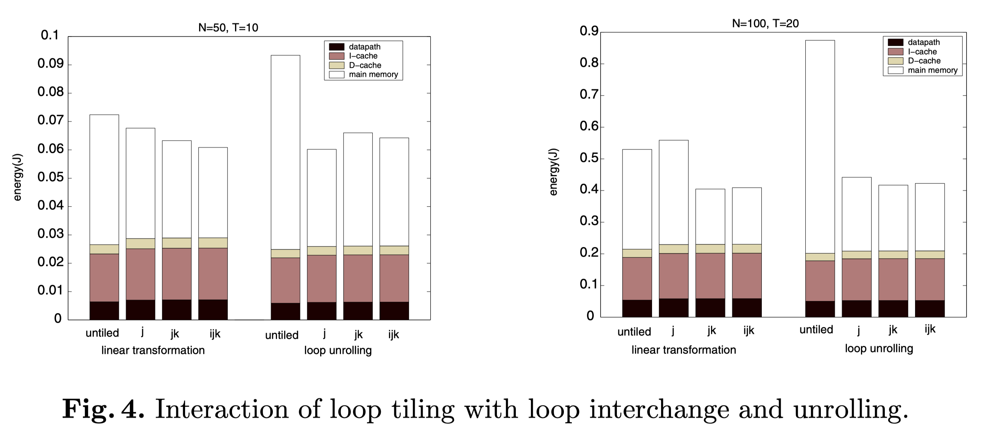
Experimental Evaluation - Interaction with Other Optimizations
tiling should be applied in general after linear loop transformations for the best energy results.
in circumstances where loop unrolling must be applied, we suggest to apply tiling as well to keep the energy consumption under control.

Slide 14
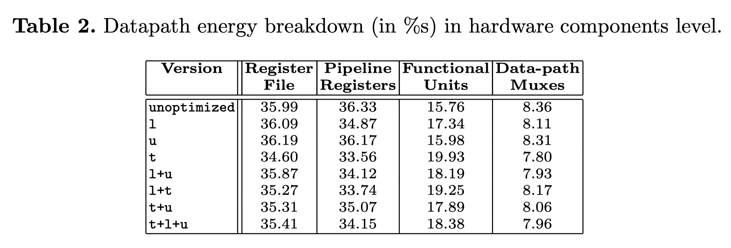
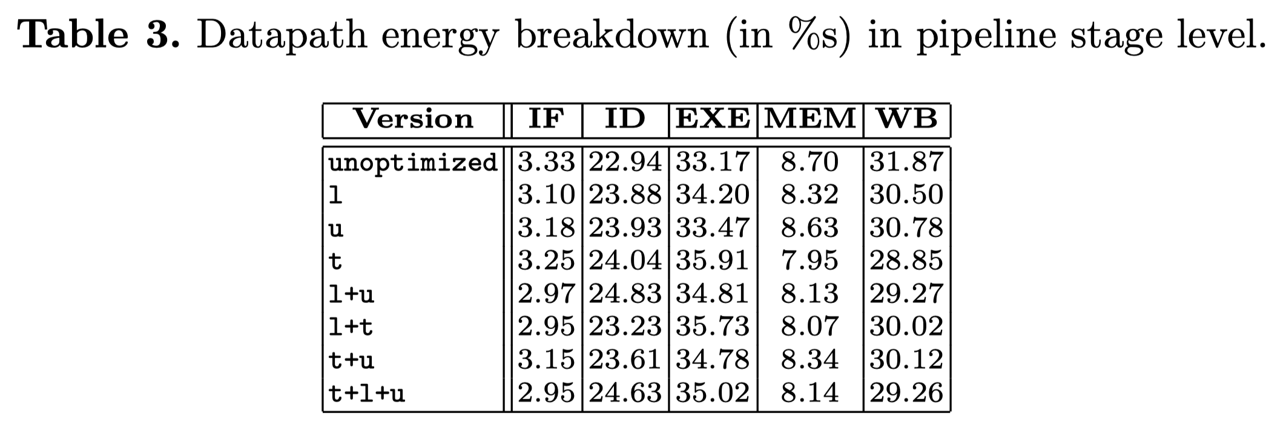
Experimental Evaluation - Analysis of Datapath Energy
the percentages remain relatively stable.
all the optimizations increase the energy consumption in functional units
The most significant increase occurs with tiling, and it is more than 26%.
observe that most of the energy is spent in the ID, EXE, and WB stages.
l: linear loop transformation
u: loop unrolling
t: tiling

Slide 15
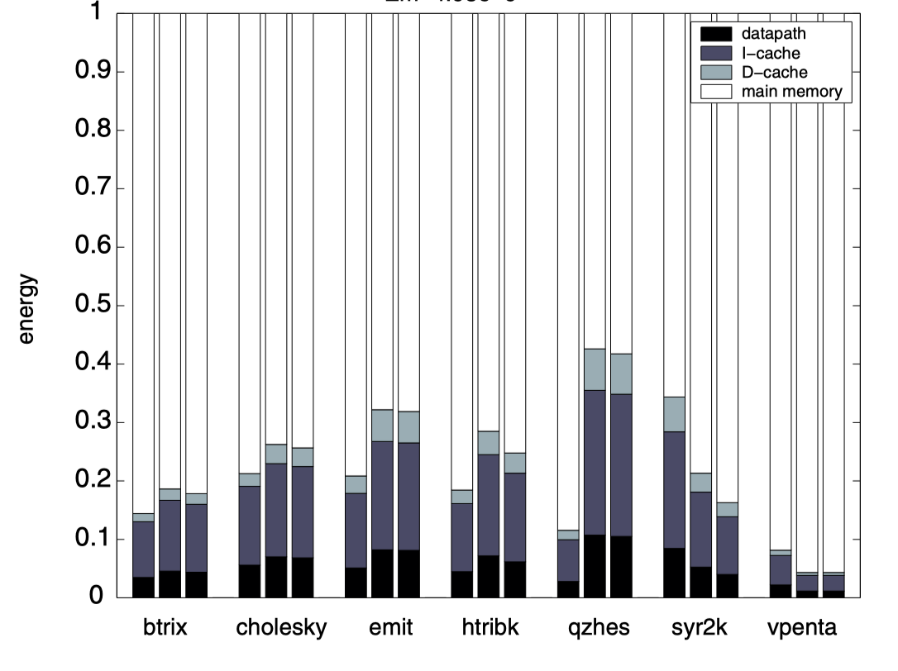
Experimental Evaluation - Sensitivity to Technology Changes
The first four loop nests in this table are from the Spec92/Nasa7 benchmark suite; syr2k.1 is from Blas; and htribk.2 and qzhes.4 are from the Eispack library.
found that the energy behavior of these nests are similar to that of the matrix-multiply.
untiled、tiled (ijk,T=5) 和 tiled (ijk,T=10)

Slide 16
Conclusions
the energy performance of tiling is very sensitive to input size and tile size.
selecting a suitable tile size for a given computation involves tradeoﬀs between energy and performance, because the best tile sizes from the performance point of view are not necessarily the best tile sizes from the energy point of view.
tailoring tile size to the input size generally results in lower energy consumption than working with a fixed tile size.

Slide 17
谢谢！

