Slide 1

AsyMo: Scalable and Efficient Deep-Learning Inference on Asymmetric Mobile CPUs
MobiCom 2021

Slide 2
Introduction
DL 推理在mobile CPUs上存在较差的性能scalability以及功耗使用不高效的问题
主要问题在于：
  poor scalability：improper task partitioning, unbalanced task distribution
  energy inefficiency: unawareness of model behaviour
AsyMo：for the thread pool implementation of DL frameworks
  leverage the execution determinism of DL inference, and build an optimal execution plan offline by jointly considering model structures and hardware characteristics
  performance scalability: cost-model-directed partitioning and asymmetry-aware task scheduling
  energy saving: determines the least-energy cost frequency based on data reuse rate of a model

Slide 3
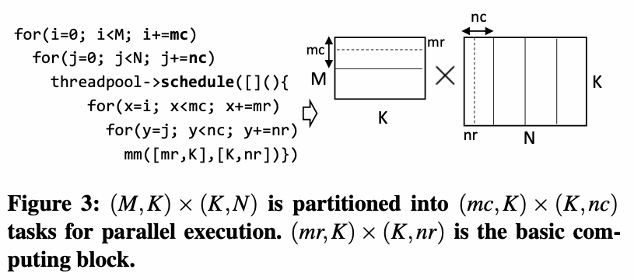
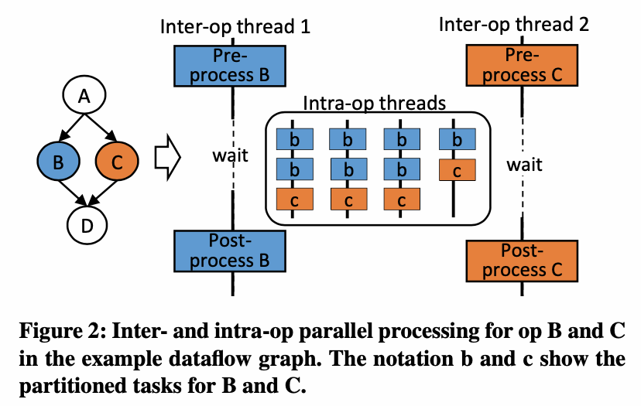
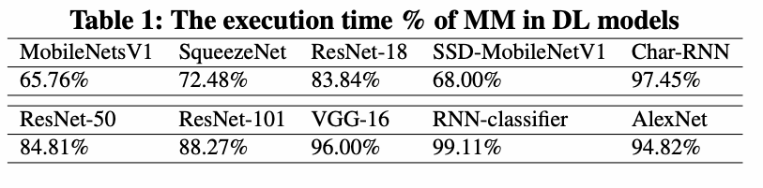
Background
MM partitioning
Parallelism in DL inference
大部分DL模型的执行开销在MM算子上，所以本文主要考虑对于MM的处理

Slide 4
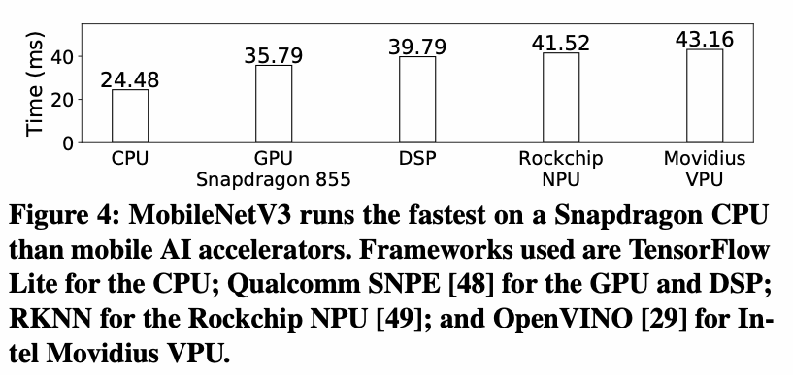
Background
为什么针对CPU做？
  CPUs are always available on every mobile/edge device, but AI accelerators are not.
  The ecosystem of AI accelerators is closed and immature.
  Specialized accelerators lack the flexibility to adapt novel DL algorithms, and thus may not always perform well.

Slide 5
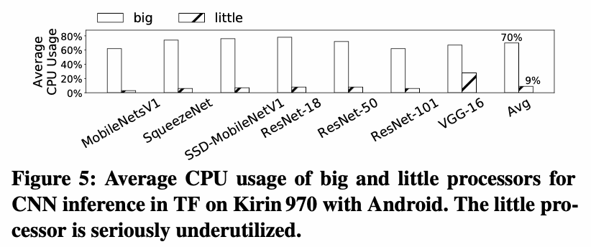
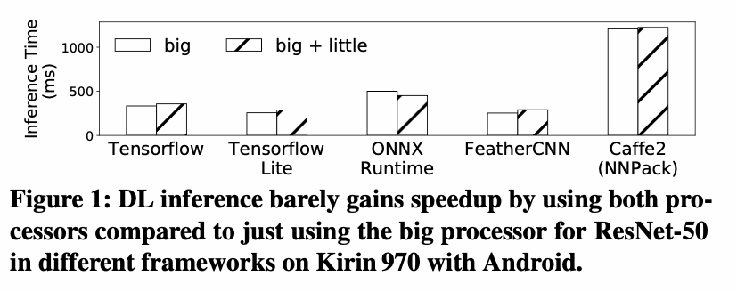
Motivation
Poor performance scalability on AMP(Asymmetric Multi-Processor)
  unbalance between big and little processors: The number of tasks executed on the little processor is much less than its capability.
  unbalance within a processor: the task distribution of an MM in VGG-16 is 90, 77, 94, 95 for the big-core processor, and 40, 36, 25, 33 for the little-core processor

Slide 6
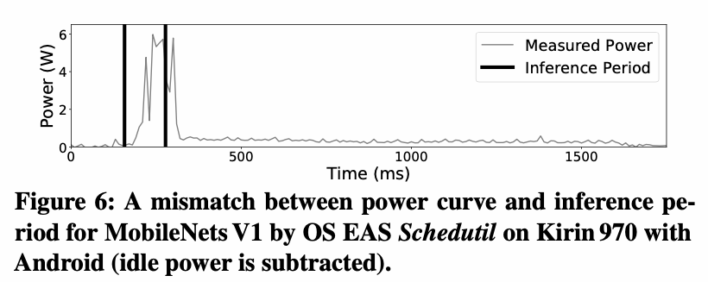
Motivation
DVFS(Dynamic Voltage and Frequency Scaling) mismatch
  a big mismatch between OS CPU frequency scaling and DL inference
    CPU power在inference开始后34ms才开始增加，在inference结束后25ms才开始降低
  AsyMo sets CPU frequency directly for DL inference to eliminate the extra energy cost and performance slowdown due to DVFS mismatch

Slide 7
AsyMo system design
The design of AsyMo is based on the unique characteristics:
  DL inference
    deterministic execution
    embarrassingly parallel tensor operation: The AsyMo just needs to balance the number of tasks on each core
    typical hardware behaviour characteristics: Conv is a typical computation-intensive workload while FC is memory-intensive
  mobile AMP CPUs
    asymmetric core capability: big and little core
    small caches
    separated caches: big and little core
    interference-prone environment: easily to be interfered by system services or other workloads

Slide 8
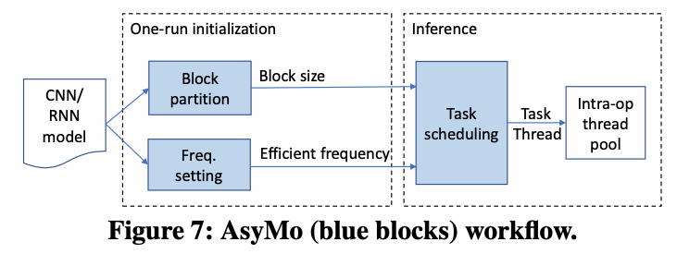
AsyMo system design
One-run initialization
  calculates the proper task size for every MM of the model on both big and little processors.
  find the least-energy frequency for the model
Inference
  the asymmetry-aware scheduler of AsyMo binds each intra-op thread to one CPU core, and schedules tasks fairly to each thread

Slide 9
Cost-model-directed block partitioning
Design guidelines
  interference-prone environment
  -> threads lagging (even with task stealing)
  -> task size should be minimized
  reducing task size may increase memory accesses
  -> task size should be maximized but remain within cache limitations

Slide 10
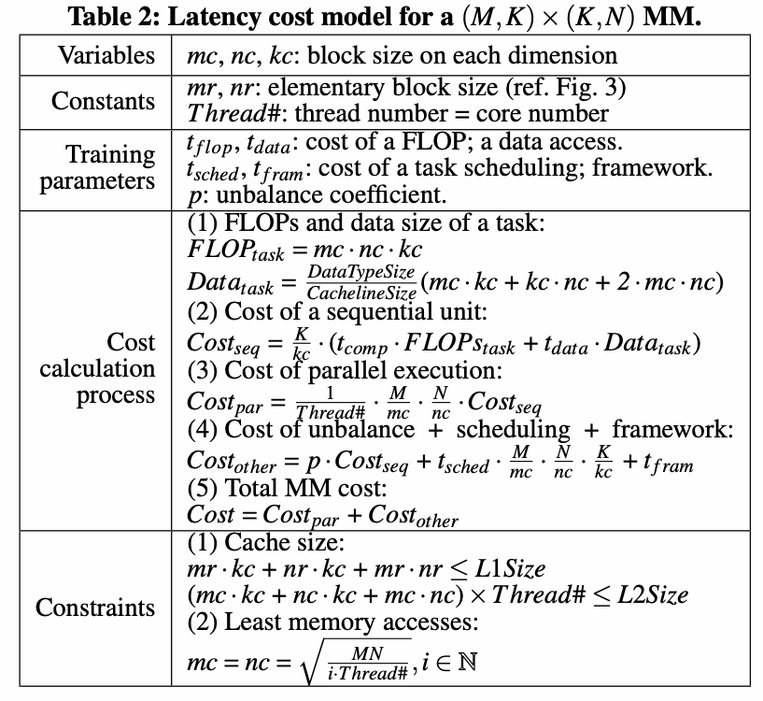

MM cost model
interference-prone environment:
  Step(4): The unbalance cost is the time that some threads wait for others to finish all their tasks. Thus, it is a multiple of sequential cost.
reduce memory accesses, two constraints:
  elementary compute block should reside in L1 cache
  reduce total memory accesses (Eq.1) of MM
    Since (M/mc)(N/nc) = i×Thread#,i ∈ N, i.e., the number of sequential units is a multiple of the number of threads, for a fixed i, the minimum value of Eq. (1) is achieved when mc = nc.

Slide 11
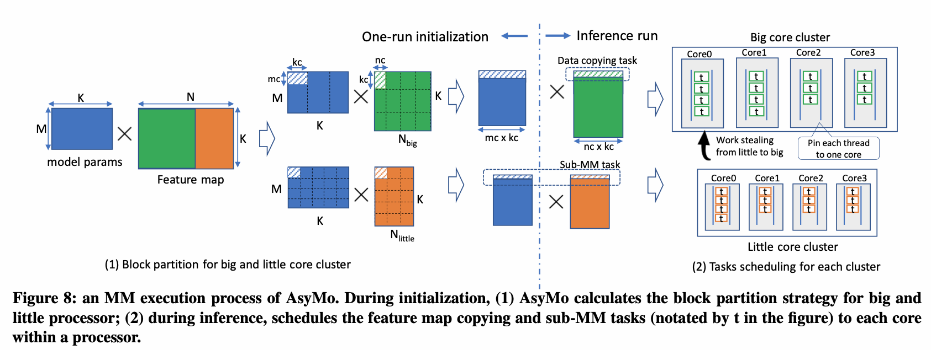
Partitioning for big and little processors
conducts processor-level partitioning by dividing the bigger matrix into two sub-matrices
  the proper block size is different on each processor
  the separation can avoid costly data transfer between the two processors
conducts core-level partitioning within each processor

Slide 12
Asymmetry-aware scheduling
Guidelines:
  balance the number of tasks on each core and processor
  avoid unnecessary data movement between processors
Scheduler:
  sets the intra-op thread pool equal to the core number, and uses OS thread affinity to bind each thread to a core
  schedules each task to the shortest thread queue in the corresponding processor
  work stealing: big core can steal task on a little core, the other way around is forbidden
    the block size of a big core can be too large for the cache of a little core
  schedules the data copying task and the corresponding compute task within the same processor, which can avoid the costly accesses to the remote cache.

Slide 13
Frequency setting for energy efficiency
offline profile energy curves over frequency for computation and memory-access benchmarks on target CPUs
find the least-energy frequency for MM and MV ops of a model by the corresponding cure
  MM is computation intensive and MV is memory intensive.

Slide 14
Cost model training and energy profiling
Cost model training
  The cost model only needs to be trained once for each CPU rather than each model.
  select 15 MM sizes and 20 MV sizes in the data set
    Each MM or MV also includes a range of block sizes. In total, there are 270 settings in the data set.
  AsyMo trains the cost model through linear regression and K-folder (K = 10) cross validation using scikit-learn package.
Profiling of energy-frequency curves
  offline profiles energy curves over frequency for computation and memory-access benchmarks on target CPUs
  This profiling only needs to be done once for each CPU.

Slide 15
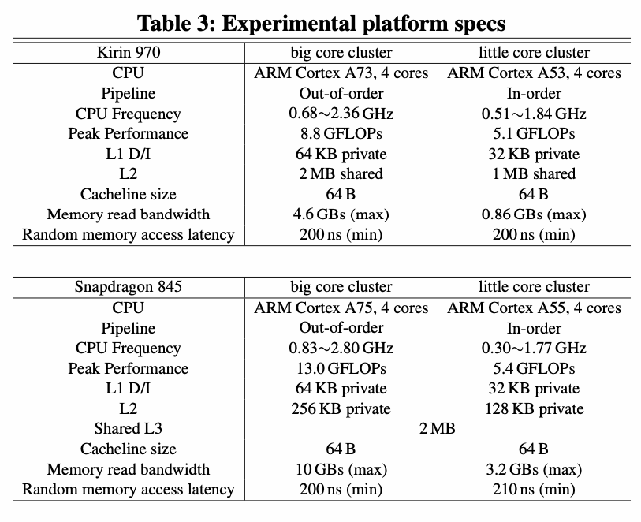
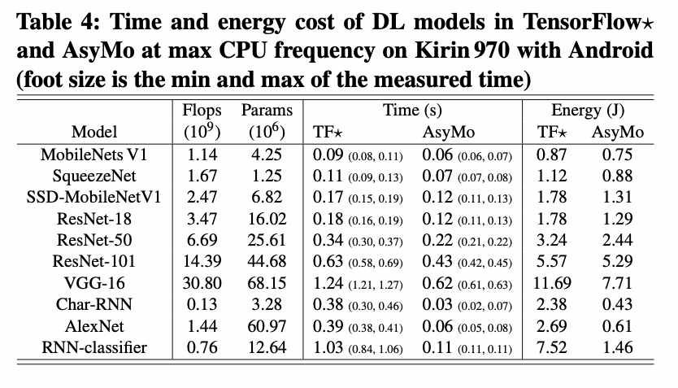
Evaluation
The average performance for Conv-dominant improves 48% by AsyMo, while energy efficiency increases by 22%.

Slide 16
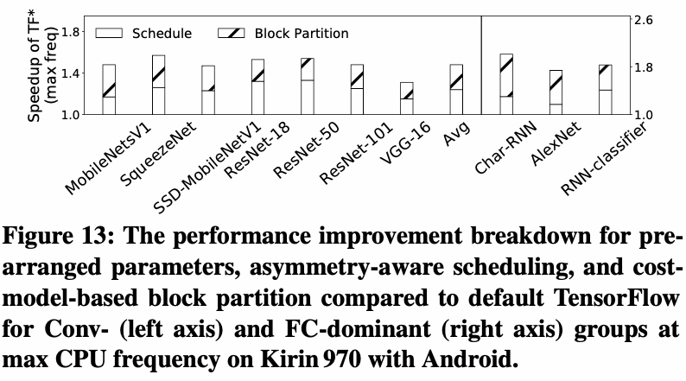
Evaluation
AsyMo scheduling improves performance by 24% for Conv- dominant models on average.
Block partition improves another 24% on average.

