Slide 1


Analytical cache modeling and tilesize optimization for tensor contractions
SC2019

Slide 2
Intro
Data movement between processor and memory hierarchy is a fundamental bottleneck that limits the performance of many applications on modern computer architectures
  improving data locality: tiling and loop permutation
  Challenge: selecting effective tile-sizes and loop permutations
This paper provides an analytical model based approach to multi-level tile size optimization and permutation selection for tensor contractions
Follow-up
  Analytical characterization and design space exploration for optimization of CNNs [ASPLOS 2021]

Slide 3
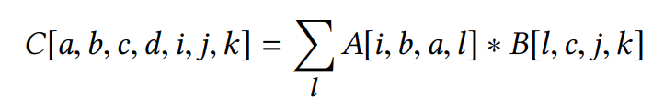
Tensor contraction
Example: two 4D tensors are contracted to produce a 6D tensor
  can be expressed as a 7-dimensional loop nest, with one loop for each of the indices {a,b,c,i,j,k,l}
all loops of an arbitrary tensor contraction are fully permutable and hence fully tileable with hyper-rectangular tiles
Notes:
张量缩约

Slide 4
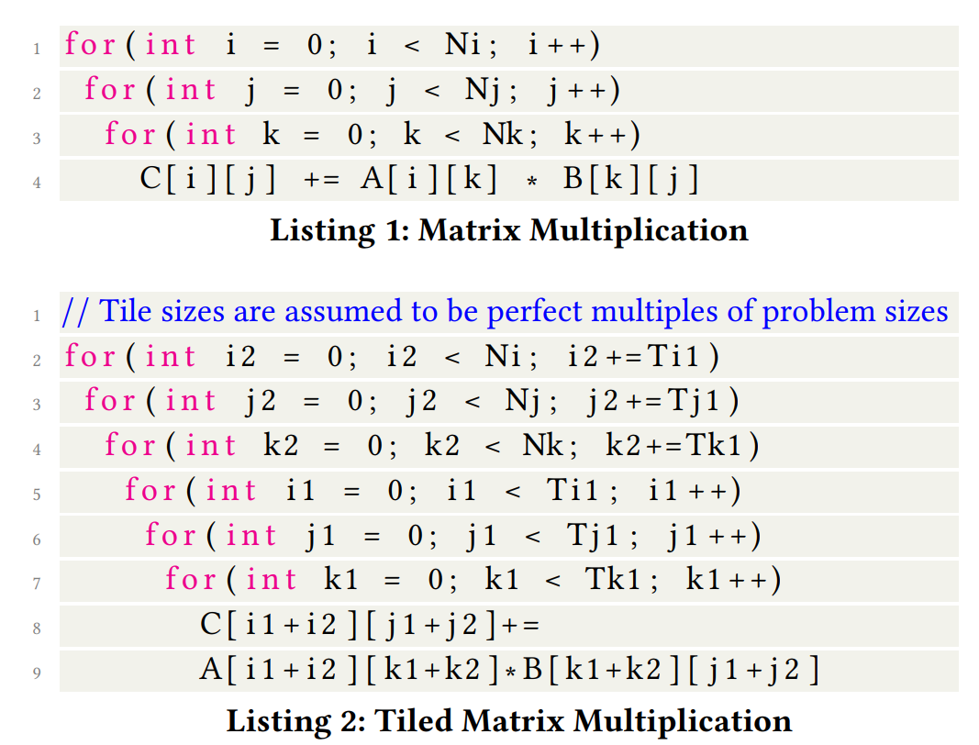
Zero/Full Inter-Tile Reuse
The innermost tiling loop is the one indexed by k2
  successive tiles along k2 would repeatedly access exactly the same slice of data for C, while completely distinct slices of data would be accessed by successive tiles for A and B
  Assuming that the combined data-footprint of a tile just fills the cache, we will have full inter-tile data reuse for elements of C, but no data reuse for A and B.

Slide 5
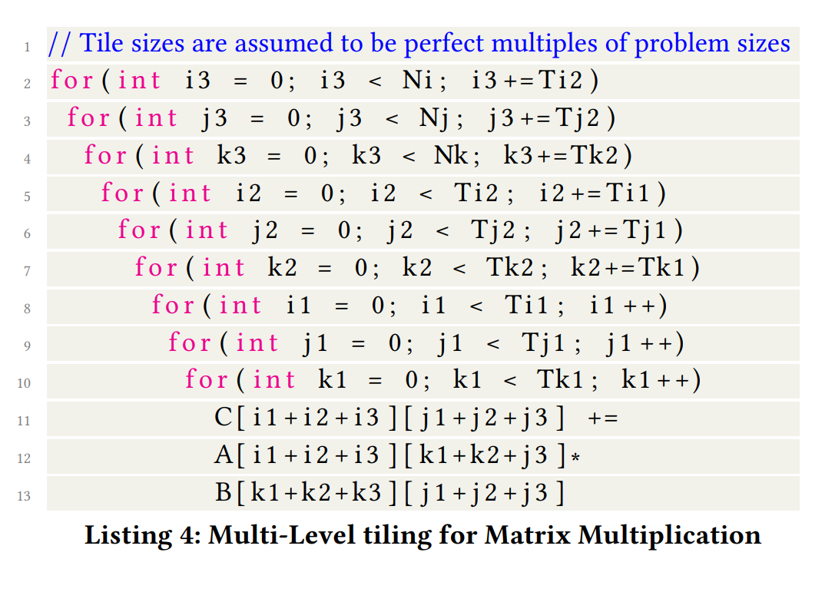
Only Innermost Tiling Loop Matters
multi-level cache hierarchy: multi-level tiling
  Tile sizes at each level: the data-footprint of a tile is close to the cache/scratchpad capacity but does not exceed it
huge space of permuted orders for the tiling loops
  7 tiling loops, 3 level cache: (7!)³ possible configurations
only the choice of the innermost tiling loop affects the total data volume
  As successive tiles of the innermost tiling loop are executed, the data for tensors not indexed by that loop stays invariant, while the data slices for other tensors will be completely disjoint from those used in the previous tiles
  Reduce from (7!)³ to (7)³

Slide 6
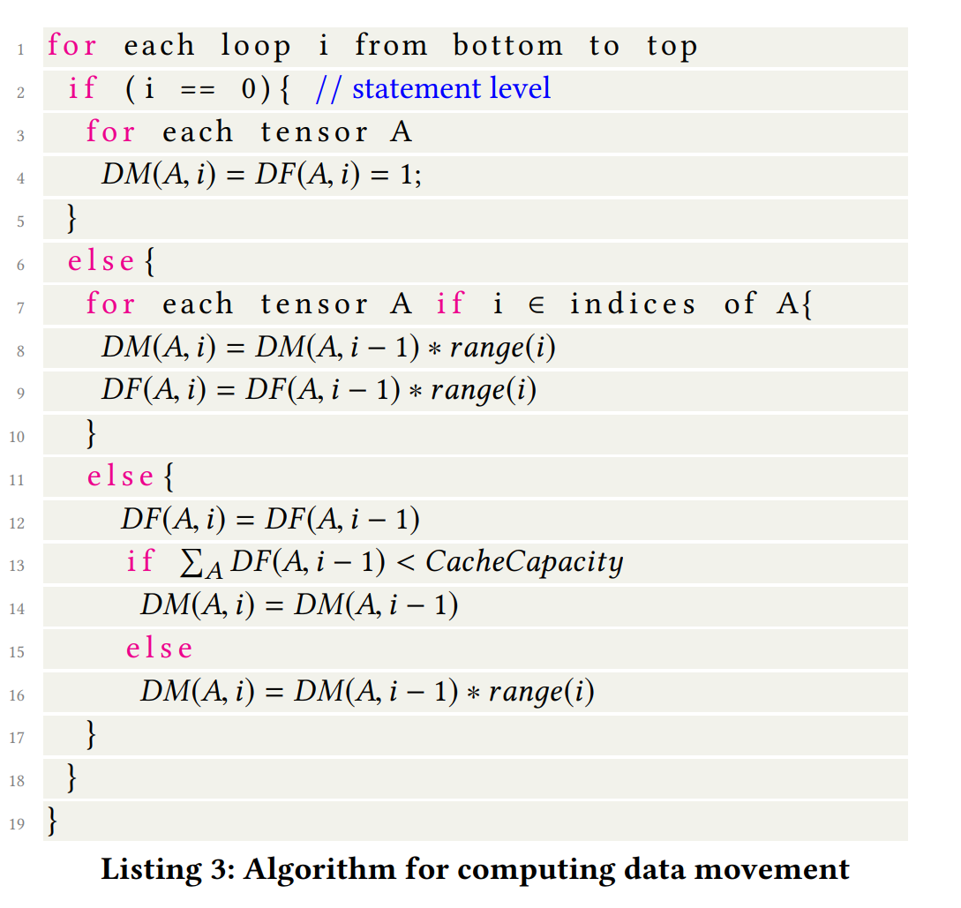
ANALYTICAL CACHE MODELING
Assumption: memory/cache bandwidth is the main performance bottleneck
  Memory/cache latency can be hidden using prefetching
DF(A, i)
  represent the data footprint of array A corresponding loop to i
DM(A,i)
  represent the data movement between cache and the main memory corresponding to array A at loop i
  Multi-Level cache modeling: DM(A, i, l)

Slide 7


ANALYTICAL CACHE MODELING
Predicting execution time based on data movement
  L: the number of cache levels
  C_{l}: the cache at level l
  BW_{l}: the maximum main-memory bandwidth of cache at level l
  C_DM(l): the volume of data transferred between C_{l} and C_{l−1}
  C_time(l): the time required to move C_DM(l) elements between C_{l} and C_{l−1}
  For a given loop permutation P,
  The predicted execution time is:

Slide 8
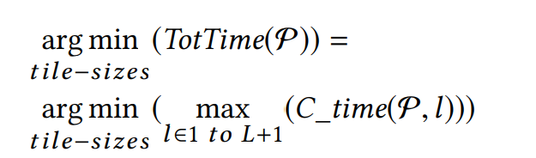
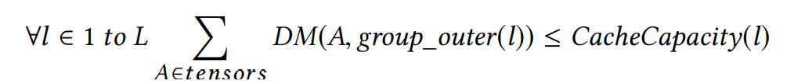
ANALYTICAL CACHE MODELING
Tile size and loop permutation selection
  objective: find the tile sizes such that minimizes the total execution time
  capacity constraint: the sum of data movement for all arrays at each cache level l (C_DM(l)) is constrained to be less than or equal to cache capacity at that level
    group_outer(l): outermost tiling loop corresponding to cache level l

Slide 9
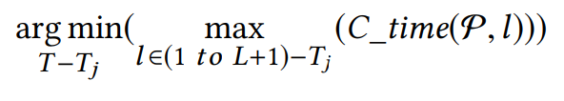
ANALYTICAL CACHE MODELING
Tile size and loop permutation selection
  Optimistic assumption: reducing the data movement cost corresponding to the most constrained cache level will achieve the best performance
    the tile-sizes of other cache levels may not be optimal
  T_{l} :set of tile sizes such that all tile sizes in T_{l} affect the data movement at cache level l (C_DM(l))
  j: the most constrained cache level
  next constrained cache level can be found using
    This processes can then be repeated for each level of cache

Slide 10
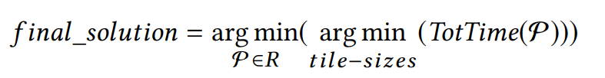
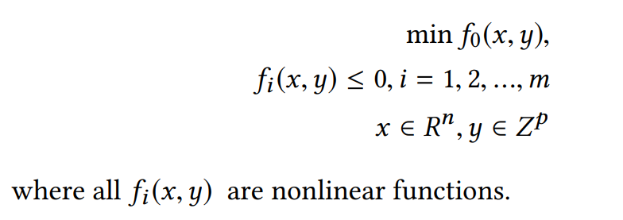
ANALYTICAL CACHE MODELING
Tile size and loop permutation selection
  compute the best permutation: iterate over all possible permutations and select the one with best-predicted execution time
    Because only innermost tiling loop matters and interleaving tiling loops corresponding to different cache levels are not beneficial, search space: (loop_num)^{cache_levels}
    Let R represent reduced search space. The final solution is given by
  Solver
    use a non-convex, nonlinear programming problem from Couenne, which is a branch and bound algorithm to solve Mixed-Integer Nonlinear Programming (MINLP) problems of the form

Slide 11
MICRO KERNEL
MICRO KERNEL: MAXIMIZE SIMD INSTRUCTION UTILIZATION
  achieve peak machine throughput: keep the functional unit busy
    sufficient Instruction Level Parallelism (ILP) is maintained
    the memory stalls are avoided/minimized by effectively using the cache
  Use BLIS micro-kernel, Github

Slide 12
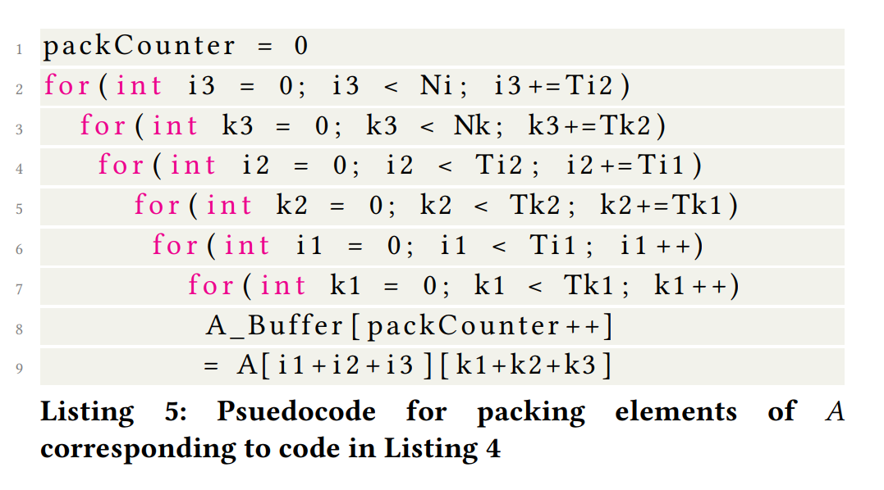
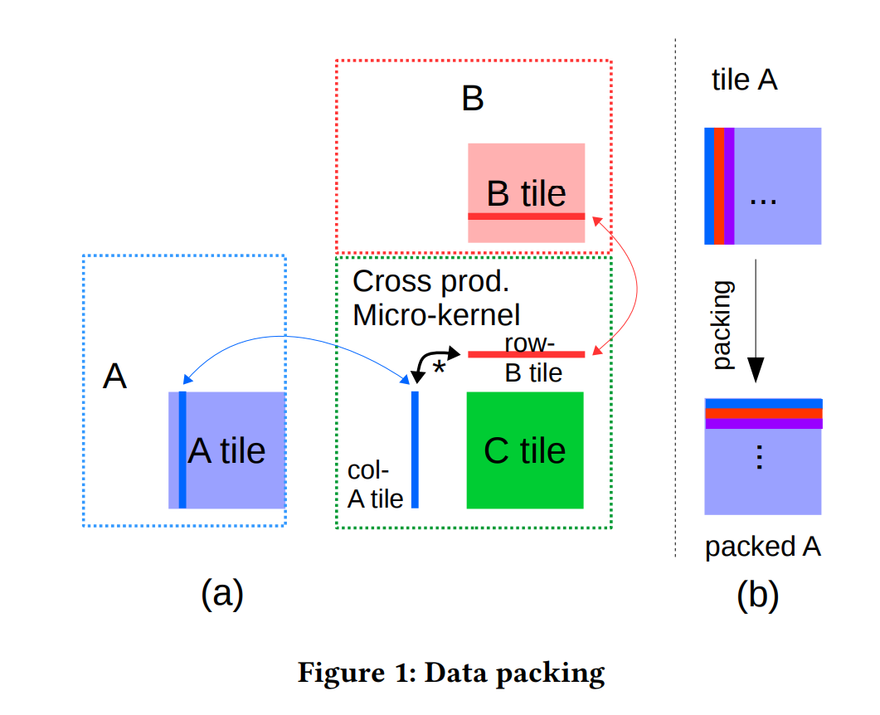
PACKING
A packing routine is a transformation that copies a tile of a tensor into a contiguous buffer
  Efficient use of SIMD instructions requires that the input data is stored contiguously in memory in the order that is accessed by the microkernel
    vector loads, reduce TLB misses

Slide 13
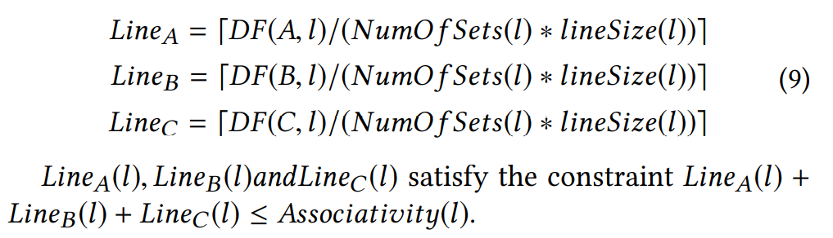
PACKING
Reducing Conflict Misses
  Typical caches in modern architecture are set-associative. （组间直接映射，组内全相联映射）
    a memory access can produce conflict misses, where a line in cache is swapped out and replaced even if that line was not the Least Recently Used (LRU) element (same set)
  the packed buffers are distributed along all the sets in the cache
    packed buffers occupy contiguous regions of memory
  Since most caches are not programmable, loading elements of one tensor could evict elements of other tensors.
    In order to prevent this the number of cache lines each tensor occupies is carefully controlled

Slide 14
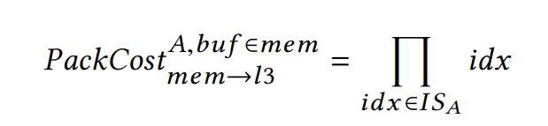
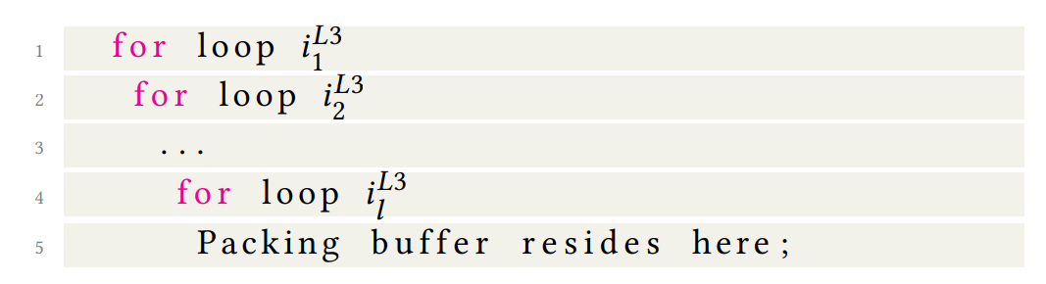
Packing Data Movement Model
The packing routine adds additional data movement and computations which could increase the time cost.
  Assume that A is the only tensor that needs to be packed and packing is done at the last level of cache (ll)
  IS: the iteration space (the set of all loops); IS_{A}: a subset of IS which contains all indices used to access A.

Slide 15
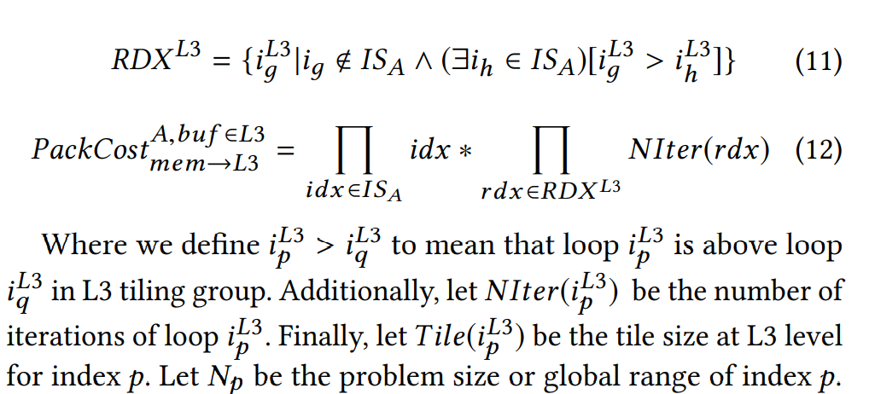
Packing Data Movement Model
If a buffer for packing A is created at L3 level then we have the following
  Assume i2 is a reuse index for A.
    Note that the A packing buffer must be filled at each iteration of loop i2, even if i2 is a reuse index for A

Slide 16
EXPERIMENTS
Platforms
  an Intel Core i7-6700K dual socket 28-core Broadwell processor and an Intel Xeon CPU E5-2680 v4 single socket quad core Skylake processor
two tensor contraction libraries
  TBLIS
  TCL: use either the Intel MKL library or BLIS for GEMM
TCCG benchmarks

Slide 17
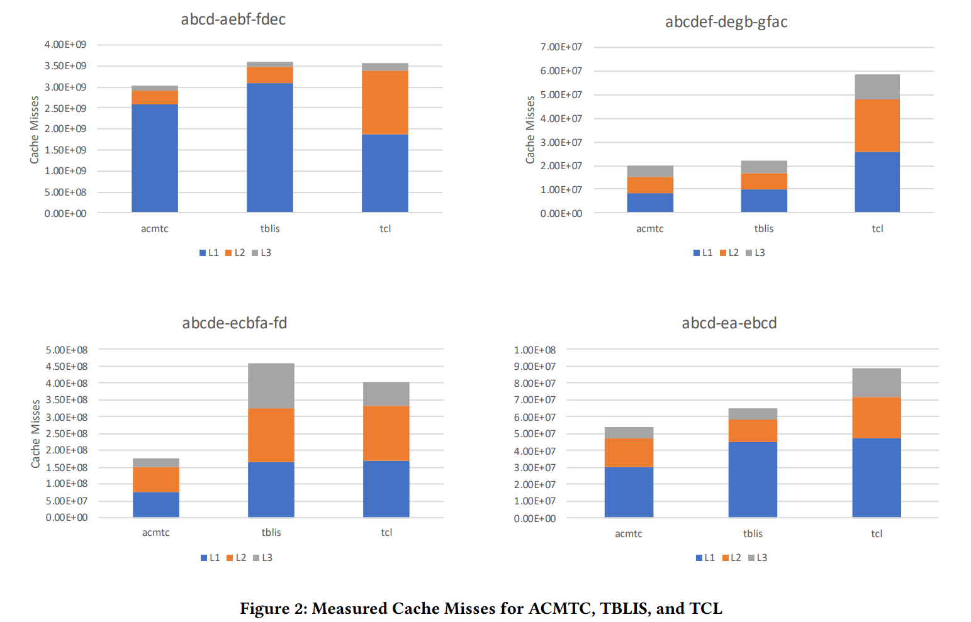
EXPERIMENTS

Slide 18
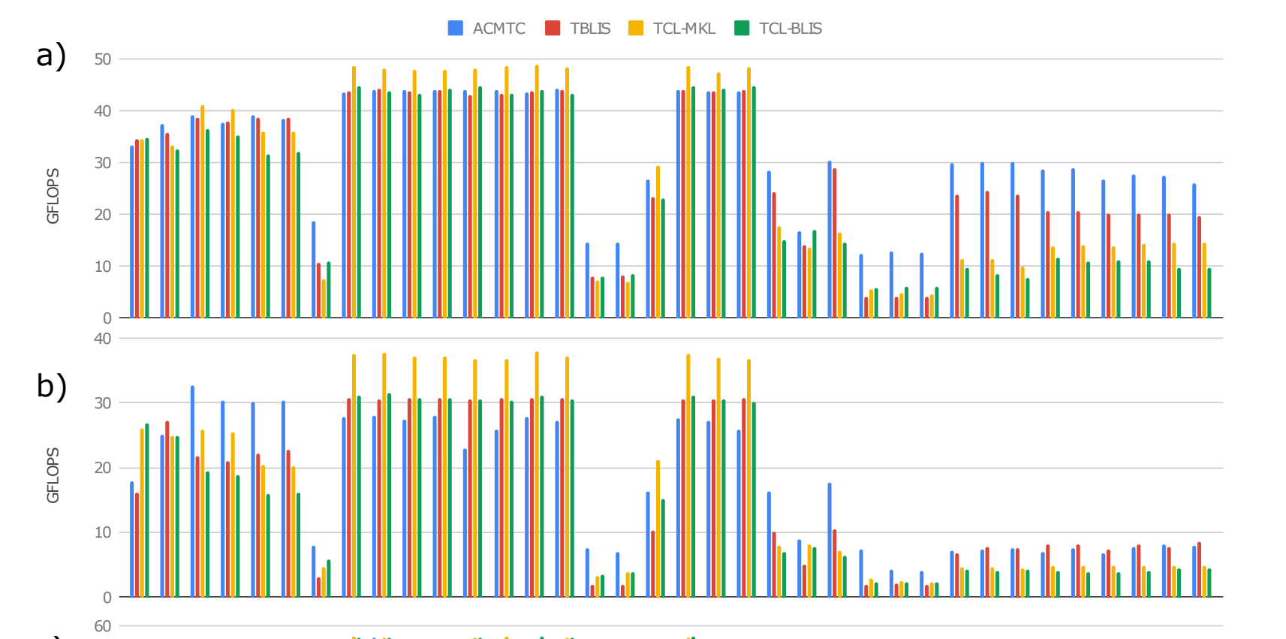
EXPERIMENTS
the geometric mean of the speedup is 1.25x versus TBLIS, 1.41x versus TCL-MKL, and 1.51x versus TCL-TBLIS.

Slide 19
谢谢！敬请批评指正！
黄奕桐
hyt@mail.ustc.edu.cn
中国科学技术大学 计算机学院

