Slide 1
CHAMELEON: ADAPTIVE CODE OPTIMIZATION FOR
EXPEDITED DEEP NEURAL NETWORK COMPILATION
Byung Hoon Ahn1 , Prannoy Pilligundla1 ,
Amir Yazdanbakhsh2 , Hadi Esmaeilzadeh1
1 University of California, San Diego
2 Google Research
ICLR 2020

Slide 2
Motivation
Stochastic optimization passes
  TVM, Tensor Comprehension, STOKE
  Not only too time consuming but also suboptimal
  the optimizing compilation time can be around 10 hours for ResNet-18
Oblivious to the patterns in the design space of schedules
  Inefficient search or even converges to suboptimal solutions
Greedy sampling neglects the distribution of the candidate solutions
  Significant of redundant candidate configurations iterated
  Prone to invalid configurations which prolongs the optimization time

Slide 3
Contribution
Chameleon
  Adaptive Exploration module
  Adaptive Sampling algorithm
Project page
  https://bitbucket.org/act-lab/chameleon

Slide 4
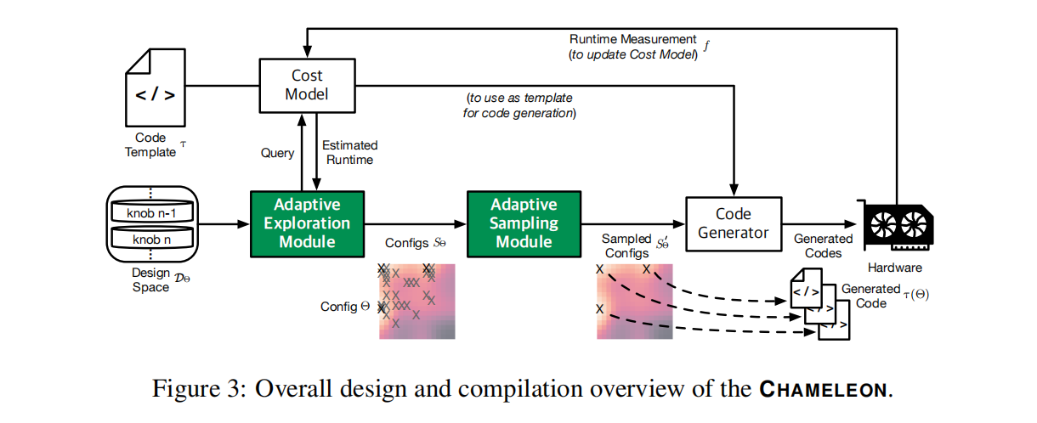
Overall Design

Slide 5
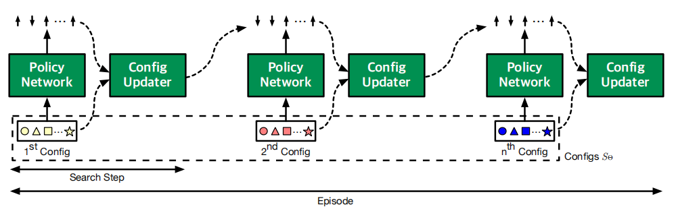
Adaptive Exploration
actor-critic style RL model
Begins with a set of initial configurations
Takes multiple search steps (episode) for each of the configurations.
Update agent with rewards fed back with cost model

Slide 6
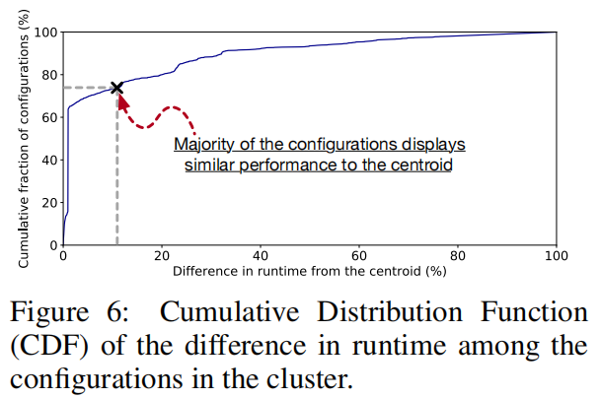
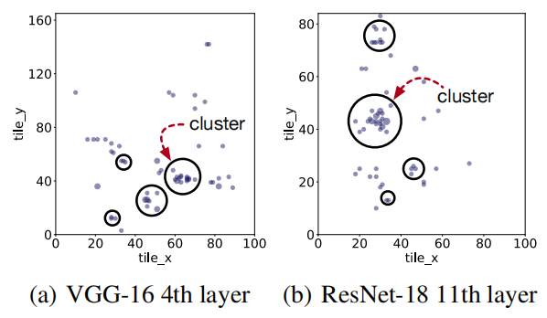
Adaptive Sampling
The candidate configurations are clustered in subregions of the design space
While the design space’s surface is discrete and un-smooth, a large fraction of configurations within each cluster achieve similar runtime

Slide 7
Adaptive Sampling
Cluster the candidate configurations
Select the centroid of each cluster as the representative
Trade off on the number of clusters
  More centroids for better performance
  Fewer centroids for a reduced number of hardware measurements.

Slide 8
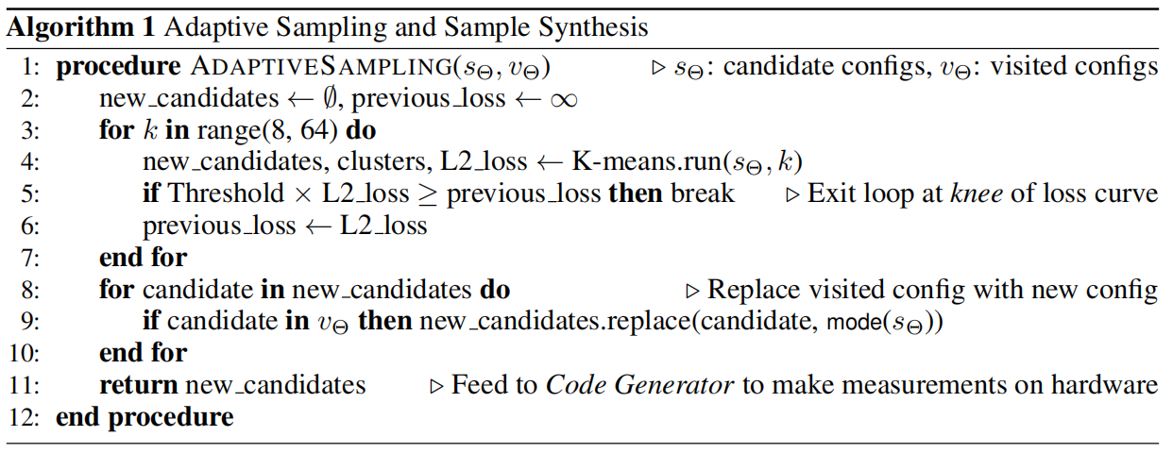
Adaptive Sampling

Slide 9
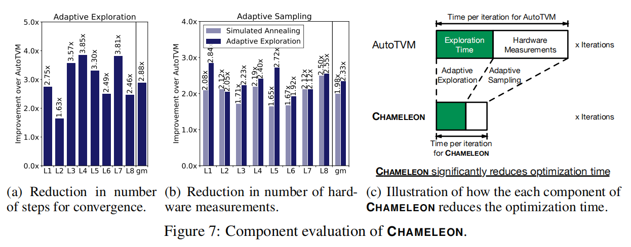
Evaluation

Slide 10
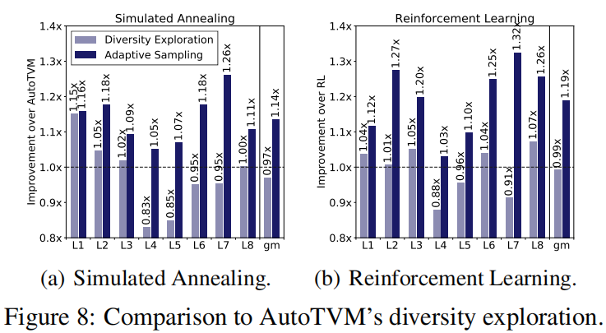
Evaluation

Slide 11
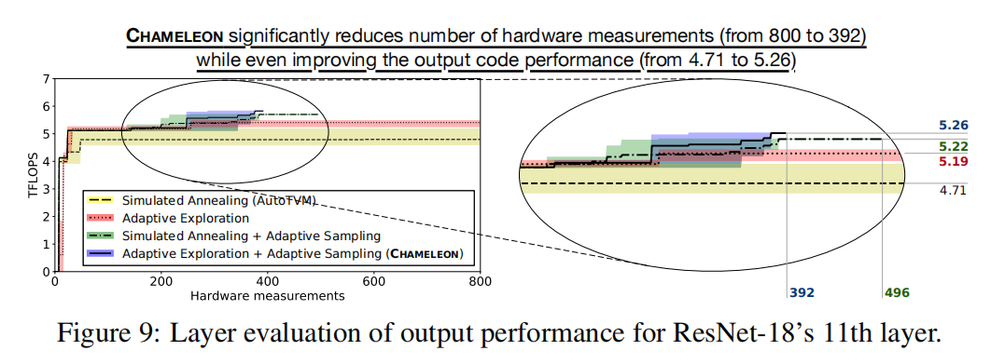
Evaluation

Slide 12
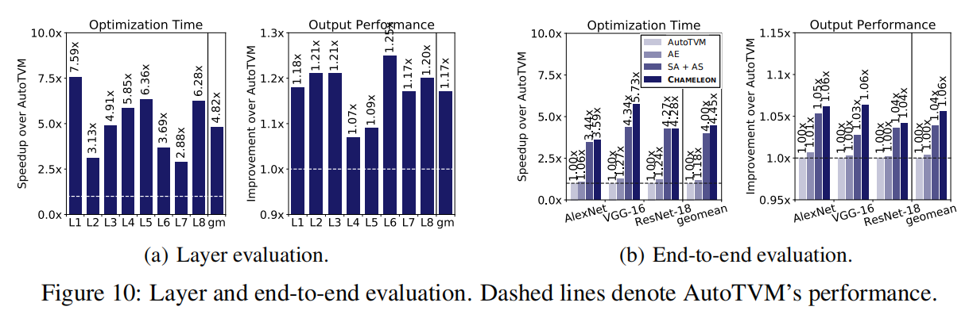
Evaluation

Slide 13
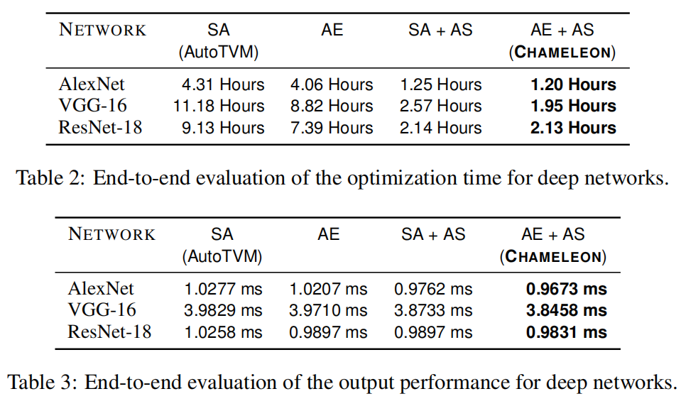
Evaluation

