Slide 1

Efficient GPU Memory Management for Nonlinear DNNs
HPDC 2020

Slide 2
Introduction
As the networks going wider and deeper, the limited GPU memory becomes a significant bottleneck, restricting the size of networks to be trained.
  Inception-V4 requests up to 45GB memory to keep the entire network on the GPU in training
  the largest GPU memory capacity offered by the commercial NVIDIA Volta architecture so far is 32GB
vDNN and SuperNeurons offload data of one network layer when it is not required in the near future and can be released from GPU DRAM, saving space for other layers
  offloading data structures from the GPU to CPU or prefetching data back to GPU from CPU layer by layer brings significant inefficiency
  none of the existing work presents an efficient solution to handle the memory fragmentation problem for nonlinear networks

Slide 3
Contributions
empirically study and demonstrate the inefficiency of memory swapping and memory allocation solutions in existing works
present a memory-efficient graph analysis to construct an execution order for nonlinear networks and propose a dynamic offload/prefetch strategy to maximize the perfor- mance and usage of bandwidth
design the first unified memory pool for nonlinear networks and propose a Group Tensors By Mobility (GTBM) placement policy to conserve contiguity for different tensors based on the newly defined tensor mobility
implement Dymem to evaluate various nonlinear DNNs and perform comprehensive evaluations with various depths. It achieves memory cost reduction by up to 31% and improves the end-to-end throughput for nonlinear networks by up to 42%.

Slide 4
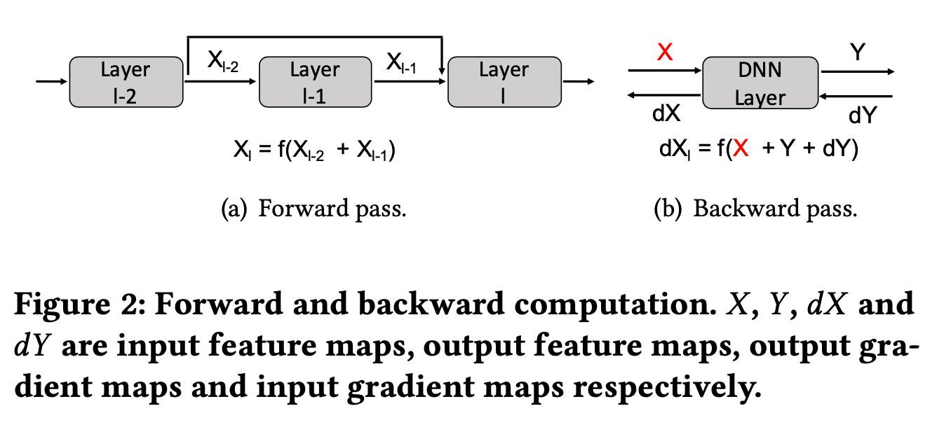
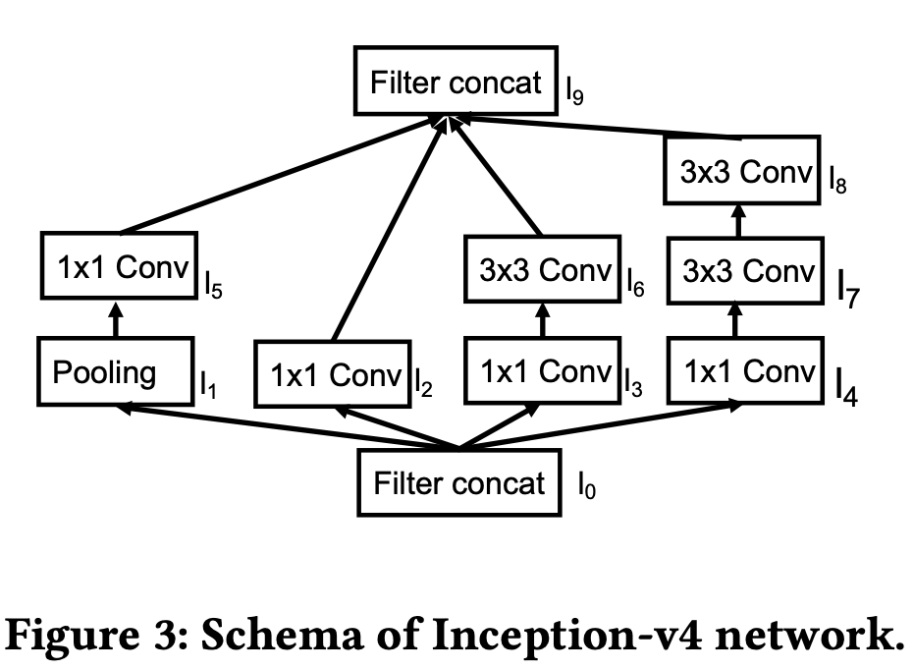
BACKGROUND AND MOTIVATION
DNNs Training on GPUs
Nonlinearities in DNNs
  nonlin- ear connections: fan and join

Slide 5
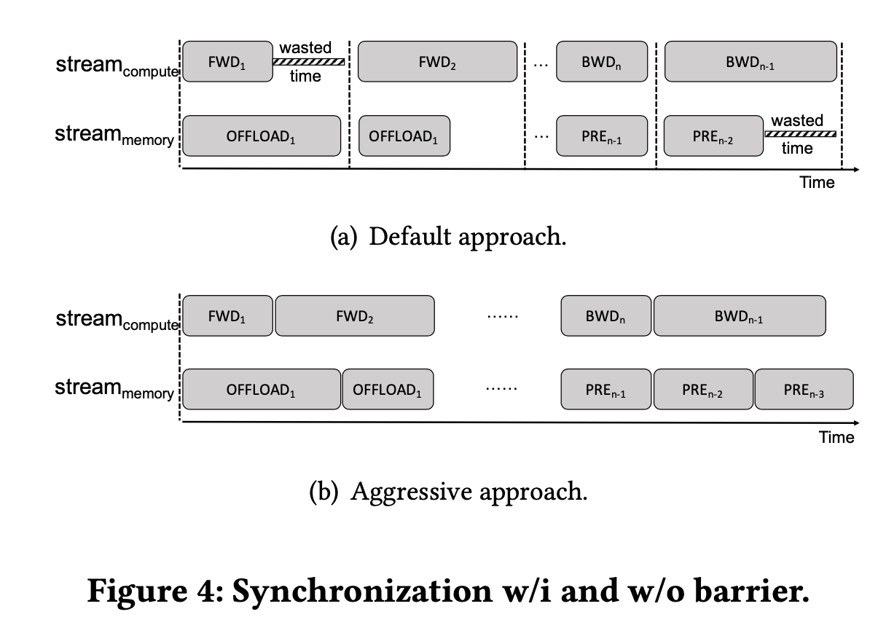
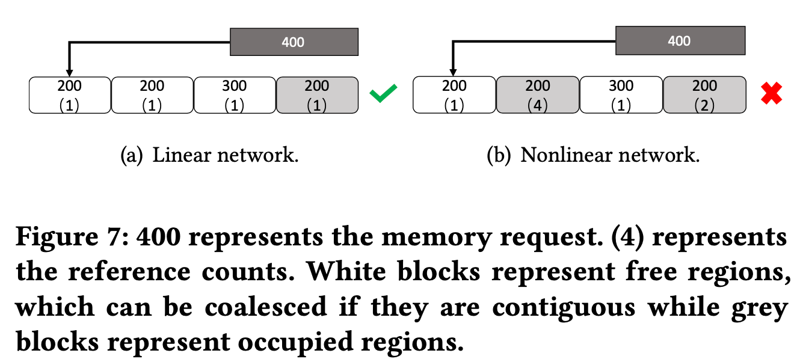
Motivation for Efficient GPU Memory Management
vDNN and Superneurons choose to offload selected layers to the preallocated pinned CPU memory and prefetch these data back to GPU when required
  To ensure the safety of parallel streams, they enforce a synchronization at the end of each layer, which means the communication and computation stream cannot advance each other in both the backward and forward passes

Slide 6
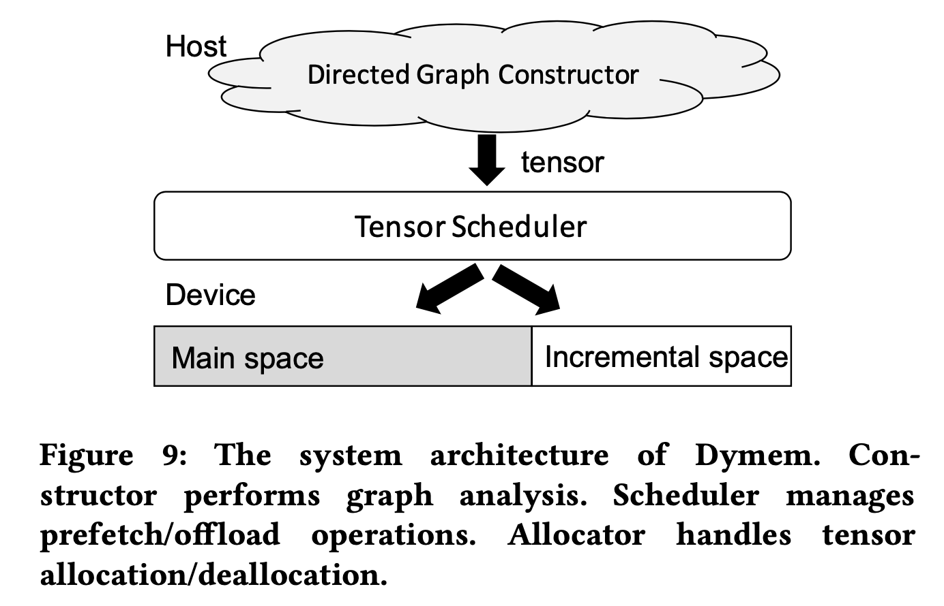
SYSTEM DESIGN AND IMPLEMENTATION
dynamic memory manager (Dymem)
  automatically manage the memory usage of DNNs while minimizing the overhead and maximizing the reduction of memory load

Slide 7
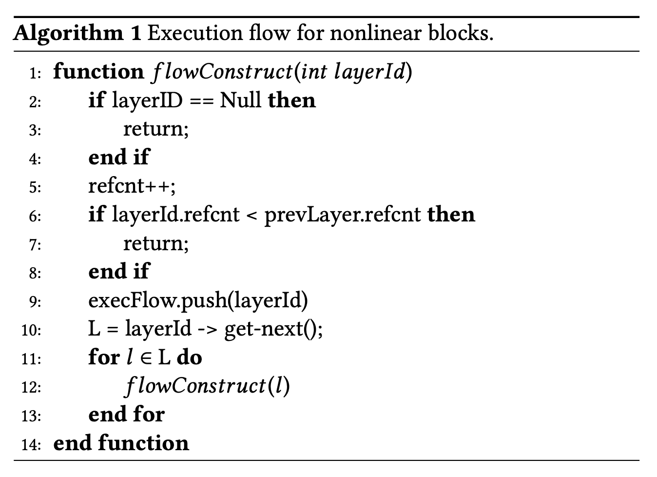
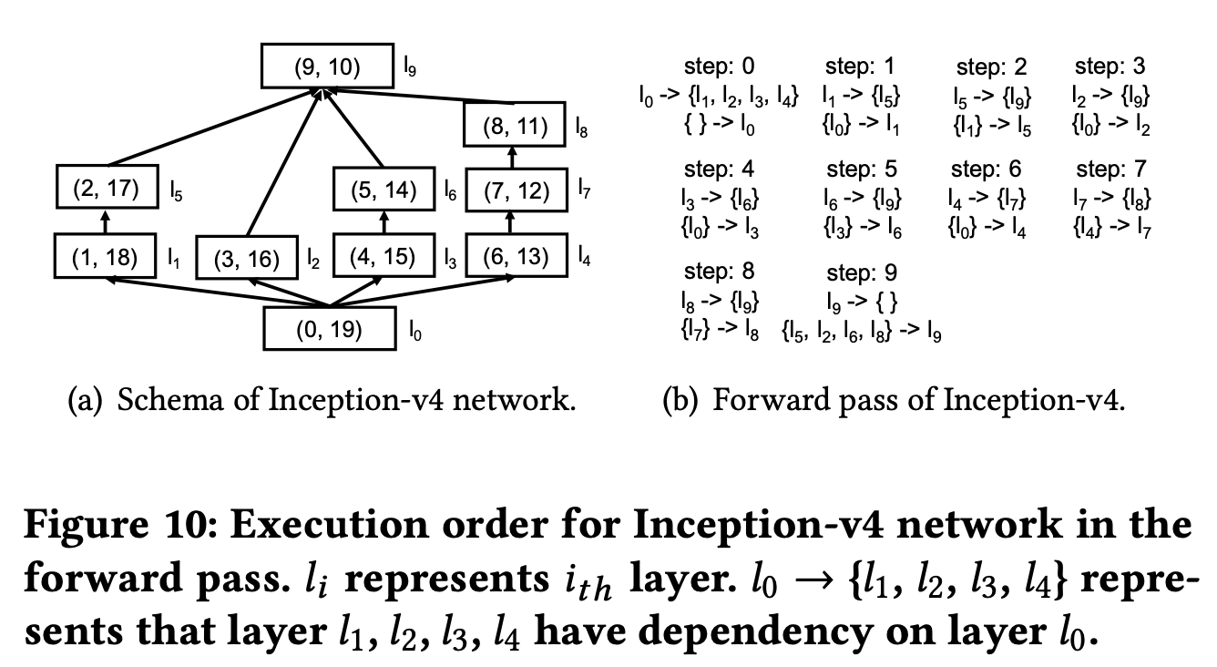
Execution Graph Construction
Depth-First-Search (DFS) algorithm is used to decide the execution sequences for nonlinear dependencies
  DFS requires less memory space to reach the join connection node in the nonlinear blocks when exploring the traversal path.

Slide 8
Dependency Aware Memory Offloading and Prefetching
employ two separate cudaStreams to transfer tensors in/out of external memory asynchronously
  stream_{compute} sequences all the computations in the forward and backward pass
  stream_{memory} is responsible for the tensor placement, movement, allocation, and deallocation
Offload
  During forward propagation, if layer_{n} is available for offloading, stream_{memory} can asynchronously swap feature maps from this layer via non-blocking memory transfer
  As for stream_{compute} , layer_{n}’s computation can be started as soon as layer_{n−1}’s computation is completed without waiting the completion of the offload operation of layer_{n−1}.

Slide 9
Dependency Aware Memory Offloading and Prefetching
Memory Prefetch
  In the backward pass, prefetching the offloaded input feature maps back to GPU can be overlapped with the computation of backward propagation using cudaMemcpyAsync () as well.

Slide 10
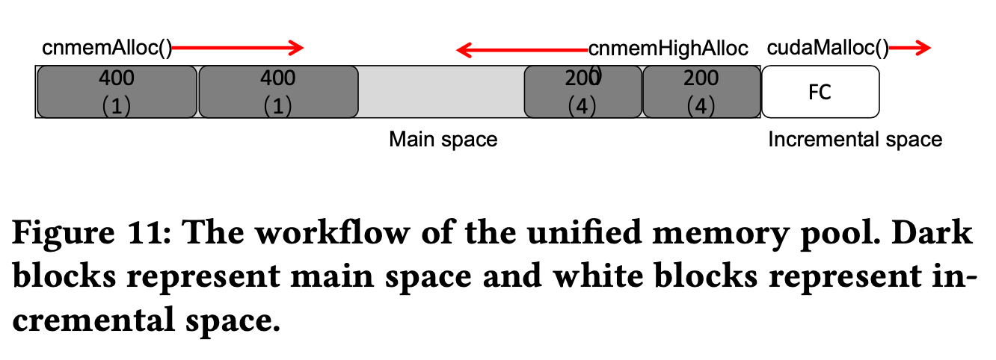
Contiguity-conserving Memory Management
Group Tensors By Mobility(GTBM)
  Movable tensors: tensors with one reference count
    Allocate from the low-end available address; it only resides on the GPU for one step and then will be offloaded to the CPU memory
  Temporary tensors: known to exist for a very short period of time, such as fork connections or tensors waiting to be joined
    starting from the high-end available address; the tensors that have higher reference counts are always allocated before the ones with lower references
  Reclaimed tensors: tensors from layers that are not selected for offloading
    incremental space

Slide 11
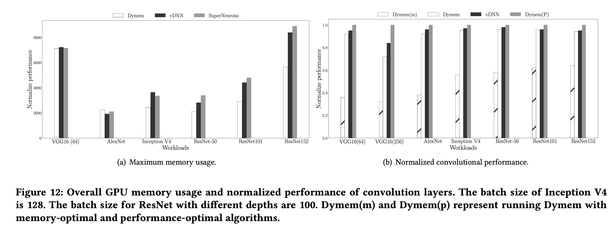
EVALUATION
GeForce GTX TITAN X with 12 GB GPU memory
  a dynamic strategy: The runtime will profile the available memory space when it enters a new layer and increment the amount of GPU memory for workspace (CONV) in a fine-grained granularity

