Slide 1
The Meaning of Multi-Language Programs
Jacob Burton Matthews
Doctoral Dissertation, 2007
The University of Chicago

Slide 2
Introduction
Q: How can we reason formally about multi-language programs?
  How can we show that the embeddings respect their constituents’ type systems?
  How can we mesh two languages with different type systems?
  How can we mesh two languages with different evaluation strategies?
  How does the expressive power of a multi-language system relate to the expressive power of the individual languages it comprises?
  How can we design a multi-language system so that the reasoning we perform on its constituents is still valid when we combine them?
A: A formal framework for examining multi-language systems.

Slide 3
Outline
Background: different multi-language systems
Give operational semantics to multi-language systems [1]
  Simple typed/Untyped lambda calculus
  Call by value
Enrich type system with parametric polymorphism [2]
Support different evaluation strategies [3]
Application: a DSEL design [4]
[1] POPL, 2007, Operational Semantics for Multi-Language Programs
[2] ESOP, 2008, Parametric polymorphism through run-time sealing
[3] Technical Report of UChicago, 2008, Equation-preserving multilanguage systems
[4] MIT Press, 2008, Reduction Semantics and Redex

Slide 4
Background
Guiding principle that gets two languages to work together
  Both language establish some common base for data exchange and control-flow (e.g., a particular assembly language calling convention)
  Each language independently maps that common base into more appropriate language-specific construct.

Slide 5
Background: Different ways to make that principle concrete
The protocol-based approach
  Features
    A network protocol (RPC) for exchanging data and flow control
    Each party to a communication maintains its own data structures
  Examples
    CORBA, COM: IDL-based
    PolySPINner, Mockingbird: seamless by pairing data definitions
    Grechanik2004: present a foreign object as a reflected object
  Strengths
    Widely different languages interoperate easily
  Weaknesses
    Harder to monitor global invariants (e.g., garbage-collection algorithm)
    Marshalling, communication, and unmarshalling are quite expensive

Slide 6
Background: Different ways to make that principle concrete
The foreign interface approach
  Features
    Host mimics foreigner’s calling conventions in compiled code, and a linker combines separately-compiled host and foreigner modules together
    On the same machine, in the same address space
  Examples
    FORTRAN II, SML, Haskell, OCaml, JNI
  Problems
    Choose good representations for values (e.g., SML real array → C double[], exactly the same bits, freely exchange values with these types without any conversion)
    Mediate between incompatible assumptions (e.g., memory management, [OurWorkSANER2020])
    Writing low-level conversions by hand is mechanical
      IDL-based: FI is designed to reuse, not to interoperate
      C/C++ header files as IDL [SWIG]
      Write glue code in host
      Verify certain safety properties of glue code [Furr2005, Furr2006, OurWorkISSRE2021]

Slide 7
Background: Different ways to make that principle concrete
The common runtime approach
  Features
    Each language’s runtime sits atop the same commonly shared higher-level runtime core (providing garbage collection, networking, and threads and their associated locking mechanisms)
  Examples
    .NET CLR, JVM
  Problems
    Intermediate representations that support interoperation effectively and safely [Shao FLINT]
  Strengths
    Standardize system-level services, each language need not be conscious of low-level details of making a shared address space work
  Weaknesses
    The common core must make assumptions about the services its clients will want (e.g., share the same garbage collector)

Slide 8
Background: Different ways to make that principle concrete
The embedded language approach
  Features
    A special case of the common runtime approach
    Foreigner is compiled directly into host, two languages will commingle types, values and control
  Examples
    Source to source translation
  Strengths
    Values are easy to expose to each other
  Weaknesses
    Scale: require to write a new compiler
    Asymmetric: some features of foreigner are missing

Slide 9
Background: Different ways to make that principle concrete
The domain-specific embedded languages [DSEL, Hudak]
  Features
    A offshoot of the embedded language approach
    Embed a domain-specific language into a general-purpose language
  Examples
    Macros represented embedded languages in Lisp
  Strengths
    Actually insert foreigner into host and interoperate directly
    Existing program analysis tools work as well “for free”
  Weaknesses
    Limited realm of application

Slide 10
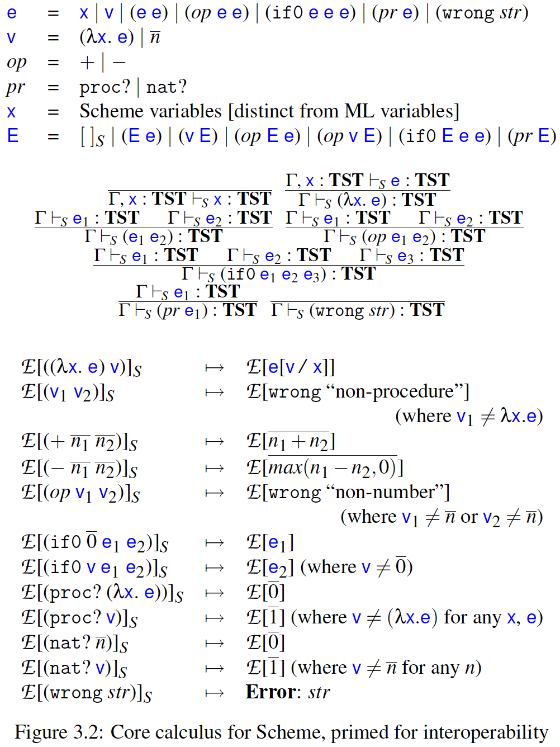
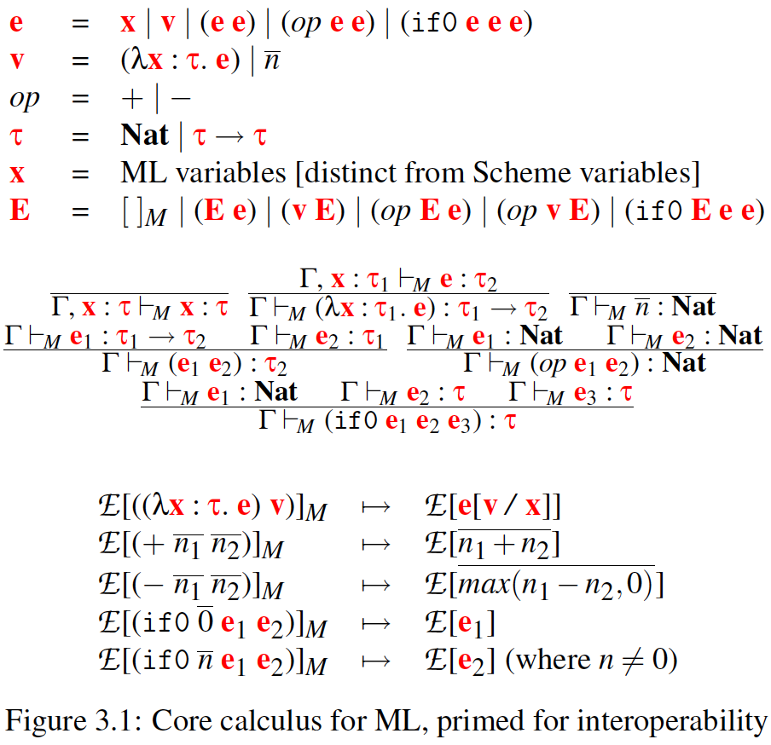
Multi-Language Systems
Boundaries: regulate both control flow and value conversion between languages
  Host
    ML: Simple-typed lambda calculus
  Foreign
    Scheme: untyped call-by-value lambda calculus

Slide 11


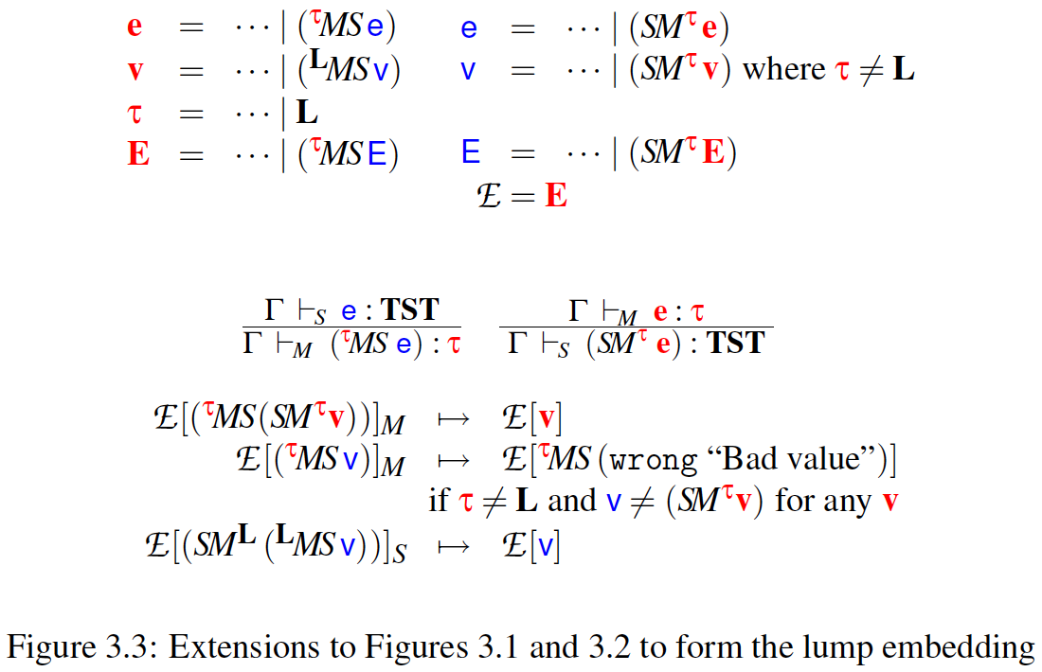
The Lump Embedding
A language sees another language’s values as opaque lumps that cannot be used directly, only returned
  Syntax
    MS boundary (ML-outside, Scheme-inside, Scheme → ML)
    SM boundary
  Typing rules
    Type L
  Evaluation contexts
  Reduction rules

Slide 12
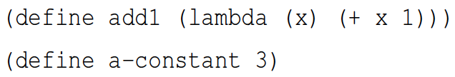
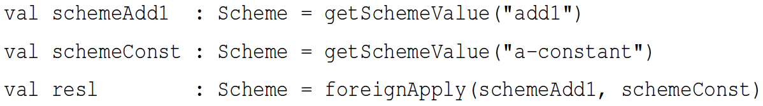
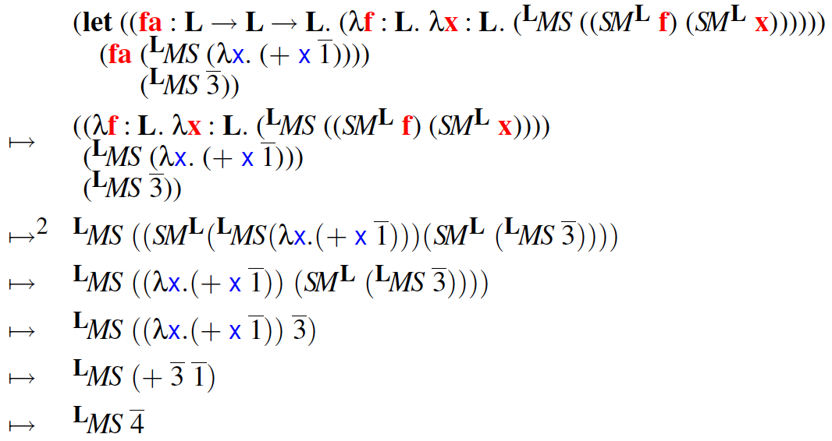
The Lump Embedding
An example
  Scheme
  ML
  Reduction steps

Slide 13
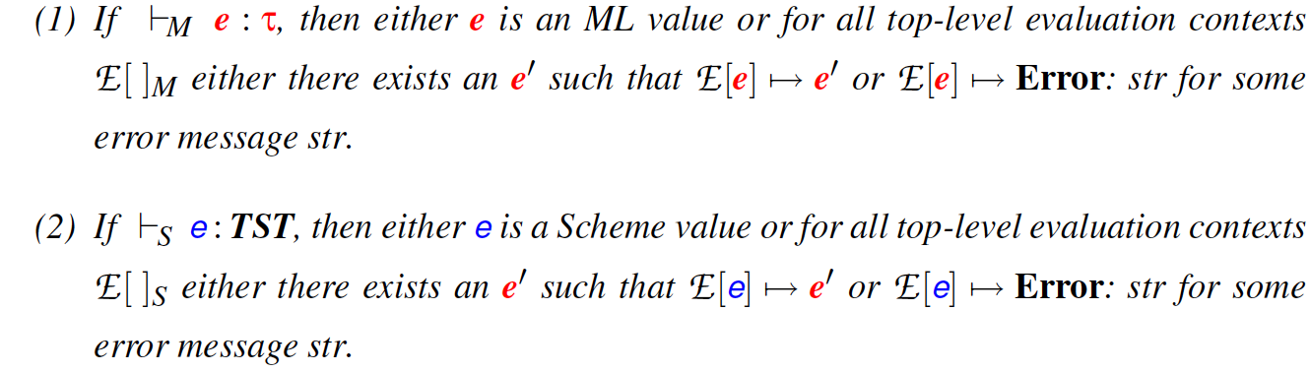
The Lump Embedding
Type soundness
  Preservation
  Progress
  Entail that both languages are type-sound with respect to their own type system s

Slide 14
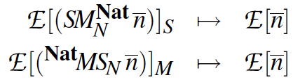






The Natural Embedding
Lump + type-directed strategies for conversions
  Reduction rules for boundary-crossing numbers
  Reduction rules for boundary-crossing procedures (no equivalent, )
  Reduction rules for boundary-crossing error transitions
    We cannot know if a Scheme function always produces a value
    that can be converted to the appropriate type.
Host (ML): $τ_{1}^{M}→τ_{2}^{M}$
$${SM}_{N}^{τ_{1}^{M}}$$
$$τ_{2}^{M}{MS}_{N}$$
Foreign (Scheme): $τ_{1}^{S}→τ_{2}^{S}$

Slide 15


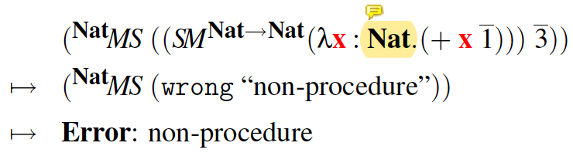
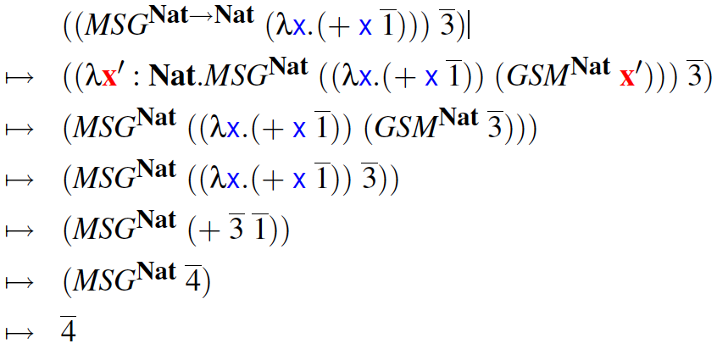
The Natural Embedding
The Simple Natural Embedding
  Guarded boundary: →
    Detect concrete, first-order witnesses to an invalid type ascription
  Lump embedding
  Natural embedding

Slide 16


The Natural Embedding
The Simple Natural Embedding
  Guard + boundary: →
    Contract

Slide 17

Thanks, Q&A
Mingzhe Hu
University of Science and Technology of China
School of Cyberspace Security
https://www.mingzhehu.cn
hmz18@mail.ustc.edu.cn

