Slide 1
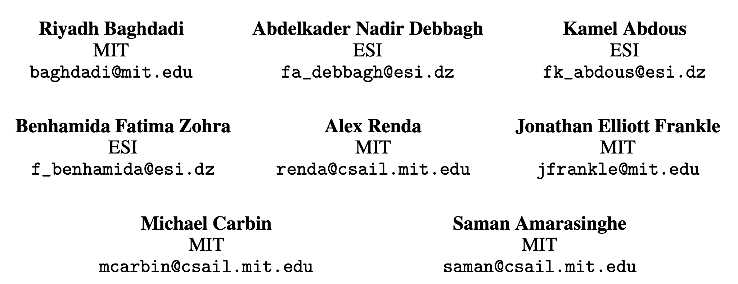
TIRAMISU: A Polyhedral Compiler for Dense and Sparse Deep Learning
NIPS2019

Slide 2
homepage: http://tiramisu-compiler.org A polyhedral compiler for dense and sparse deep learning and data parallel algorithms
相关论文
  Tiramisu: A Polyhedral Compiler for Expressing Fast and Portable Code. CGO2019
  A Unified Backend for Targeting FPGAs from DSLs. ASAP 2018
code https://github.com/Tiramisu-Compiler/tiramisu

Slide 3
特点
first DNN compiler that generates efficient code for neural networks with sparse weights.
can express and optimize the general form of RNNs (unrolling factor unknown at compile time)
支持多种后端，相比 Intel MKL-DNN 最多快 5x

Slide 4
DSL embedded in c++
two parts:
  algorithm: algorithm without specifying loop otimizations or data-layout.
  schedule: how the program should be optimized, and results formats
algorithm

Slide 5
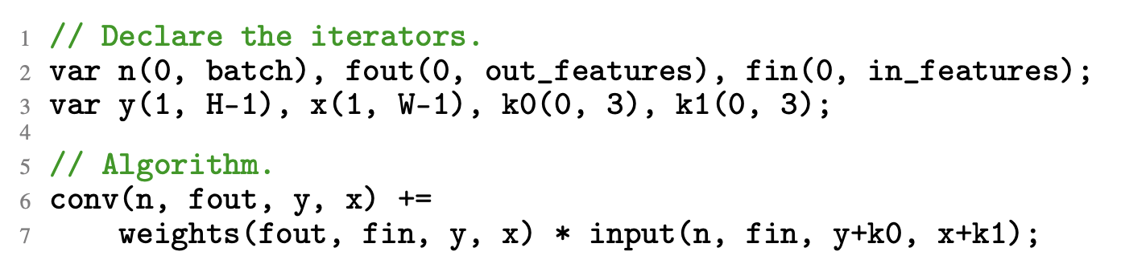
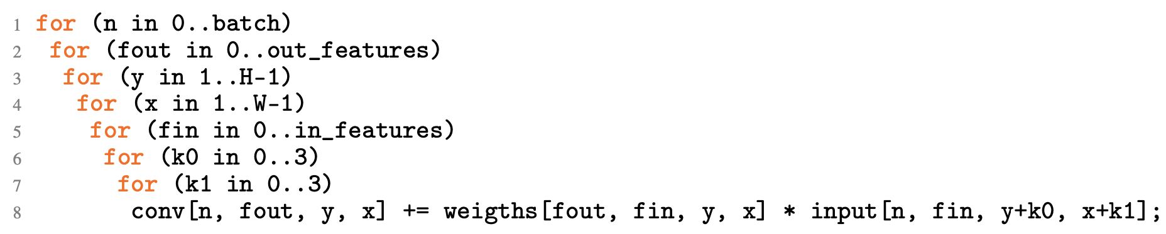
DSL : algorithm
algorithm: algorithm without specifying loop otimizations or data-layout.
equialent to

Slide 6
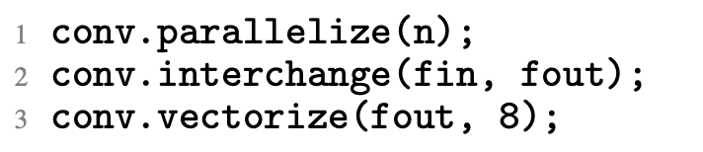
DSL: schedule
schedule: how the program should be optimized, and results formats
paralleize the loop n
interchange the loops fin and fout
vectorize the llop fout by a vector length of 8

Slide 7
DSL: schedule
four types:
  Commands for loop nest transformations: these commands include common affine transformations such as loop tiling, splitting, shifting, etc.
  Commands for mapping loop levels to hardware: examples of these include loop parallelization, vectorization, and mapping loop levels to GPU block or thread dimensions. C.vectorize(j, 4)
  Commands for manipulating data: allocate arrays; setting array properties(stored in host, device ,shared or local memory); copy data (between levels of memory); setting array accesses
  Commands for adding synchronization operations : barrier, send, receive

Slide 8
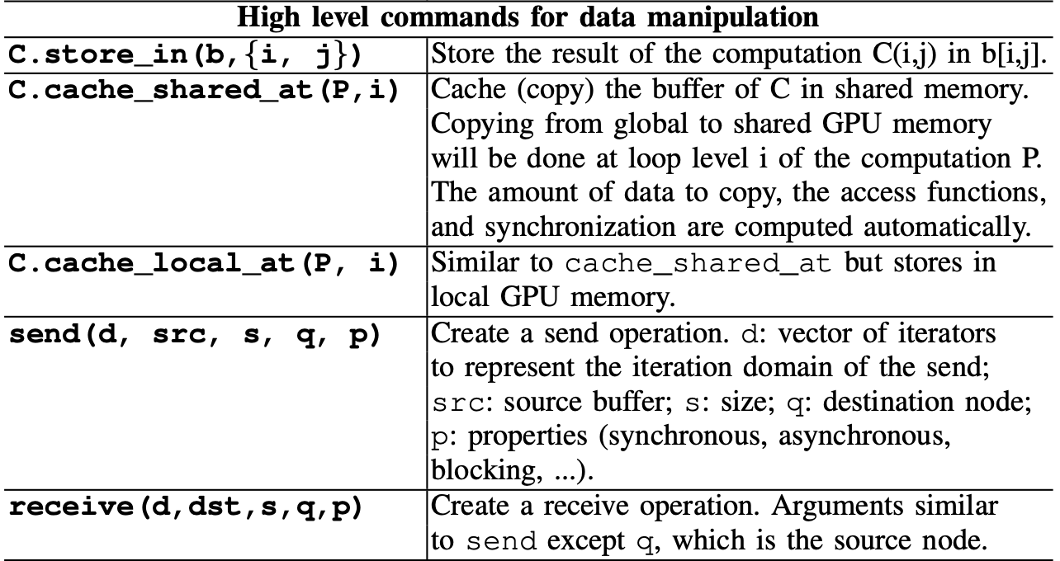
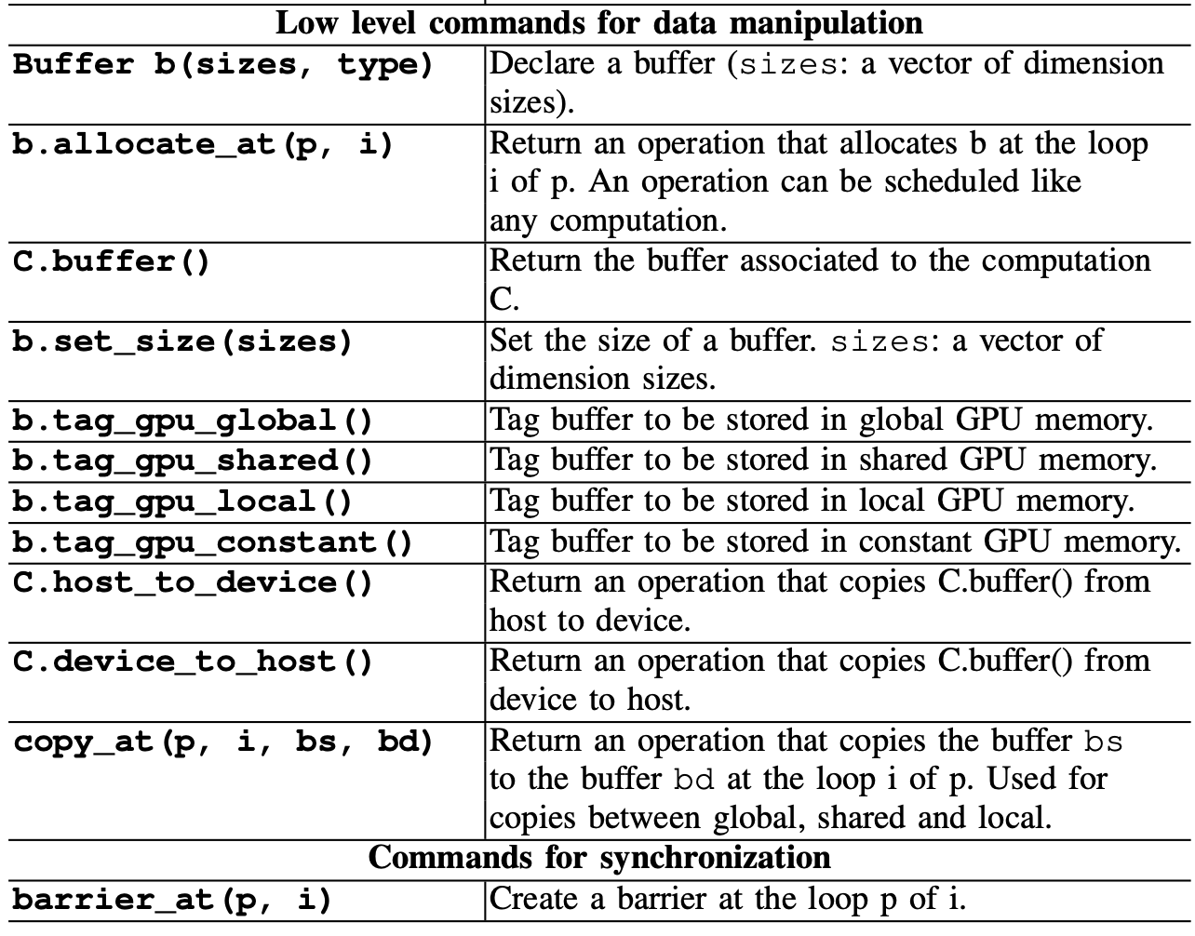
DSL: schedule

Slide 9
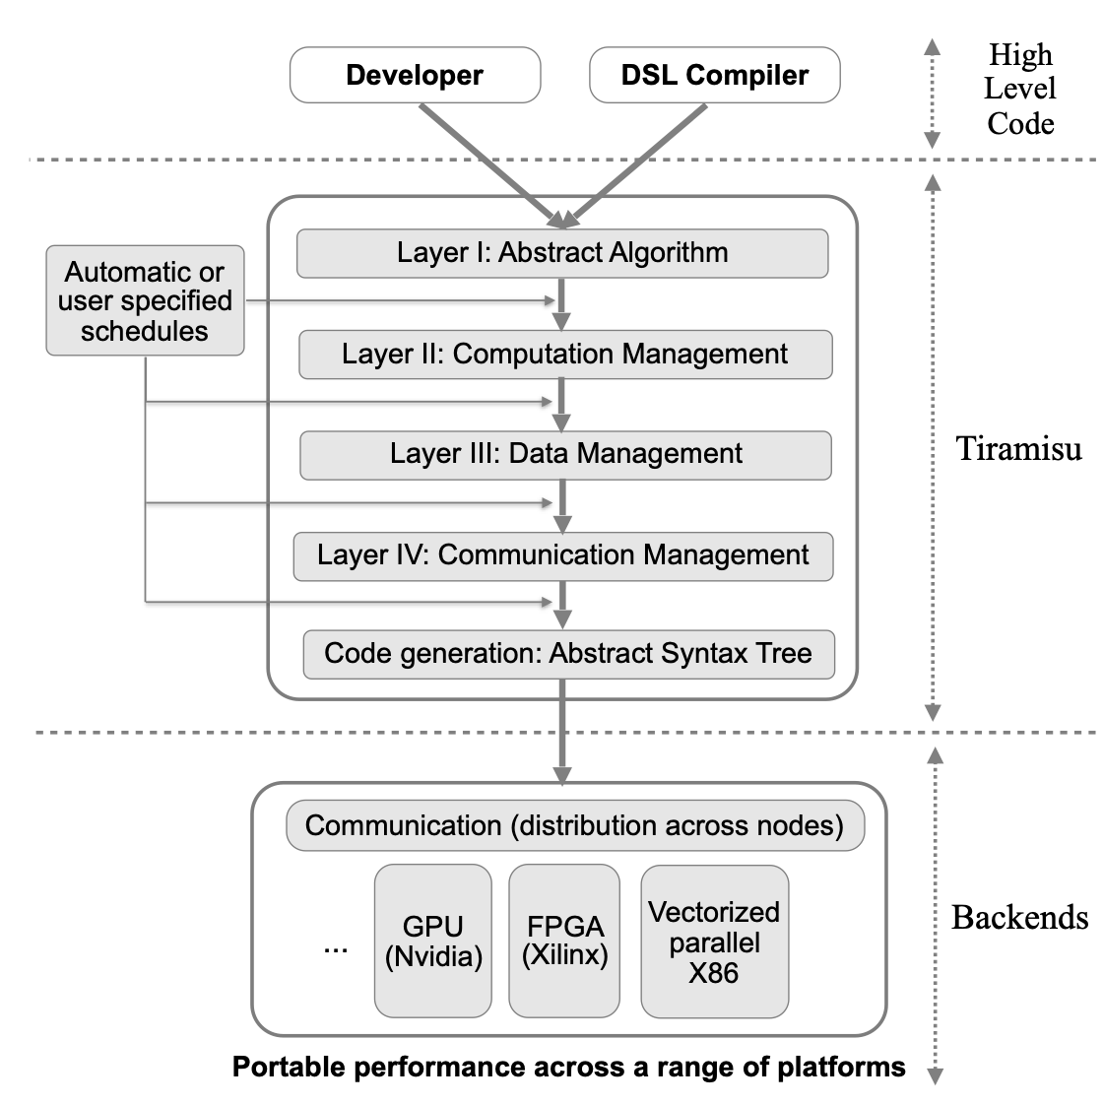
Tiramisu overview

Slide 10
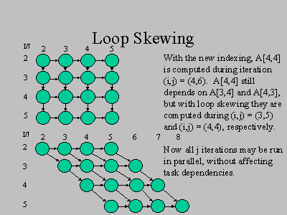
Optimizations
operator fusion, loop skewing, parallelization, multi-level tiling, loop reordering, loop unrolling, vectorization, array packing， register blocking, data prefetching, full/partial tile separation and tuning optimization parameters to the target architecture

Slide 11
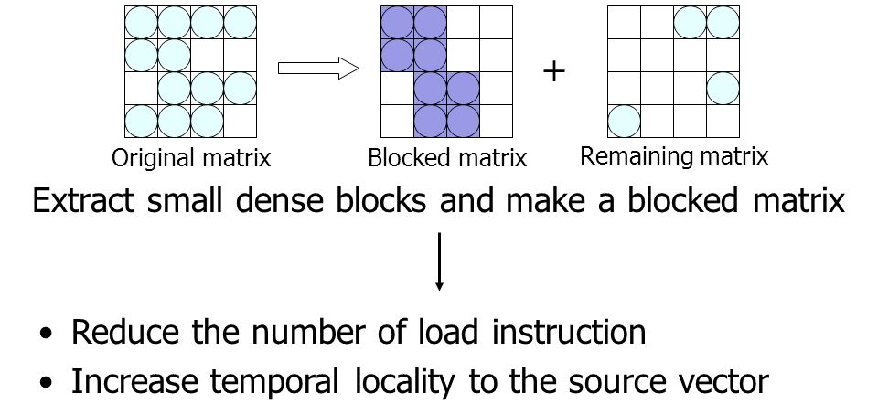
Optimizations
operator fusion, loop skewing, parallelization, multi-level tiling, loop reordering, loop unrolling, vectorization, array packing， register blocking, data prefetching, full/partial tile separation and tuning optimization parameters to the target architecture

Slide 12
Optimizations
operator fusion, loop skewing, parallelization, multi-level tiling, loop reordering, loop unrolling, vectorization, array packing， register blocking, data prefetching, full/partial tile separation and tuning optimization parameters to the target architecture
自动调优选择最佳的 tile sizes or loop unrolling factors

Slide 13
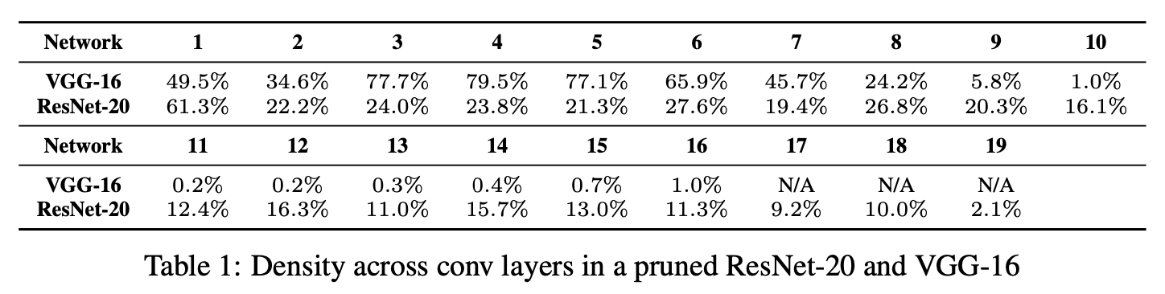
Optimizing Sparse Neural Networks
weight pruning
  iteratively trains a network
  prunes it by simply removing the 20% of weights with the lowest magnitude
prune a ResNet-20 to 21% density and a VGG-16 to only 1% density without any loss in accuracy.

Slide 14
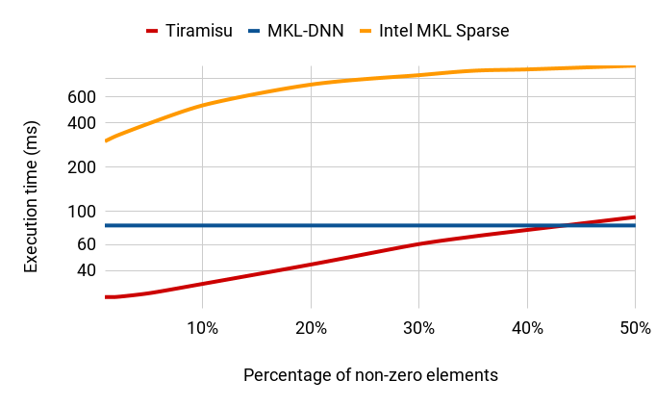
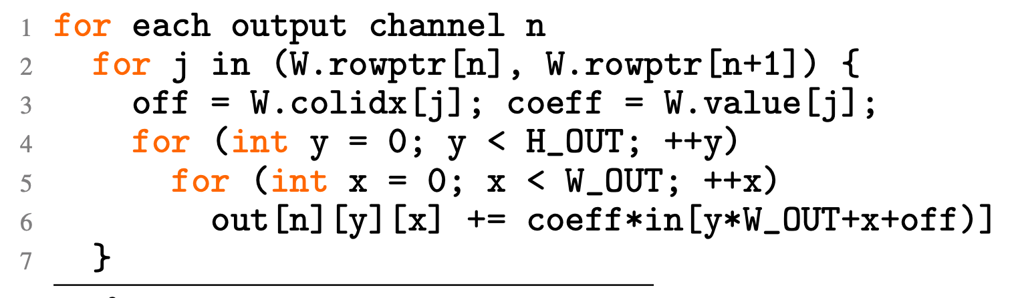
Optimizing Sparse Neural Networks
store weight tensors in CSR form

Slide 15
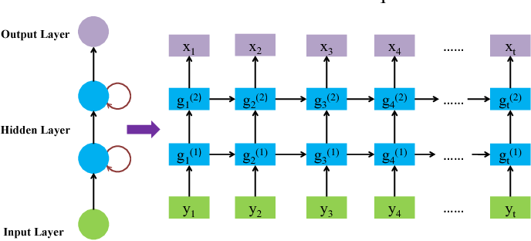
Optimizing RNN
applies a transformation known as iteration space skewing which exposes wavefront parallelism hidden in multilayer-LSTMs

Slide 16
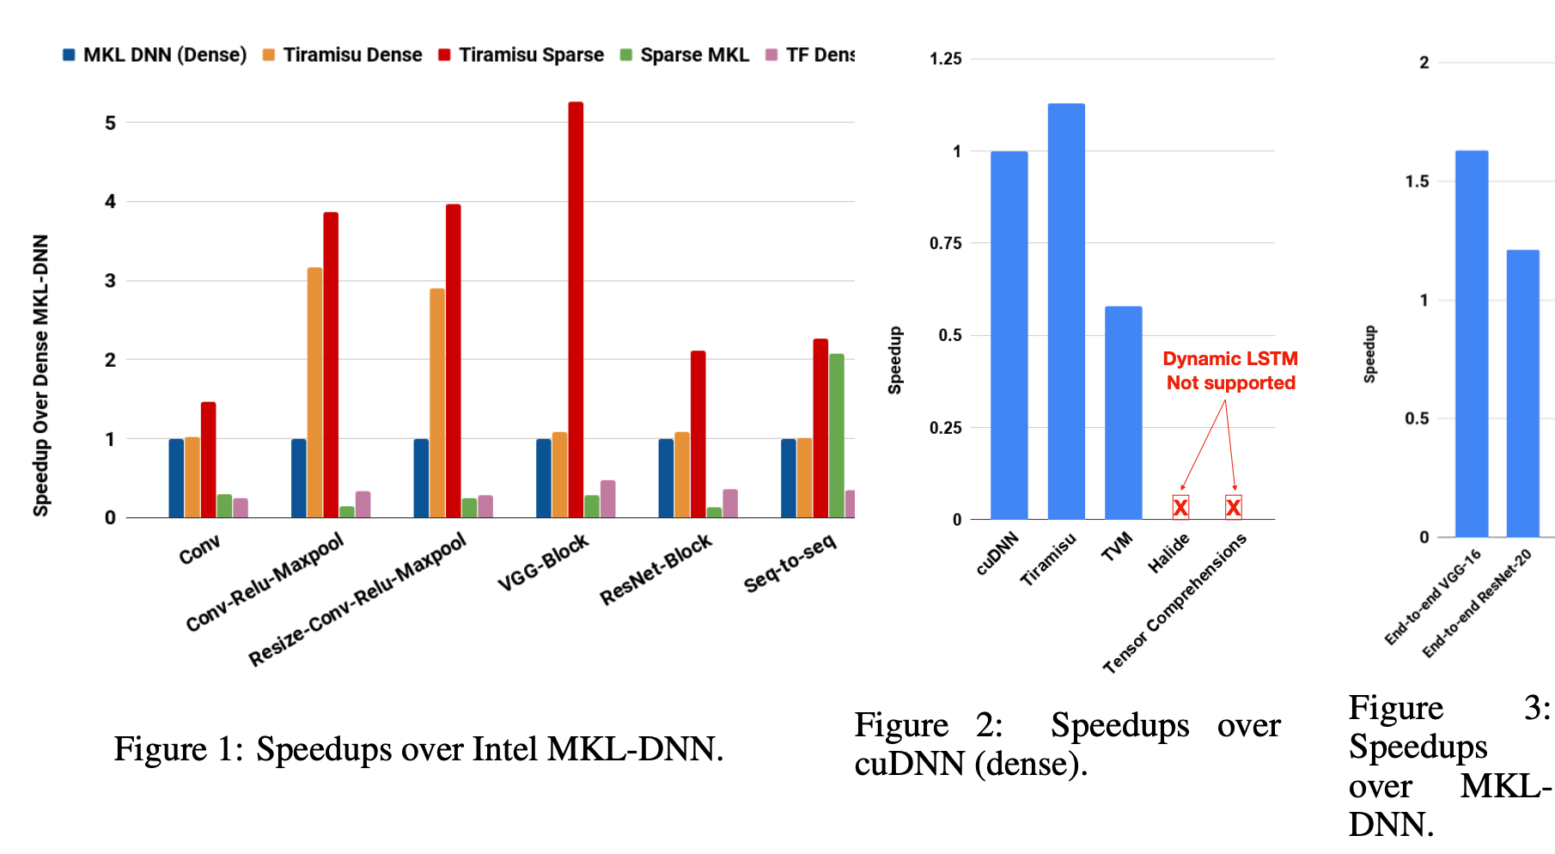
Evalutation

