Slide 1
Julia: Dynamism and Performance Reconciled by Design
Jeff Bezanson, Jiahao Chen, Benjamin Chung,
Stefan Karpinski, Viral B. Shah, Jan Vitek, Lionel Zoubritzky
OOPSLA18

Slide 2
Background
problem size and complexity is
on the rise
productivity languages
performance languages
requires significant programmer
involvement
productivity languages
  Python, MATLAB, R
  dynamic typing, garbage collection
performance languages
    C, C++, Fortran
    speed, a predictable mapping to hardware

Slide 3
Design
The Julia programming language aims to decrease the gap between productivity and performance languages.
productivity features
  dynamic types
  garbage collection
  multiple dispatch
performance
  type-specializing just-in-time compiler

Slide 4
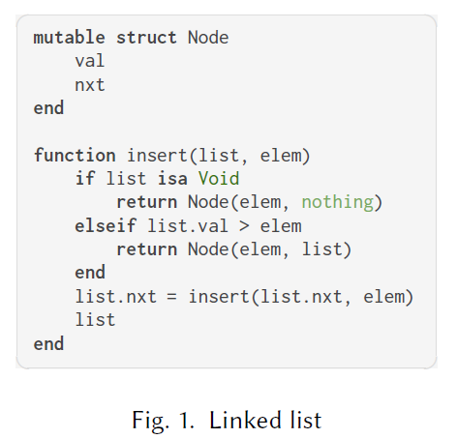
Example

Slide 5
THE JULIA PROGRAMMING LANGUAGE

Slide 6
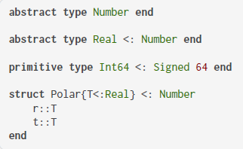
Values, Types
  Values: instances of primitive types or composite types
    primitive types: represented as sequences of bits
    composite types: represented as a collection of fields holding values
      immutable by default
  Type Declarations: abstract types, primitive types and composite types
    Types can be parametrized by bounded type
    variables and have a single supertype.
    Any is the root of the type hierarchy
    Composite types do not admit subtypes
Notes:
every value is tagged by its full type descriptio, tags are often elided when they can be inferred from context.
Abstract types cannot be instantiated; concrete types can.
Concrete types can be manipulated either by value or by reference; the choice is left to the implementation. Abstract types, however, are always manipulated by reference.
It is noteworthy that composite types do not admit subtypes; therefore, types such as Polar are final and cannot be extended with additional
fields.
Only values, not variables, have types – variables are simply names bound to values.
all values in Julia are true objects having a type that belongs to a single, fully connected type graph, all nodes of which are equally first-class as types.
Julia lets you declare your own primitive types

Slide 7
Type Annotations(::)
  Type Annotations: express constraints on fields, parameters, local variables, and method return types
    union types: Union{A,...}, Union{} is the bottom type.
    tuple types: Tuple{A,...}
      Vararg in the last, denotes any number of trailing elements
    iterated union types: TExp where A<:T<:B
    singleton types: Type{T} or Val{V}
Type variable

Slide 8

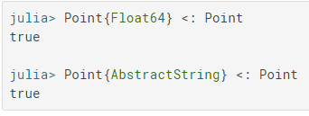
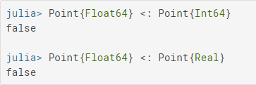
Subtyping(<: )
Union type
  Union{T1,...} <: T, all the types T1,... must be subtypes of T
  T <: Union{T1,...}, only one type, Ti, needs to be a supertype of T
Tuple types are covariant (allow to dispatch)
distributive
  Tuple{Union{A,B},C} <: Union{Tuple{A,C},Tuple{B,C}}
diagonal rule
  Tuple{T,T} where T can be seen as Union{Tuple{Int8,Int8},Tuple{Int16,Int16},...}
Julia's type parameters are invariant, rather than
being covariant
Notes:
the diagonal rule states that if a variable occurs more than once in covariant
position, it is restricted to ranging over only concrete types.

Slide 9
Dynamically-checked Type Assertions
A method executes only if all of its arguments have types that match their declarations.
Julia allows type annotations to act as checked type assertions.
  x::Int64
  f()::Int =...
Notes:
Fields and expressions can also be annotated
If that type is not a subtype of the declared type, Julia
will try to convert it to the declared type.

Slide 10
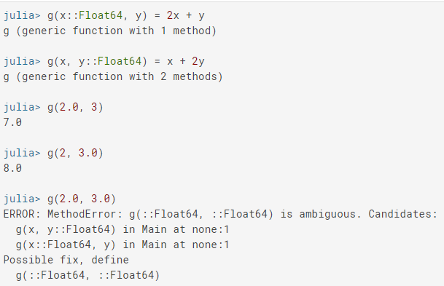
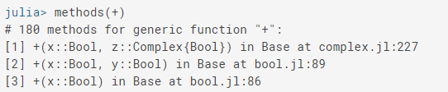
Multiple dispatch
f(::T) pick a method of f whose type T‘ is not a supertype of T and is the most specific.
In contrast to single dispatch, every position in the tuples T and T' have the same role.

Slide 11
Multiple dispatch
Julia supports higher order functions and immutable-by-default values but has no arrow types.
functions are incomparable nominal types
Thus, many traditional typed idioms are impractical, and it is impossible to dispatch on function types.
But nominal types do allow dispatch on methods passed as arguments.

Slide 12
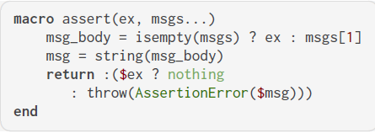
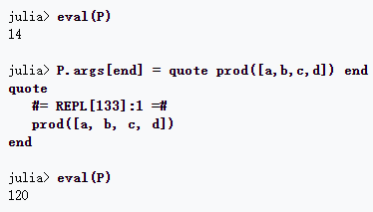
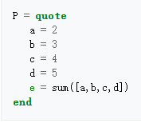

Metaprogramming
Macros, eval()
Reflection
  fieldnames(), fieldtype()
Fig 3. macro
Fig 1. quote
Fig 4. eval
Fig 2. change P
Fig 1 and Fig 2 is from Introducing Julia/Metaprogramming
Notes:
This prevents method redefinitions (through eval for instance) from affecting
the scope of currently invoked methods.
This in turn triggers a lazy recompilation
of the callers at their next invocation.

Slide 13
World age (or epoch) counter
The epoch is a monotonically increasing value that can be associated to each method definition.
When a method is compiled, it is assigned a minimum world age, set to the current epoch, and a maximum world age, set to typemax(Int).
A method is visible only if the current epoch is superior to its minimum world age.
Notes:
This prevents method redefinitions (through eval for instance) from affecting
the scope of currently invoked methods

Slide 14
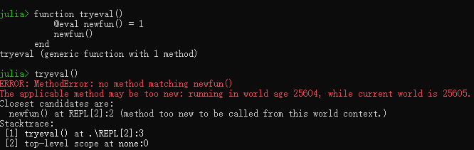
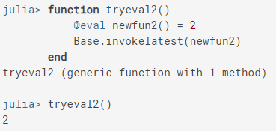
World age (or epoch) counter
can use Base.invokelatest(fun,args)
to bypass this mechanism
  cannot be statically optimized by the compiler

Slide 15
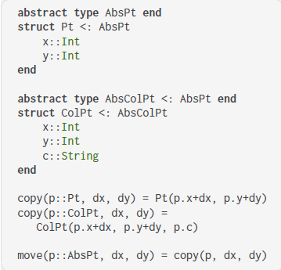
Object oriented programming
Julia’s design does not support the class-based object oriented programming style.
no way to extend a point class Pt with a color field
side effect
  abstract classes have neither fields nor methods
  so there is no documentation to remind the programmer that a copy method is needed for ColPt

Slide 16
Gradual typing
Gradual typing: a call to a function f(t::T), such as f(x), will be statically checked
In Julia, a call to f(x) will not be checked statically
In Julia, a variable, parameter, or field annotated with type T will always hold a value of type T
Gradual type systems only guarantee that values will act like type T

Slide 17
IMPLEMENTING JULIA

Slide 18
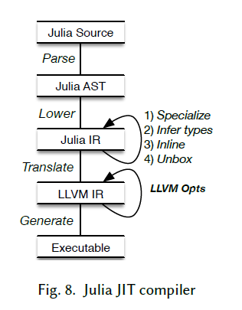
JIT
method-based JIT without compilation tiers
Julia does not support deoptimization with on-stack replacement
  once methods are compiled they are not changed

Slide 19
Method Specialization
runtime type information
Every time a method is called with a new tuple of argument types, it is specialized to these types.
Unboxing: the memory layout of all arguments is known
Devirtualization: reduces dispatch overhead and enables inlining
many different argument types
  Vararg treated as Any
  only specializes on function types if the argument is called in the method body
Notes:
Specialization：特殊化

Slide 20
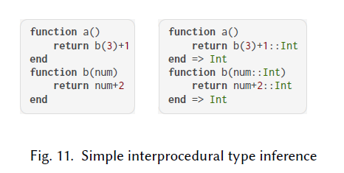
Type Inference
After specializing, type information is known.
data-flow analysis
For recursive methods cycle
elimination is performed.
  convergence
  limits the size of the inferred types
  to an arbitrary bound

Slide 21
Method Inlining
help type inference
  avoid branches
memory cost and requires additional compilation time
  a number of pragmatic heuristics

Slide 22
Object Unboxing
a variable may hold values of many types.
  In the general case, values are allocated on the heap
Unboxing allows to manipulate values directly.
don’t have a null (but have Nothing)
  so don’t need an extra tag for primitive values.
Unboxing is impossible for recursive data structures
Repeated boxing and unboxing can be expensive
heuristics used to determine when to perform unboxing

Slide 23
EXPERIMENT

Slide 24
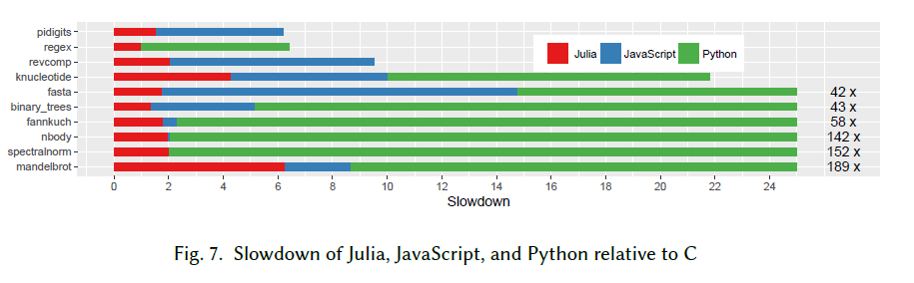
Experiment
Julia v0.6.2, CPython 3.5.3, V8/Node.js v8.11.1, GCC 6.3.0 -O2 for C
Debian 9.4 on a Intel i7-950 at 3.07GHz with 10GB of RAM.
All benchmarks ran single threaded. No other optimization flags were used.
programming language benchmark game (PLBG) suite

Slide 25
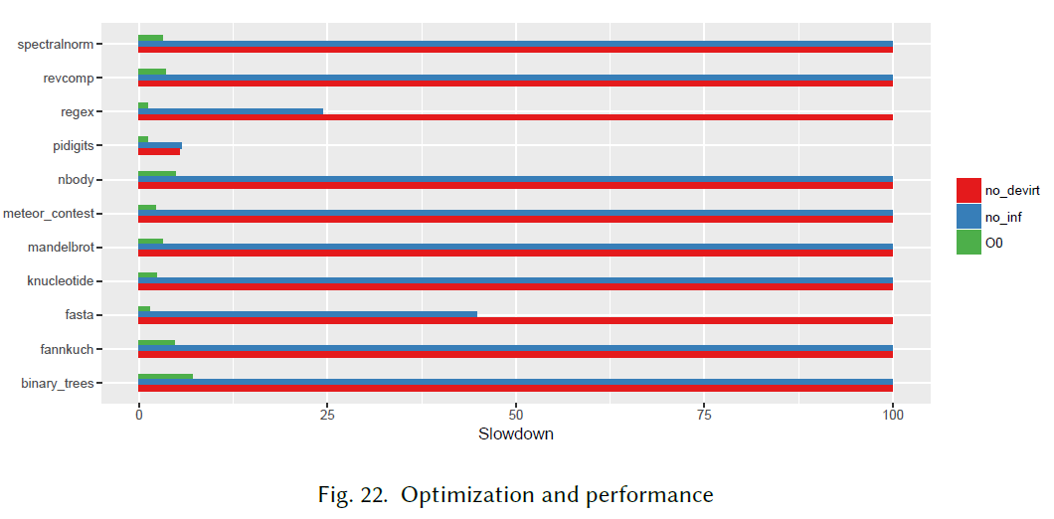
Experiment
impact of LLVM optimizations, type inference and devirtualization

